Slide 1
Exam 5 Muscle Review

Slide 2
Structure of a Skeletal Muscle
Each individual muscle cell (fiber) is surrounded by thin connective tissue called ____________
Several (between 10 and 100) muscle cells are bundled together into a ___________ by the connective tissue of the __________
All fascicles that make up a muscle are, in turn, enclosed in an outer fibrous connective tissue wrapping _____________

Slide 3
Structure of a Skeletal Muscle
Each individual muscle cell (fiber) is surrounded by thin connective tissue called endomysium
Several (between 10 and 100) muscle cells are bundled together into a fascicle by the connective tissue of the perimysium
All fascicles that make up a muscle are, in turn, enclosed in an outer fibrous connective tissue wrapping epimysium

Slide 4
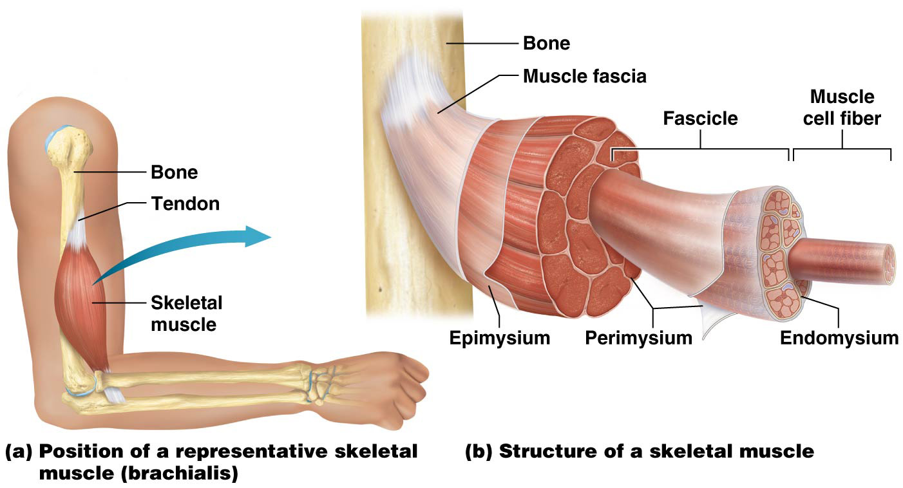
Structure of a Skeletal Muscle

Slide 5
Structure of a Skeletal Muscle
__________– describes motor neuron-muscle cell interaction that controls muscle contraction
Consists of a single motor neuron and all muscle cells it connects to
Some have only a few muscle cells, whereas others have many
Fewer number of muscle cells = more precise movements of that muscle when it contracts

Slide 6
Structure of a Skeletal Muscle
Motor unit – describes motor neuron-muscle cell interaction that controls muscle contraction; example of Cell-Cell Communication Core Principle
Consists of a single motor neuron and all muscle cells it connects to
Some motor units have only a few muscle cells, whereas others have many
Fewer number of muscle cells in a motor unit = more precise movements of that muscle when it contracts

Slide 7
Structure of a Skeletal Muscle
Fascicles and Muscle Shapes:
__________ – evenly spaced fascicles attaching to a tendon that is about the same width, often produces a straplike muscle, like sartorius in thigh

Slide 8
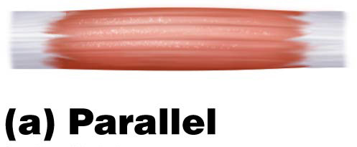
Structure of a Skeletal Muscle
Fascicles and Muscle Shapes:
Parallel – evenly spaced fascicles attaching to a tendon that is about the same width, often produces a straplike muscle, like sartorius in thigh

Slide 9
Structure of a Skeletal Muscle
Fascicles and Muscle Shapes (continued):
__________ – broad muscle that uniformly tapers into a single tendon

Slide 10
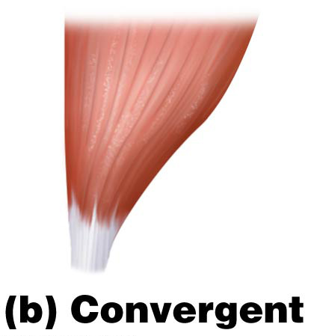
Structure of a Skeletal Muscle
Fascicles and Muscle Shapes (continued):
Convergent – broad muscle that uniformly tapers into a single tendon

Slide 11
Structure of a Skeletal Muscle
Fascicles and Muscle Shapes (continued):
A circular muscle encircles a structure, such as the opening of the eye, to close it when it contracts. Circular muscles are often referred to as __________.

Slide 12
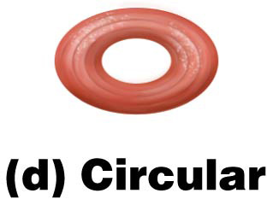
Structure of a Skeletal Muscle
Fascicles and Muscle Shapes (continued):
A circular muscle encircles a structure, such as the opening of the eye, to close it when it contracts. Circular muscles are often referred to as sphincters.

Slide 13
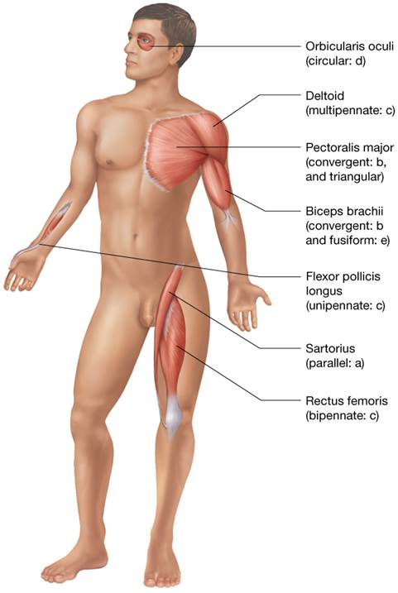
Structure of a Skeletal Muscle

Slide 14
Structure of a Skeletal Muscle
Naming muscles
Many muscles are named for:
_________________
_________________
_________________
_________________
_________________
_________________
_________________

Slide 15
Structure of a Skeletal Muscle
Naming muscles
Many muscles are named for their shape or appearance and others for their size or position
Some are named for structural considerations, such as the number of separate sections or heads with individual tendons providing multiple points of attachment.
Some named for size (major, minor, longus, brevis)
Some named for location (directional words)
Some names reveal the structures they attach to
Some named for what they do (their actions)
A number of muscle names have historical origins

Slide 16
Functions of Skeletal Muscles
Muscle contractions are involved in more than just movement of bones at a joint; other functions of muscle contraction include:
___________________________
___________________________
___________________________
___________________________

Slide 17
Functions of Skeletal Muscles
Muscle contractions are involved in more than just movement of bones at a joint; other functions of muscle contraction include:
Muscle tissue produces heat as a waste product; can be used as a homeostatic mechanism for maintaining body temperature
Contraction of the diaphragm muscle is a vital function associated with breathing
Skeletal muscles attached to skin allow for facial expression; muscles in throat assist with swallowing
Sphincters composed of skeletal muscle allow conscious control over opening and closing of body openings

Slide 18
Functions of Skeletal Muscles
Teamwork by muscles is needed for most movements, or actions. Most movements at joints involve several muscles, each with a particular job to do.
____________ (prime movers) provide most force required for a given movement
____________, usually on opposite side of joint from its agonist partner, tends to oppose and slow the action

Slide 19
Functions of Skeletal Muscles
Teamwork by muscles is needed for most movements, or actions. Most movements at joints involve several muscles, each with a particular job to do.
Agonists (prime movers) provide most force required for a given movement
Antagonists, usually on opposite side of joint from its agonist partner, tends to oppose and slow the action

Slide 20
Functions of Skeletal Muscles
Functional groups of muscles (continued):
___________- work together with the agonists. Helps supplement the force of the agonist and help guide the movement to minimize unwanted deviations.
__________- hold a bone in place, an anchoring function that makes movement more efficient and reduces risk of injury.

Slide 21
Functions of Skeletal Muscles
Functional groups of muscles (continued):
Synergists-work together with the agonists. Helps supplement the force of the agonist and help guide the movement to minimize unwanted deviations.
Fixators-hold a bone in place, an anchoring function that makes movement more efficient and reduces risk of injury.

Slide 22
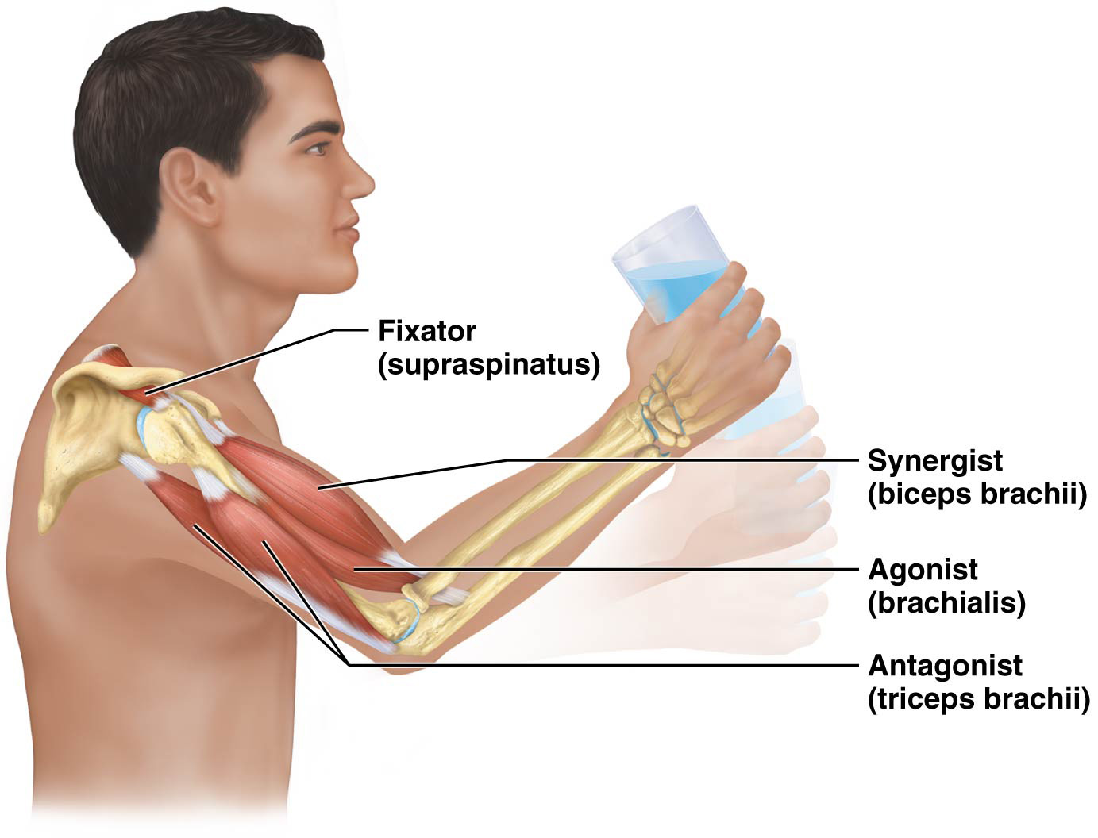
Functions of Skeletal Muscles

Slide 23
Functions of Skeletal Muscles
Muscle origin and insertion – skeletal muscles begin and end at distinct anatomical locations
__________ – anchoring point on a bone, where skeletal muscle “originates from”
__________ – insertion end of muscle is attached to the bone or structure that will be moved when the muscle contracts

Slide 24
Functions of Skeletal Muscles
Muscle origin and insertion – skeletal muscles begin and end at distinct anatomical locations
Origin – anchoring point on a bone, where skeletal muscle “originates from”
Insertion – insertion end of muscle is attached to the bone or structure that will be moved when the muscle contracts

Slide 25
Functions of Skeletal Muscles
A lever system includes three components: ________ or resistance (weight or object you are trying to move), the ________ is the effort applied to the lever, and the _________ is the pivot or hinge point
In moving the body, bones act as levers.

Slide 26
Functions of Skeletal Muscles
A lever system includes three components: load or resistance (weight or object you are trying to move), the force is the effort applied to the lever, and the fulcrum is the pivot or hinge point
In moving the body, bones act as levers. The load is the weight of the body part being moved, the force is the effort generated by muscle contractions, and the fulcrum is the joint at which movement occurs:

Slide 27
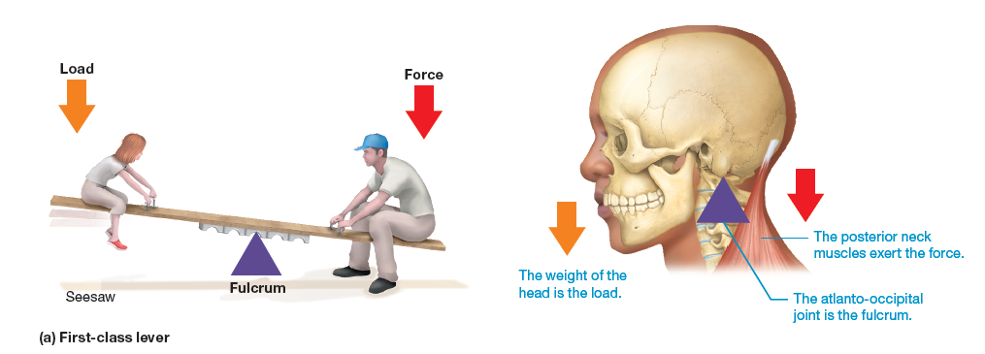
Functions of Skeletal Muscles
First-class lever – fulcrum sits between load and applied force; load moved in __________ direction than applied force

Slide 28
Functions of Skeletal Muscles
First-class lever – fulcrum sits between load and applied force; load moved in opposite direction than applied force

Slide 29
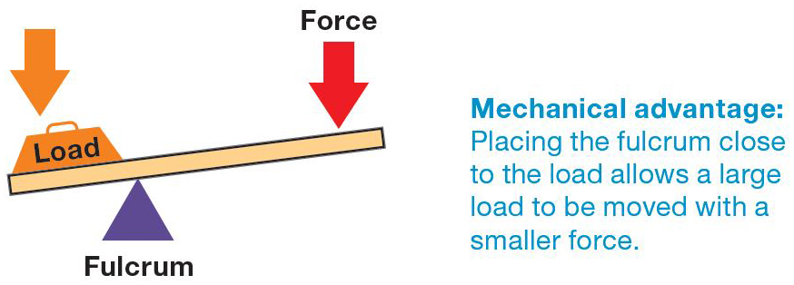
Functions of Skeletal Muscles
Lever system where fulcrum is located farther away from applied force works at mechanical advantage; allows small force to move large load over short distance

Slide 30
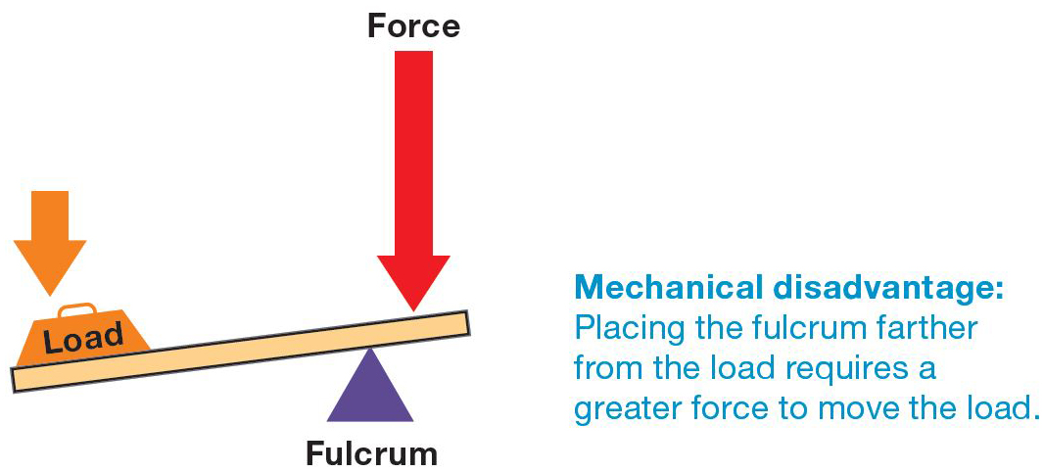
Functions of Skeletal Muscles
Lever system where fulcrum is located close to applied force and load is further away works at mechanical disadvantage; reduces load it can move; however, load can be moved faster over greater distance

Slide 31
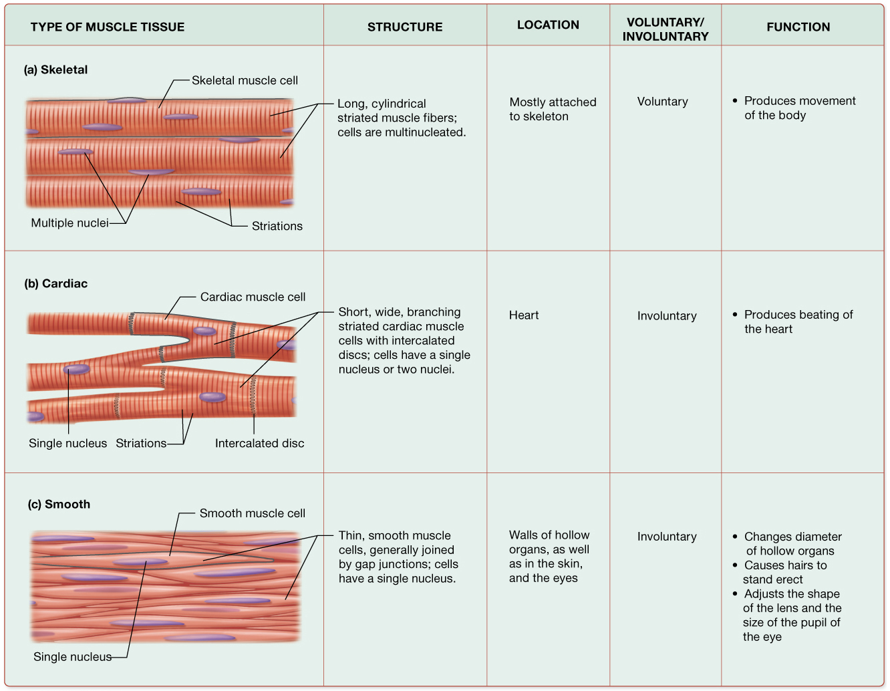
Types of Muscle Tissue

Slide 32
Properties of Muscle Cells (The first one is given to you)
1. Contractility is the ability to contract where proteins in the cell draw closer together; this does not necessarily involve shortening of the cell
2.
3.
4.
5.

Slide 33
Properties of Muscle Cells
Contractility is the ability to contract where proteins in the cell draw closer together; this does not necessarily involve shortening of the cell
Excitability –muscle cells are excitable, or responsive, in the presence of various stimuli (chemical, mechanical stretch, or local electrical signals)
Conductivity- when a muscle cell is excited, the electrical changes across the plasma membrane are rapidly conducted along the entire length of the plasma membrane (similar to a copper wire).
Extensibility- muscle cells are extensible, they can be stretched up to 3 times their resting length without damage
Elasticity – muscle cells can also return to their original shape after being stretched, a property called elasticity.

Slide 34
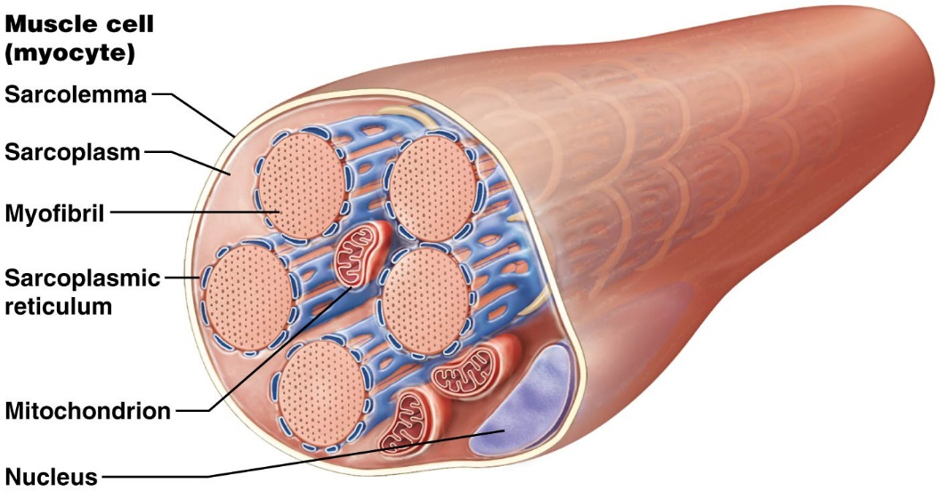
Structure of Muscle Cells
Myofibrils are unique structures found in each of the three muscle cell types:
Are essentially bundles of specialized proteins, including those involved in muscle contraction.
Each muscle cell has hundreds to thousands of myofibrils, they make up about 50-80% of its of its volume
Other organelles such as mitochondria are found packed between them.
They are arranged differently in smooth muscle cells than in skeletal and cardiac

Slide 35
Structure of Muscle Cells
Myocytes, or muscle cells, use different terminology
The __________ is the myocyte’s cytoplasm
The __________ is the myocyte’s plasma membrane
The __________(____)is a modified smooth endoplasmic reticulum that:
Forms a weblike network surrounding each myofibrils
Varies in structure in the three types of muscle tissue (discussed later)

Slide 36
Structure of Muscle Cells
Myocytes, or muscle cells, use different terminology
The sarcoplasm is the myocyte’s cytoplasm
The sarcolemma is the myocyte’s plasma membrane
The sarcoplasmic reticulum (SR) is a modified smooth endoplasmic reticulum that:
Forms a weblike network surrounding each myofibrils
Varies in structure in the three types of muscle tissue (discussed later)

Slide 37
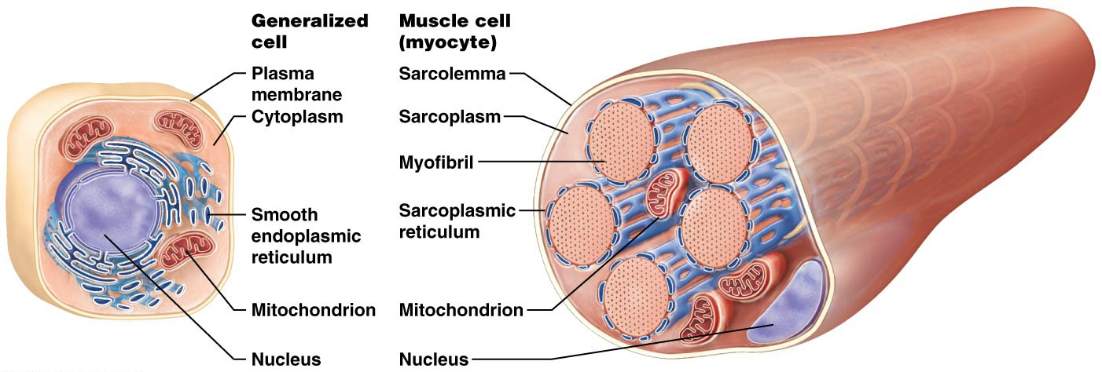
Structure of Muscle Cells

Slide 38
Structure of the Myofibril
Each myofibril is made of hundreds to thousands of protein bundles called myofilaments, which consist of one or more of the following types of proteins:
Contractile proteins which produce tension
Regulatory proteins which control when the muscle fiber can contract
Structural proteins which hold the myofilaments in their proper places and ensure the structural stability of the myofibril and the muscle fiber.

Slide 39
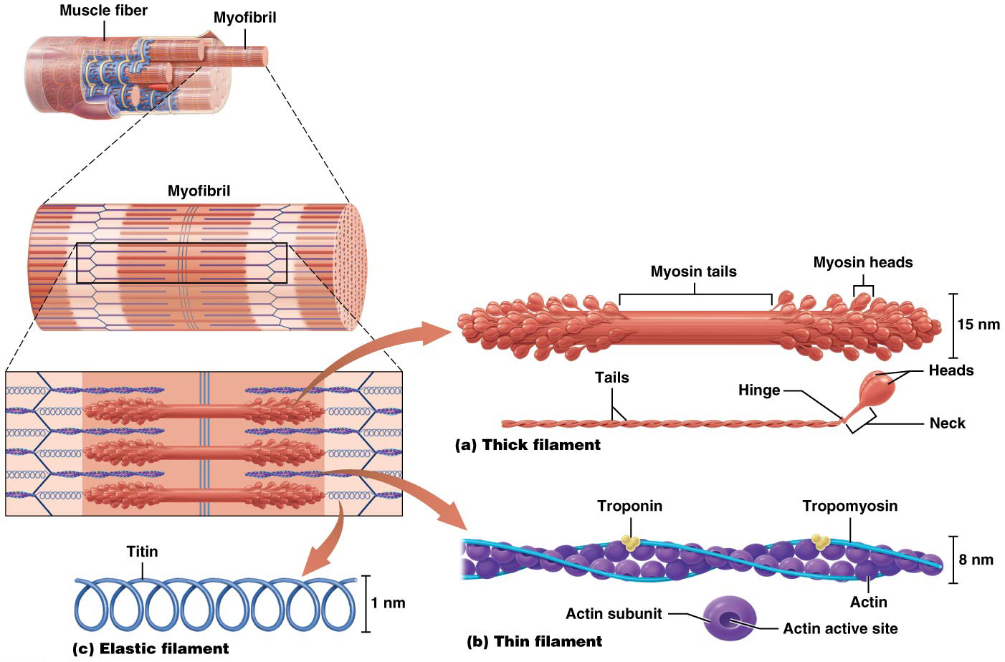
Structure of the Myofibril

Slide 40
Structure of the Myofibril
Thin filaments are composed of actin, tropomyosin, and troponin (continued):
Tropomyosin is a long, rope-like regulatory protein that spirals around the 2 actin strands, so that at rest, it covers the active sites on actin
Troponin is a small globular regulatory protein that holds tropomyosin in place

Slide 41
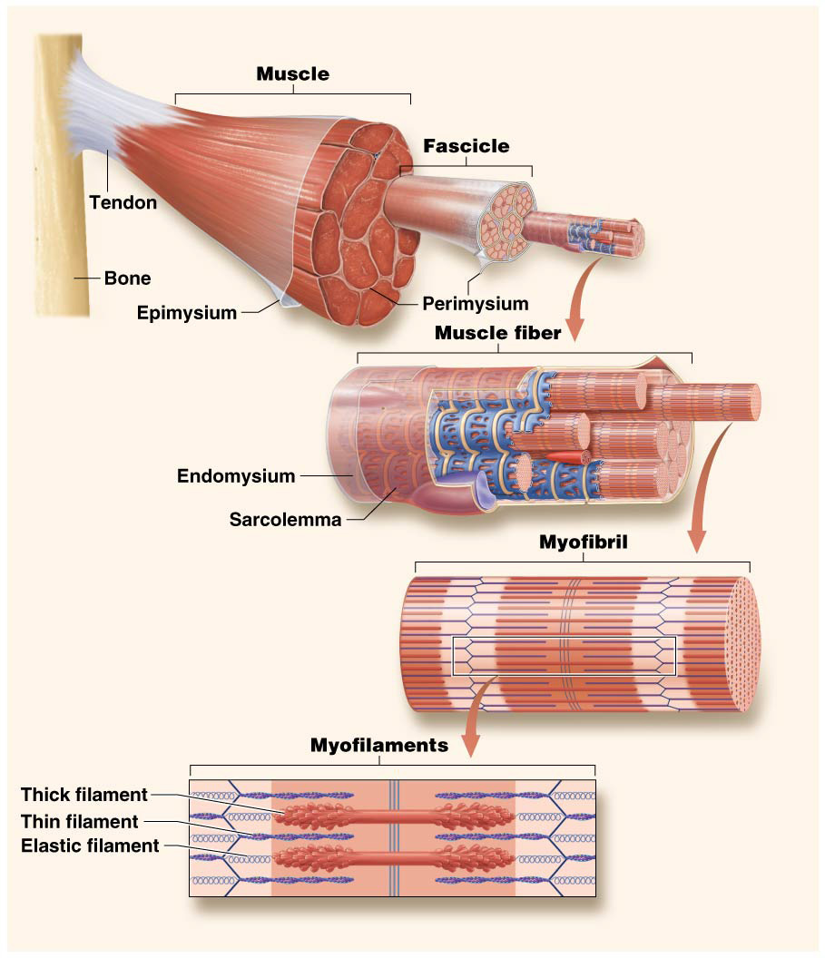
Putting It All Together: The Big Picture of Skeletal Muscle Structure

Slide 42
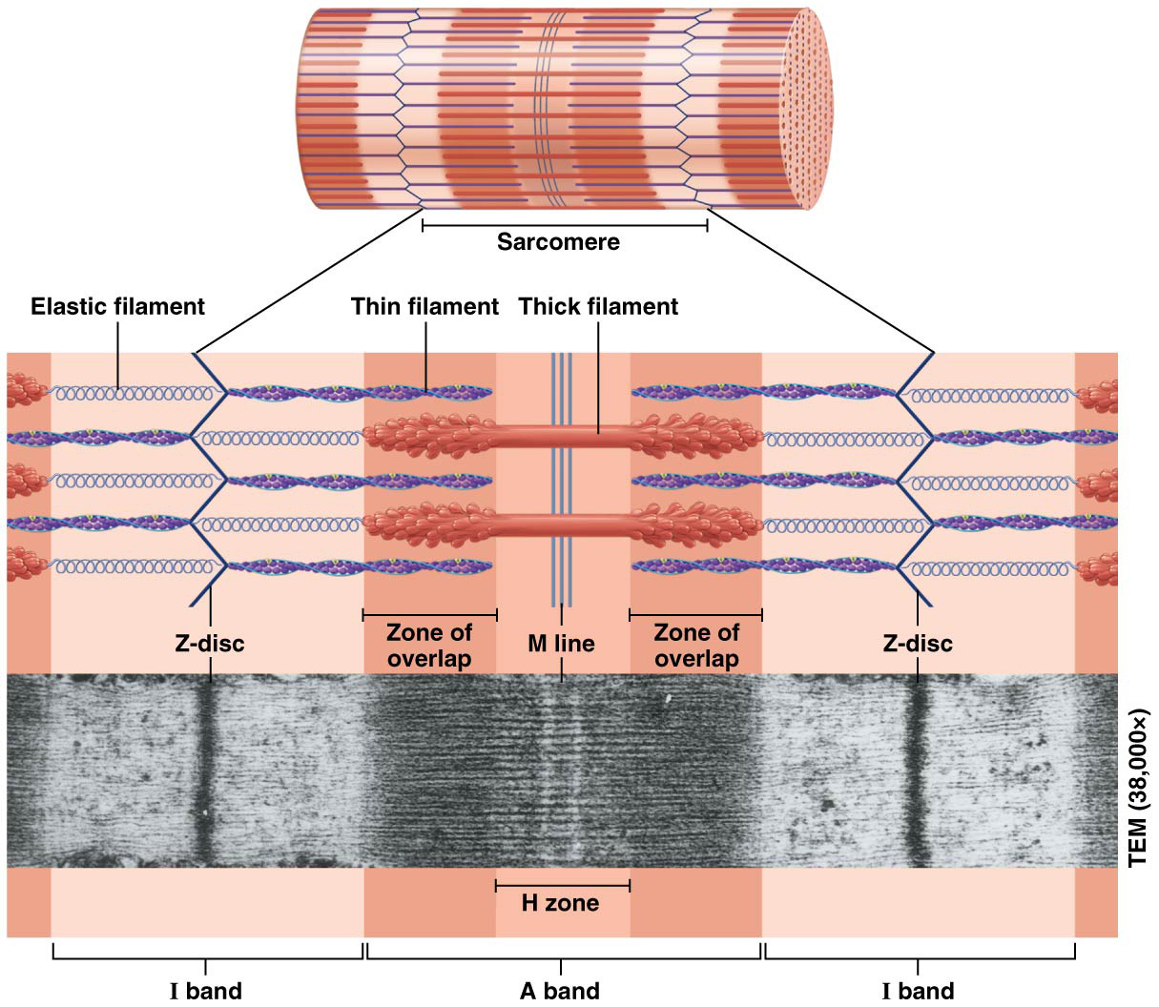
Myofilament Arrangement and the Sarcomere
Striations appear microscopically: these alternating light and dark bands are produced by the overlapping, repeating arrangement of thin and thick filaments.
The region with overlapping filaments, referred to as the zone of overlap, is where tension is generated during a muscle contraction.

Slide 43
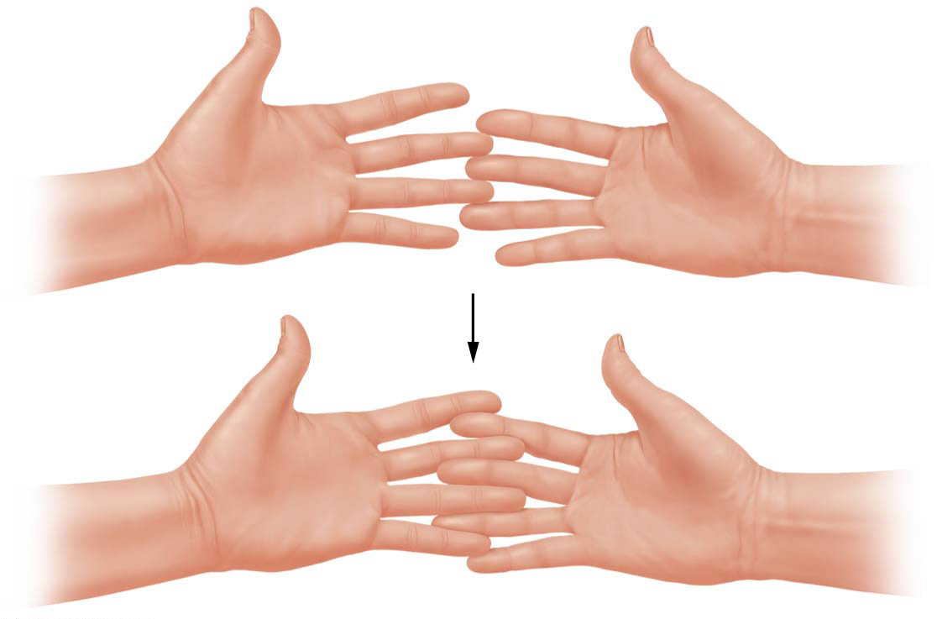
The Sliding-Filament Mechanism of Contraction
The sliding filament mechanism-Thin filaments slide past the thick filaments, generating tension throughout the whole sarcomere.
Your hands represent a single, large sarcomere, and where your fingers overlap represents the zone of overlap of the thick and thin filaments:
The inner edges of your palms are the z-discs
Now move your fingers slowly together
As you can see, your “sarcomere” (your hands) grows progressively shorter (but your fingers do not change in length)

Slide 44
The Neuromuscular Junction (NMJ)
All skeletal muscles are innervated, which means they are connected to a neuron
A single neuron, called a motor neuron, communicates with many muscle fibers; each connection is referred to as a synapse
The synapse of a motor neuron with a muscle fiber is known as the neuromuscular junction or NMJ.
The function of the NMJ is to transmit a signal, called a nerve impulse (an action potential), from the neuron to the sarcolemma of the muscle fiber

Slide 45
The Neuromuscular Junction (NMJ)
There are three components of the NMJ: axon terminal, synaptic cleft, and motor end plate
The end of an axon swells to form an axon terminal, which contains synaptic vesicles filled with the neurotransmitter acetylcholine (ACh)
The synaptic cleft is the space between axon terminal and muscle fiber into which ACh is released, filled with collagen fibers and a gel that anchors the neuron in place
The motor end plate is a specialized region of the sarcolemma whose folded surface contains many receptors for ACh. These receptor are ligand-gated ion channels, ACh is the ligand.

Slide 46
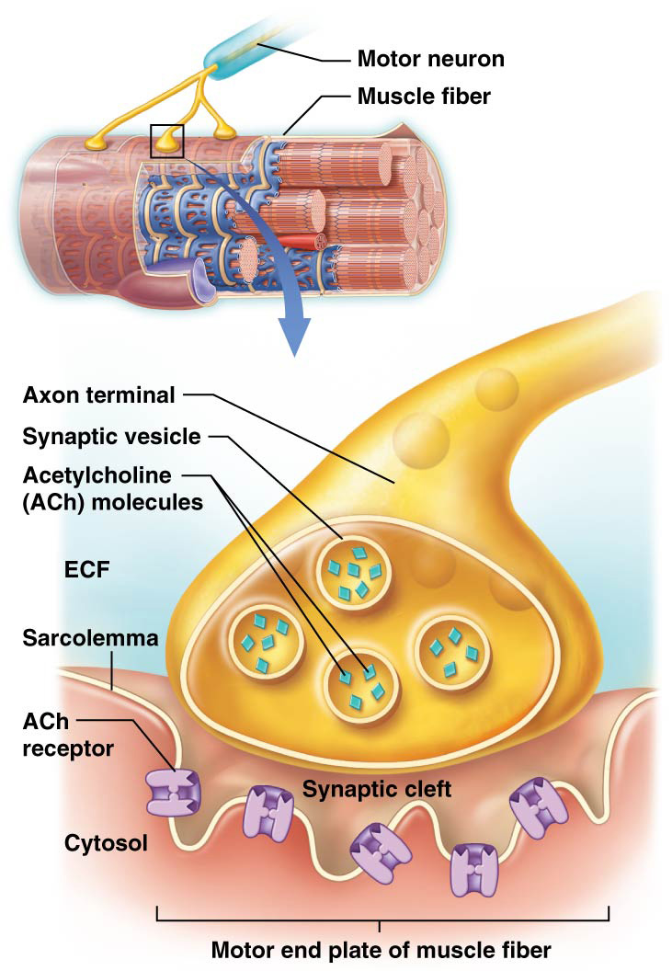
The Neuromuscular Junction (NMJ)

Slide 47
The Neuromuscular Junction
Notes:
PowerPoint keyboard shortcuts can be used to play the videos:
Alt + p = to play or pause the video
Alt, shift, left arrow = to rewind the video
Alt, shift, right arrow = to forward the video
Alt + q = stop and then start the video from the beginning
Alt + U = mute or unmute
Alt + up arrow or down arrow = increase or decrease the volume

Slide 48
Skeletal Muscle Contraction
Muscle contraction can be broken down into three phases:
the excitation phase
excitation-contraction coupling
contraction phase

Slide 49
Big Picture Animation: Excitation
Notes:
PowerPoint keyboard shortcuts can be used to play the videos:
Alt + p = to play or pause the video
Alt, shift, left arrow = to rewind the video
Alt, shift, right arrow = to forward the video
Alt + q = stop and then start the video from the beginning
Alt + U = mute or unmute
Alt + up arrow or down arrow = increase or decrease the volume

Slide 50
Review
The end plate potential is generated by the influx of _______ into the motor end plate.
calcium
sodium
potassium
chloride
Notes:
Answer: b

Slide 51
Review
The end plate potential is generated by the influx of _______ into the motor end plate.
calcium
sodium
potassium
chloride

Slide 52
Review
Acetylcholine is released in response to
A ligand binding to a receptor on the synaptic terminus
Sodium flowing into the synaptic terminus
Potassium entering the synaptic terminus
An action potential arriving at the axon terminal
Notes:
Answer: d

Slide 53
Review
Acetylcholine is released from the synaptic terminus in response to
A ligand binding to a receptor on the synaptic terminus
Sodium flowing into the synaptic terminus
Potassium entering the synaptic terminus
An action potential arriving at the axon terminal

Slide 54
Review
The term “synaptic cleft” refers to
A fold on the motor end plate
A vesicle in the synaptic terminus
The gap between the neuron and the muscle fiber
The space between adjacent muscle fibers
Notes:
Answer: c

Slide 55
Review
The term “synaptic cleft” refers to
A fold on the motor end plate
A vesicle in the synaptic terminus
The gap between the neuron and the muscle fiber
The space between adjacent muscle fibers

Slide 56
Review
The sodium channels of the motor end plate are
Ligand-gated channels
Voltage-gated channels
Na⁺/K⁺ pumps
Mechanically gated channels
Notes:
Answer: a

Slide 57
Review
The sodium channels of the motor end plate are
Ligand-gated channels
Voltage-gated channels
Na⁺/K⁺ pumps
Mechanically gated channels

Slide 58
Review
The end plate potential is
An action potential
A local repolarization
A local depolarization
A local hyperpolarization
Notes:
Answer: c

Slide 59
Review
The end plate potential is
An action potential
A local repolarization
A local depolarizaton
A local hyperpolarization

Slide 60
Big Picture Animation: Excitation-Contraction Coupling
Notes:
PowerPoint keyboard shortcuts can be used to play the videos:
Alt + p = to play or pause the video
Alt, shift, left arrow = to rewind the video
Alt, shift, right arrow = to forward the video
Alt + q = stop and then start the video from the beginning
Alt + U = mute or unmute
Alt + up arrow or down arrow = increase or decrease the volume

Slide 61
Review
The channels that open in the sarcolemma surrounding the motor endplate and generate an action potential are
Ligand-gated channels
Voltage-gated channels
Na⁺/K⁺ pumps
Mechanically gated channels
Notes:
Answer: b

Slide 62
Review
The channels that open in the sarcolemma surrounding the motor endplate and generate an action potential are
Ligand-gated channels
Voltage-gated channels
Na⁺/K⁺ pumps
Mechanically gated channels

Slide 63
Review
The term “propagate” when referring to an action potential means
Stimulate
Inhibit
Magnify
Spread
Notes:
Answer: d

Slide 64
Review
The term “propagate” when referring to an action potential means
Stimulate
Inhibit
Magnify
Spread

Slide 65
Review
In order to trigger a muscle contraction, an action potential must reach the
Sarcomeres
Mitochondria
Triads
Nuclei
Notes:
Answer: c

Slide 66
Review
In order to trigger a muscle contraction, an action potential must reach the
Sarcomeres
Mitochondria
Triads
Nuclei

Slide 67
Review
A triad consists of
Two terminal cisternae and a T-tubule
An M line and two zones of overlap
Two T-tubules and a terminal cisterna
A zone of overlap and two M lines
Notes:
Answer: a

Slide 68
Review
A triad consists of
Two terminal cisternae and a T-tubule
An M line and two zones of overlap
Two T-tubules and a terminal cisterna
A zone of overlap and two M lines

Slide 69
Review
________ is released from the SR in response to arrival of an action potential
Na⁺
K⁺
P_{i}
Ca⁺⁺
Notes:
Answer: d

Slide 70
Review
________ is released from the SR in response to arrival of an action potential
Na⁺
K⁺
P_{i}
Ca⁺⁺

Slide 71
Big Picture Animation: Preparation for Contraction
Notes:
PowerPoint keyboard shortcuts can be used to play the videos:
Alt + p = to play or pause the video
Alt, shift, left arrow = to rewind the video
Alt, shift, right arrow = to forward the video
Alt + q = stop and then start the video from the beginning
Alt + U = mute or unmute
Alt + up arrow or down arrow = increase or decrease the volume

Slide 72
Review
Tropomyosin
Covers actin active sites
Binds calcium ions
Is a small, globular protein
Has three subunits
Notes:
Answer: a

Slide 73
Review
Tropomyosin
Covers actin active sites
Binds calcium ions
Is a small, globular protein
Has three subunits

Slide 74
Review
Troponin has three subunits. Which of the following does NOT bind to one of these subunits?
Actin
Myosin
Calcium
Tropomyosin
Notes:
Answer: b

Slide 75
Review
Troponin has three subunits. Which of the following does NOT bind to one of these subunits?
Actin
Myosin
Calcium
Tropomyosin

Slide 76
Review
Choose the correct sequence of events that occur in preparation for contraction
Action potential arrives at triad, calcium is released from the terminal cisternae, calcium binds to troponin, tropomyosin exposes the actin active sites
Tropomyosin exposes the actin active sites, calcium binds to troponin, action potential arrives at triad, calcium is released from the terminal cisternae
Calcium is released from the terminal cisternae, calcium binds to troponin, action potential arrives at triad, tropomyosin exposes the actin active sites
Calcium binds to troponin, action potential arrives at triad, calcium is released from the terminal cisternae, tropomyosin exposes the actin active sites
Notes:
Answer: a

Slide 77
Review
Choose the correct sequence of events that occur in preparation for contraction
Action potential arrives at triad, calcium is released from the terminal cisternae, calcium binds to troponin, tropomyosin exposes the actin active sites
Tropomyosin exposes the actin active sites, calcium binds to troponin, action potential arrives at triad, calcium is released from the terminal cisternae
Calcium is released from the terminal cisternae, calcium binds to troponin, action potential arrives at triad, tropomyosin exposes the actin active sites
Calcium binds to troponin, action potential arrives at triad, calcium is released from the terminal cisternae, tropomyosin exposes the actin active sites

Slide 78
Big Picture Animation: Contraction
Notes:
PowerPoint keyboard shortcuts can be used to play the videos:
Alt + p = to play or pause the video
Alt, shift, left arrow = to rewind the video
Alt, shift, right arrow = to forward the video
Alt + q = stop and then start the video from the beginning
Alt + U = mute or unmute
Alt + up arrow or down arrow = increase or decrease the volume

Slide 79
Review
Hydrolysis of ATP is responsible for
Release of the myosin heads from the actin active sites
Recocking of the myosin heads
The power stroke
The movement of tropomyosin, exposing the actin active sites
Notes:
Answer: b

Slide 80
Review
Hydrolysis of ATP is responsible for
Release of the myosin heads from the actin active sites
Recocking of the myosin heads
The power stroke
The movement of tropomyosin, exposing the actin active sites

Slide 81
Review
The binding of ATP to myosin is responsible for
Release of the myosin heads from the actin active sites
Recocking of the myosin heads
The power stroke
The movement of tropomyosin, exposing the actin active sites
Notes:
Answer: a

Slide 82
Review
The binding of ATP to myosin is responsible for
Release of the myosin heads from the actin active sites
Recocking of the myosin heads
The power stroke
The movement of tropomyosin, exposing the actin active sites

Slide 83
Review
The release of ADP and P_{i} from myosin occurs during
Release of the myosin heads from the actin active sites
Recocking of the myosin heads
The power stroke
The movement of tropomyosin, exposing the actin active sites
Notes:
Answer: c

Slide 84
Review
The release of ADP and P_{i} from myosin occurs during
Release of the myosin heads from the actin active sites
Recocking of the myosin heads
The power stroke
The movement of tropomyosin, exposing the actin active sites

Slide 85
Review
The myosin heads return to their low-energy (relaxed) state during
Release of the myosin heads from the actin active sites
Recocking of the myosin heads
The power stroke
The movement of tropomyosin, exposing the actin active sites
Notes:
Answer: c

Slide 86
Review
The myosin heads return to their low-energy (relaxed) state during
Release of the myosin heads from the actin active sites
Recocking of the myosin heads
The power stroke
The movement of tropomyosin, exposing the actin active sites

Slide 87
Review
The power stroke
Pulls the thick filaments toward the Z lines
Positions the myosin heads in their high-energy position
Shortens the length of the thin filaments
Pulls the thin filaments toward the M lines
Notes:
Answer: d

Slide 88
Review
The power stroke
Pulls the thick filaments toward the Z lines
Positions the myosin heads in their high-energy position
Shortens the length of the thin filaments
Pulls the thin filaments toward the M lines

Slide 89
Big Picture Animation: Relaxation
Notes:
PowerPoint keyboard shortcuts can be used to play the videos:
Alt + p = to play or pause the video
Alt, shift, left arrow = to rewind the video
Alt, shift, right arrow = to forward the video
Alt + q = stop and then start the video from the beginning
Alt + U = mute or unmute
Alt + up arrow or down arrow = increase or decrease the volume

Slide 90
Review
During muscle fiber relaxation, calcium channels in the SR close because
The resting membrane potential is restored
Calcium levels in the SR are depleted
Calcium is released from the SR
Calcium is pumped into the extracellular fluid
Notes:
Answer: a

Slide 91
Review
During muscle fiber relaxation, calcium channels in the SR close because
The resting membrane potential is restored
Calcium levels in the SR are depleted
Calcium is released from the SR
Calcium is pumped into the extracellular fluid

Slide 92
Review
During muscle fiber relaxation
Calcium levels in the sarcoplasm rise
Calcium is pumped back into the SR
Calcium is released from the SR
Calcium is pumped into the extracellular fluid
Notes:
Answer: b

Slide 93
Review
During muscle fiber relaxation
Calcium levels in the sarcoplasm rise
Calcium is pumped back into the SR
Calcium is released from the SR
Calcium is pumped into the extracellular fluid

Slide 94
Review
Acetylcholinesterase in the synaptic cleft degrades acetylcholine, allowing
Depolarization of the motor end plate
Calcium levels in the sarcoplasm to rise
Tropomyosin to expose actin active sites
Ligand-gated sodium channels to close
Notes:
Answer: d

Slide 95
Review
Acetylcholinesterase in the synaptic cleft degrades acetylcholine, allowing
Depolarization of the motor end plate
Calcium levels in the sarcoplasm to rise
Tropomyosin to expose actin active sites
Ligand-gated sodium channels to close

Slide 96
Review
Sarcolemma repolarization during relaxation
Means that the interior of the cell becomes less negative
Restores the resting membrane potential
Only occurs at the motor end plate of the fiber
Is caused by closure of calcium channels
Notes:
Answer: b

Slide 97
Review
Sarcolemma repolarization during relaxation
Means that the interior of the cell becomes less negative
Restores the resting membrane potential
Only occurs at the motor end plate of the fiber
Is caused by closure of calcium channels

Slide 98
Review
Which aspect of muscle relaxation requires ATP?
Motor end plate repolarization
Blockage of actin active sites by tropomyosin
Sarcomeres returning to their original length
Pumping calcium ions back into the SR
Notes:
Answer: d

Slide 99
Review
Which aspect of muscle relaxation requires ATP?
Motor end plate repolarization
Blockage of actin active sites by tropomyosin
Sarcomeres returning to their original length
Pumping calcium ions back into the SR

Slide 100
Rigor Mortis
After death, muscle spasms occur over the entire body, a condition known as rigor mortis- the progressive stiffening of skeletal muscles that begins about 3–4 hours after death, as the pumps that drive calcium ions back into the SR no longer have ATP to fuel their activity
As a result, Ca⁺⁺ ions remain in the cytosol, where they bind to troponin and initiate a muscle contraction
The muscle fibers are unable to relax without ATP, so the myosin heads cannot detach from actin
The muscles remain in spasm until the proteins in the myofilaments begin to degenerate, about 48–72 hours after death

