Slide 1
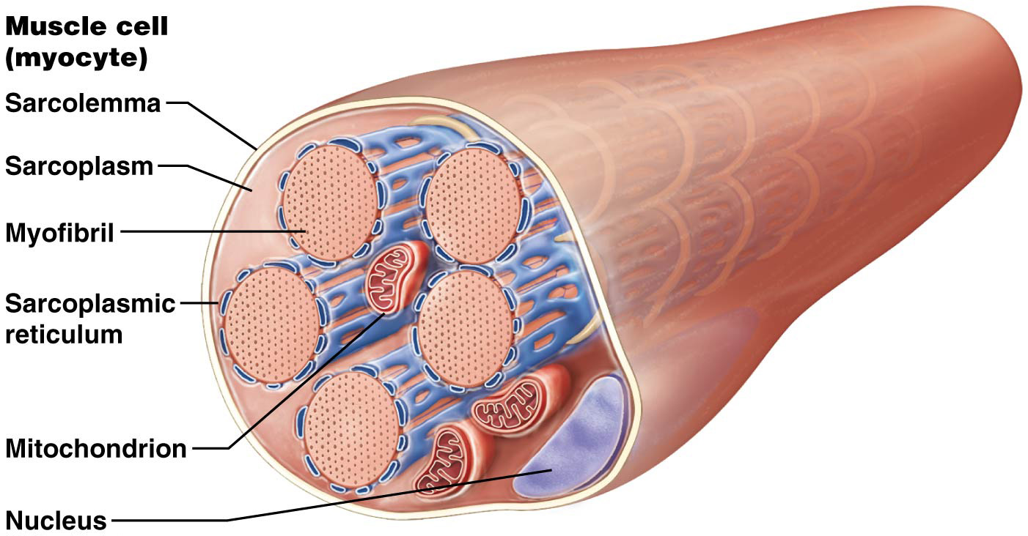
REMEMBER? Structure of the Skeletal Muscle Fiber
The myofibrils, the most abundant organelle, are made up of mostly contractile proteins
The sarcoplasmic reticulum (SR) surrounds the myofibrils and stores and releases calcium ions,
activities vital to muscle
contraction and relaxation

Slide 2
Remember?
Each myofibril is made of hundreds to thousands of protein bundles called myofilaments
There are three types of myofilaments, each with characteristic contractile, regulatory, and/or structural proteins:
Thick filaments are composed of many molecules of contractile protein ____________
Thin filaments are composed of the proteins ________, __________, and ___________
Elastic filaments are composed of a single massive, spring-like structural protein called titin that helps stabilize the myofibril structurally, elastic filaments resist excessive stretching and provide elasticity to the muscle fiber.

Slide 3
Remember?
Each myofibril is made of hundreds to thousands of protein bundles called myofilaments
There are three types of myofilaments, each with characteristic contractile, regulatory, and/or structural proteins:
Thick filaments are composed of many molecules of contractile protein myosin
Thin filaments are composed of the proteins actin, tropomyosin, and troponin
Elastic filaments are composed of a single massive, spring-like structural protein called titin that helps stabilize the myofibril structurally, elastic filaments resist excessive stretching and provide elasticity to the muscle fiber.

Slide 4
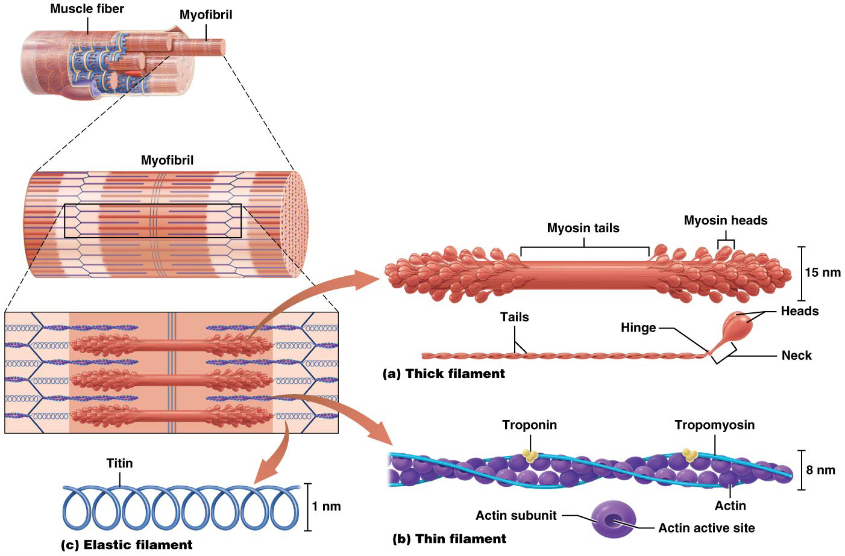
Structure of the Myofibril

Slide 5
Putting It All Together: The Big Picture of Skeletal Muscle Structure
Remember that multiple skeletal muscle fibers together with surrounding endomysium form a __________.
Each fascicle is surrounded by a layer of connective tissue called the _________
Bundles of fascicles together make up a skeletal muscle, the entire muscle is covered by a layer of connective tissue called ___________.

Slide 6
Putting It All Together: The Big Picture of Skeletal Muscle Structure
Remember that multiple skeletal muscle fibers together with surrounding endomysium form a fascicle.
Each fascicle is surrounded by a layer of connective tissue called the perimysium
Bundles of fascicles together make up a skeletal muscle, the entire muscle is covered by a layer of connective tissue called epimysium.

Slide 7
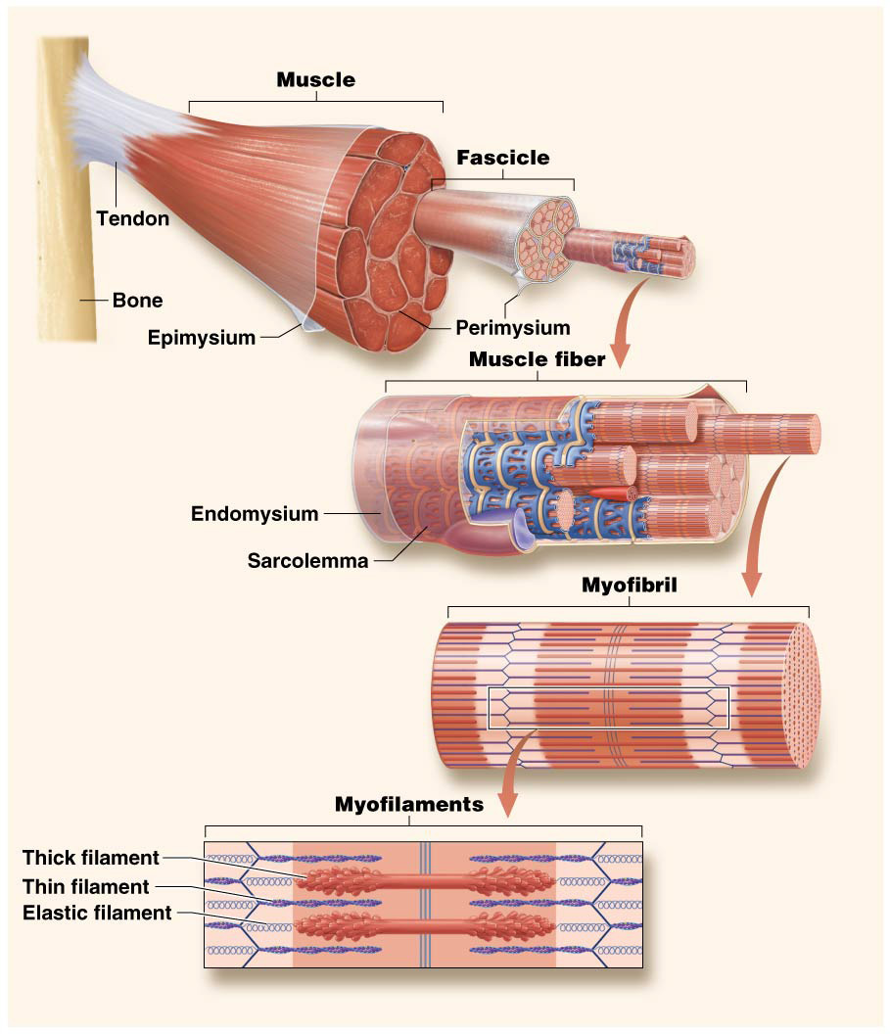
Putting It All Together: The Big Picture of Skeletal Muscle Structure

Slide 8
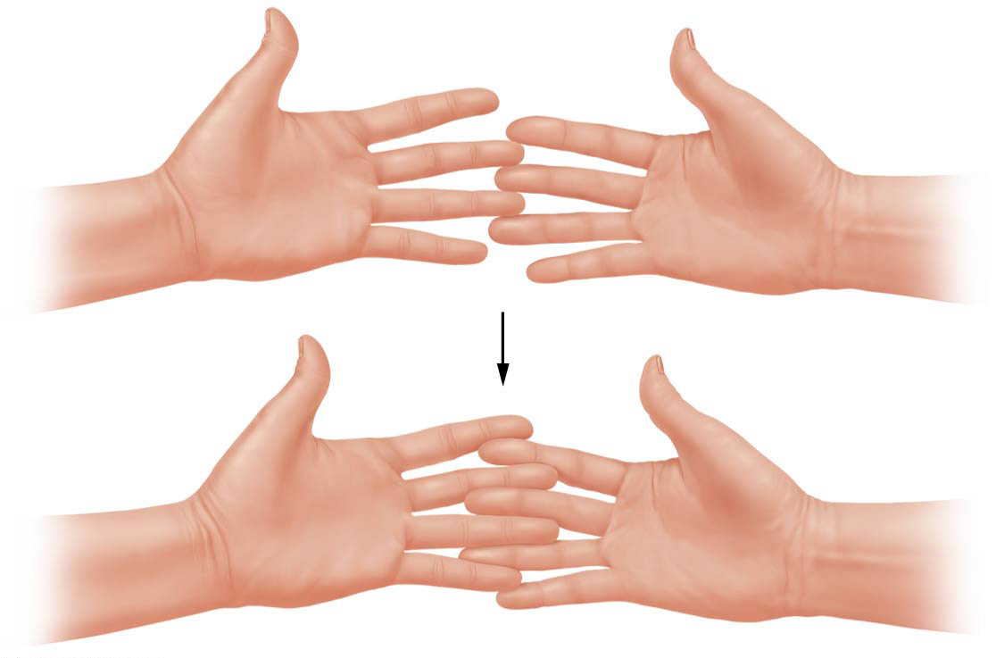
The Sliding-Filament Mechanism of Contraction
Your hands represent a single, large sarcomere, and where your fingers overlap represents the zone of overlap of the thick and thin filaments:
The inner edges of your palms are the z-discs
Now move your fingers slowly together
As you can see, your “sarcomere” (your hands) grows progressively shorter (but your fingers do not change in length)

Slide 9
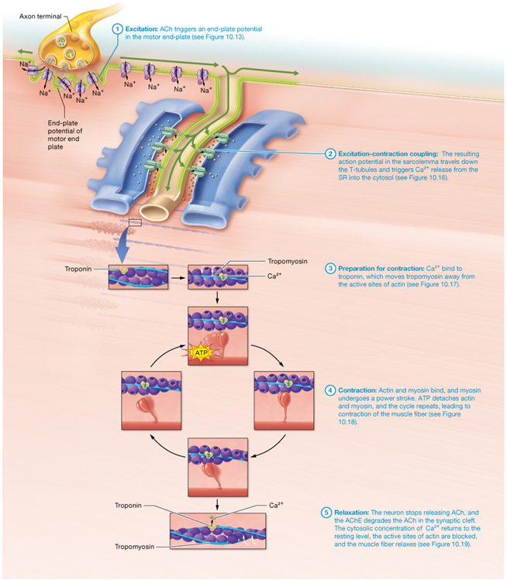
The Big Picture of Skeletal Muscle Contraction and Relaxation

Slide 10
Sources of Energy for Muscle Contraction
The required ATP is generated by:
Immediate cytosolic reactions
Glycolytic catabolism in the cytosol
Oxidative catabolism in the mitochondria
All three processes may occur simultaneously in muscle fibers during contractions, but they are used in different proportions, depending on the resources and needs of the cells

Slide 11
Immediate Sources of Energy for Muscle Contraction
When contraction begins, the main immediate energy source of the muscle fiber is stored as ATP, this ATP is rapidly consumed, but is regenerated almost immediately by a reaction using a molecule called creatine phosphate (CP). CP is found primarily in muscle fibers and is 5–6 times more abundant than ATP in cytosol; ATP produced by creatine phosphate reaction provides the muscles with enough energy for about an additional 10 seconds of maximal muscle activity.

Slide 12
Creatine Supplementation
Dietary supplement manufacturers market creatine supplements as a way to improve muscle strength and performance. The evidence to support these claims is mixed.
Research has demonstrated that supplementation with creatine does mildly improve performance for activities that require short bursts of muscle activity
The effects on endurance-type activities are minimal to nonexistent

Slide 13
Creatine Supplementation
Creatine may actually be detrimental to athletes in certain sports because supplementation causes weight gain from water retention.
No long-term studies done
Massive doses can have negative health implications such as kidney damage
Skeletal muscles have a maximal storage capacity for creatine; therefore, the excess is excreted in the urine
Quality control is left up to individual manufacturers; no requirement that active ingredient actually be present in bottle purchased

Slide 14
Glycolytic Energy Sources
When immediate energy sources are depleted, muscle fibers turn to glycolysis (glycolytic or anaerobic catabolism) to make ATP.
Glycolysis is a series of reactions that occurs in the cytosol of all cells, glucose is broken down to produce 2 ATP per molecule of glucose.
A muscle fiber has two potential sources of glucose for glycolysis: glucose from the bloodstream and a storage form of glucose called glycogen.

Slide 15
Glycolytic Energy Sources
Glycolysis, or anaerobic catabolism, does not require oxygen directly, however the fate of the product of glycolysis (2 molecules of pyruvate) depends on the availability of oxygen to the muscle fiber :
If oxygen is abundant, enters the mitochondria for oxidative catabolism, which will then occur simultaneously with glycolysis as long as glucose is available
If oxygen is not abundant, the pyruvate is converted into two molecules of lactic acid (lactate), which can either be converted back into glucose by the liver or enters the mitochondria and is used for oxidative catabolism

Slide 16
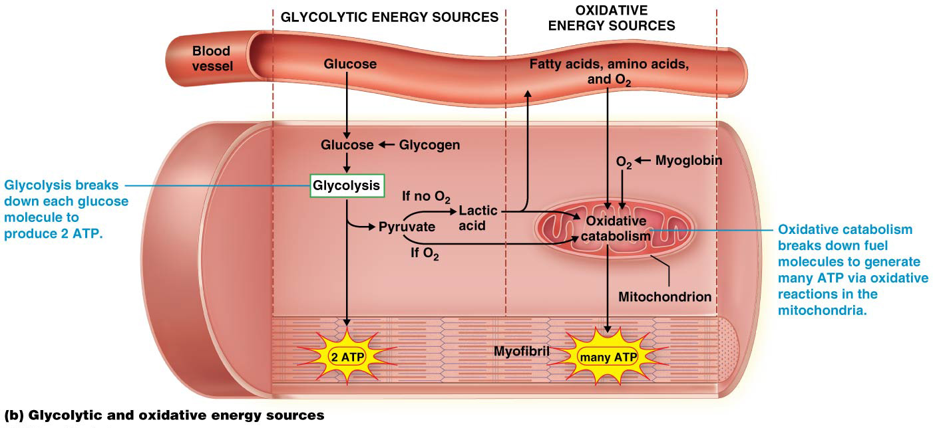
Glycolytic Energy Sources

Slide 17
Oxidative Energy Sources
Combined immediate and anaerobic glycolytic energy sources are adequate for short bursts of activity (like a 400 meter race). However, longer-lasting muscle activity requires a muscle fiber to use mostly oxidative or aerobic catabolism
Occurs in mitochondria
Electrons are removed from carbon-based molecules and the energy liberated is then used to fuel the synthesis of ATP.
Oxidative catabolism produces MORE ATP than glycolysis
The amount of ATP depends on the type of fuel used by the fiber
Glucose is generally preferred fuel for muscle fibers, the one they use first, when glucose becomes less available they will catabolize fatty acids and amino acids if necessary

Slide 18
Oxidative Energy Sources
Oxidative catabolism can provide ATP for hours, as long as oxygen and fuels are available, after only 1 minute of skeletal muscle activity it is the predominant source of ATP for almost all muscle fibers.
After several minutes, nearly 100% of the ATP produced is by this aerobic process

Slide 19
Oxidative Energy Sources Notice the final step is the transfer of electrons to a molecule of oxygen, which is why this type of metabolism is called aerobic catabolism

Slide 20
FLASHBACK……..

Slide 21
Which organ system removes metabolic wastes from the blood, maintains fluid and electrolyte balance and stimulates blood cell production?

Slide 22
Urinary System

Slide 23
Name ALL six levels of organization
1.
2.
3.
4.
5.
6.

Slide 24
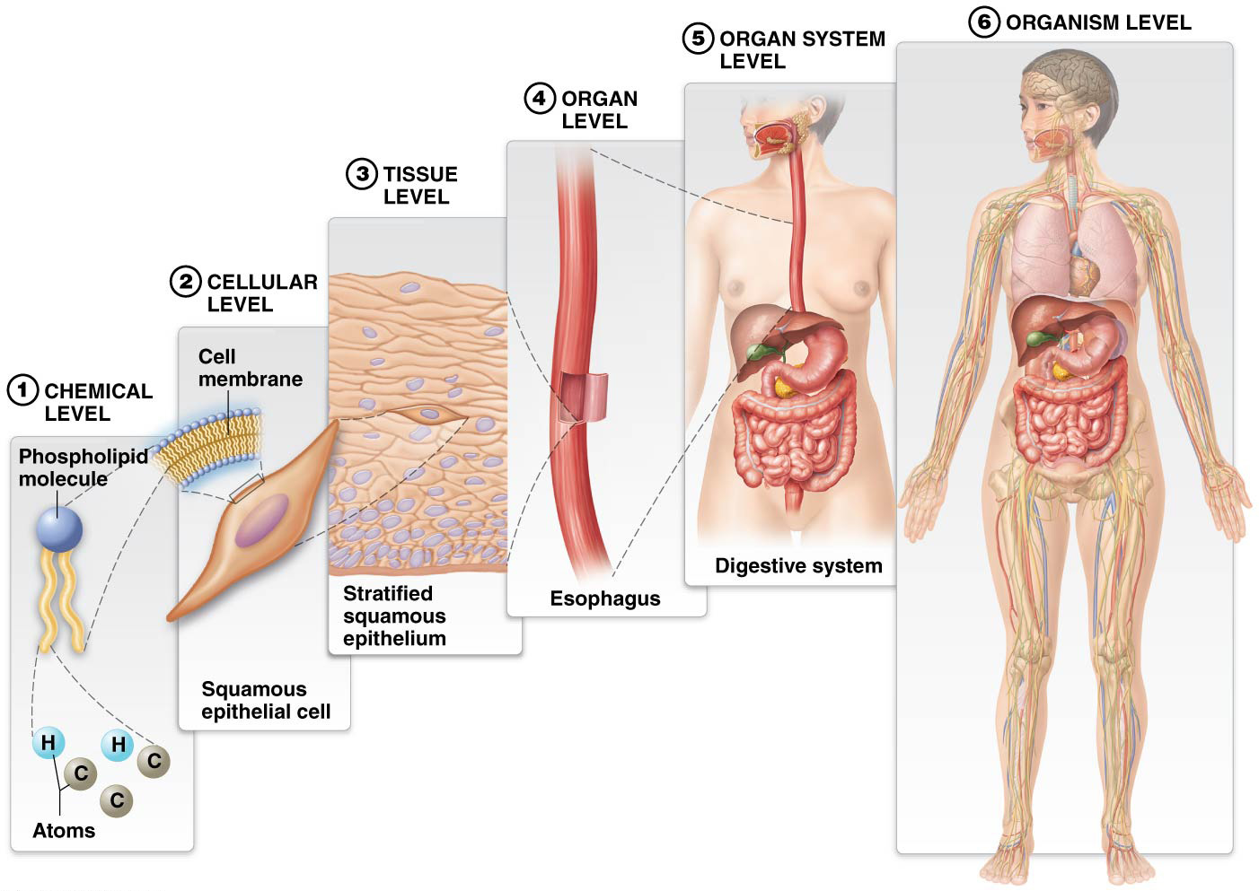
Levels of Structural Organization and Body Systems

Slide 25
Characteristics of Living Organisms
Living Organisms share distinct properties:
__________ are basic units of life
Smallest unit that can carry out functions of life
All organisms are composed of ______.

Slide 26
Characteristics of Living Organisms
Living Organisms share distinct properties:
Cellular composition: cells are basic units of life
Smallest unit that can carry out functions of life
All organisms are composed of cells

Slide 27
Types of Anatomy and Physiology
Study of human body (continued):
_________ __________– studies surface markings of body
_________ _________– examines structures that can be seen with unaided eye
__________ ___________ – studies structures that can only be seen with aid of a microscope; include: Histology (study of tissues) and Cytology (study of cells)

Slide 28
Types of Anatomy and Physiology
Study of human body (continued):
Surface anatomy – studies surface markings of body
Gross anatomy – examines structures that can be seen with unaided eye
Microscopic anatomy – studies structures that can only be seen with aid of a microscope; include: Histology (study of tissues) and Cytology (study of cells)

Slide 29
_______ __________– study of structure or form of human body
_________ _________– study of body’s functions

Slide 30
Human anatomy – study of structure or form of human body
Human physiology – study of body’s functions

Slide 31
Core Principles in A&P
Feedback Loops Core Principle – two mechanisms vital to maintenance of homeostasis:
Positive feedback loops – less common than negative feedback loops; effector activity ________and ________ initial stimulus; shuts off when conditions return to the normal range

Slide 32
Core Principles in A&P
Feedback Loops Core Principle – two mechanisms vital to maintenance of homeostasis:
Positive feedback loops – less common than negative feedback loops; effector activity increases and reinforces initial stimulus; shuts off when conditions return to the normal range

Slide 33
Core Principles in A&P
Negative feedback loops (continued):
Negative feedback loops – ______ initial change in a regulated variable; _____ output
When a change in status of a regulated variable is detected, a series of events is triggered to return variable to its normal value

Slide 34
Core Principles in A&P
Negative feedback loops (continued):
Negative feedback loops – oppose initial change in a regulated variable; reduce output
When a change in status of a regulated variable is detected, a series of events is triggered to return variable to its normal value

Slide 35
Twitch Contraction
A muscle twitch is the smallest muscle contraction; is the response of a muscle fiber to a single action potential in a motor neuron, are laboratory phenomena, they don’t occur in whole muscles in the body. They are useful in experiments to study different types of contractions.
The three phases of a twitch on a myogram include the following:
The latent period is the time it takes the action potential to spread through the sarcolemma
The contraction period marked by rapid increase in tension as crossbridge cycles occur repeatedly.
The relaxation period tension decreases due to the decreasing calcium ion concentration in the cytosol

Slide 36
Twitch Contraction
Between the start of the latent period and start of the contraction period, there is an interval of about 5ms during which the muscle CANNOT respond to another stimulus, this period is called the refractory period
Cardiac muscle and smooth muscle have refractory periods as long as their contractions, so the cells must fully relax before they can contract a second time

Slide 37
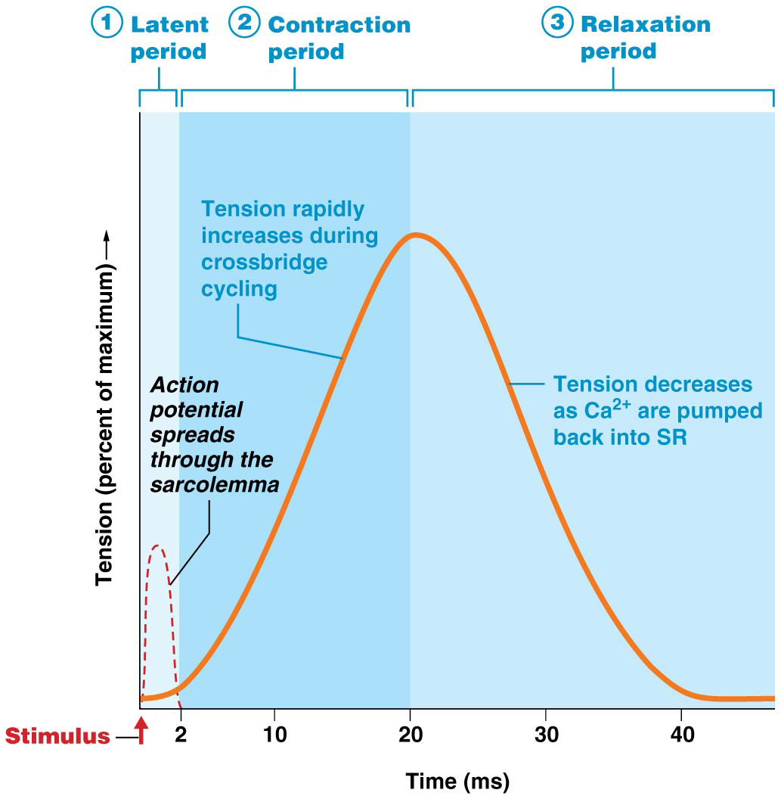
Twitch Contraction
The tension produced during a twitch varies considerably with several factors:
Timing and frequency of stimulation
Length of the fiber at rest
Type of muscle fiber

Slide 38
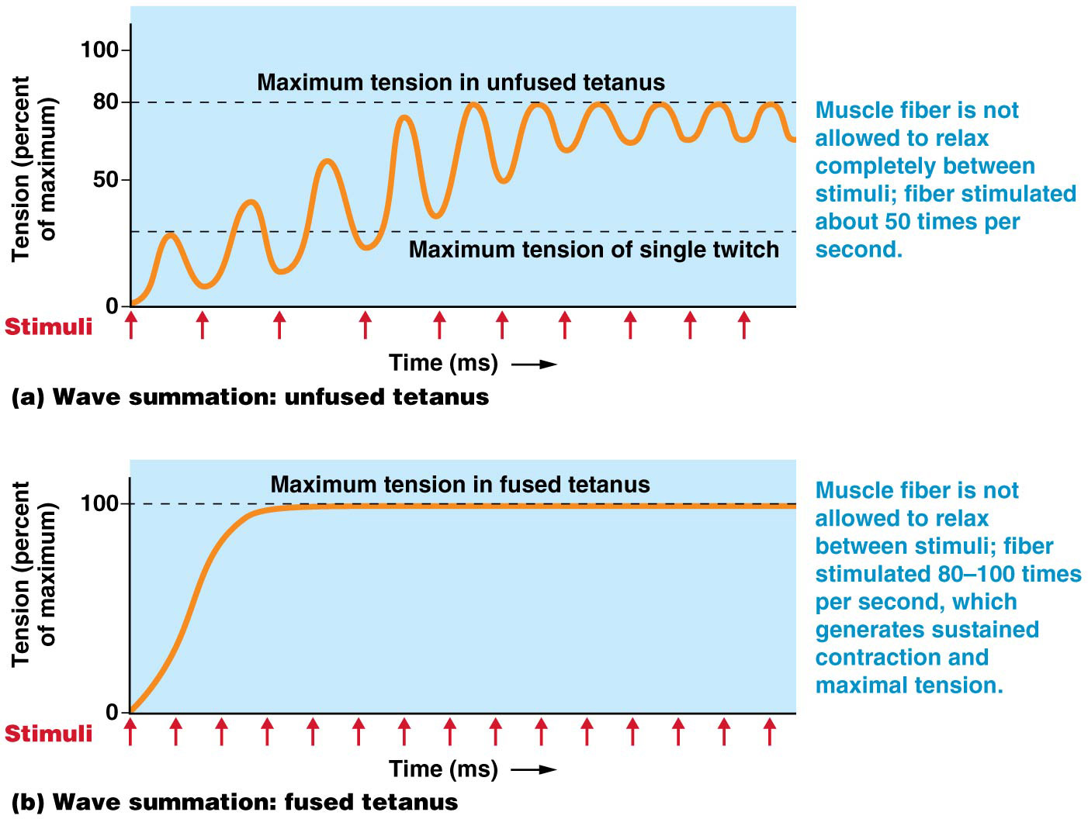
Tension Production and the Timing and Frequency of Stimulation

Slide 39
The Length-Tension Relationship
The length-tension relationship –the relationship between the length of the sarcomeres of a muscle fiber while at rest and the amount of tension that can be generated by a contraction.
optimal length of a sarcomere is the length of the muscle fiber at which the most crossbridges can form, allowing the fiber to generate almost 100% of the tension that is possible to produce.

Slide 40
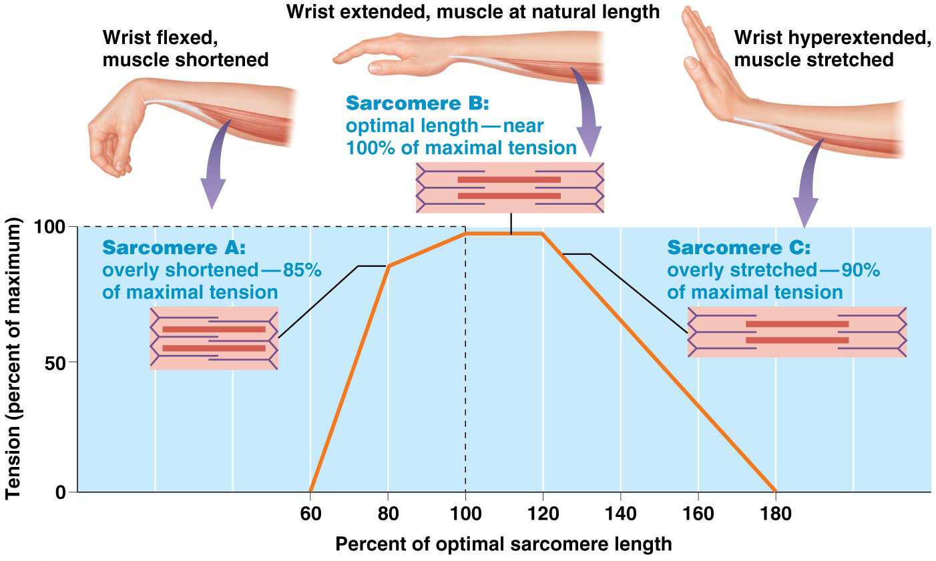
The Length-Tension Relationship

Slide 41
Classes of Skeletal Muscle Fibers
Most muscles contain all fiber classes, each of which is stimulated under different conditions
A baseball player sitting in the dugout uses primarily type I fibers in the back and abdomen to remain sitting upright
When the player gets up and jogs to the plate to bat, primarily type IIa fibers in the legs are used
When the player hits the ball, the bat is swung using type IIx fibers in the arms

Slide 42
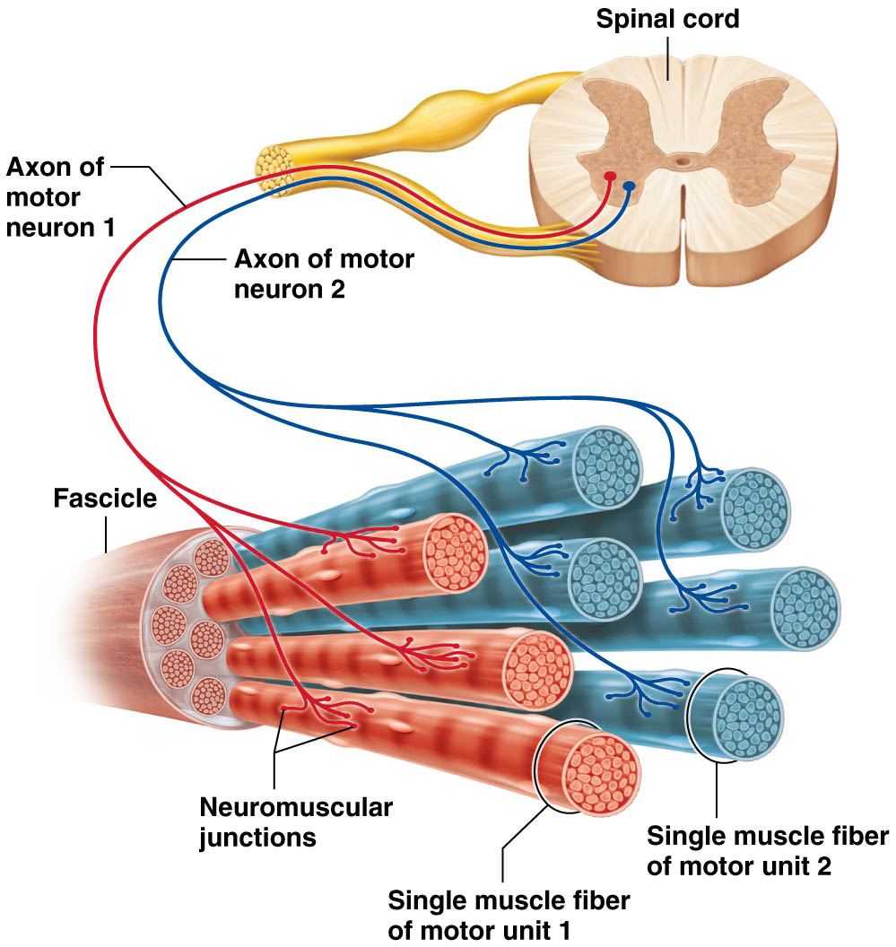
Motor Units

Slide 43
Types of Muscle Contractions
Isotonic contractions (iso= “same”, tono= “tension”) produces enough tension to initially move a load, such as a weight, and then maintains that same level of tension throughout the contraction. SAME TENSION but CHANGING length
Isotonic concentric contraction –the tension generated is greater than that of the external load, and so the muscle cell shortens with the contraction.
Isotonic eccentric contraction- The tension generated is less than that of the external load, and so the muscle cell lengthens with the contractions.
Isometric contractions (-metr= “measure”) results when the external load is equal to the force generated by the muscle. SAME length but CHANGING tension

Slide 44
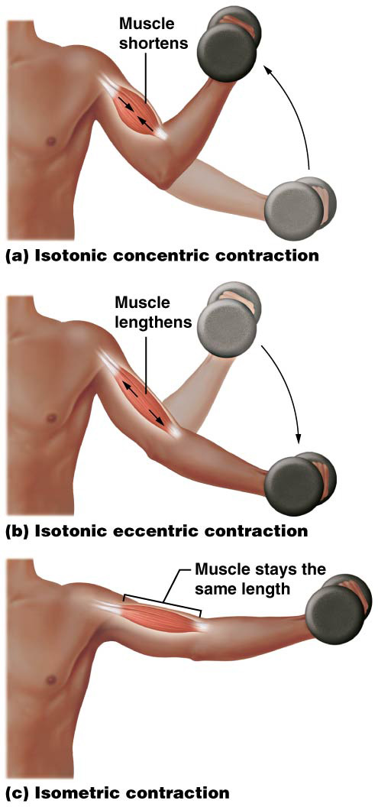
Types of Muscle Contractions
A muscle is able to lengthen while it is contracting because the elastic filaments in its myofibrils allow it to stretch considerably

Slide 45
Changes Caused By Physical Training
The principle of myoplasticity – a muscle will alter its structure to follow its function.
The majority of mature skeletal muscle fiber nuclei are amitotic, meaning that they generally do not undergo mitosis, therefore the changes are within the muscle fibers themselves, not in the number of muscle fibers.
Satellite cells (a small population of unspecialized cells) do retain mitotic ability, can help repair injured skeletal muscle
The precise structural and biochemical changes depend on the type of training chosen, endurance or resistance training

Slide 46
Changes Caused By Physical Training
Endurance training is defined as training with a large increase in the frequency of motor unit activation and a moderate increase in force production—in other words, more repetitions with lighter weight
It leads to the following primarily biochemical changes most dramatically in type I fibers, but even in type II:
Increased oxidative enzymes, and mitochondria (and associated proteins)
More efficient use of fatty acids and other fuels for ATP production
Increased fatigue resistance
Increases in the blood vessel network supplying the muscle

Slide 47
Changes Caused By Physical Training
Resistance, or strength, training involves a moderate increase in the frequency of motor unit activation and a large increase in force production—in other words, fewer repetitions with heavier weight
It causes primarily anatomical changes; both the number of myofibrils and the diameter of the muscle fibers increase, a change called hypertrophy
With hypertrophy comes a decreased proportion of mitochondrial proteins and blood supply to the muscle, because of fiber enlargement, and not because mitochondria or vessels are actually lost
This can decrease endurance, so a balanced program combining both types of training is recommended for most people

Slide 48
Changes Caused By Physical Training
In response to physical inactivity, the diameter of the muscle fiber decreases due to loss of myofibrils, a condition called atrophy.
The amount of oxidative enzymes decreases
The fiber has a lower capacity for oxidative catabolism
The result is a decline in both strength and endurance.
Muscle atrophy is a particular problem for people who are bedridden or have lost the use of their limbs.

Slide 49
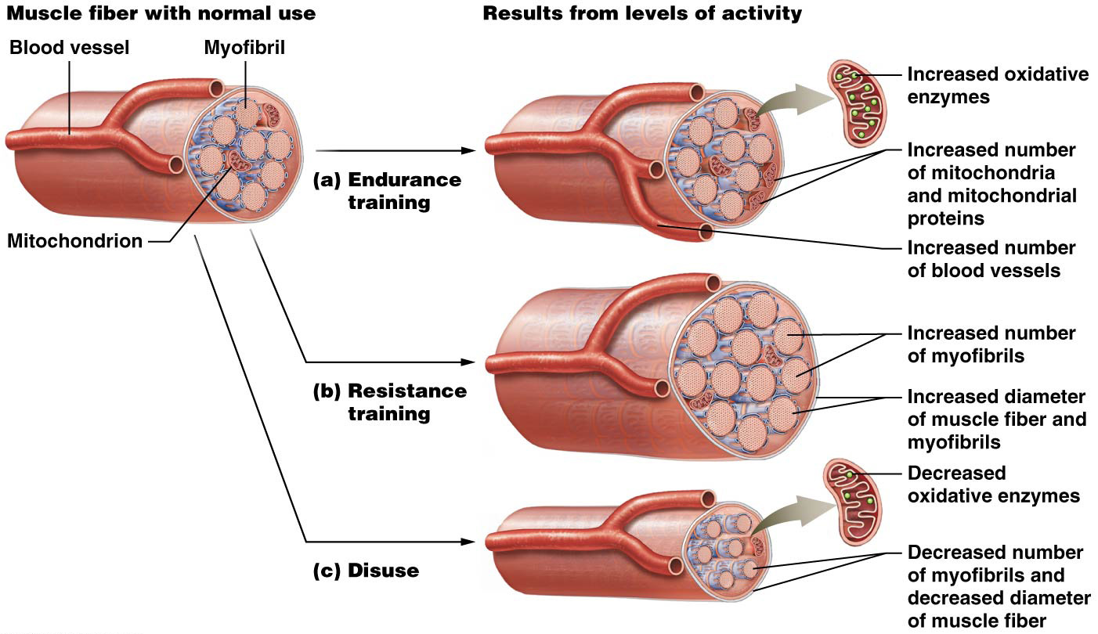
Changes Caused By Physical Training

Slide 50
Smooth Muscle
Smooth muscle is widely distributed in the body, typically lining hollow organs, it is also present elsewhere such as in the arrector pili muscle in the dermis and the muscles in the iris of the eye.
Has the following functions:
Propels materials through hollow organs, a process called peristalsis
Forms sphincters (in the digestive and urinary systems) that control the passage of materials by opening and closing
Regulates flow controls the flow of materials through certain hollow organs by changing the diameter of the tubes (such as blood vessels, the respiratory tract, and the gastrointestinal tract),

Slide 51
Smooth Muscle
Smooth muscle cells contain myosin and actin filaments arranged differently than in skeletal and cardiac muscle; there are no sarcomeres and no striations

Slide 52
Smooth Muscle
Several thin filaments radiate from each dense body to surround a single thick filament; the ratio of thin to thick filaments is higher than in skeletal muscle
Both thick and thin filaments are longer than those in skeletal muscle and the thin filaments lack troponin
The myosin heads have opposite-facing hinges
A thick filament contains myosin heads along its entire length

Slide 53
Smooth Muscle
Smooth muscle cells are structurally different from skeletal muscle fiber in three ways:
lack motor end plates
the SR is much less extensive
there are no T-tubules

Slide 54
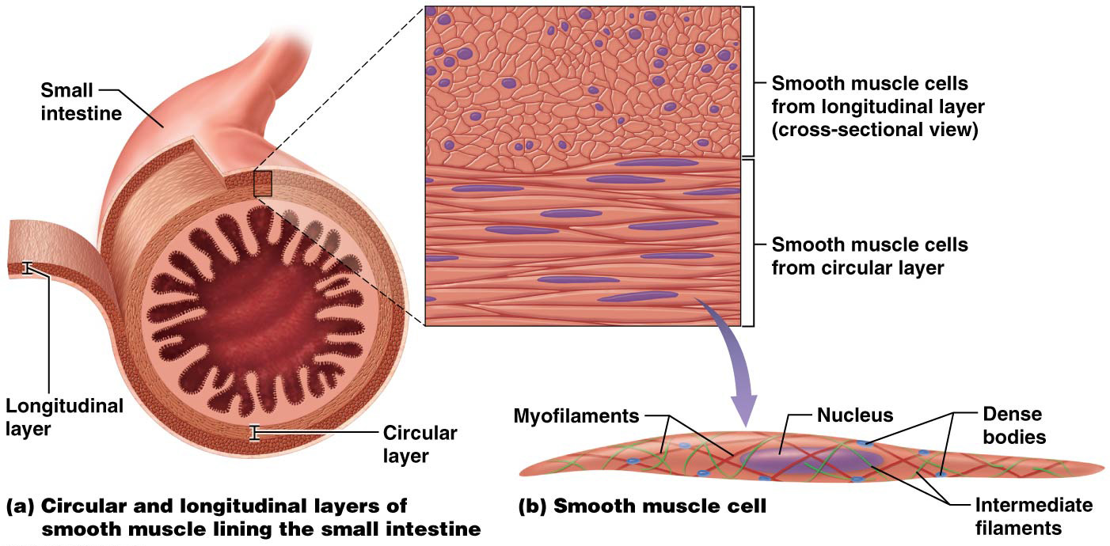
Smooth Muscle

Slide 55
Smooth Muscle
Smooth Muscle Contraction and Relaxation
Contraction of smooth muscle involves a different cascade of events:
Calcium ions bind to a protein in the sarcoplasm called calmodulin (Cam)
The calcium ion-Cam complex activates and enzyme associated with myosin, called myosin light chain kinase (MLCK)
MLCK causes activation of myosin ATPase
The crossbridge cycle then begins

Slide 56
Smooth Muscle
Smooth Muscle Contraction and Relaxation (continued):
As the crossbridge cycles repeat, the crossbridges pull actin along the length of the myosin, and the muscle cell changes shape from long and thin to fat and globular
Smooth muscles can contract up to 80% of their resting length, whereas skeletal muscle can only contract a maximum of 30–40% of their resting length
Most smooth muscle cell contractions consume as little as 1/100 the amount of ATP used by skeletal muscle fibers.

Slide 57
Smooth Muscle
Smooth Muscle Contraction and Relaxation (continued):
Relaxation begins with removal of Ca⁺⁺ from the cytosol, as this concentration declines, calcium ions dissociate from calmodulin, and MLCK is inactivated.
At this point, the muscle cell either relaxes or enters the latch state, during this state, the muscle cell maintains tension while consuming very little ATP. The latch state is very important in terms of the ability of smooth muscle to maintain a state of energy-efficient sustained contraction, as is found in sphincters, which must stay contracted to remain closed.

Slide 58
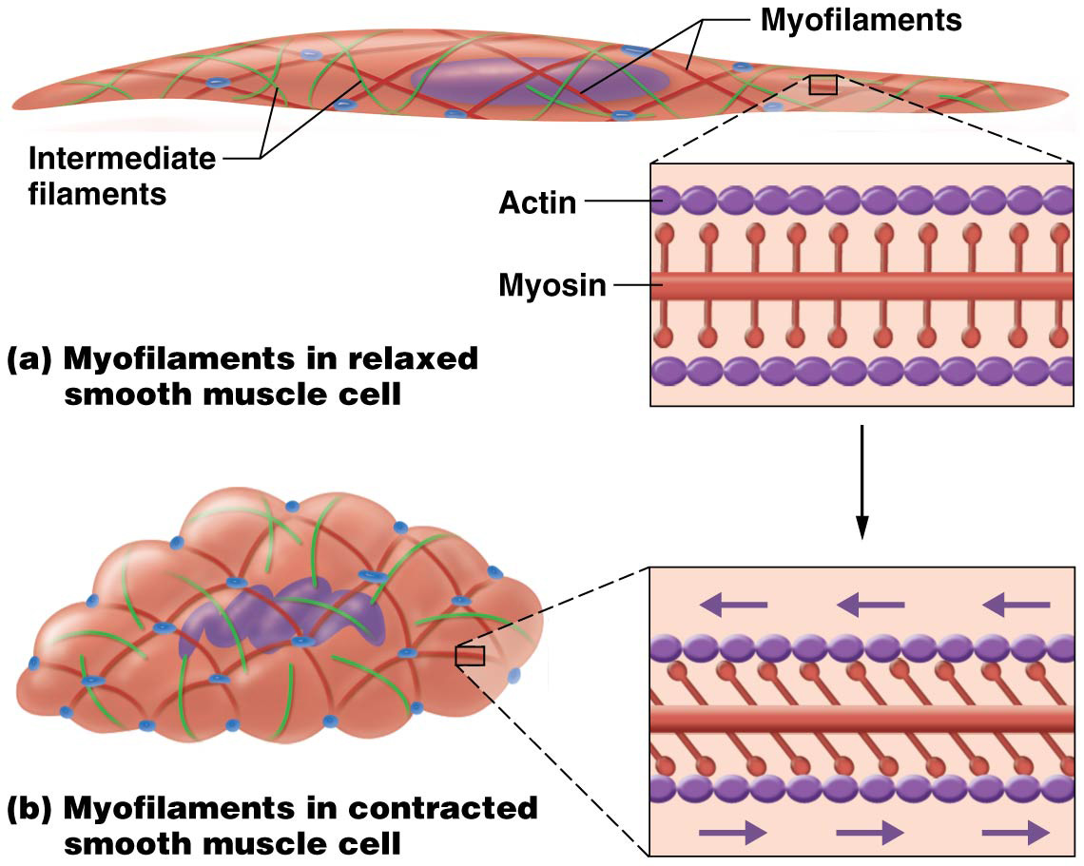
Smooth Muscle

Slide 59
Cardiac Muscle
Cardiac muscle cells more closely resemble skeletal muscle: both are striated and consist of sarcomeres, have T-tubules and extensive networks of SR
Differences:
Shorter, branched cells with one or two nuclei and abundant myoglobin
Mitochondria account for 30% of the cytoplasmic volume
Intercalated discs link cells together, contain gap junctions and desmosomes, join cardiac muscle cells electrically and physically, permitting the heart to contract as a coordinated unit

Slide 60
Cardiac Muscle
Unlike skeletal muscle fibers, cardiac fibers do not require stimulation from the nervous system to generate action potentials; their electrical activity is coordinated by a small population of pacemaker cells
Cardiac pacemaker cells rhythmically and spontaneously generate action potentials that trigger the remaining cardiac muscle cells to have action potentials as well.
This allows cardiac muscle tissue to be autorhythmic, it sets its own rhythm.

Slide 61
FLASHBACK………

Slide 62
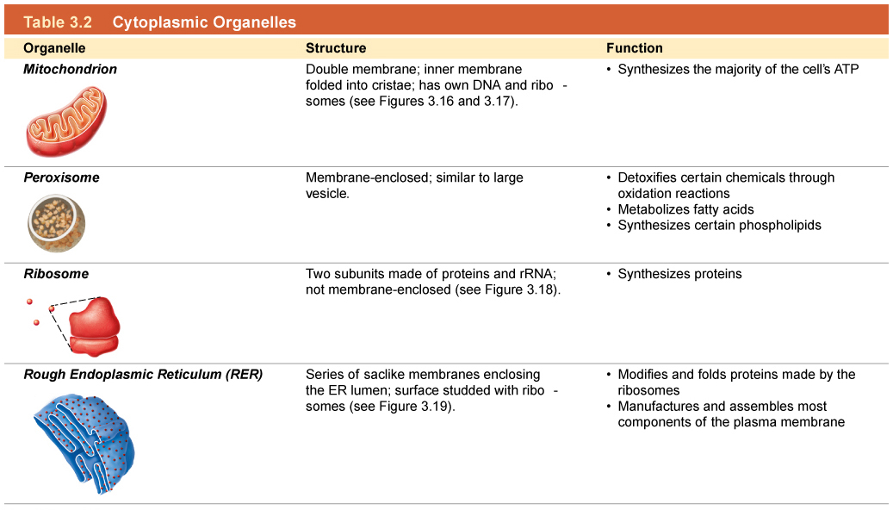
Cytoplasmic Organelles-FILL IN THE FUNCTIONS BELOW

Slide 63
Cytoplasmic Organelles

Slide 64
Name the 3 Types of Cell Junctions
1.
2.
3.

Slide 65
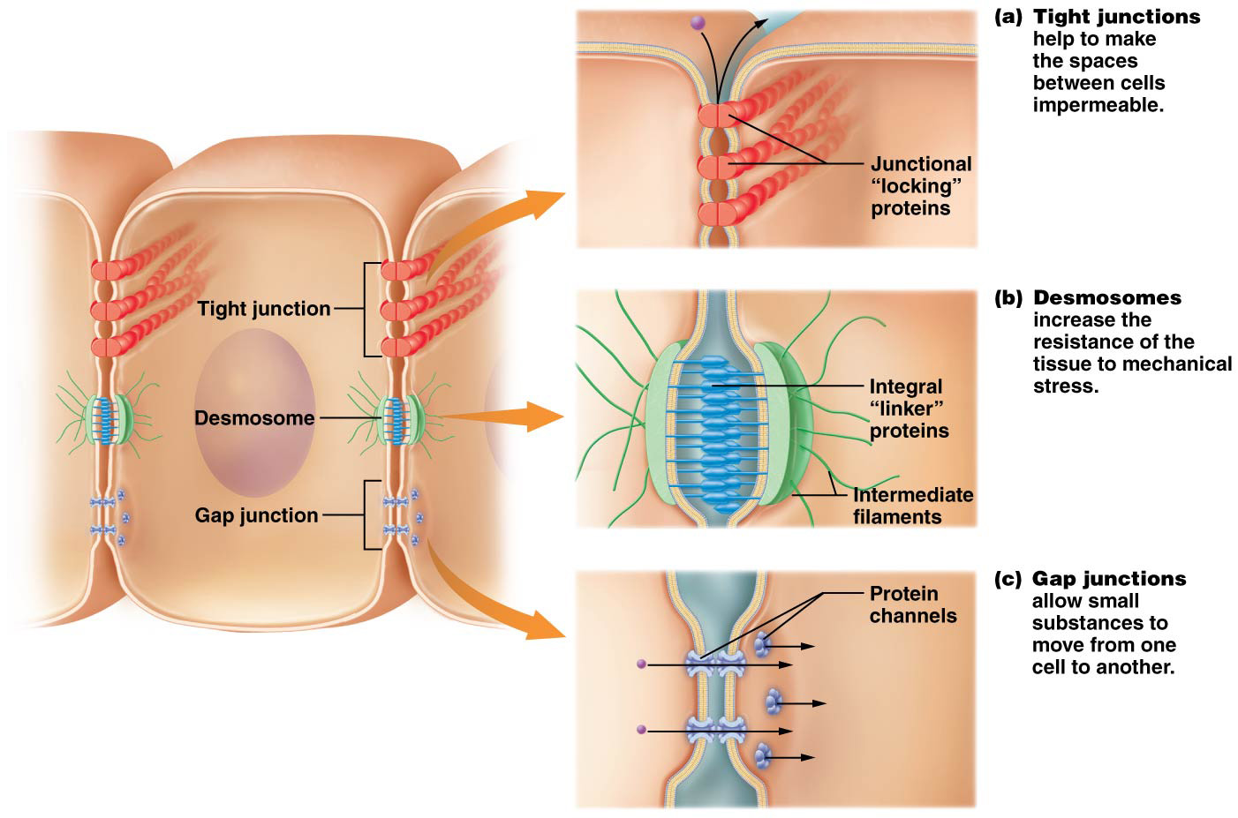
REMEMBER……. Cell Junctions

Slide 66
___________ – anything that has mass and occupies space; can exist in three states: solid, liquid, or gas
___________ – study of matter and its interactions

Slide 67
Matter – anything that has mass and occupies space; can exist in three states: solid, liquid, or gas
Chemistry – study of matter and its interactions

Slide 68
____________– found in central core of atom (atomic nucleus); positively charged
________– found in atomic nucleus; slightly larger than protons; no charge.
_________– found outside atomic nucleus; negatively charged

Slide 69
Protons (p⁺) – found in central core of atom (atomic nucleus); positively charged
Neutrons (n⁰) – found in atomic nucleus; slightly larger than protons; no charge.
Electrons (e⁻) – found outside atomic nucleus; negatively charged

Slide 70
________ _________– regions surrounding atomic nucleus where electrons exist; each can hold a certain number of electrons:
1st shell (closest to nucleus) can hold ___ electrons
2nd shell can hold ____ electrons
3rd shell can hold 18 electrons but “satisfied” with ____
Some atoms may have more than 3 shells

Slide 71
Electron shells – regions surrounding atomic nucleus where electrons exist; each can hold a certain number of electrons:
1st shell (closest to nucleus) can hold 2 electrons
2nd shell can hold 8 electrons
3rd shell can hold 18 electrons but “satisfied” with 8
Some atoms may have more than 3 shells

Slide 72
The human body is made up of four major elements:
Hydrogen
_________
Carbon
_________

Slide 73
The human body is made up of four major elements:
Hydrogen
Oxygen
Carbon
Nitrogen

Slide 74
There are 3 basic types of mixtures: ________, _______, and ____________ .

Slide 75
There are 3 basic types of mixtures: suspensions, colloids, and solutions

Slide 76
Skin Structure
Skin accounts for 10−15% of an individual’s total body weight, it is the largest organ in body; more than just an outer covering; complex organ with many functions important for homeostasis
Known as cutaneous membrane; has two main components:
Epidermis – superficial layer that consists of keratinized stratified squamous epithelium resting on a basement membrane
Dermis – deep to epidermis and basement membrane; consists of loose connective tissue and dense irregular connective tissue

Slide 77
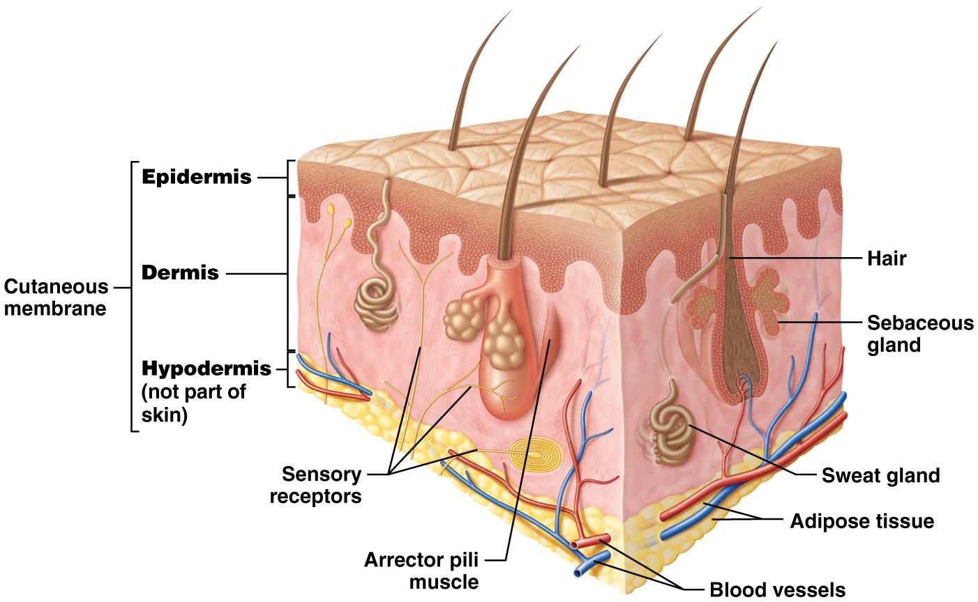
Skin Structure

Slide 78
Skin Structure
Accessory structures of skin – embedded in cutaneous membrane: sweat glands, sebaceous glands, hair, and nails
Skin contains sensory receptors and arrector pili muscles (small bands of smooth muscle associated with hair)
Epidermis is avascular:
Must rely on diffusion of oxygen and nutrients from blood vessels in deeper dermis; limits epidermal thickness
Nearly 50% of cells in epidermis are too far from adequate blood supply to sustain life; superficial layers are made up entirely of dead cells

Slide 79
Skin Structure
Hypodermis – also known as superficial fascia or subcutaneous fat, is deep to dermis
Not actually part of the skin, but it anchors the skin to deeper structures like muscle and bone
Made of loose connective and adipose tissues; has an abundant blood supply

Slide 80
Functions of the Integumentary System
Integumentary system has following functions that are critical for protecting underlying organs or for maintaining homeostasis:

Slide 81
Functions of the Integumentary System
Integumentary system has following functions that are critical for protecting underlying organs or for maintaining homeostasis:
Protection from mechanical trauma, pathogens, and environment:
Stratified squamous, keratinized epithelium provides a continuous durable but flexible surface; protects body from mechanical trauma like stretching, pressure, or abrasions
Provides a continuous barrier to invasion by microorganisms or pathogens that can cause disease
Contains cells of immune system that destroy pathogens before they invade deeper tissues
Skin absorbs UV radiation from the sun before it can damage the underlying tissues.
Glands secrete antimicrobial substances; sebaceous gland secretions give surface of skin slightly acidic pH (acid mantle); deters growth of many pathogens
Skin secretes lipid-based chemicals that have nonpolar covalent bonds; repel molecules with polar covalent bonds (like water and salts); critical for maintaining water and electrolyte homeostasis
Skin plays a critical role in vitamin D synthesis

Slide 82
The Epidermis
Epidermis – most superficial layer; composed of several cell types; most numerous are keratinocytes
Make up about 95% of epidermis; have two structural features that make epidermis stronger and less susceptible to mechanical trauma:
Manufacture keratin – tough fibrous protein that makes epidermis more resistant to mechanical trauma; demonstrates Structure-Function Core Principle
Linked by numerous desmosomes; makes epidermis stronger

Slide 83
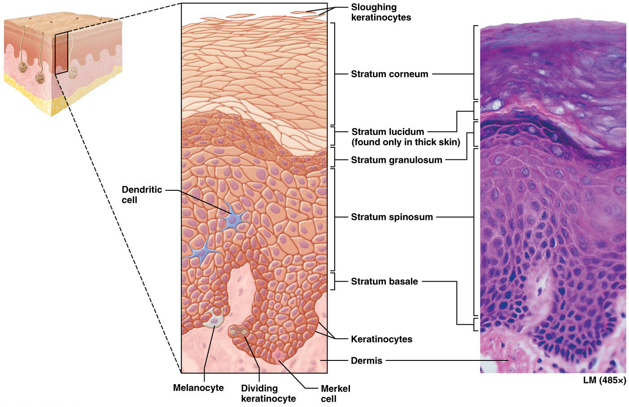
The Epidermis

Slide 84
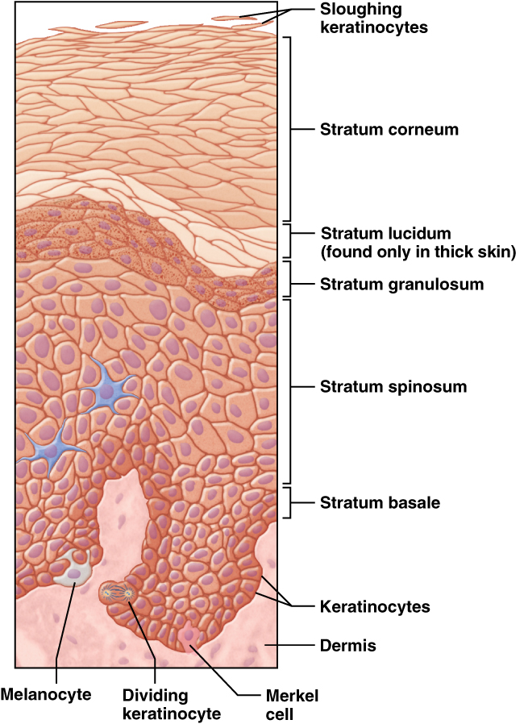
Study Boost: Remembering the Strata of the Epidermis
Here is a simple trick to remember strata of epidermis:
“Brilliant Studying Gives Loads of Confidence”
If you get confused as to which stratum is superficial and which is deep, think of the “B” in “basale” as standing for “bottom”; it is bottom layer

Slide 85
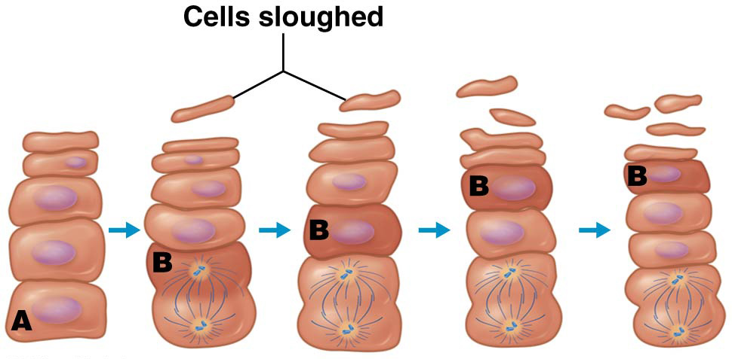
Concept Boost: Understanding Epidermal Growth
Suppose for simplicity’s sake that skin has one row of cells in each epidermal stratum, as shown:
Cell A undergoes mitosis, and one of its two daughter cells (cell B in diagram) is now in stratum spinosum
Other daughter cell of cell A divides again, producing two more daughter cells, one of which pushes cell B into stratum granulosum

Slide 86
Concept Boost: Understanding Epidermal Growth
Cell B is now quite far from blood supply; becomes coated with lipid-based substance; causes it to die
Stem cells continue to divide, pushing cell B even farther away from blood supply, into stratum lucidum and then into stratum corneum
Cell B is now a dead cell filled with keratin; will eventually be sloughed off skin surface

Slide 87
Other Cells of the Epidermis
Dendritic (Langerhans) cells – located in stratum spinosum; phagocytes of immune system; protect skin and deeper tissues from pathogens
Merkel cells – oval cells scattered throughout stratum basale; sensory receptors associated with small neurons in dermis:
Detect light touch and discriminate shapes and textures
Especially numerous in regions that are specialized for touch; fingertips, lips, and at base of hairs
Melanocytes – located in stratum basale; produce protein melanin; skin pigment ranging from orange-red to brown-black

Slide 88
Thick and Think Skin
As with all structures, form of epidermis in various parts of body differs to match its function, in agreement with Structure-Function Core Principle
Certain body locations are subject to great deal of mechanical stress, including palms of hands, palmar surface of fingers, soles of feet and plantar surface of toes; in these locations find thick skin

Slide 89
The Dermis
Dermis – highly vascular layer deep to epidermis
Functions:
Provides blood supply for epidermis
Contains sensory receptors
Anchors epidermis in place
Composed of two distinct layers made up of two types of connective tissue

Slide 90
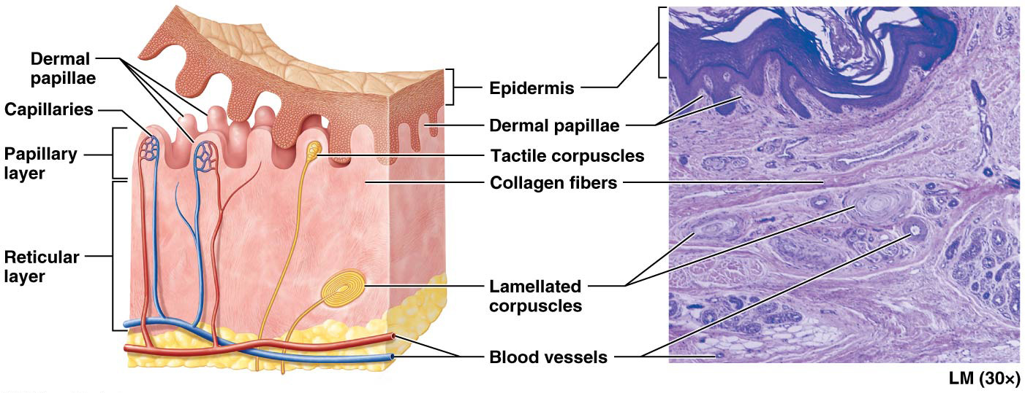
The Dermis

Slide 91
Skin Markings
Skin markings – small visible lines in epidermis created by interaction between dermis and epidermis; some of the most obvious are seen in thick skin of palmar surfaces of hands and fingers and plantar surface of feet and toes, here the dermal papillae are extremely prominent and thick collagen fibers arrange them into dermal ridges.
Dermal ridges indent overlying epidermis and produce epidermal ridges; enhance gripping ability of hands and feet:
Epidermal ridges occur in characteristic patterns; loops, arches, and whorls; genetically determined and unique to each person
Sweat pores open along these ridges and leave a thin film or fingerprint when we touch most surfaces

Slide 92
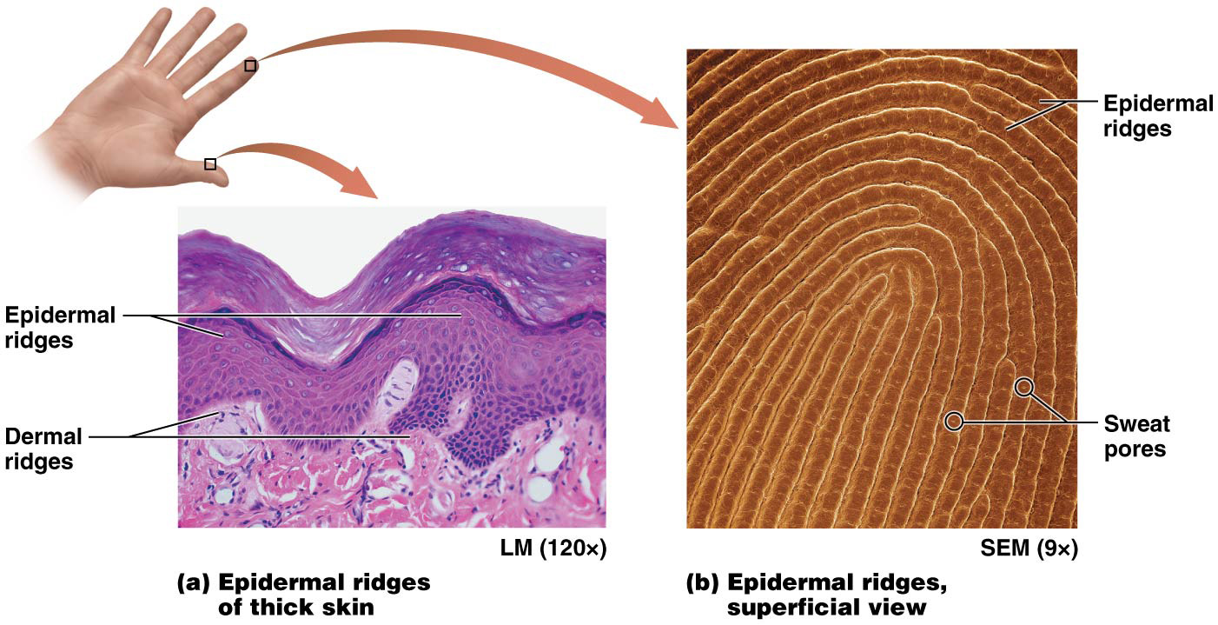
Skin Markings

Slide 93
Skin Markings
Skin markings (continued):
Reticular layer is also responsible for certain skin markings, throughout the dermis, gaps between the bundles of collagen indent the epidermis, forming lines called tension or cleavage lines:
If a skin wound is parallel to tension lines, its edges tend to stay closed and heal better with less risk of scarring.
In areas of body, such as surrounding joints, reticular layer is tightly anchored to deeper structures, this creates deep creases called flexure lines

Slide 94
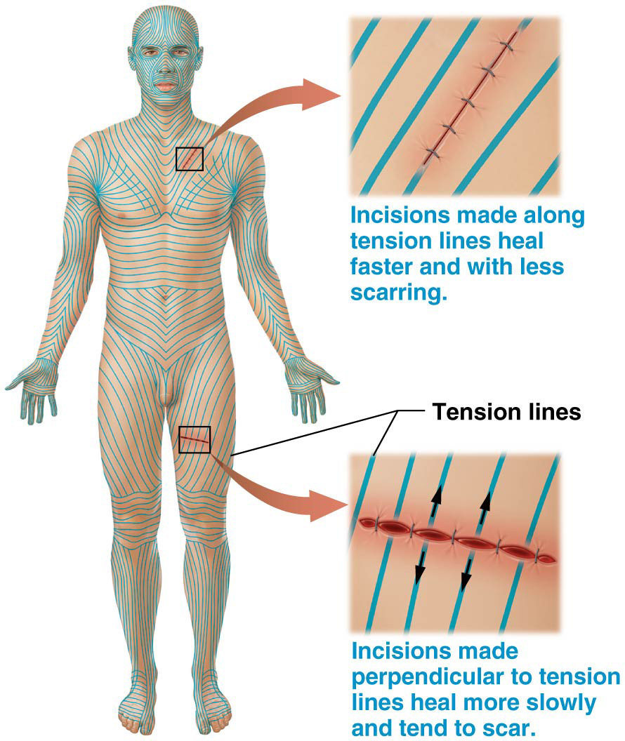
Skin Markings

Slide 95
Melanin
Human skin color is little more than the amount of a pigment called melanin produced in the epidermis:
Produced by melanocytes in stratum basale of epidermis
Ranges in color from orange-red to black

Slide 96
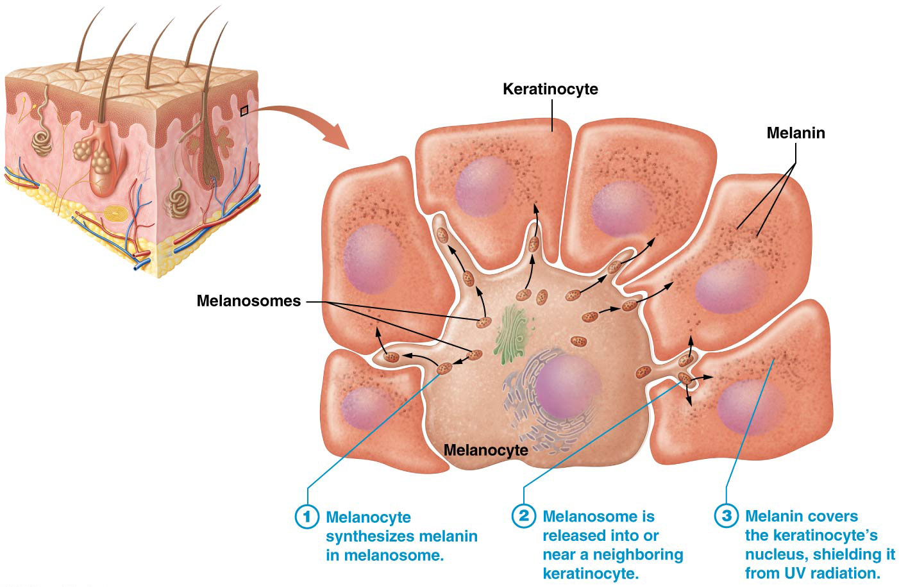
Melanin

Slide 97
Melanin
Skin color (continued):
Melanin synthesis increases upon exposure to UV radiation from the sun or sunlamps; leads to tanning or darkening of skin pigmentation; UV radiation has both immediate and delayed effects on skin pigmentation:
Immediate action is to oxidize the melanin already formed within the keratinocytes, causes melanin to rapidly darken
UV radiation also damages DNA of melanocytes; increases production of additional melanin. These secondary effects become visible about 72 hours after exposure to UV but last longer than melanin oxidation.

Slide 98
Melanin
Skin color (continued):
One function of melanin is to protect the DNA of keratinocytes from mutations induced by UV radiation. Such mutations may form cancerous cells.
Melanin does not provide COMPLETE protection from DNA damage, it absorbs some of UV radiation but not all of it.
People of all skin pigmentations can develop skin cancer and can sunburn

Slide 99
Melanin
Skin color (continued):
Second function of melanin is to decrease the synthesis of vitamin D in response to UV radiation; vitamin D levels must be kept within a specific range, as excess amounts can lead to calcium imbalance and kidney failure.
The role of melanin in vitamin D synthesis may explain the evolution of different skin pigmentation in different parts of the world.
Individuals living in regions exposed to high amounts of UV radiation (such as Africa) may have developed darker skin to prevent excess vitamin D production
People in areas with less UV radiation (such as northern Europe) developed lighter skin so they could synthesize enough vitamin D

Slide 100
Tanning and a “Healthy Tan”
Tanning – $5-billion-a-year business in United States alone; number of salons has soared from 10,000 to 50,000 in last decade; promotes notion of “healthy tan”
THERE IS NO SUCH THING AS A HEALTHY TAN!
Two types of UV rays reach earth’s surface, UVA and UVB; (UVA rays are linked with tanning and UVB rays associated with producing sunburn)
Mechanism of increased melanin production is the same for BOTH types of rays-oxidative damage to existing melanin and DNA damage to melanocytes that can lead to skin cancer; UVA ages skin at a much faster rate
ANY amount of tanning damages melanocytes and other skin elements, ages skin prematurely, and increases risk of skin cancer

Slide 101
Skin Color as a Diagnostic Tool
The color resulting from hemoglobin also depends on how much oxygen is bound to it.
When high amounts are bound, its iron becomes more oxidized and assumes a brighter red color
When extremely low amounts of oxygen are bound to hemoglobin, it turns dark reddish-purple. Then skin takes on a faint bluish color known as cyanosis.
Skin may appear cyanotic when an individual has breathing difficulties, when hemoglobin and red blood cell levels are too low, or when hemoglobin is unable to bind to oxygen.
Cyanosis is a sign that the person IS IN TROUBLE AND NEEDS IMMEDIATE ASSISTANCE

Slide 102
Hair
Accessory structures or appendages of integument include hair, nails, and glands; derived from epithelium; assist in overall function of integumentary system:
Hair (pili) – small filamentous structures that project from surface of skin over entire body except in regions with thick skin, lips, and parts of external genitalia

Slide 103
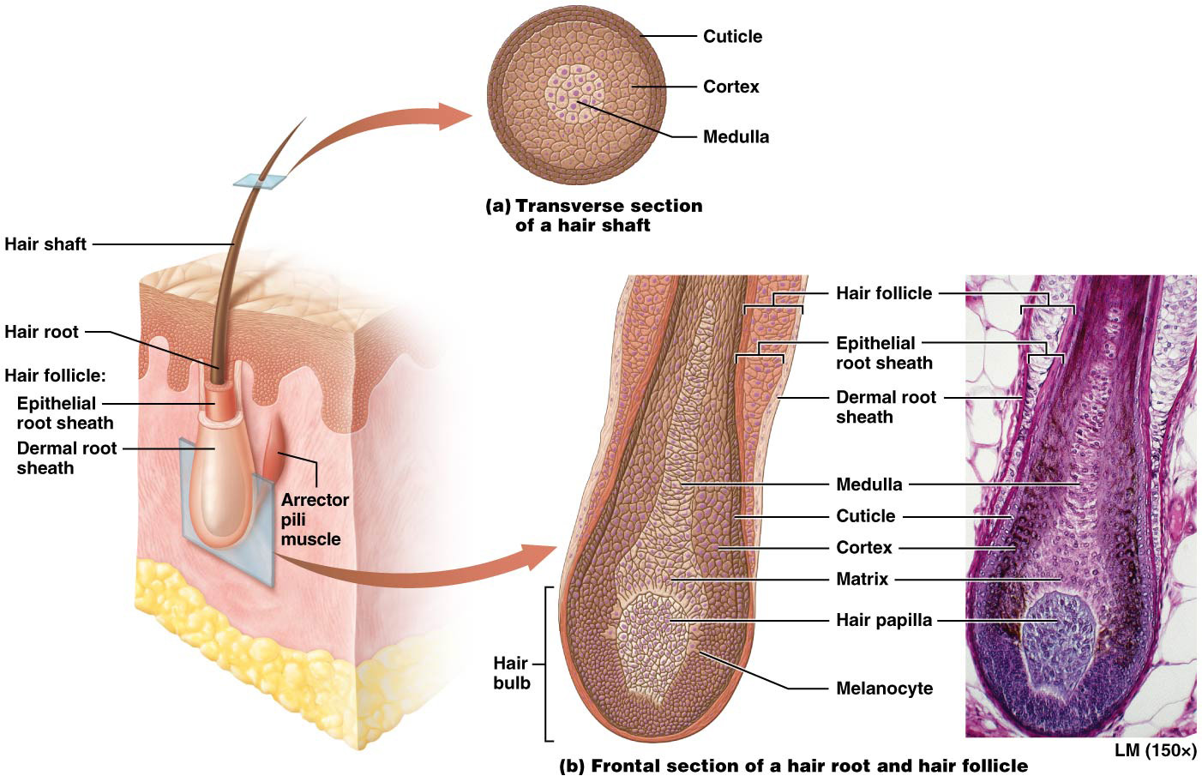
Hair

Slide 104
Hair
Hair – too sparse in humans to play a significant role in thermoregulation, as it does in other mammals:
Does provide protection by preventing substances and organisms from external environment from entering eyes and nose
On head, protects underlying skin of scalp from UV radiation and mechanical trauma
Hairs also participate in sensation because they are associated with small sensory neurons that help them sense the environment.
Hair is derived from epidermis, and so consists of stratified squamous keratinized epithelial cells.

Slide 105
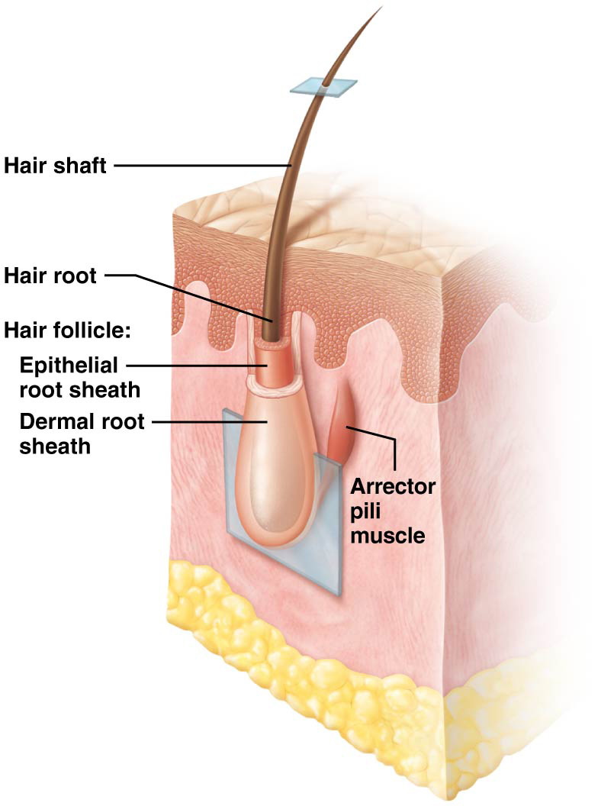
Hair Structure
Hair – composed of two main parts; shaft and root; both composed of columns of keratinized epithelial cells in various stages of development
Shaft
Portion of hair that projects from skin’s surface
Cells in shaft are dead/ completed keratinization process

Slide 106
Hair Structure
Hair structure (continued):
Surrounding epithelial root sheath is a dermal root sheath; consists of connective tissue; supports follicle and keeps it separate from dermis
Small bands of smooth muscle called arrector pili muscles attach to dermal root sheath on one end and dermal papillary layer on the other
Contraction of these tiny muscles causes hair to stand up (piloerection); gives skin a dimpled appearance, commonly called “goosebumps”

Slide 107
Hair Growth
Hair growth averages between 1−1.5 cm per month; varies between individuals; growth is not continuous but occurs in a cycle with following two main phases:
During growth stage, mitosis occurs in matrix:
Cells divide and push cells above them farther away from blood supply where they keratinize and die
Stage varies in duration from a month to as long as six years; depends on location of hair

Slide 108
Hair Growth
Hair growth (continued):
During resting stage, cells in matrix cease dividing and start to die:
Follicle shortens and hair is pushed toward surface where it remains dormant for one to several months
Falls out on its own or is pushed out by a new hair in growth stage

Slide 109
Hair Pigment and Texture
Hair color and texture (continued):
Hair color is largely determined by melanin
Melanocytes located in the matrix manufacture melanin that interacts with keratinocyts just as it does in the epidermis
Blond hair melanocytes produce very little melanin
Darker hair melanocytes produce more melanin
Red hair has a special reddish pigment containing iron
Melanocytes produce less melanin with aging so hair eventually turns gray or white

Slide 110
Nails
Nail growth occurs at nail matrix; actively dividing cells push those above them distally; keratinocytes making up a nail die and keratinize as they are pushed further from the blood supply, grow an average of 0.5 mm per week; toenails grow more slowly
Nails do not contain melanocytes; mostly translucent except at region called lunula; half-moon shaped region of proximal nail plate that represents an area of keratin accumulation
Primary function of nails – protection of underlying tissue (distal tips of the fingers and toes) from trauma; can be used as tools, enabling more precise gripping of items when picked up

Slide 111
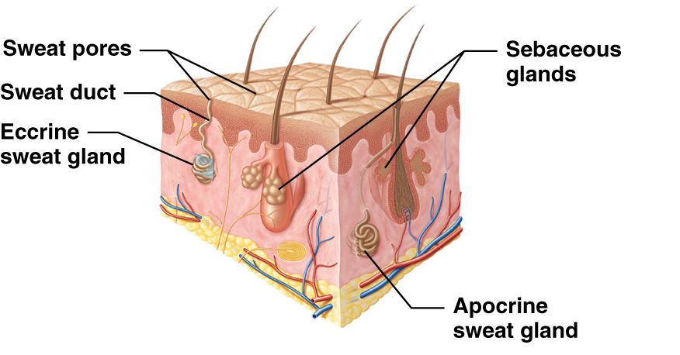
Glands
Skin contains two basic types of glands; both derived from epithelial cells in epidermis but located deeper in dermis
Sweat (sudoriferous) glands that produce sweat
Sebaceous glands that produce sebum or oil

Slide 112
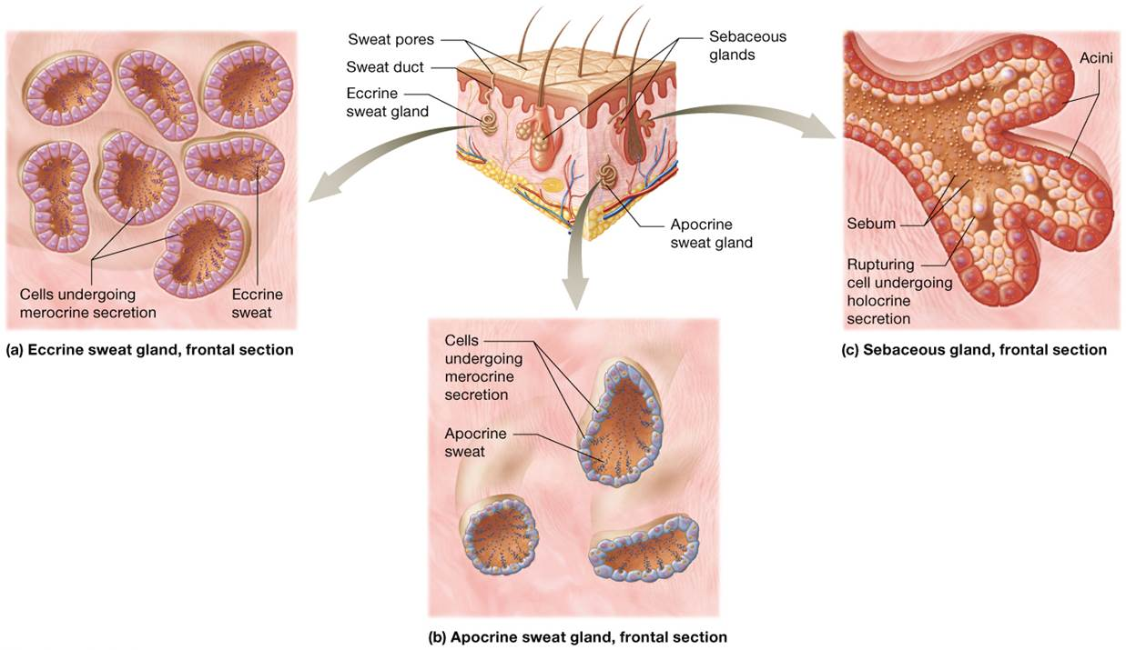
Glands

Slide 113
Wounds
Wound –defined as any disruption in skin’s integrity; Various forms:
Lacerations (cuts)
Burns
Skin cancers

Slide 114
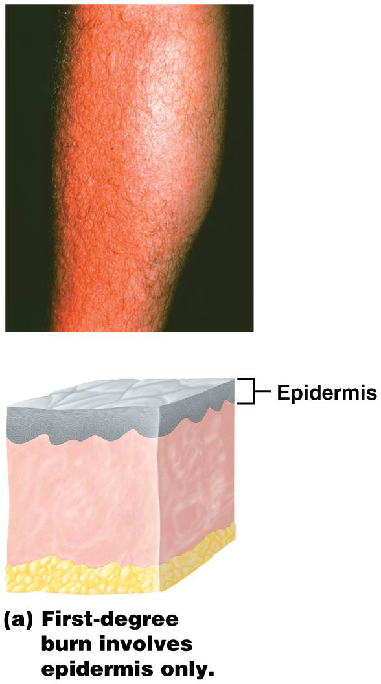
Burns
Burn – wound caused by agents such as heat, extreme cold, electricity, chemicals, and radiation; grouped into three classes according to extent and depth of tissue damage:
First-degree burns (superficial burns)
Most minor, only damage epidermis
Skin may develop erythema (red appearance) and some mild pain without any permanent damage

Slide 115
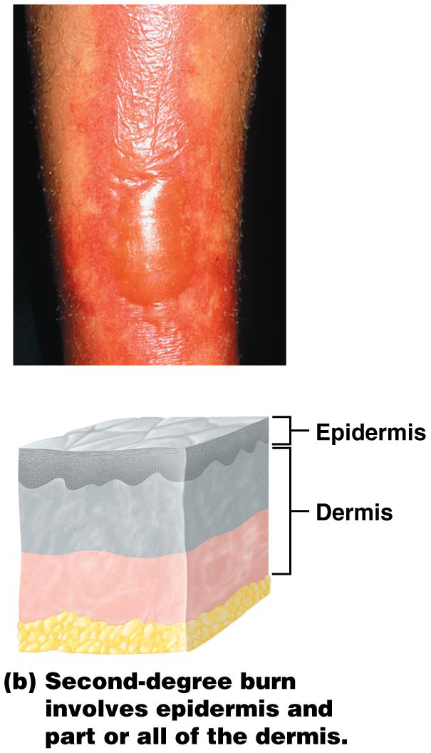
Burns
Burns (continued):
Second-degree burns (partial thickness burns)
Involve epidermis and part or all of dermis
Result in significant pain, blistering, and possibly scarring

Slide 116
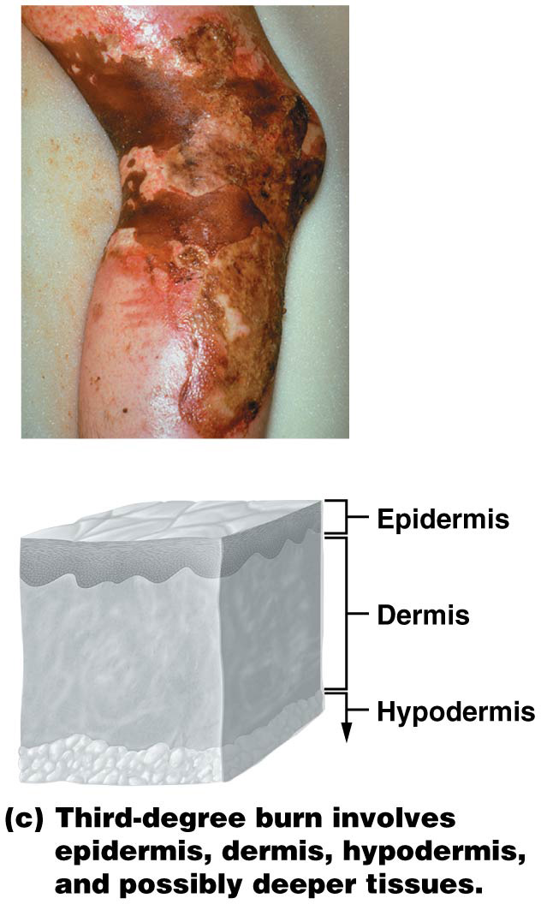
Burns
Burns (continued):
Third-degree burns (full thickness burns)
Most damaging burns
Involve epidermis, dermis, hypodermis; potentially even deeper tissue, like muscle or bone
Not generally painful at first because nerves are destroyed too

Slide 117
Burns
Burns (continued):
Third-degree burns (full thickness burns) (continued):
Typically result in major tissue damage and significant scarring with loss of hair follicles and diminished or absent keratin production
Often problems with dehydration due to massive fluid loss from swelling; also at great risk for infection

Slide 118
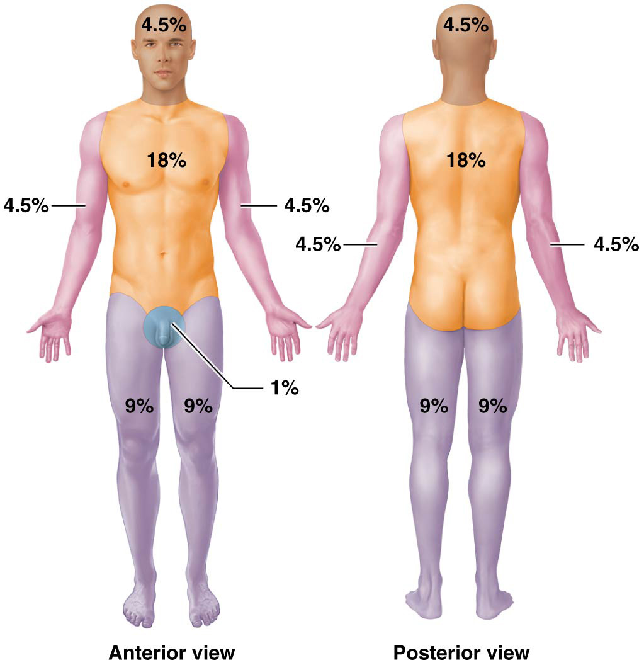
Burns
Rule of nines
Body is divided into 11 areas each representing 9% of the total body surface area
Useful clinical tool for grading extent of burn; severity and extent of burn is used to direct treatment options

Slide 119
Skin Cancer
Cancer – one of most common diseases in world; caused by mutations in DNA that induce a cell to lose control over its cell cycle:
Tumor- cluster of undifferentiated cells
Cancerous tumors are characterized by their ability to metastasize (spread to other tissues through the cardiovascular or lymphatic system)
Tumors then grow in new areas, where the tumor cells alter the structure of a tissue and prevent it from functioning normally

Slide 120
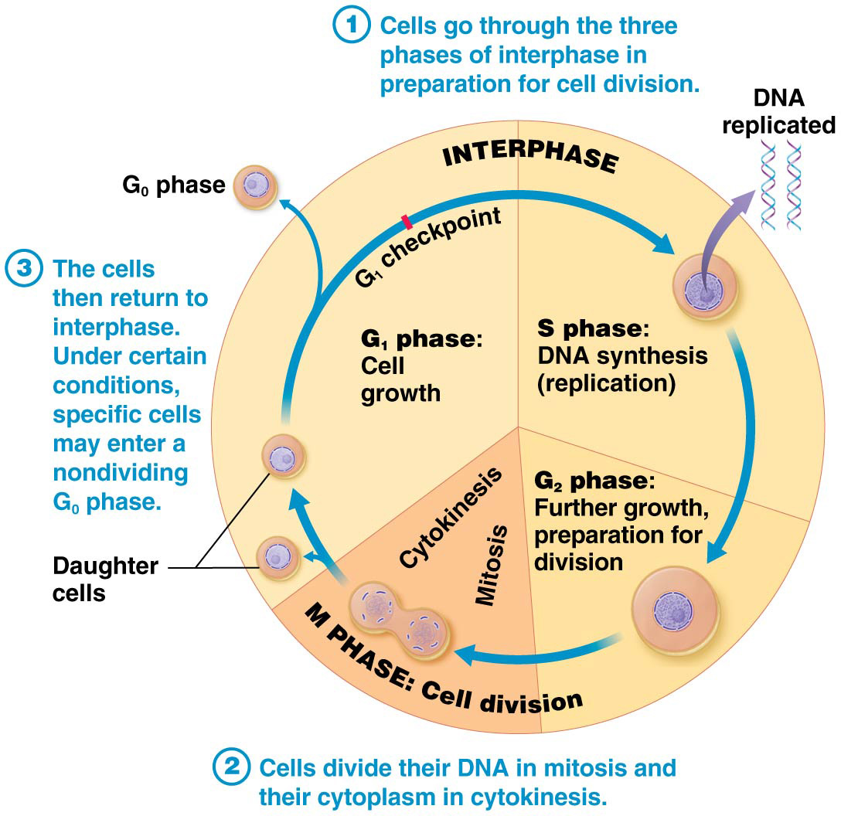
FLASH BACK…………. Phases of the Cell Cycle

Slide 121
Skin Cancer
Three common cancers affect skin; linked to UV radiation exposure; other factors can play a role too:
Exposure to carcinogens (agents that induce cancer)
Exposure to other forms of radiation

Slide 122
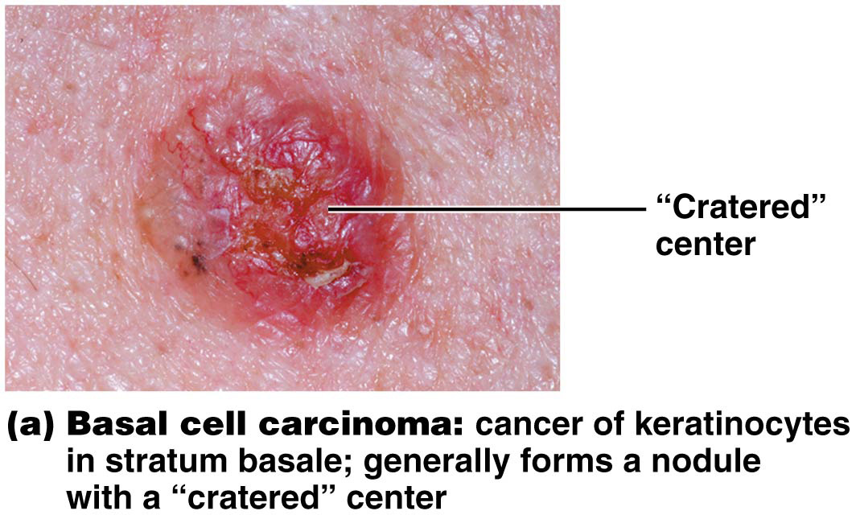
Skin Cancer
Basal cell carcinoma
Most common of all cancers, including skin cancer
Arises from keratinocytes in stratum basale of epidermis
Typically found on skin that is regularly exposed to UV radiation
Generally forms a nodule with a central crater that ulcerates
Generally does not metastasize
Surgical removal usually resolves it completely

Slide 123
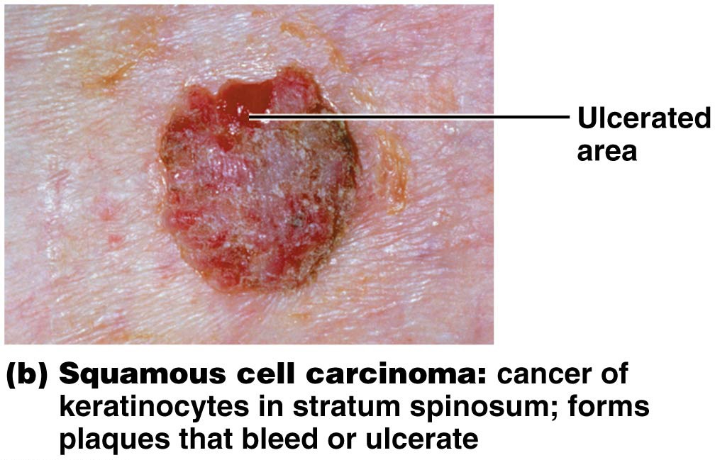
Skin Cancer
Squamous cell carcinoma
Second most common skin cancer
Cancer of keratinocytes of stratum spinosum
Tends to form scaly plaques that ulcerate or bleed, most common on head and neck
More likely to metastasize than basal cell carcinoma; but typically can still be managed with surgery

Slide 124
Skin Cancer
Malignant melanoma – cancer of melanocytes
MOST dangerous skin cancer
Early detection of melanoma is critical due to its tendency to metastasize
“Arms” of cancerous melanocytes extend down into dermis and access dermal blood vessels; enables cells to spread to other tissues via bloodstream
Treated with surgical removal and possibly other options such as radiation therapy and chemotherapy
Prognosis depends on size of the tumor, depth to which it extends into dermis, and whether it has metastasized to other tissues

Slide 125
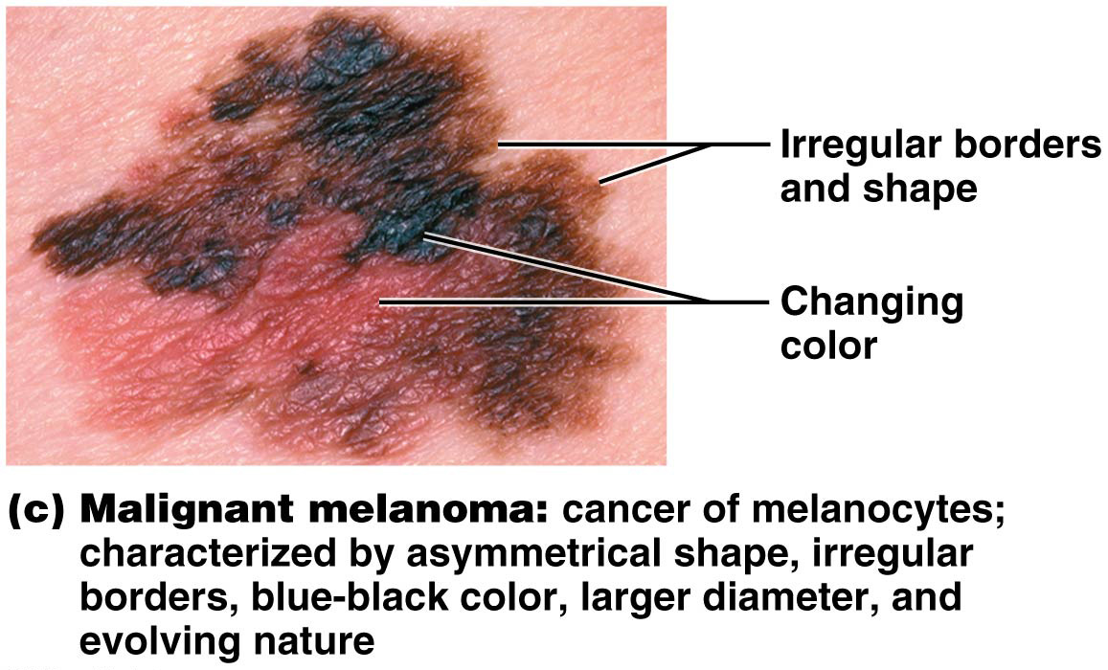
Skin Cancer
Malignant melanoma can be distinguished from other skin cancers and normal moles using ABCDE rule:
(A): Asymmetrical shape (two sides do not match)
(B): Border irregularity
(C): Color, usually blue-black or a variety of colors
(D): Diameter generally larger than 6 mm (size of a pencil eraser)
(E): Evolving (changing) shape and size

