Slide 1
Exam 4 Review

Slide 2
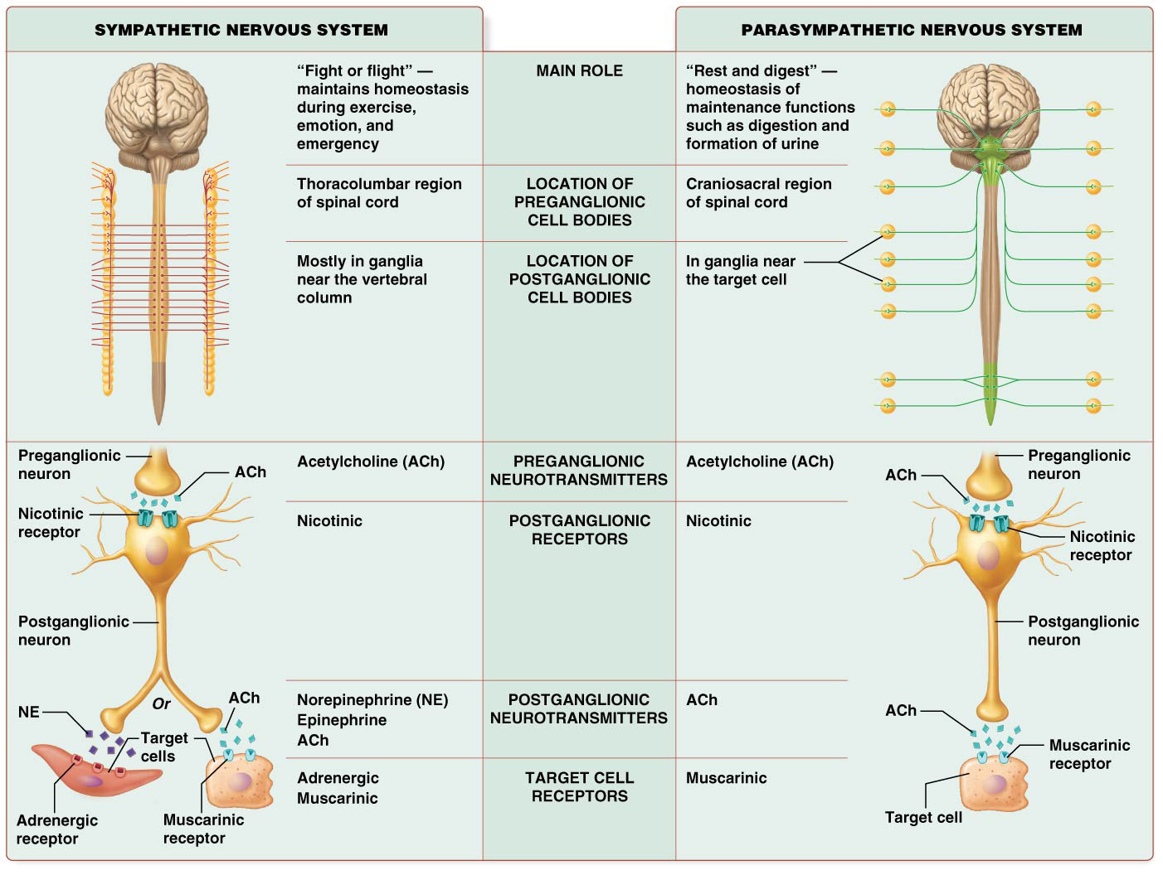

Slide 4
Divisions of the PNS
PNS is classified functionally into 2 divisions:
Sensory division – consists of sensory (afferent) neurons that detect and transmit sensory stimuli to CNS; has 2 anatomical subdivisions:
________ sensory division –it detects stimuli of the general senses that arise external to the body and internal. Also contains special sensory neurons that detect stimuli of special senses.
________ sensory division -relays sensory information from the organs of abdominopelvic and thoracic cavities, such as blood pressure.

Slide 5
Divisions of the PNS
PNS is classified functionally into 2 divisions:
Sensory division – consists of sensory (afferent) neurons that detect and transmit sensory stimuli to CNS; has 2 anatomical subdivisions:
Somatic sensory division –it detects stimuli of the general senses that arise external to the body and internal. Also contains special sensory neurons that detect stimuli of special senses.
Visceral sensory division -relays sensory information from the organs of abdominopelvic and thoracic cavities, such as blood pressure.

Slide 6
Divisions of the PNS
Motor division CONTINUED
___________(fight or flight division) – maintains homeostasis when body is engaged in physical work and mediates visceral responses to emotions
___________ (rest and digest division) – involved in digestion and maintaining body’s homeostasis at rest

Slide 7
Divisions of the PNS
Motor division CONTINUED
ANS is further divided into sympathetic and parasympathetic nervous systems
Sympathetic nervous system (fight or flight division) – maintains homeostasis when body is engaged in physical work and mediates visceral responses to emotions
Parasympathetic system (rest and digest division) – involved in digestion and maintaining body’s homeostasis at rest

Slide 8
Overview of Peripheral Nerves and Associated Ganglia
Two collections of axons connect PNS with spinal cord’s gray matter; anterior root containing _____ neurons from anterior horn and posterior root containing _______ neurons that enter posterior horn

Slide 9
Overview of Peripheral Nerves and Associated Ganglia
Two collections of axons connect PNS with spinal cord’s gray matter; anterior root containing motor neurons from anterior horn and posterior root containing sensory neurons that enter posterior horn

Slide 10
Overview of Peripheral Nerves and Associated Ganglia
Spinal nerves (continued):
Posterior root features a swollen area that houses cell bodies of sensory neurons called posterior root ganglion (or dorsal root ganglion)
Posterior and anterior roots fuse to form _________just lateral to posterior root ganglion

Slide 11
Overview of Peripheral Nerves and Associated Ganglia
Spinal nerves (continued):
Posterior root features a swollen area that houses cell bodies of sensory neurons called posterior root ganglion (or dorsal root ganglion)
Posterior and anterior roots fuse to form spinal nerve just lateral to posterior root ganglion

Slide 12
Overview of Peripheral Nerves and Associated Ganglia
Spinal nerves (continued):
All 31 pairs of spinal nerves are ______ nerves

Slide 13
Overview of Peripheral Nerves and Associated Ganglia
Spinal nerves (continued):
All 31 pairs of spinal nerves are mixed nerves

Slide 14
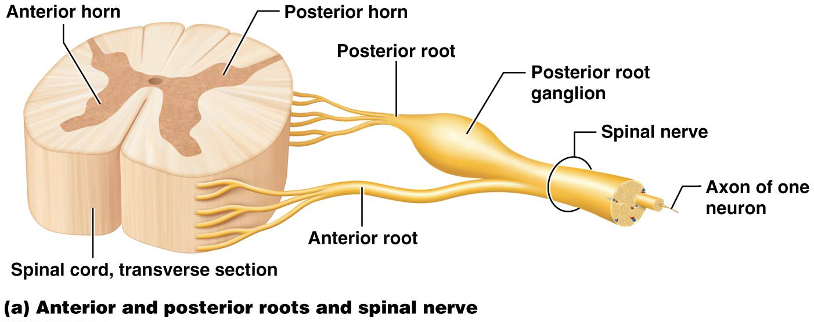
Overview of Peripheral Nerves and Associated Ganglia

Slide 15
Overview of Peripheral Nerves and Associated Ganglia
Structures of nerves:
_____________ – outermost layer of connective tissue that holds motor and sensory axons together
____________ – within nerve, small groups of bundled axons surrounded by connective tissue called perineurium
Each axon within a fascicle is surrounded by its own connective tissue sheath called ______________

Slide 16
Overview of Peripheral Nerves and Associated Ganglia
Structures of nerves:
Epineurium – outermost layer of connective tissue that holds motor and sensory axons together
Fascicles – within nerve, small groups of bundled axons surrounded by connective tissue called perineurium
Each axon within a fascicle is surrounded by its own connective tissue sheath called endoneurium

Slide 17
The Sensory Cranial Nerves
Three cranial nerves contain axons of only sensory neurons:
1.
2.
3.

Slide 18
The Sensory Cranial Nerves
Three cranial nerves contain axons of only sensory neurons:
1. Olfactory (I)
2. Optic (II)
3. Vestibulocochlear (VIII)

Slide 19
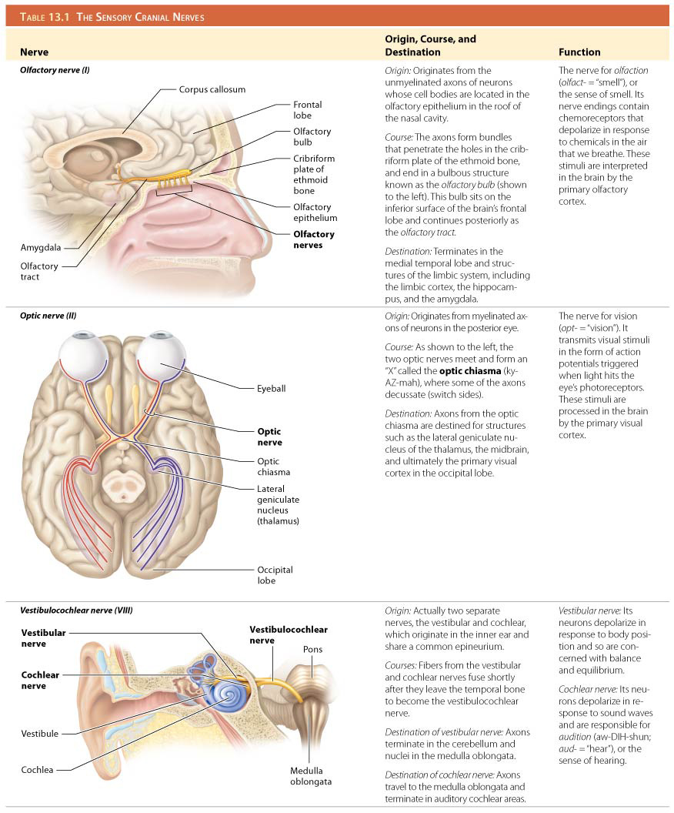
The Sensory Cranial Nerves

Slide 20
The Motor Cranial Nerves
Five cranial nerves contain primarily axons of motor neurons with their associated sensory axons responsible for proprioception:
1.
2.
3.
4.
5.

Slide 21
The Motor Cranial Nerves
Five cranial nerves contain primarily axons of motor neurons with their associated sensory axons responsible for proprioception:
Oculomotor (III)
Trochlear (IV)
Abducens (VI)
Accessory (XI)
Hypoglossal (XII)

Slide 22
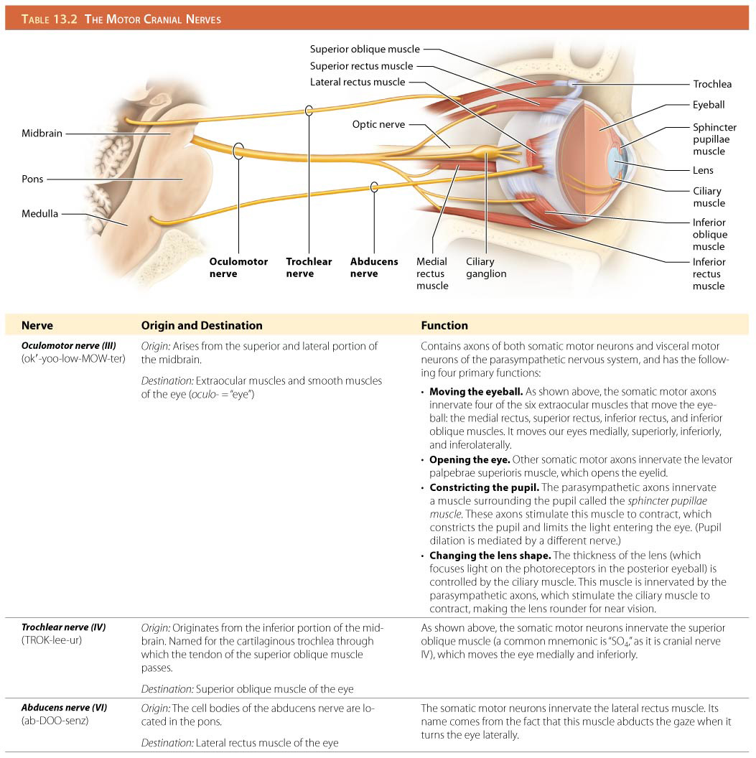
The Motor Cranial Nerves

Slide 23
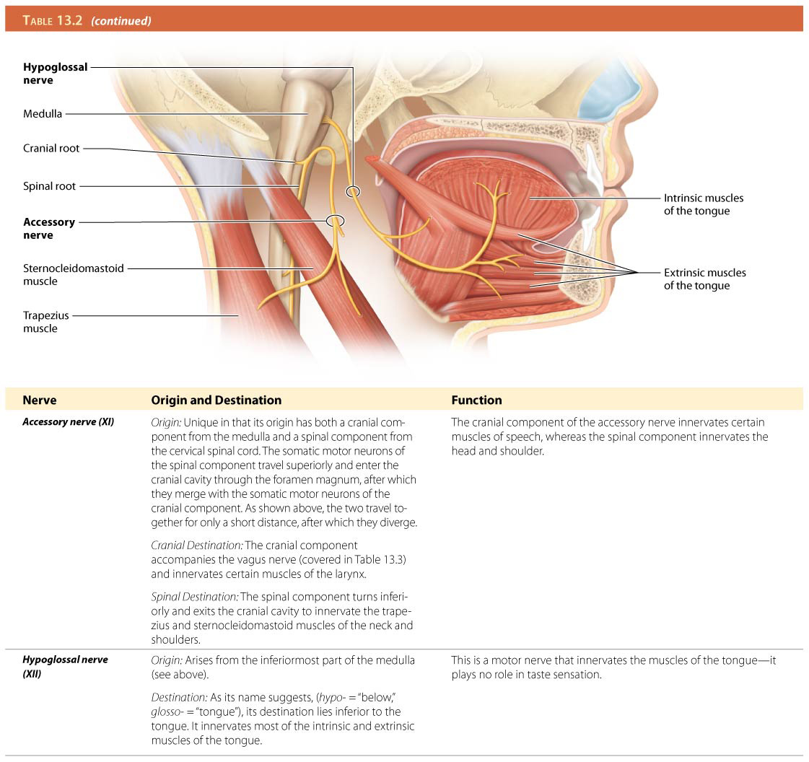
The Motor Cranial Nerves

Slide 24
The Mixed Cranial Nerves
Four cranial nerves contain axons of both sensory and motor neurons:
1.
2.
3.
4.

Slide 25
The Mixed Cranial Nerves
Four cranial nerves contain axons of both sensory and motor neurons:
Trigeminal (V)
Facial (VII)
Glossopharyngeal (IX)
Vagus (X)

Slide 26
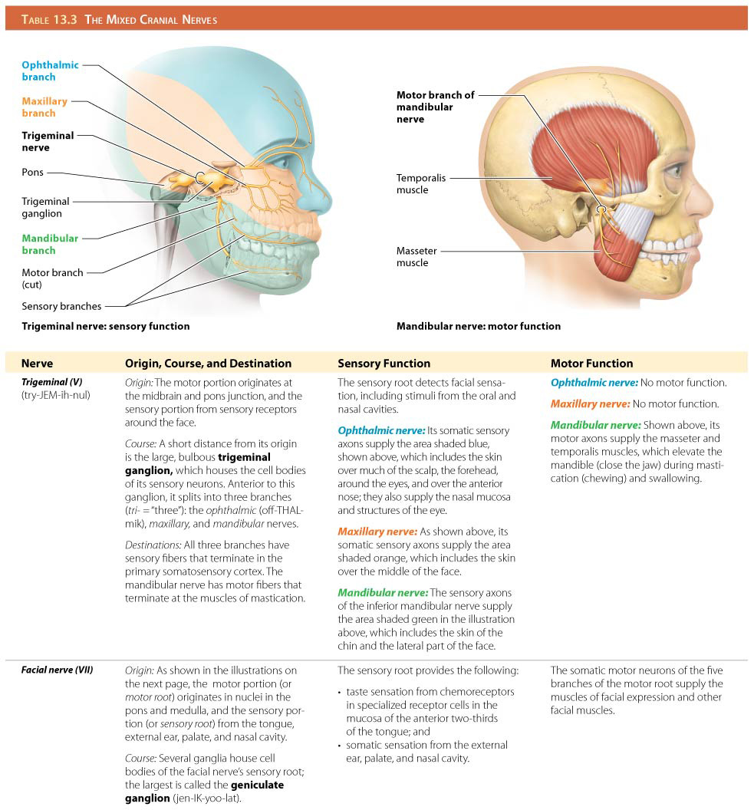
The Mixed Cranial Nerves

Slide 27
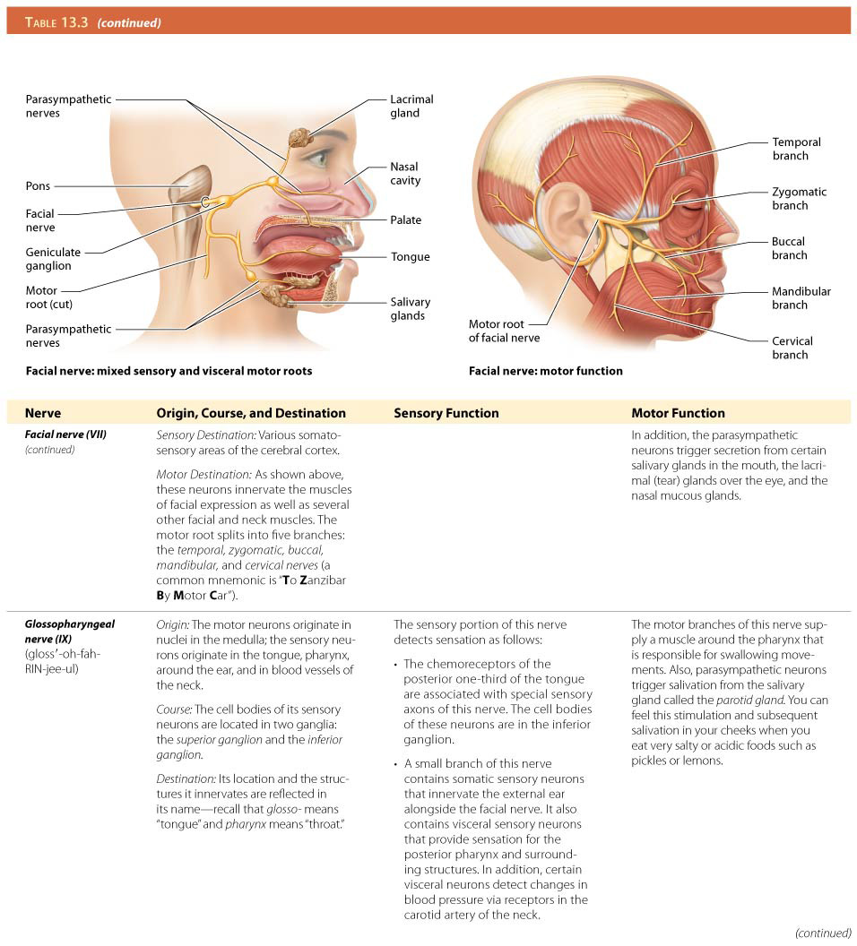
The Mixed Cranial Nerves

Slide 28
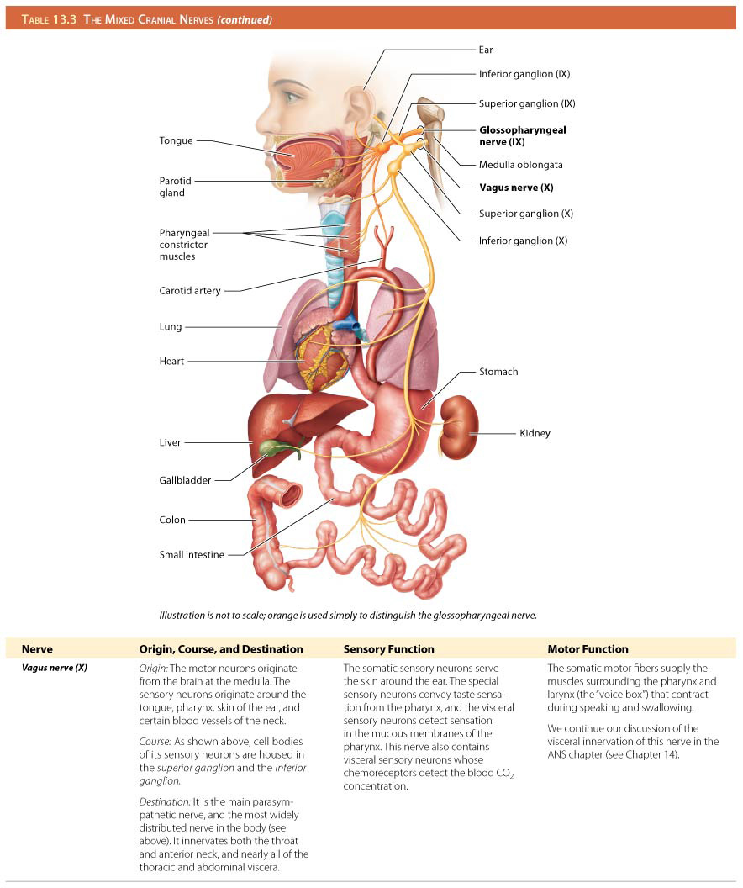
The Mixed Cranial Nerves

Slide 29
Structure of Spinal Nerves and Spinal Nerve Plexuses
Spinal nerve – short, because about 1-2cm after it forms and leaves the vertebral cavity it splits into 2 nerves:
1.
2.

Slide 30
Structure of Spinal Nerves and Spinal Nerve Plexuses
Spinal nerve – short, because about 1-2cm after it forms and leaves the vertebral cavity it splits into 2 nerves: posterior ramus and anterior ramus:
Posterior ramus – travels to posterior side of body
Anterior ramus – travels to anterior side of body and/or to an upper or lower limbs

Slide 31
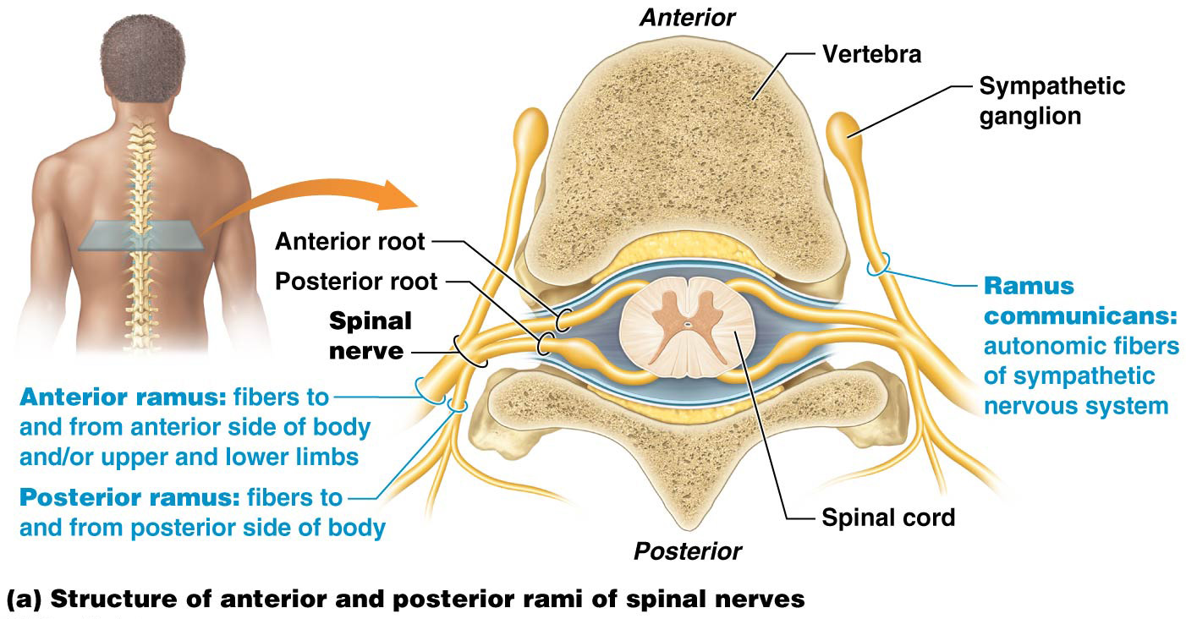
Structure of Spinal Nerves and Spinal Nerve Plexuses

Slide 32
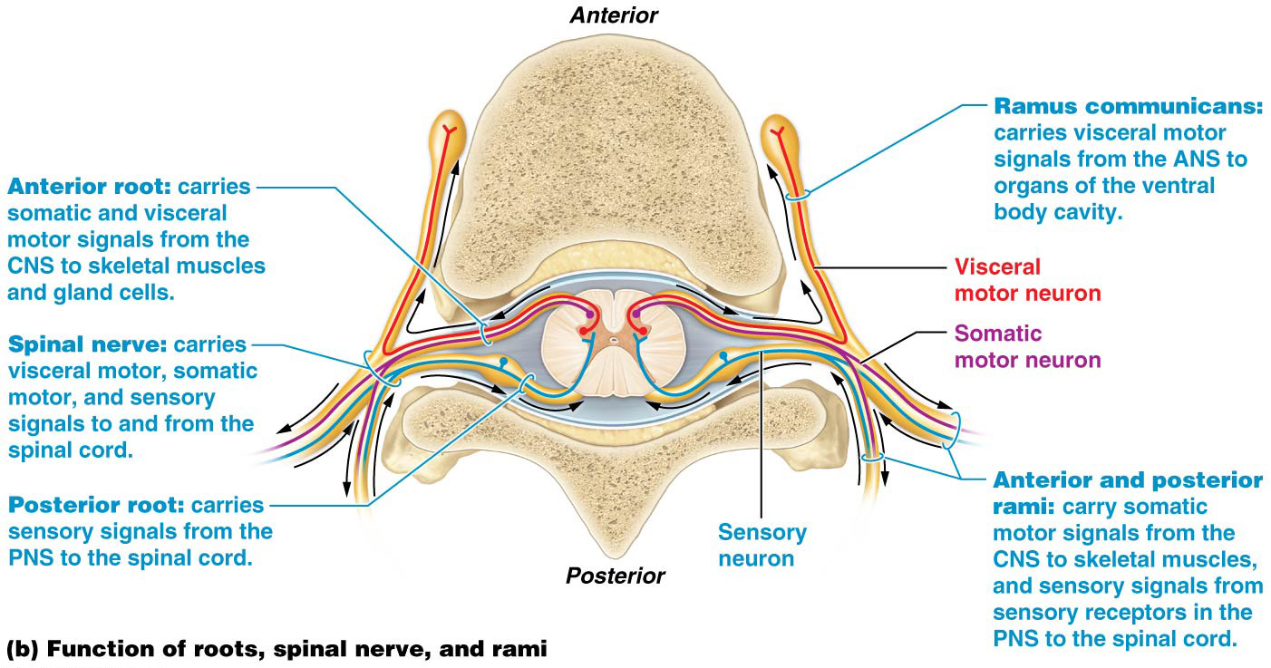
Structure of Spinal Nerves and Spinal Nerve Plexuses

Slide 33
Structure of Spinal Nerves and Spinal Nerve Plexuses
_____ pairs of spinal nerves:
___ pairs of cervical nerves
___ pairs of thoracic nerves
___ pairs each of lumbar and sacral nerves
___ pair of coccygeal nerves
Anterior rami of cervical, lumbar, and sacral spinal nerves merge to form complicated-looking networks of nerves called nerve plexuses

Slide 34
Structure of Spinal Nerves and Spinal Nerve Plexuses
31 pairs of spinal nerves:
8 pairs of cervical nerves
12 pairs of thoracic nerves
5 pairs each of lumbar and sacral nerves
1 pair of coccygeal nerves
Anterior rami of cervical, lumbar, and sacral spinal nerves merge to form complicated-looking networks of nerves called nerve plexuses

Slide 35
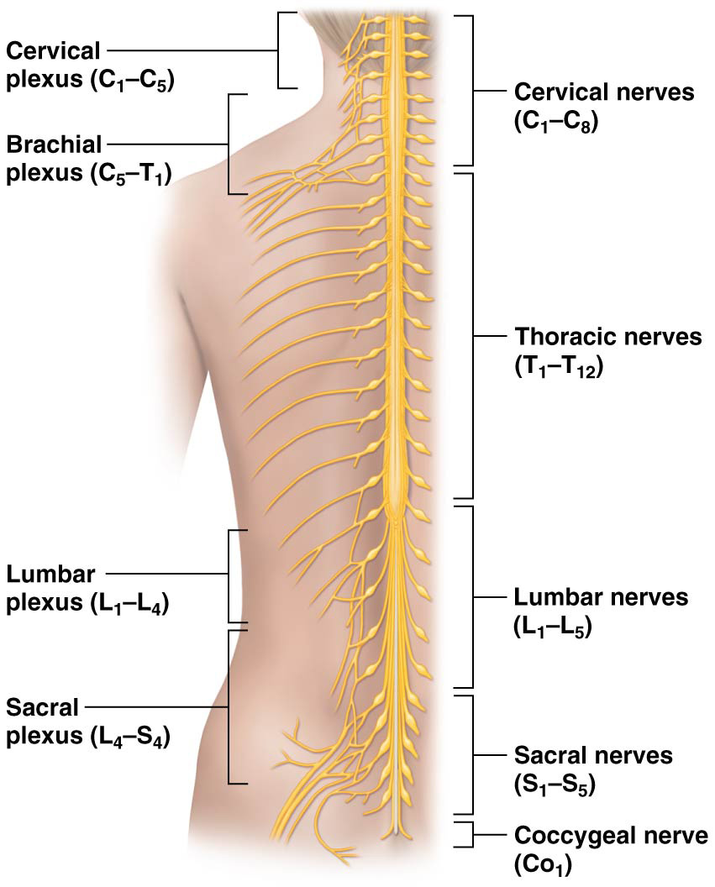
Structure of Spinal Nerves and Spinal Nerve Plexuses

Slide 36
Right and left __________are found deep in neck lateral to 1st through 4th cervical vertebrae
Plexus consists largely of anterior rami of C₁–C₄ and small contributions from C5 and hypoglossal nerve (cranial nerve XII)
Nerves of each cervical plexus has cutaneous branches; innervate skin of neck and sections of head, chest, and shoulders
Motor branches of these nerves innervate certain muscles in neck
_________ nerve – major motor branch, contains axons from C₃ to C_{5,} C4 is main contributor, (“3-4-5 to stay alive”); innervates diaphragm, main nerve that drives breathing

Slide 37
Cervical Plexuses
Right and left cervical plexuses are found deep in neck lateral to 1st through 4th cervical vertebrae
Plexus consists largely of anterior rami of C₁–C₄ and small contributions from C5 and hypoglossal nerve (cranial nerve XII)
Nerves of each cervical plexus has cutaneous branches; innervate skin of neck and sections of head, chest, and shoulders
Motor branches of these nerves innervate certain muscles in neck
Phrenic nerve – major motor branch, contains axons from C₃ to C_{5,} C4 is main contributor, (“3-4-5 to stay alive”); innervates diaphragm, main nerve that drives breathing

Slide 38
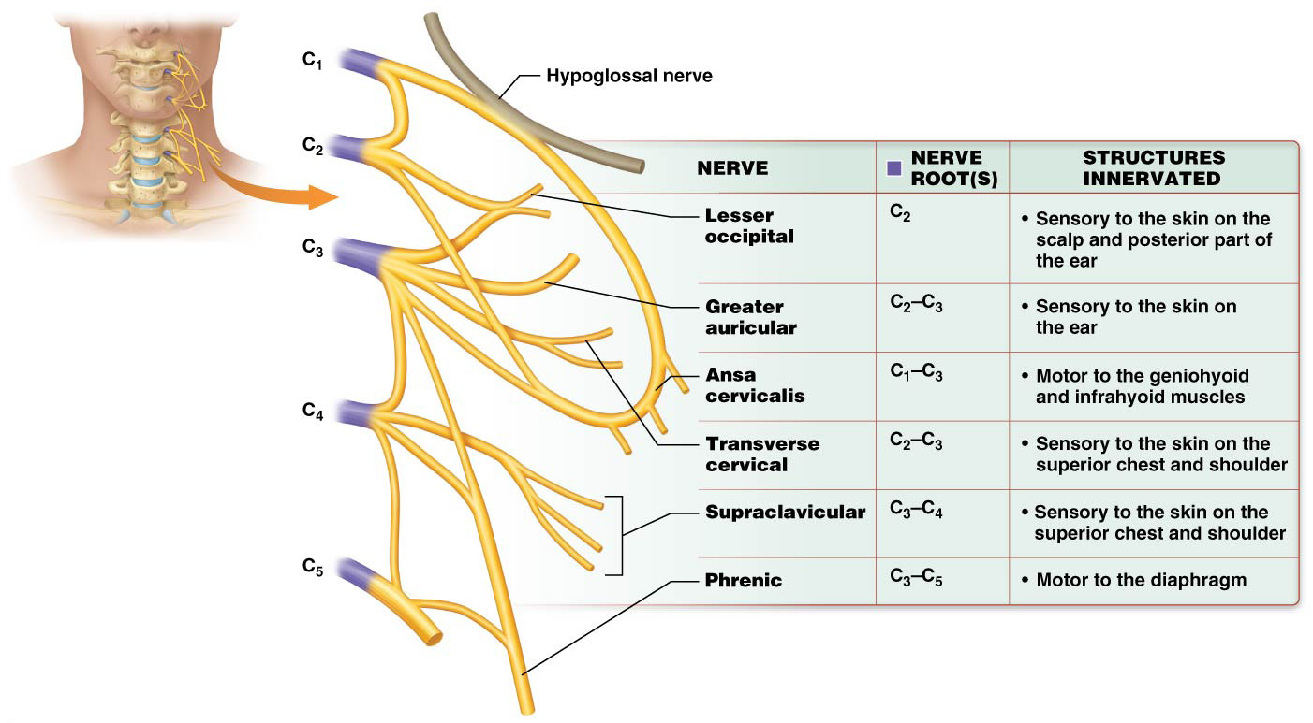
Cervical Plexuses

Slide 39
__________–Provides motor and sensory innervation to upper limbs; originates from anterior rami of spinal nerves C5-T1

Slide 40
Brachial Plexuses
Brachial plexuses –Provides motor and sensory innervation to upper limbs; originates from anterior rami of spinal nerves C5-T1
First structures formed in brachial plexus are large trunks
C₅ and C₆ typically unite to form superior trunk
C₇ forms the middle trunk
C₈ and T₁ combine to form the inferior trunk

Slide 41
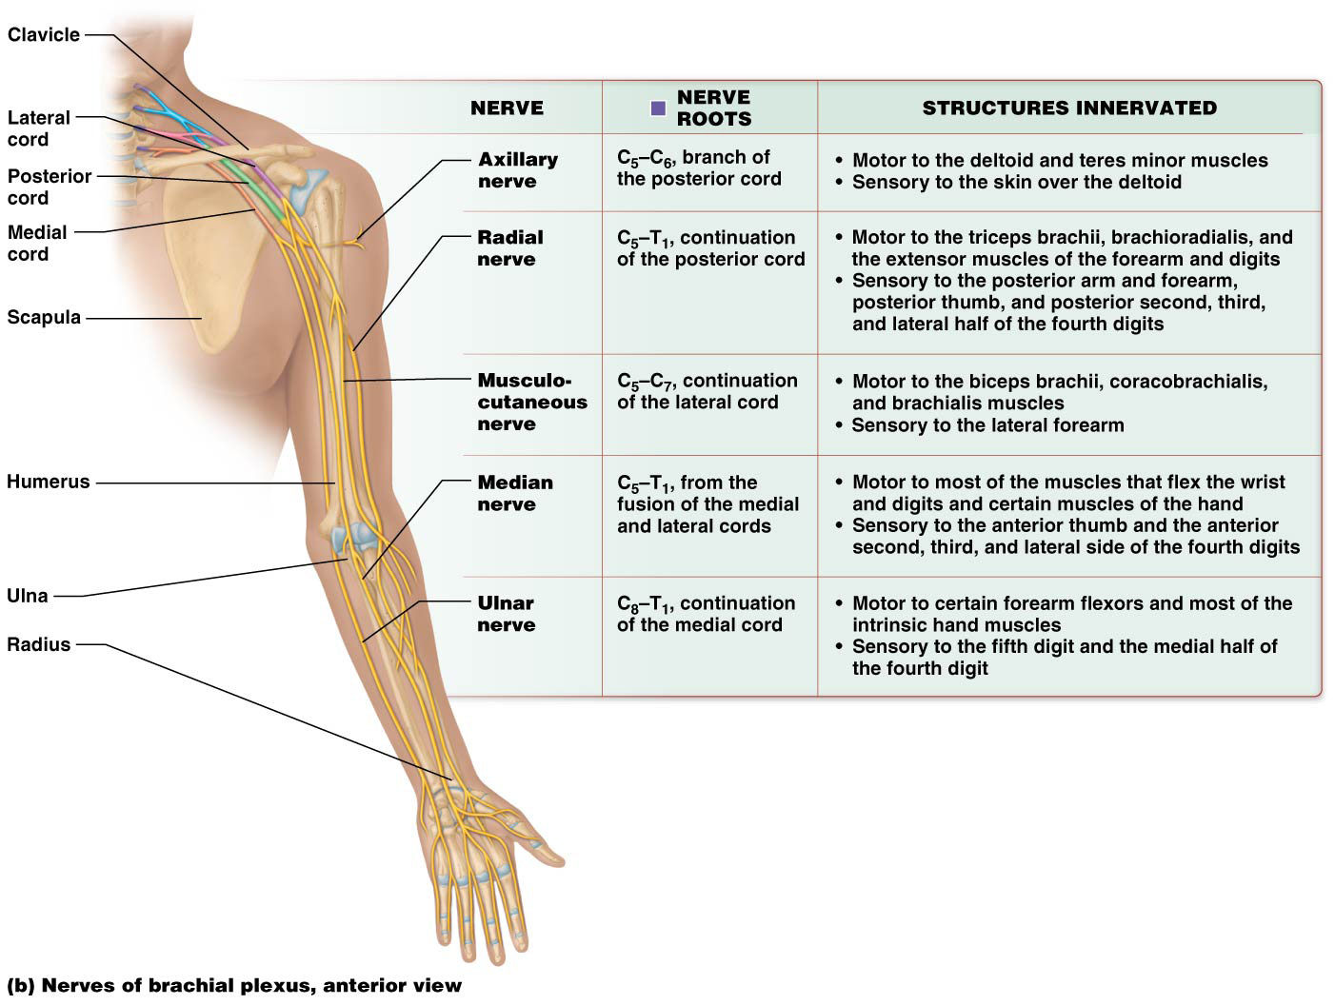
Brachial Plexuses

Slide 42
Left and right ___________are derived from anterior rami of L₁–L₄; anterior to vertebrae; embedded within psoas muscle; primarily serve structures of the pelvis and lower extremity. Most nerve roots separate into anterior and posterior divisions.

Slide 43
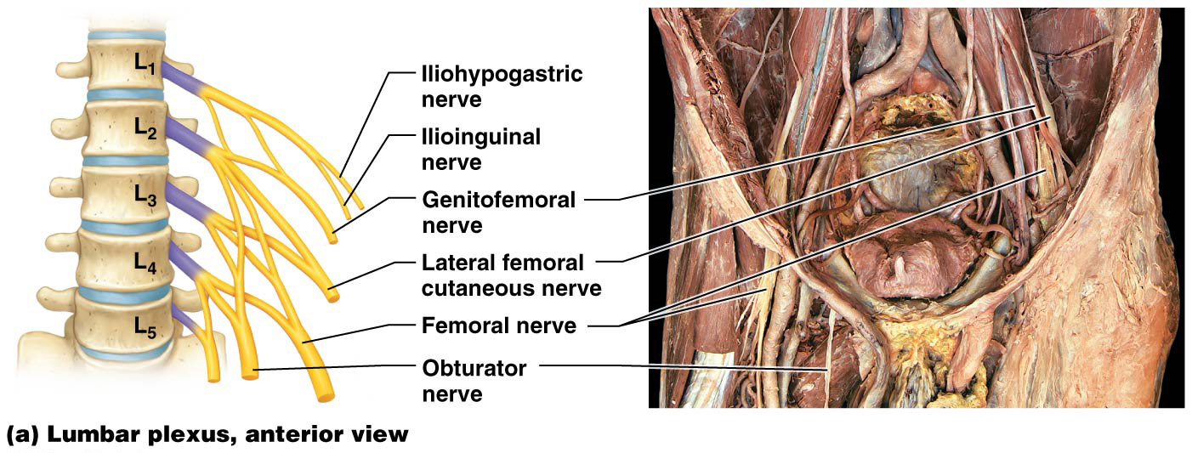
Lumbar Plexuses
Left and right lumbar plexuses are derived from anterior rami of L₁–L₄; anterior to vertebrae; embedded within psoas muscle; primarily serve structures of the pelvis and lower extremity. Most nerve roots separate into anterior and posterior divisions.

Slide 44
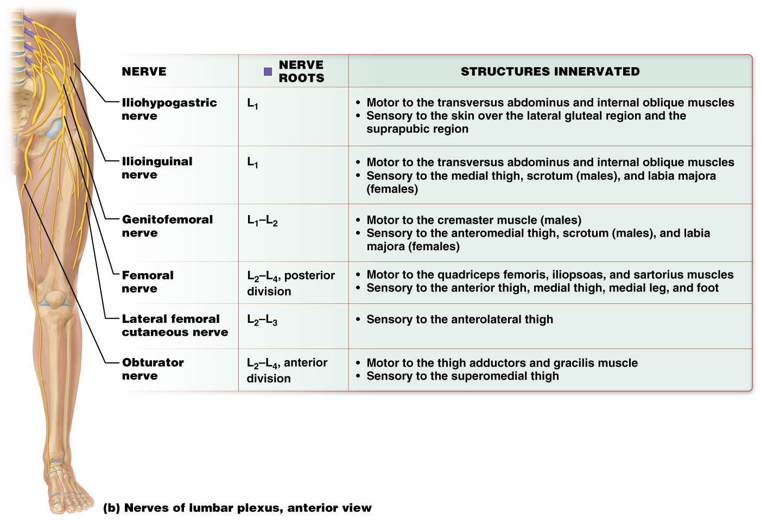
Lumbar Plexuses

Slide 45
Right and left ________ are formed from anterior rami of spinal nerves L₄–S₄; nerves innervate structures of pelvis, gluteal region, and much of lower extremity; each plexus is divided into anterior and posterior divisions

Slide 46
Sacral Plexuses
Right and left sacral plexuses are formed from anterior rami of spinal nerves L₄–S₄; nerves innervate structures of pelvis, gluteal region, and much of lower extremity; each plexus is divided into anterior and posterior divisions

Slide 47
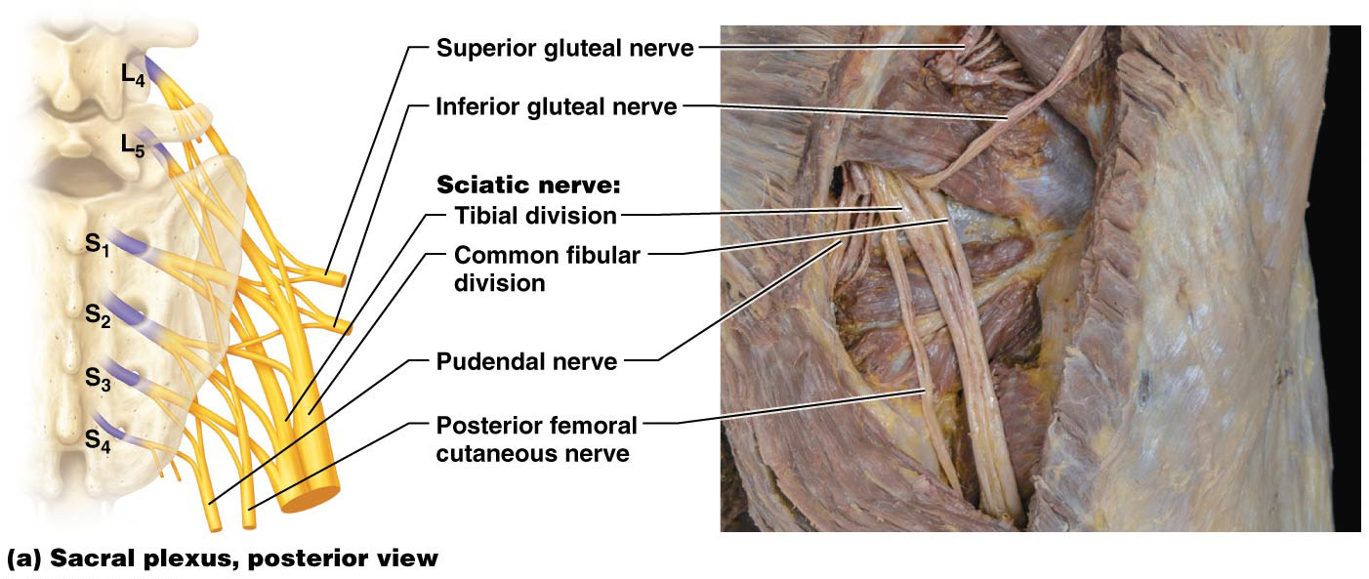
Sacral Plexuses

Slide 48
Sacral Plexuses
Sacral plexus divisions:
_______– longest and largest nerve in body; contains axons from both anterior and posterior divisions
Travels from the pelvis though the greater sciatic notch and enters the thigh by passing between the greater trochanter and the ischial tuberosity.
Within posterior thigh, it serves the hip joint before it splits into its two main branches, the tibial nerve and common fibular nerve

Slide 49
Sacral Plexuses
Sacral plexus divisions:
Sciatic nerve – longest and largest nerve in body; contains axons from both anterior and posterior divisions
Travels from the pelvis though the greater sciatic notch and enters the thigh by passing between the greater trochanter and the ischial tuberosity.
Within posterior thigh, it serves the hip joint before it splits into its two main branches, the tibial nerve and common fibular nerve

Slide 50
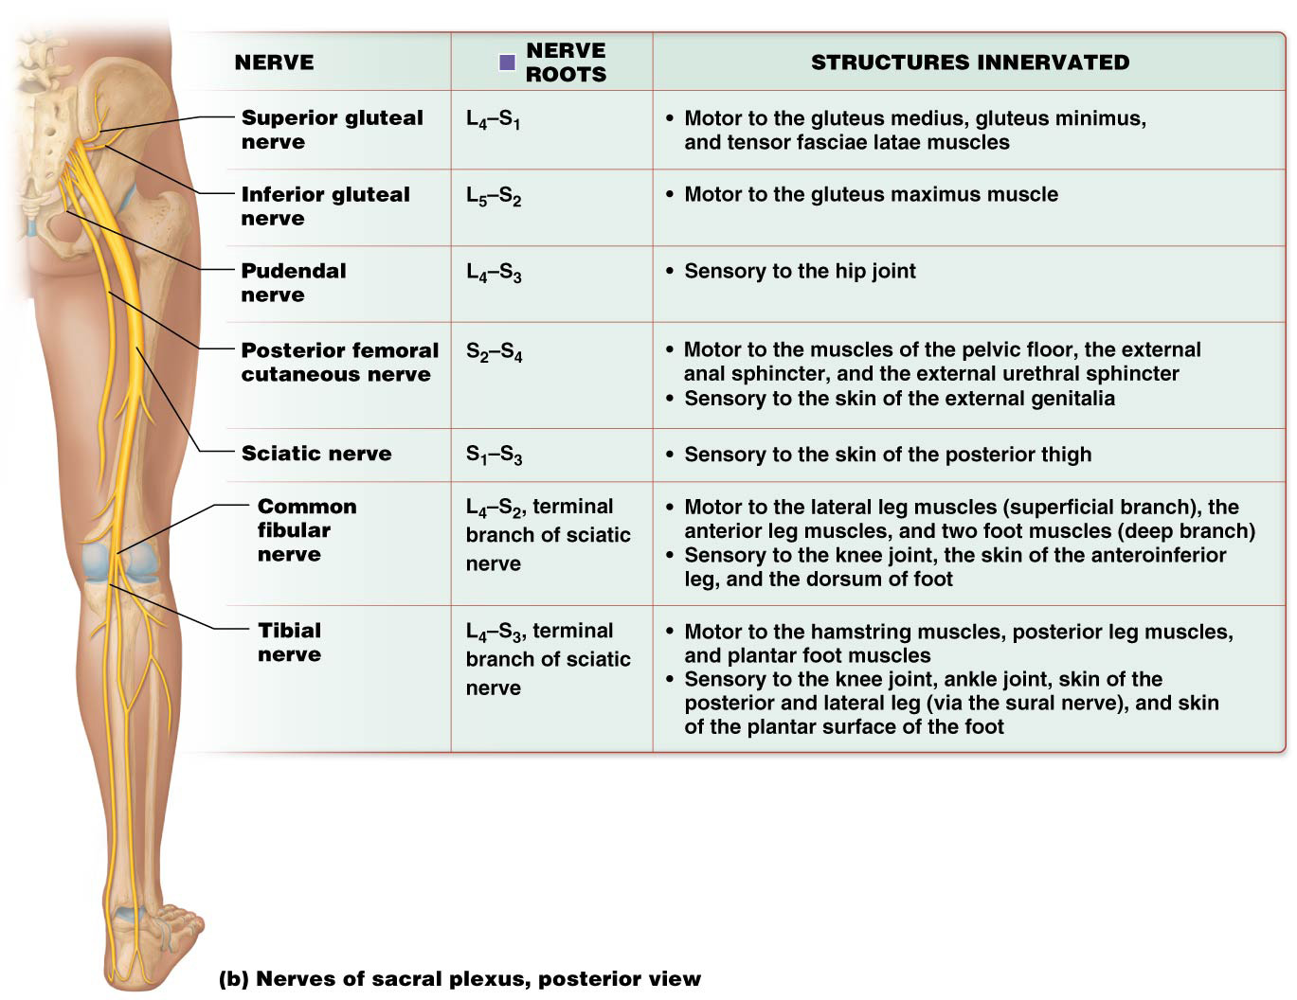
Sacral Plexuses

Slide 51
From PNS to CNS: Sensory Reception and Receptors
____________– conversion of a stimulus into an electrical signal:
Before any stimulus arrives, the ion channels in axolemma are closed → stimulus is detected by a sensory receptor → sodium ion channels open → sodium ions flow into axoplasm → temporary depolarization (receptor potential)
If enough sodium ion enters, membrane potential may reach threshold → voltage-gated sodium ion channels open → action potential is propagated along axon toward CNS

Slide 52
From PNS to CNS: Sensory Reception and Receptors
Sensory transduction (continued):
____________-respond rapidly with high intensity to stimuli but stop sending signals after a certain time period (called adaptation); receptors detect initiation of stimuli but ignore ongoing stimuli (ex, looking for your sunglasses but they are on your head)
___________- respond to stimuli with constant action potentials that don’t diminish over time (ex, throbbing of your ankle for a week after an injury)

Slide 53
From PNS to CNS: Sensory Reception and Receptors
Sensory transduction (continued):
Rapidly adapting receptors respond rapidly with high intensity to stimuli but stop sending signals after a certain time period (called adaptation); receptors detect initiation of stimuli but ignore ongoing stimuli (ex, looking for your sunglasses but they are on your head)
Slowly adapting receptors respond to stimuli with constant action potentials that don’t diminish over time (ex, throbbing of your ankle for a week after an injury)

Slide 54
Classification of Sensory Receptors
Sensory receptors can be sorted into following classifications by location of stimuli they detect:
___________ – usually close to body’s surface; detect stimuli originating from outside body (including an object’s texture, temperature, and color)
___________ – usually found within body’s interior; detect stimuli originating inside the body (including blood pressure, stretch or urinary bladder, etc.)

Slide 55
Classification of Sensory Receptors
Sensory receptors can be sorted into following classifications by location of stimuli they detect:
Exteroceptors – usually close to body’s surface; detect stimuli originating from outside body (including an object’s texture, temperature, and color)
Interoceptors – usually found within body’s interior; detect stimuli originating inside the body (including blood pressure, stretch or urinary bladder, etc.)

Slide 56
Classification of Sensory Receptors
Sensory receptors can be classified by type of stimuli that causes them to depolarize and generate a receptor potential:
________________ – encapsulated interoceptors or exteroceptors found in musculoskeletal system, skin, and in many different organs; depolarize in response to anything that mechanically deforms tissue; including external stimuli such as light touch and vibration and internal stimuli such as stretch and pressure.

Slide 57
Classification of Sensory Receptors
Sensory receptors can be classified by type of stimuli that causes them to depolarize and generate a receptor potential:
Mechanoreceptors – encapsulated interoceptors or exteroceptors found in musculoskeletal system, skin, and in many different organs; depolarize in response to anything that mechanically deforms tissue; including external stimuli such as light touch and vibration and internal stimuli such as stretch and pressure. Mechanism behind their sensory transduction is found within their specialized ion channels called mechanically gated ion channels

Slide 58
Classification of Sensory Receptors
Sensory receptors can be classified by type of stimuli that causes them to depolarize and generate a receptor potential (continued):
___________ – exteroceptors that respond to thermal stimuli, depolarizing in response to temperature changes, most of which are slowly adapting receptors; separate receptors detect hot and cold stimuli
___________ – an interoceptor or exteroceptor; depolarizes in response to certain chemicals (in body fluids or air); chemicals that are specific for the receptor bind and trigger ion channels to open, which generates a receptor potential and perhaps an action potential.

Slide 59
Classification of Sensory Receptors
Sensory receptors can be classified by type of stimuli that causes them to depolarize and generate a receptor potential (continued):
Thermoreceptors – exteroceptors that respond to thermal stimuli, depolarizing in response to temperature changes, most of which are slowly adapting receptors; separate receptors detect hot and cold stimuli
Chemoreceptors – an interoceptor or exteroceptor; depolarizes in response to certain chemicals (in body fluids or air); chemicals that are specific for the receptor bind and trigger ion channels to open, which generates a receptor potential and perhaps an action potential.

Slide 60
Classification of Sensory Receptors
Sensory receptors can be classified by type of stimuli that causes them to depolarize and generate a receptor potential (continued):
_________ – special sensory exteroceptors found only in eye; depolarize in response to light
__________ – receptors that depolarize in response to noxious stimuli, generally exteroceptors; slowly adapting receptors

Slide 61
Classification of Sensory Receptors
Sensory receptors can be classified by type of stimuli that causes them to depolarize and generate a receptor potential (continued):
Photoreceptors – special sensory exteroceptors found only in eye; depolarize in response to light
Nociceptors – receptors that depolarize in response to noxious stimuli, generally exteroceptors; slowly adapting receptors
(Although nociception is not a primary function of mechanoreceptors, thermoreceptors, chemoreceptors, and photoreceptors, each type of receptor can transmit stimuli that the brain can perceive as painful.)

Slide 62
Classification of Sensory Receptors
Classes of mechanoreceptors:
___________
Found in floors of epidermal ridges, primarily in skin of hands (especially fingertips)
Action potentials appear to stem from mechanically gated ion channels in the nerve ending
Slowly adapting receptors, have the finest special resolution of any of the skin mechanoreceptors, primarily detect discriminative touch stimuli such as form and texture.

Slide 63
Classification of Sensory Receptors
Classes of mechanoreceptors:
Merkel cell fibers consist of a nerve ending surrounded by a capsule of Merkel cells
Found in floors of epidermal ridges, primarily in skin of hands (especially fingertips)
Action potentials appear to stem from mechanically gated ion channels in the nerve ending
Slowly adapting receptors, have the finest special resolution of any of the skin mechanoreceptors, primarily detect discriminative touch stimuli such as form and texture.

Slide 64
Classification of Sensory Receptors
Classes of mechanoreceptors (continued):
_______________--– in dermal papillae; rapidly adapting receptors; more numerous than Merkel cell fibers, transmit discriminative touch stimuli, although resolution is not as fine.
________________– receptors found in dermis, hypodermis, and ligaments; slowly adapting receptors respond to stretch and movement

Slide 65
Classification of Sensory Receptors
Classes of mechanoreceptors (continued):
Tactile corpuscles (Meissner corpuscles) – in dermal papillae; rapidly adapting receptors; more numerous than Merkel cell fibers, transmit discriminative touch stimuli, although resolution is not as fine.
Ruffini endings (bulbous corpuscles) – receptors found in dermis, hypodermis, and ligaments; slowly adapting receptors respond to stretch and movement

Slide 66
Classification of Sensory Receptors
Classes of mechanoreceptors (continued):
______________ – layered onion-like appearance; rapidly adapting receptors found deep within dermis; detect high-frequency vibratory and deep pressure stimuli; example of Structure-Function Core Principle
______________– free nerve endings surrounding base of hair follicles found only in thin skin; respond to stimuli that cause hair to bend
______________ – in musculoskeletal system; detect movement and position of a joint or body part

Slide 67
Classification of Sensory Receptors
Classes of mechanoreceptors (continued):
Lamellated corpuscles (Pacinian corpuscles) – layered onion-like appearance; rapidly adapting receptors found deep within dermis; detect high-frequency vibratory and deep pressure stimuli; example of Structure-Function Core Principle
Hair follicle receptors – free nerve endings surrounding base of hair follicles found only in thin skin; respond to stimuli that cause hair to bend
Proprioceptors – in musculoskeletal system; detect movement and position of a joint or body part

Slide 68
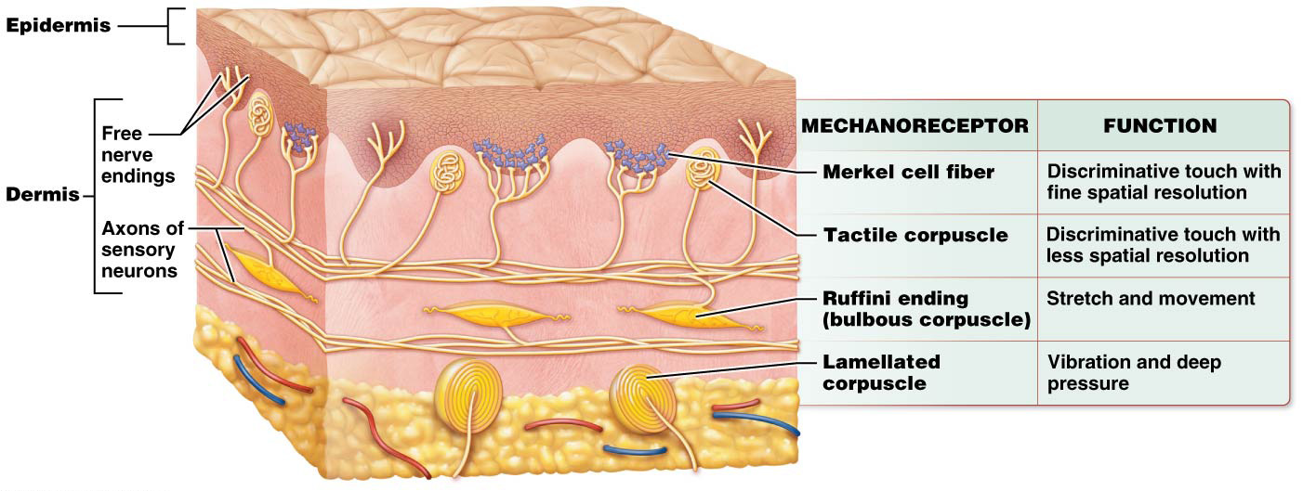
Classification of Sensory Receptors

Slide 69
Classification of Sensory Receptors
Types of thermoreceptors – usually small knobs on end of free nerve endings in skin, 2 types of thermoreceptors:
___________– respond to temperatures between 10 °C and 40 °C (50–104 °F); in superficial dermis
___________– respond to temperatures between 32 °C and 48 °C (90–118 °F); deep in dermis
Temperatures outside these ranges are detected by nociceptors; reason extremes of temperature are interpreted as pain

Slide 70
Classification of Sensory Receptors
Types of thermoreceptors – usually small knobs on end of free nerve endings in skin, 2 types of thermoreceptors:
“Cold” receptors – respond to temperatures between 10 °C and 40 °C (50–104 °F); in superficial dermis
“Hot” receptors – respond to temperatures between 32 °C and 48 °C (90–118 °F); deep in dermis
Temperatures outside these ranges are detected by nociceptors; reason extremes of temperature are interpreted as pain

Slide 71
Sensory Neurons
Somatic sensory neurons are pseudounipolar neurons with three main components:
_________– cell bodies located in posterior (dorsal) root ganglion, lateral to spinal cord; cell bodies of cranial nerves are in cranial nerve ganglia in head and neck
__________– long axon that transmits action potential from sensory receptor to neuron’s central process
__________– exits cell body and travels through posterior root; enters posterior horn (or brainstem for cranial nerves), transmits an action potential from the peripheral process to the posterior horn, eventually synapsing on a neuron in the spinal cord or brainstem.

Slide 72
Sensory Neurons
Sensory neurons are generally classified according to the speed with which their peripheral axons conduct action potentials, 2 factors determine speed:
1.
2.
Large-diameter axons with thick myelin sheaths conduct fastest impulses; include axons that:
Convey proprioceptive information to CNS
Convey discriminative and nondiscriminative touch information
Small-diameter axons with least myelin transmit action potentials slowest; include axons that carry pain and temperature stimuli to CNS

Slide 73
Sensory Neurons
Sensory neurons are generally classified according to the speed with which their peripheral axons conduct action potentials, 2 factors determine speed:
diameter of axon
thickness of its myelin sheath
Large-diameter axons with thick myelin sheaths conduct fastest impulses; include axons that:
Convey proprioceptive information to CNS
Convey discriminative and nondiscriminative touch information
Small-diameter axons with least myelin transmit action potentials slowest; include axons that carry pain and temperature stimuli to CNS

Slide 74
Sensory Neurons
____________– areas served by a particular neuron; each somatic sensory neuron has an extensive network of branches in the skin, the more branching that exists, the larger the neurons receptive field
The skin of the fingertips is richly innervated with sensory neurons, and each of these neurons has a relatively small receptive field.
Skin of forearm is innervated by much smaller number of neurons, so each neuron has a somewhat larger receptive field.
Body regions that have a primary function of sensing the environment (like fingertips) contain MORE neurons and smaller receptive fields

Slide 75
Sensory Neurons
Receptive fields – areas served by a particular neuron; each somatic sensory neuron has an extensive network of branches in the skin, the more branching that exists, the larger the neurons receptive field
The skin of the fingertips is richly innervated with sensory neurons, and each of these neurons has a relatively small receptive field.
Skin of forearm is innervated by much smaller number of neurons, so each neuron has a somewhat larger receptive field.
Body regions that have a primary function of sensing the environment (like fingertips) contain MORE neurons and smaller receptive fields

Slide 76
Different regions of the body contain neurons with receptive fields of varying size.
These differences account for the fact that you can accurately determine an object’s size and texture with your fingertips, but not with your forearm or back.
The relative sizes of receptor fields can be measured by _____________________– in this test two stimuli are placed closely together on the skin, stimuli are then moved apart until the subject can feel two distinct points.

Slide 77
Different regions of the body contain neurons with receptive fields of varying size.
These differences account for the fact that you can accurately determine an object’s size and texture with your fingertips, but not with your forearm or back.
The relative sizes of receptor fields can be measured by two-point discrimination threshold – in this test two stimuli are placed closely together on the skin, stimuli are then moved apart until the subject can feel two distinct points.

Slide 78
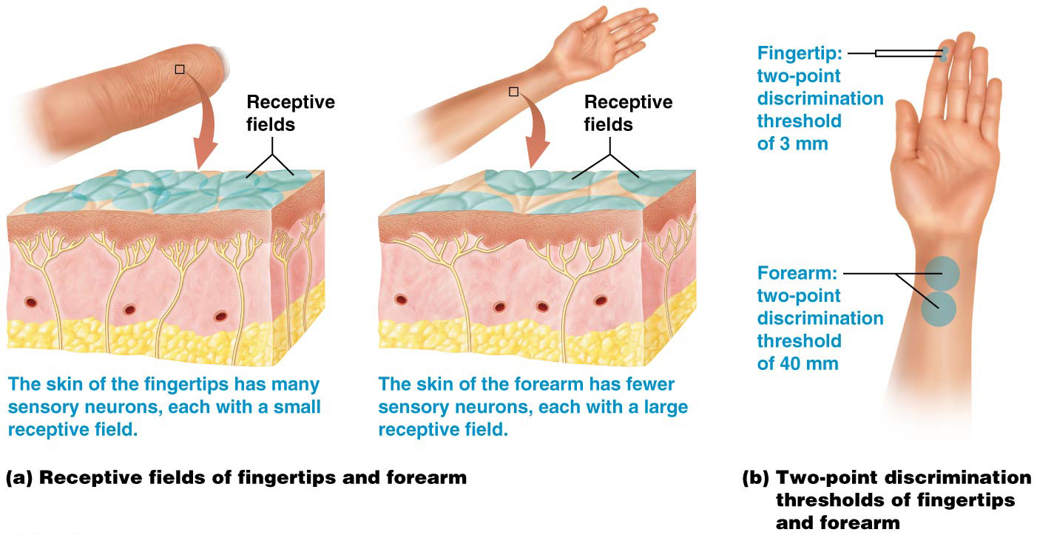
Sensory Neurons

Slide 79
Dermatomes and Referred Pain
Skin can be divided into different segments called _____________ based on spinal nerve that supplies region with somatic sensation
can be used clinically to test integrity of sensory pathways to different parts of body

Slide 80
Dermatomes and Referred Pain
Skin can be divided into different segments called dermatomes based on spinal nerve that supplies region with somatic sensation
Dermatomes can be combined to assemble a dermatome map; represents all (except first cervical spinal nerve) of the spinal nerves.
Dermatome maps can be used clinically to test integrity of sensory pathways to different parts of body
For example, a patient with a cervical spinal cord injury may be able to feel his lateral hand, thumb, 2nd and 3rd digits, but unable to feel his medial hand or 4th or 5th digits. This would tell you the location of the spinal cord injury-about level of C8.

Slide 81
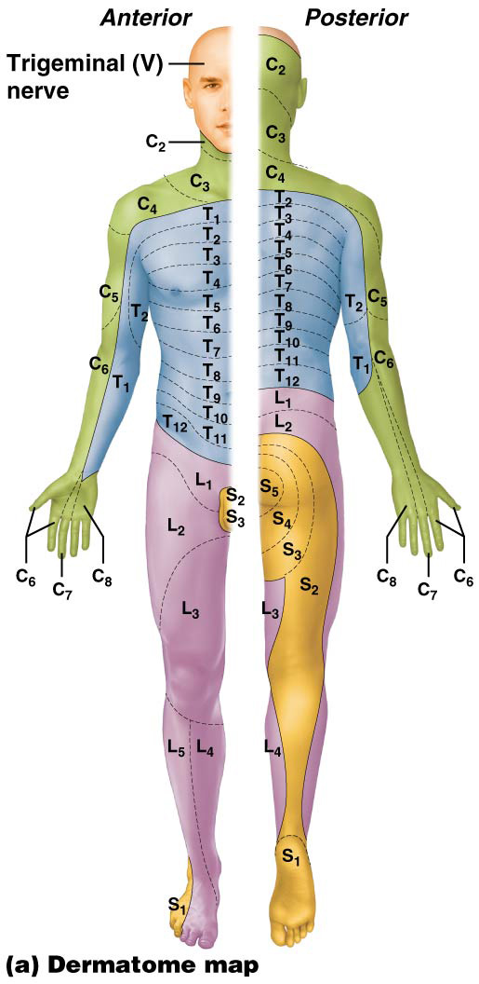
Dermatomes and Referred Pain

Slide 82
Dermatomes and Referred Pain
Many spinal nerves carry both somatic and visceral neurons, so visceral sensations travel along the same pathways as do somatic sensations. This anatomical arrangement has a consequence known as _____________-

Slide 83
Dermatomes and Referred Pain
Many spinal nerves carry both somatic and visceral neurons, so visceral sensations travel along the same pathways as do somatic sensations. This anatomical arrangement has a consequence known as referred pain.
Referred pain- pain that originates in an organ is perceived as cutaneous pain
Referred pain is generally located along dermatome for that nerve. Ex, pain caused by a heart attack is often perceived as pain in anterior chest wall, left arm, neck and lower jaw. This is because nerves that carry pain signals from the heart serve these particular dermatomes.

Slide 84
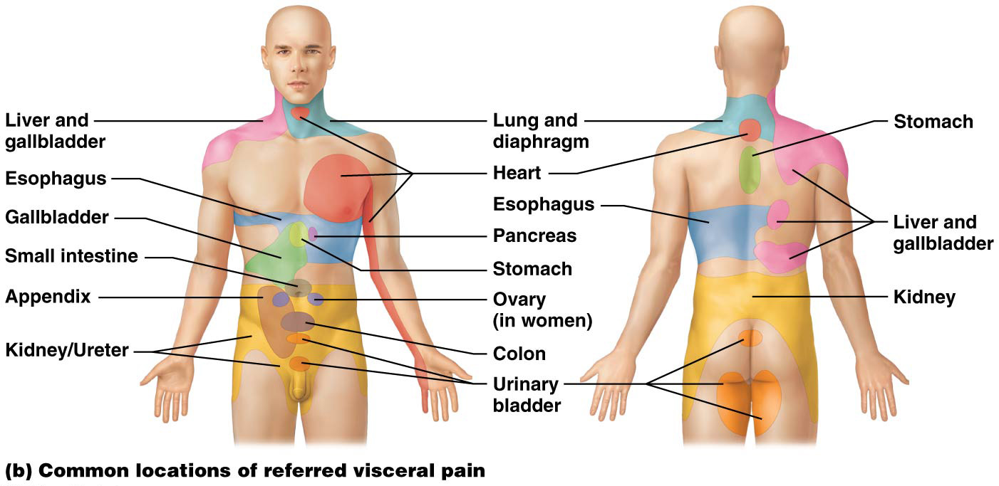
Dermatomes and Referred Pain

Slide 85
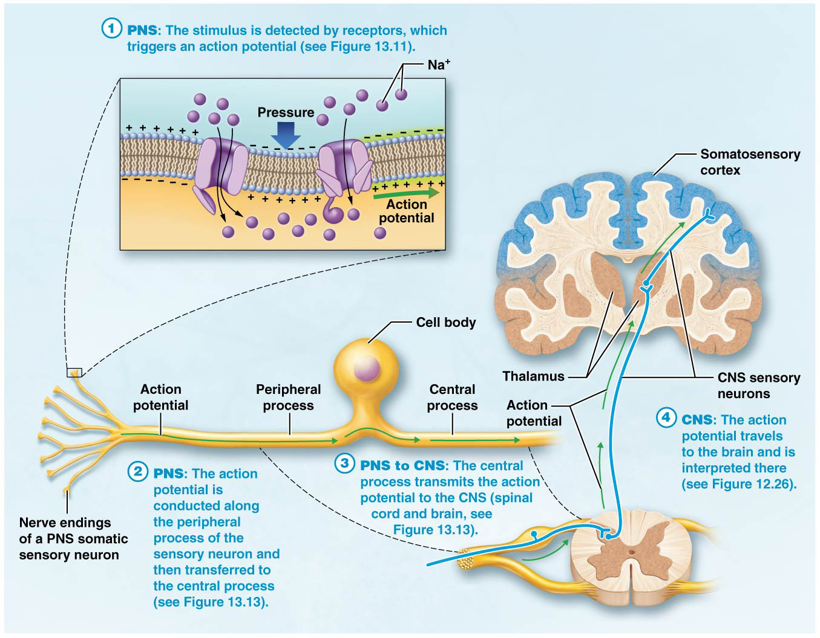
The Big Picture of Detection and Interpretation of Somatic Sensation by the Nervous System

Slide 86
From CNS to PNS: Motor Output
There is a close relationship between muscular and nervous systems, skeletal muscle fibers are voluntary; contract only when stimulated to do so by a somatic motor neuron
CNS initiates movement:
________________– in primary motor cortex make decision to move and initiate that movement; but not in contact with muscle fiber itself
________________– receive messages from upper motor neurons; in contact with skeletal muscle fibers; release acetylcholine onto muscle fibers to initiate contraction

Slide 87
From CNS to PNS: Motor Output
There is a close relationship between muscular and nervous systems, skeletal muscle fibers are voluntary; contract only when stimulated to do so by a somatic motor neuron
CNS initiates movement:
Upper motor neurons – in primary motor cortex make decision to move and initiate that movement; but not in contact with muscle fiber itself
Lower motor neurons – receive messages from upper motor neurons; in contact with skeletal muscle fibers; release acetylcholine onto muscle fibers to initiate contraction

Slide 88
The Role of Lower Motor Neurons
Lower motor neurons – multipolar neurons whose cell bodies are in either __________ horn of spinal cord or _________; axons are in PNS
Motor neuron pools – groups of lower motor neurons that innervate same muscle; found together in anterior horn of spinal cord

Slide 89
The Role of Lower Motor Neurons
Lower motor neurons – multipolar neurons whose cell bodies are in either anterior horn of spinal cord or brainstem; axons are in PNS
Motor neuron pools – groups of lower motor neurons that innervate same muscle; found together in anterior horn of spinal cord

Slide 90
____________ – programmed, automatic responses to stimuli; usually protective preventing tissue damage in someway, occur in a three-step sequence of events called a ___________

Slide 91
Reflex Arcs
Reflexes – programmed, automatic responses to stimuli; usually protective preventing tissue damage in someway, occur in a three-step sequence of events called a reflex arc
Reflexes begin with a sensory stimulus and finish with a rapid motor response
Neural integration between sensory stimulus and motor response occurs in CNS, typically within brainstem or spinal cord

Slide 92
The Role of Stretch Receptors in Skeletal Muscles
Some of the most common reflexes occur without our realizing it. These reflexes are part of normal movement and allow the CNS to correct motor error and prevent muscle damage.
Sensory component of these reflexes is detected by mechanoreceptors within muscles and tendons called ___________and ____________, monitor muscle length and force of contraction; communicate this information to spinal cord, cerebellum, and cerebral cortex

Slide 93
The Role of Stretch Receptors in Skeletal Muscles
Some of the most common reflexes occur without our realizing it. These reflexes are part of normal movement and allow the CNS to correct motor error and prevent muscle damage.
Sensory component of these reflexes is detected by mechanoreceptors within muscles and tendons called muscle spindles and Golgi tendon organs, monitor muscle length and force of contraction; communicate this information to spinal cord, cerebellum, and cerebral cortex

Slide 94
The Role of Stretch Receptors in Skeletal Muscles
___________– tapered structures found embedded among regular contractile muscle fibers (extrafusal muscle fibers) (continued):
Within each spindle are 2-12 specialized muscle fibers, intrafusal muscle fibers, have contractile filaments composed of actin and myosin at their poles; innervated by motor neurons
Contractile filaments are absent in the central area of intrafusal fibers

Slide 95
The Role of Stretch Receptors in Skeletal Muscles
Muscle spindles – tapered structures found embedded among regular contractile muscle fibers (extrafusal muscle fibers) (continued):
Within each spindle are 2-12 specialized muscle fibers, intrafusal muscle fibers, have contractile filaments composed of actin and myosin at their poles; innervated by motor neurons
Contractile filaments are absent in the central area of intrafusal fibers

Slide 96
The Role of Stretch Receptors in Skeletal Muscles
_____________– mechanoreceptors located within tendons near muscle-tendon junction; have following features:
Monitor tension generated by a muscle contraction
Consist of an encapsulated bundle of collagen fibers attached to about 20 extrafusal muscle fibers
Contain a single somatic sensory axon whose endings are wrapped around its enclosed collagen fibers. The rate at which these neurons fire depends on the amount of muscle tension generated with each contraction-the greater the tension, the more rapidly they fire.

Slide 97
The Role of Stretch Receptors in Skeletal Muscles
Golgi tendon organs – mechanoreceptors located within tendons near muscle-tendon junction; have following features:
Monitor tension generated by a muscle contraction
Consist of an encapsulated bundle of collagen fibers attached to about 20 extrafusal muscle fibers
Contain a single somatic sensory axon whose endings are wrapped around its enclosed collagen fibers. The rate at which these neurons fire depends on the amount of muscle tension generated with each contraction-the greater the tension, the more rapidly they fire.

Slide 98
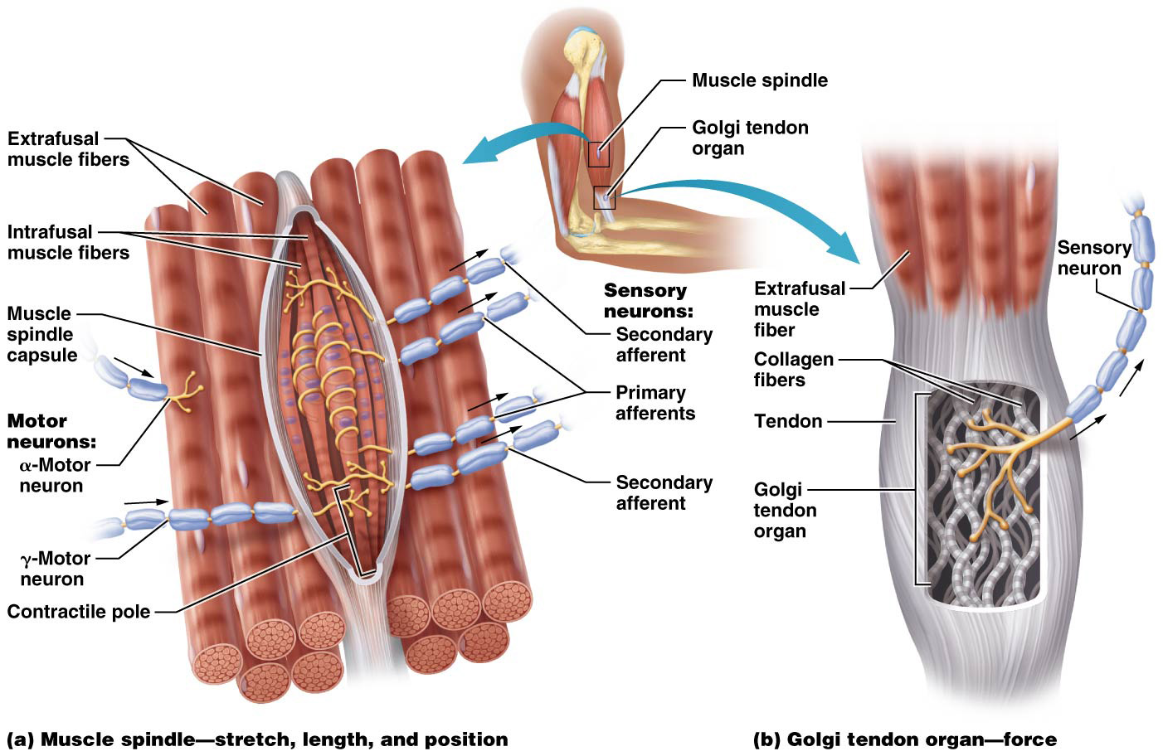
The Role of Stretch Receptors in Skeletal Muscles

Slide 99
Types of Reflexes
Reflexes can be classified by at least two criteria:
1.
2.

Slide 100
Types of Reflexes
Reflexes can be classified by at least two criteria:
1. Number of synapses that occur between neurons involved in arc
2. Type of organ in which reflex takes place, either visceral or somatic

Slide 101
Simplest reflex arcs (_____________ reflexes) involve only a single synapse within spinal cord between a sensory and motor neuron; more complicated types of reflex arcs (_________ reflexes) involve multiple synapses

Slide 102
Simplest reflex arcs (monosynaptic reflexes) involve only a single synapse within spinal cord between a sensory and motor neuron; more complicated types of reflex arcs (polysynaptic reflexes) involve multiple synapses

Slide 103
Types of Reflexes
When a muscle is stretched it deviates from its optimal length, the body’s reflexive response is to shorten the muscle so that it returns to its optimal length via a monosynaptic reflex known as _______________.
Patellar (knee-jerk) reflex is an example

Slide 104
Types of Reflexes
When a muscle is stretched it deviates from its optimal length, the body’s reflexive response is to shorten the muscle so that it returns to its optimal length via a monosynaptic reflex known as simple stretch reflex.
Patellar (knee-jerk) reflex is example of simple stretch reflexes

Slide 105
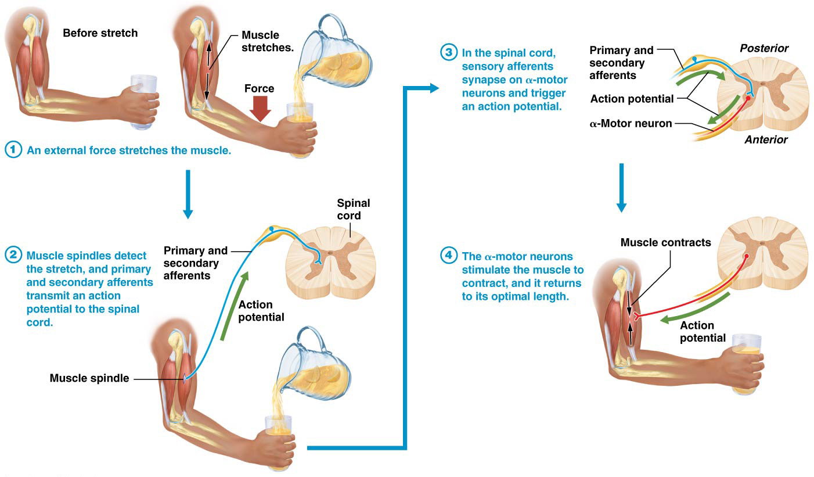
Types of Reflexes

Slide 106
Types of Reflexes
____________-– polysynaptic reflex; also protects muscles and tendons from damage
Causes muscle relaxation; opposite of simple stretch reflex action
When tension in muscle and tendon increases dramatically, Golgi tendon organs signal spinal cord and cerebellum
Motor neurons innervating muscle are inhibited while antagonist muscles are simultaneously activated
The Golgi tendon reflex is part of the reason why you should perform certain weight-lifting exercises with a spotter, if the weight is too heavy, the Golgi tendon reflex might cause you to drop the weight. Although this would prevent muscle/tendon damage, you could be seriously injured by dropping the weight on yourself.

Slide 107
Types of Reflexes
Golgi tendon reflex – polysynaptic reflex; also protects muscles and tendons from damage
Causes muscle relaxation; opposite of simple stretch reflex action
When tension in muscle and tendon increases dramatically, Golgi tendon organs signal spinal cord and cerebellum
Motor neurons innervating muscle are inhibited while antagonist muscles are simultaneously activated
The Golgi tendon reflex is part of the reason why you should perform certain weight-lifting exercises with a spotter, if the weight is too heavy, the Golgi tendon reflex might cause you to drop the weight. Although this would prevent muscle/tendon damage, you could be seriously injured by dropping the weight on yourself.

Slide 108
Types of Reflexes
__________________
When you touch a very hot object or step on a tack you almost immediately pull your hand or foot away from the source of pain, these are examples of the _______________involves rapidly conducting nociceptive afferents and multiple synapses in spinal cord
___________________occurs simultaneously, when flexion reflex is stimulated, the hip extensors of opposite limb are triggered to contract, in the given example
Allows for withdrawal from painful stimulus

Slide 109
Types of Reflexes
Flexion (withdrawal) and crossed-extension spinal reflexes:
When you touch a very hot object or step on a tack you almost immediately pull your hand or foot away from the source of pain, these are examples of the flexion or withdrawal reflex- involves rapidly conducting nociceptive afferents and multiple synapses in spinal cord
Crossed-extension reflex occurs simultaneously with flexion reflex, when flexion reflex is stimulated, the hip extensors of opposite limb are triggered to contract, in the given example
Allows for withdrawal from painful stimulus

Slide 110
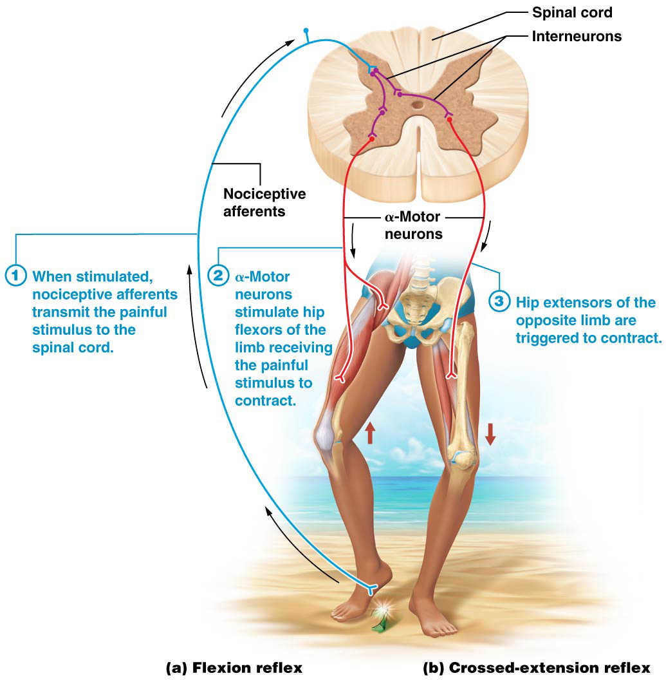
Types of Reflexes

Slide 111
Types of Reflexes
Cranial nerve reflexes – several polysynaptic reflex arcs involve cranial nerves
_____________– triggered when visceral sensory nerve endings of glossopharyngeal nerve in posterior throat are stimulated unilaterally
______________– triggered when a stimulus reaches somatic sensory receptors of trigeminal nerve in thin outer covering of eye (cornea); something contacts eye leading to a blink response

Slide 112
Types of Reflexes
Cranial nerve reflexes – several polysynaptic reflex arcs involve cranial nerves
Gag reflex – triggered when visceral sensory nerve endings of glossopharyngeal nerve in posterior throat are stimulated unilaterally
Corneal blink reflex – triggered when a stimulus reaches somatic sensory receptors of trigeminal nerve in thin outer covering of eye (cornea); something contacts eye leading to a blink response

Slide 113
Sensory and Motor Neuron Disorders
Disorders that impact sensory and motor neurons of PNS are collectively called peripheral neuropathies
Sensory neuron disorders – symptoms and severity depends on which spinal or cranial nerve is involved
_________________– most often result from injury to a spinal or cranial nerve or injury of lower motor neuron cell body; prevent motor nerve from stimulating skeletal muscle contraction

Slide 114
Sensory and Motor Neuron Disorders
Disorders that impact sensory and motor neurons of PNS are collectively called peripheral neuropathies
Sensory neuron disorders – symptoms and severity depends on which spinal or cranial nerve is involved
Lower motor neuron disorders – most often result from injury to a spinal or cranial nerve or injury of lower motor neuron cell body; prevent motor nerve from stimulating skeletal muscle contraction

Slide 115
Sensory and Motor Neuron Disorders
Upper motor neuron disorders – impact neurons of CNS, so not considered peripheral neuropathies
Can result from damage or disease anywhere along pathways from motor cortices to spinal cord
Body’s initial response to upper motor neuron damage is _____________, characterized by paralysis; believed to result from “shock” experienced by spinal cord circuits when input from upper motor neurons is removed

Slide 116
Sensory and Motor Neuron Disorders
Upper motor neuron disorders – impact neurons of CNS, so not considered peripheral neuropathies
Can result from damage or disease anywhere along pathways from motor cortices to spinal cord
Body’s initial response to upper motor neuron damage is spinal shock, characterized by paralysis; believed to result from “shock” experienced by spinal cord circuits when input from upper motor neurons is removed

Slide 117
Sensory and Motor Neuron Disorders
Upper motor neuron disorders (continued):
After a few days shock wears off and ___________ often develops; characterized by an increase in stretch reflexes, an increase in muscle tone, and a phenomenon called ___________ (alternating contraction/relaxation of stretched muscle)

Slide 118
Sensory and Motor Neuron Disorders
Upper motor neuron disorders (continued):
After a few days shock wears off and spasticity often develops; characterized by an increase in stretch reflexes, an increase in muscle tone, and a phenomenon called clonus (alternating contraction/relaxation of stretched muscle)
Spasticity is likely due to a loss of normal inhibition mediated by upper motor neurons

Slide 119
Sensory and Motor Neuron Disorders
Upper motor neuron disorders (continued):
____________-also develops; elicited by stroking bottom of foot:
Healthy adult will flex toes, a response known as plantar reflex
Patient with an upper motor neuron disorder will extend hallux (big toe) and splay out other toes
A positive sign is often present in infants up to 18 months old and does not signify pathology; same response in an adult is always considered abnormal

Slide 120
Sensory and Motor Neuron Disorders
Upper motor neuron disorders (continued):
Babinski sign also develops; elicited by stroking bottom of foot:
Healthy adult will flex toes, a response known as plantar reflex
Patient with an upper motor neuron disorder will extend hallux (big toe) and splay out other toes
A positive Babinski sign is often present in infants up to 18 months old and does not signify pathology; same response in an adult is always considered abnormal

Slide 121
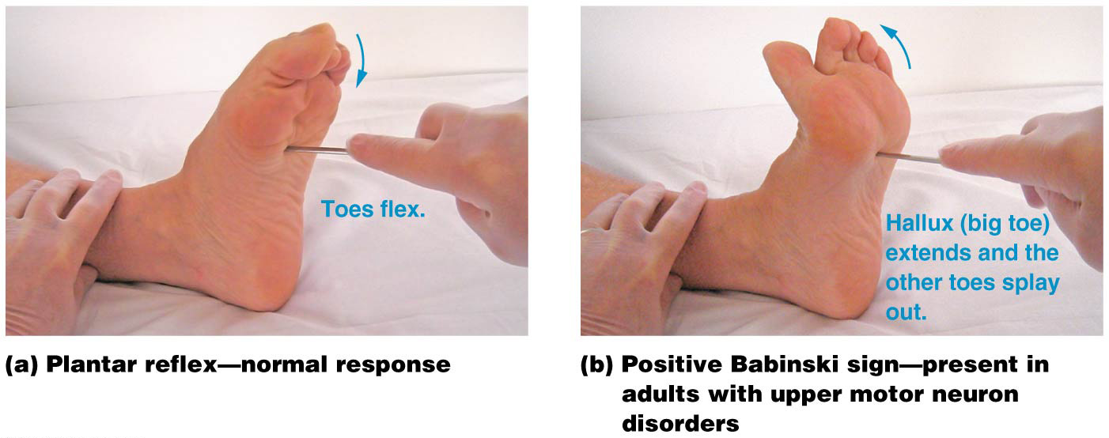
Sensory and Motor Neuron Disorders

Slide 122
Amyotrophic Lateral Sclerosis
___________________,also known as Lou Gehrig’s disease, involves degeneration of cell bodies of motor neurons in anterior horn of spinal cord as well as upper motor neurons in cerebral cortex; cause of degeneration is unknown at present; many factors likely play a role
Most common early feature of disease is muscle weakness, particularly in distal muscles of limbs and hands; over time weakness spreads to other muscle groups; upper motor neuron symptoms also develop

Slide 123
Amyotrophic Lateral Sclerosis
Amyotrophic lateral sclerosis (ALS), also known as Lou Gehrig’s disease, involves degeneration of cell bodies of motor neurons in anterior horn of spinal cord as well as upper motor neurons in cerebral cortex; cause of degeneration is unknown at present; many factors likely play a role
Most common early feature of disease is muscle weakness, particularly in distal muscles of limbs and hands; over time weakness spreads to other muscle groups; upper motor neuron symptoms also develop

Slide 124
Amyotrophic Lateral Sclerosis
Death typically results within 5 years of disease’s onset; in most forms of ALS, cognitive functions are spared; patient is fully aware of effects and complications of disease
Although intensive research efforts are ongoing, at this time there is no cure or treatment that prevents disease progression

