Slide 1
Human Anatomy & Physiology
Second Edition
Chapter 04
Histology
PowerPoint® Lectures created by Suzanne Pundt, University of Texas at Tyler
Copyright © 2019, 2016 Pearson Education, Inc. All Rights Reserved

Slide 2
Module 4.1 Introduction to Tissues

Slide 3
Histology
Histology – study of normal structures of tissues (a group of structurally and functionally related cells and their external environment that together perform common functions); all tissues share two basic components:
Consist of discrete population of cells that are related in structure and function
Have a surrounding material called extracellular matrix (ECM)

Slide 4
Types of Tissues
Four primary tissue types are distinguished by kinds and number of cells, amount and composition of ECM, and their specific functions:
Epithelial tissues (epithelia) – tightly packed sheets of cells with no visible ECM; cover and line all body surfaces and cavities; specialized epithelia form glands that manufacture secretions such as sweat, saliva, or chemical messengers called hormones
Connective tissues – connect all other tissues in body to one another; ECM is a prominent feature for most connective tissue types with cells scattered throughout; bind, support, protect, and allow for transportation of substances

Slide 5
Types of Tissues
Types of Tissues (continued):
Muscle tissues, capable of generating force and contracting; little ECM between cells
Nervous tissues consist of cells capable of generating, sending, receiving messages, and cells that support this activity, has unique ECM

Slide 6
The Extracellular Matrix
Extracellular matrix (ECM) – composed of the substances surrounding the cells in a tissue; consists of two main components, ground substance and protein fibers: The proportion of these components varies, the ECM in different tissues can be a fluid, thick gel, or a solid. ECM is made by the cells of the tissue.
ECM performs a variety of functions:
Provides tissue with strength to resist tensile (stretching) and compressive forces
Directs cells to their proper places within a tissue and holds cells in their proper positions
Regulates development, mitotic activity, and survival of cells

Slide 7
The Extracellular Matrix
The shapeless, gel-like ground substance makes up most of ECM and contains extracellular fluid (ECF or interstitial fluid); components include water, nutrients, ions, and three families of macromolecules: glycosaminoglycans (GAGs), proteoglycans, and glycoproteins.
Glycosaminoglycans (GAGs) – long, straight polysaccharide chains. Examples include chondroitin sulfate and hyaluronic acid.
Negative charges of certain sugars in a GAG attract positively charged ions in ECF
Ions create concentration gradient within ECF; draws water out of cells and blood vessels by osmosis
Effectively “traps” water in ECM; helps ECM to resist compression;

Slide 8
The Extracellular Matrix
Ground substance (continued):
Proteoglycans consist of GAGs bound to a protein core (structure resembles bottle brush)
Thousands of proteoglycans can bind to a very long GAG such as hyaluronic acid, forming huge proteoglycan “aggregates”
Helps make ECM firmer, more solid, and resistant to compression
Aggregates also act as barrier to diffusion of substances through ECM; protects underlying tissue from invading microorganisms

Slide 9
The Extracellular Matrix
Ground substance (continued):
Glycoproteins- different types known collectively as cell-adhesion molecules (CAMs)
Adhere cell to cell and into their places within ECM
CAMS bind to cell surface proteins as well as protein fibers and proteoglycans; help maintain normal tissue architecture

Slide 10
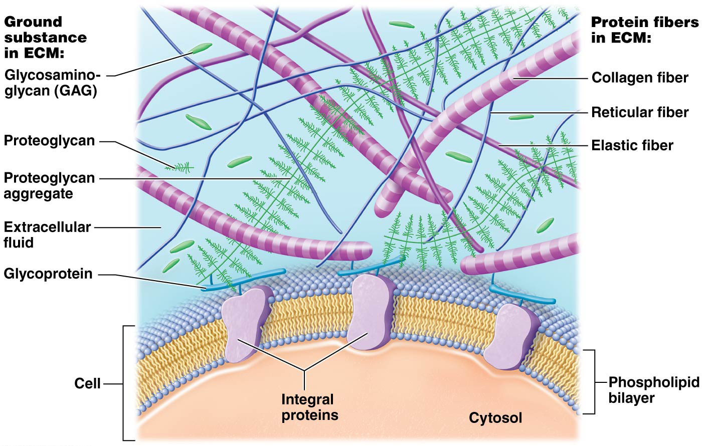
The Extracellular Matrix

Slide 11
The Extracellular Matrix
Protein fibers – embedded within ground substance; long molecules composed of multiple fibrous subunits with a ropelike structure; great deal of tensile strength; three protein fiber types are found within ECM: Collagen, elastic, and reticular
Collagen fibers, collagen proteins make up 20–25% of all protein in body; collagen fibers composed of multiple subunits of a fibrous protein; resistant to tension (pulling and stretching forces) and pressure

Slide 12
The Extracellular Matrix
Protein fibers (continued):
Elastic fibers – may be stretched to 1 and ½ times their resting length without breaking (property called extensibility). When stretching force is removed they return to their original length (property called elasticity). Elastic fibers are composed of a protein called elastin that is surrounded by glycoproteins.
Reticular fibers – thin, type of collagen fiber; form a meshwork or scaffold that supports cells and ground substance of many tissues; form a weblike structure in organs like spleen that help trap foreign cells

Slide 13
The Extracellular Matrix

Slide 14
Diseases of Collagen and Elastic Fibers
Protein fibers of ECM are vital to structural integrity of many tissues and organs, as illustrated by:
Marfan syndrome – abnormal elastic fibers; tall stature with long limbs and fingers; multiple skeletal abnormalities, recurrent joint dislocations, heart valve and lens (eye) abnormalities and dilation of aorta; aortic dissection (rupture) is most lethal complication

Slide 15
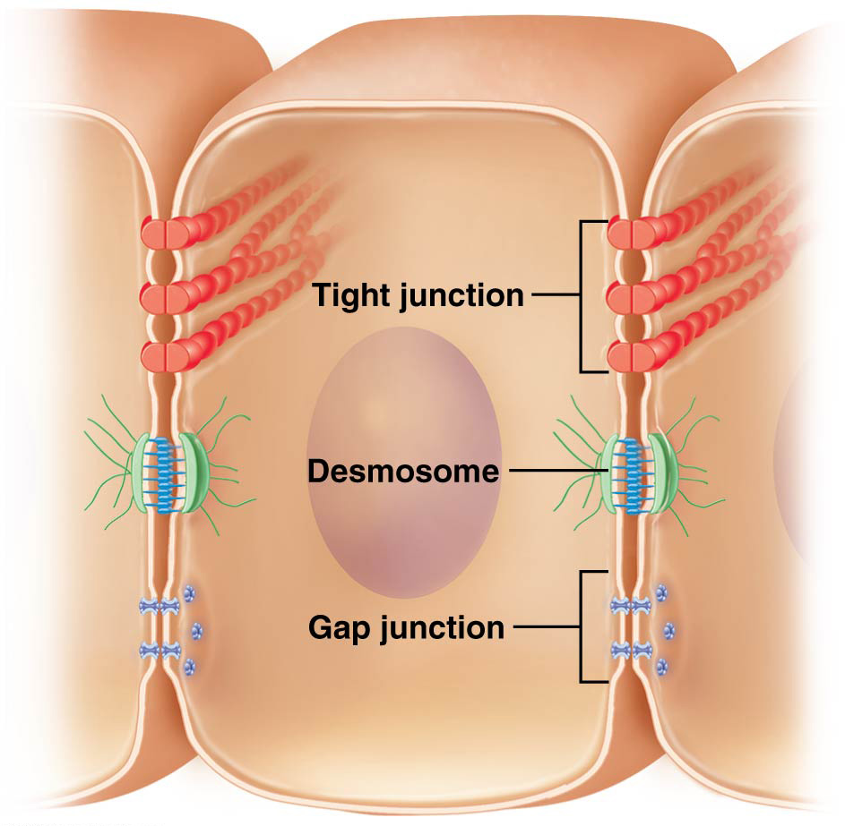
Cell Junctions
Cells may be linked in two ways: cell-adhesion molecules or by cell junctions
Cell junctions :
Tight junctions
Desmosomes
Gap junctions

Slide 16
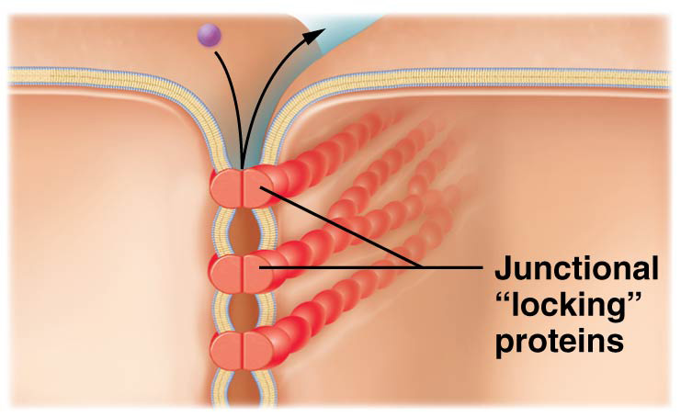
Cell Junctions
Tight junctions, also known as occluding junctions, hold cells tightly together such that space between is impermeable to movement of macromolecules
Integral proteins of adjacent cells’ plasma membranes are locked together forming a seal around apical perimeter of cell
Seal may not be complete allowing for leakage in some tissues
Example – found between cells in blood vessels; prevent blood from exiting vessels
LIKE A ZIPPER ON A FREEZER BAG

Slide 17
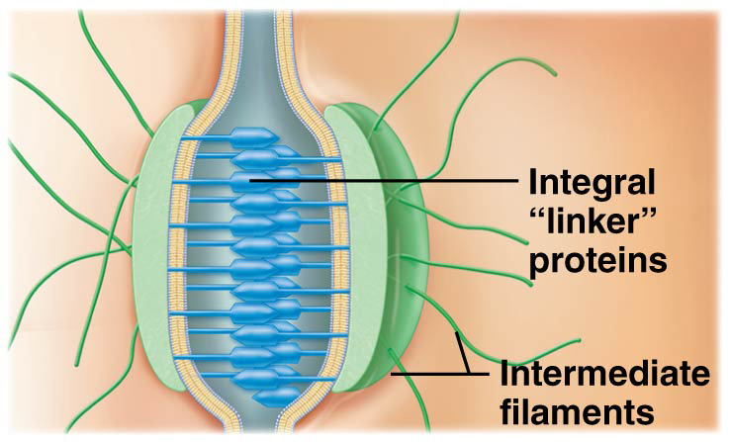
Cell Junctions
Desmosomes – composed of linking integral proteins; materials in extracellular fluid may pass through space between cells
Increase strength of a tissue by holding cells together so mechanical stress is more evenly distributed
Integral “linker” proteins are attached to intermediate filaments of cytoskeleton for structural reinforcement
Found in tissues subjected to a great deal of mechanical stress such as epithelia of skin
LIKE A BUTTON or SNAP

Slide 18
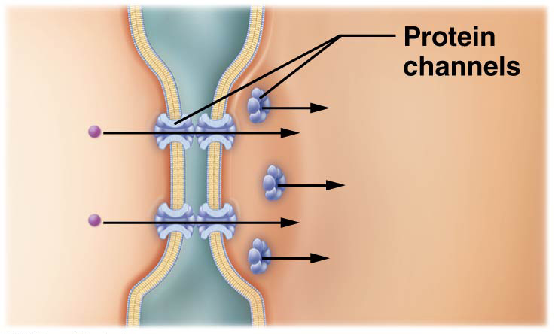
Cell Junctions
Gap junctions are small pores formed by protein channels between adjacent cells that allow small substances to flow freely between each cell’s cytoplasm
Found in between cells that communicate with electrical signals such as cardiac muscle cells
Gap junctions illustrate the Cell-Cell Communication Core Principle

Slide 19
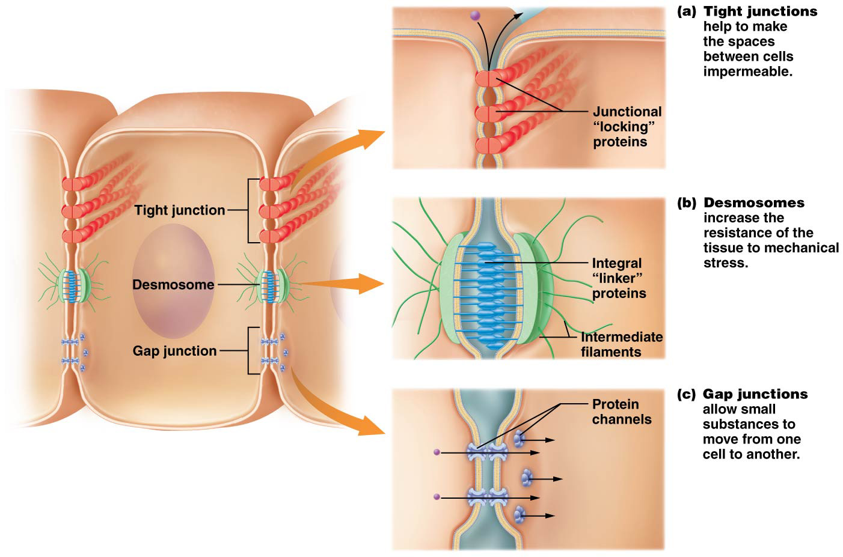
Cell Junctions
Figure 4.2 Cell junctions.

Slide 20
Module 4.2 Epithelial Tissues

Slide 21
Epithelial Tissues
Epithelial tissues – found on every internal and external body surface; barriers between body and external environment; line organs and fluid-filled cavities; serve following additional functions:
Protection – shield underlying tissues from mechanical and thermal injury
Immune defenses – form physical barriers; prevent invasion by microorganisms; house cells of immune system enhancing protective function

Slide 22
Epithelial Tissues
Epithelial tissues – additional functions (continued)
Secretion – form glands that produce substances like hormones and oils; secreted into blood or through ducts respectively
Transport into other tissues – selectively permeable barriers; certain substances are able to cross these barriers by passive or active transport and enter other tissues
Sensation – most associated with a rich nerve supply; detects changes in internal and external environments; taste buds are examples of specialized sensory epithelial cells

Slide 23
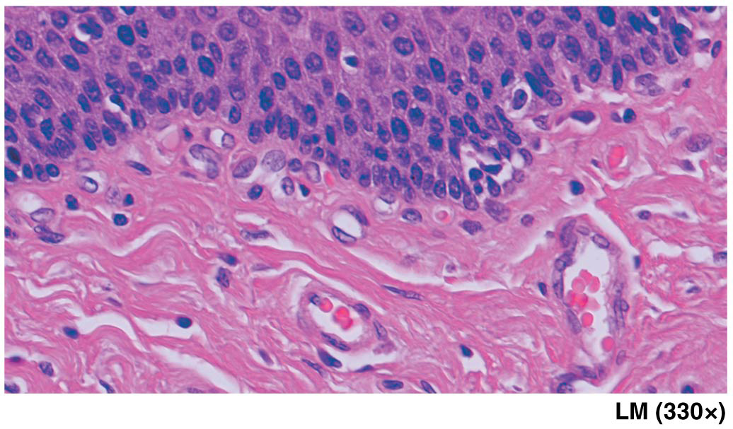
Concept Boost: But It All Looks Pink!
Key to identifying tissues is to reduce every tissue to simplest components: cells and extracellular regions containing different types of chemicals
Shown here is a section of esophagus (tubular organ; transports food from mouth to stomach)
Each structure that contains a dark purple nucleus is a cell

Slide 24
Concept Boost: But It All Looks Pink!
Shown here is a section of esophagus (continued):
Ground substance generally either looks clear or has just a slight tinge of color; protein fibers generally look like wavy or straight lines
Occasionally, collagen fibers form bundles that might resemble certain cell types; easiest way to differentiate them is to look for nuclei; if bundles lack nuclei, then they are likely to be collagen fibers

Slide 25
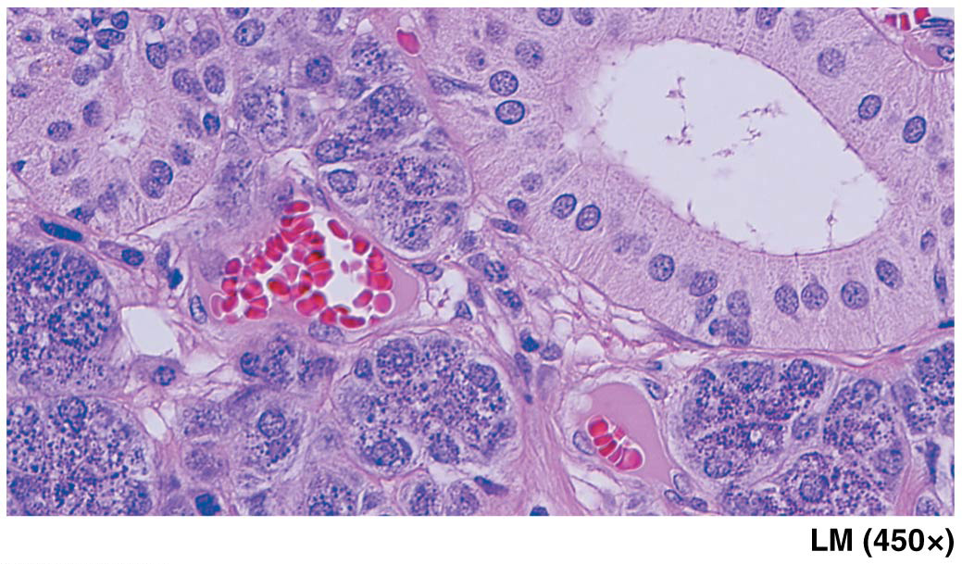
Concept Boost: But It All Looks Pink!
Next section is sublingual gland (salivary gland that produces saliva) under tongue
Contains clusters of small, light red, round discs that lack nuclei
You may not immediately recognize these discs as cells because they lack nuclei, but they are in fact cells called red blood cells or erythrocytes; located in blood vessels; will be visible in many different tissue sections

Slide 26
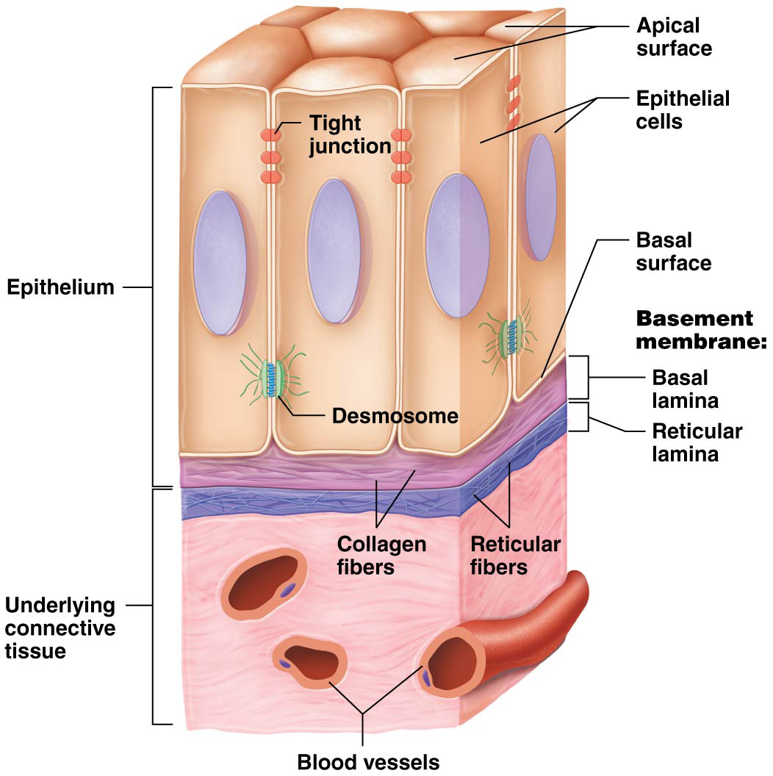
Components and Classification of Epithelia
Epithelial tissues consist mostly of tightly packed cells generally joined together by tight junctions and desmosomes
Structural arrangement make sheets of cells fairly impermeable and resistant to physical stresses and mechanical injury

Slide 27
Components and Classification of Epithelia
Epithelial tissues are avascular (lack blood vessels and must obtain oxygen and nutrients by diffusion from deeper tissues); limits their thickness
ECM is found beneath cells in a thin basement membrane; has two components:
Basal lamina – ECM synthesized by epithelial cells; consists of mostly collagen fibers and ground substance
Reticular lamina – synthesized by underlying connective tissue; consists of reticular fibers and ground substance
Together these two layers “glue” epithelial tissue to underlying connective tissue; anchor underlying blood vessels in place; provide a barrier between epithelia and underlying tissues

Slide 28
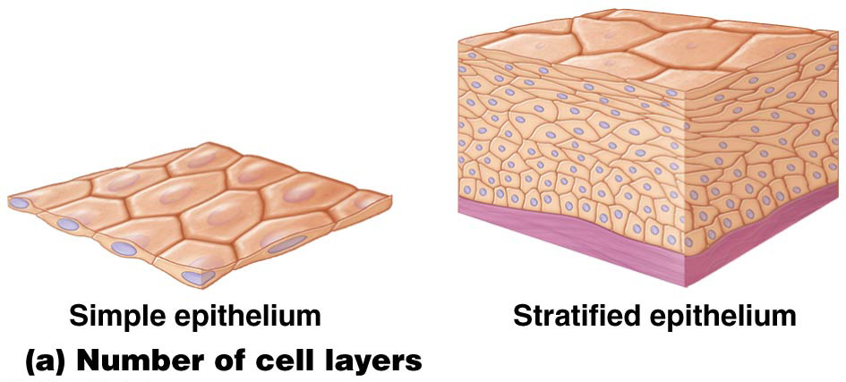
Components and Classification of Epithelia
Epithelial tissue – classified based on two criteria: number of cell layers and shape of cells in those layers; both have functional significance
Simple epithelia consist of a single cell layer
Stratified epithelia consist of more than one cell layer

Slide 29
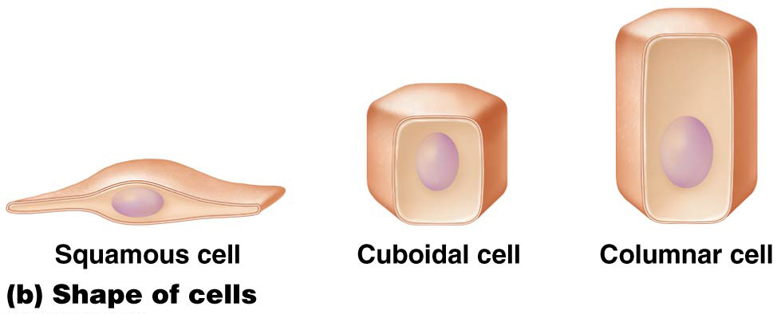
Components and Classification of Epithelia
Epithelial tissue – classification (continued):
Squamous cells are flattened
Cuboidal cells are short
Columnar cells are tall and elongated

Slide 30
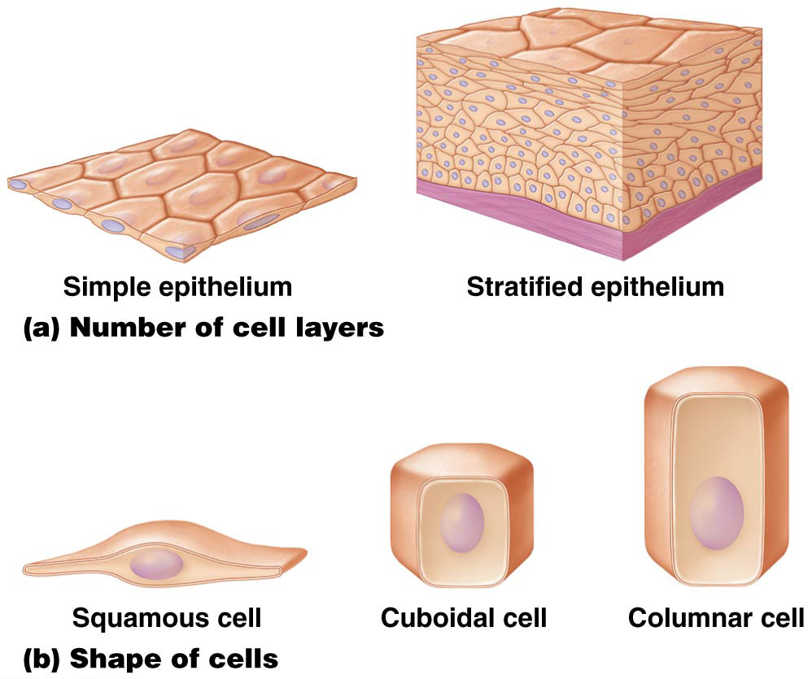
Components and Classification of Epithelia

Slide 31
Covering and Lining Epithelia
Covering and lining epithelia – found on inner and outer body surfaces; each cell shape can be found in varying thicknesses in broad, flat sheets; often called membranes a term that can include the underlying basement membrane as well):
Simple epithelia – one cell-layer thick, their thinness makes them perfect for transportation of substances

Slide 32
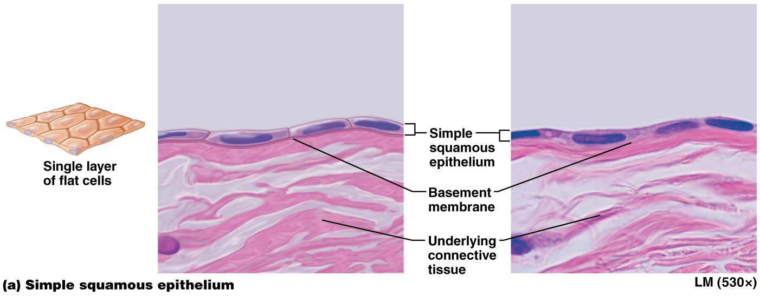
Covering and Lining Epithelia
Four types of simple epithelia:
Simple squamous epithelium – very thin single layer of cells with a “fried egg” appearance; allows rapid diffusion of substances like oxygen, carbon dioxide, fluids, and ions; found in air sacs of lung, specific segments of kidney tubules, and lining blood vessels

Slide 33
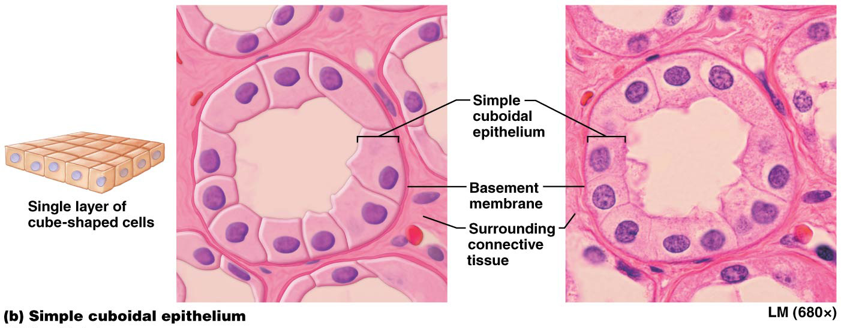
Covering and Lining Epithelia
Four types of simple epithelia (continued):
Simple cuboidal epithelium – single layer of cube-shaped cells with large central nucleus; thin enough for rapid substance diffusion; found in segments of renal tubules, respiratory passages, ducts of many glands, and thyroid gland

Slide 34
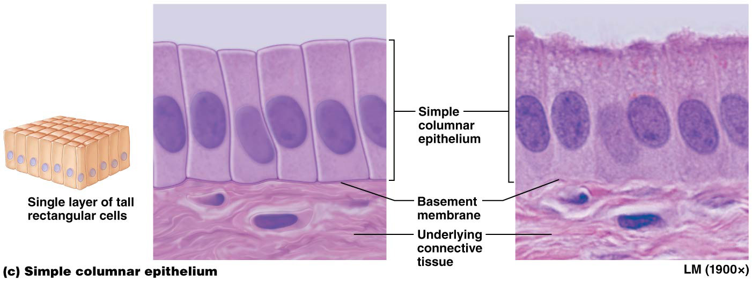
Covering and Lining Epithelia
Four types of simple epithelia (continued):
Simple columnar epithelium – single layer of rectangular-shaped cells with nuclei located generally in basal portion of cell; often has microvilli on apical plasma membrane (drastically increases surface area for absorption of substances) or cilia (propel substances through hollow organs); cells with microvilli are found in small intestine and ciliated cells are found in uterine tubes and segments of respiratory tract

Slide 35
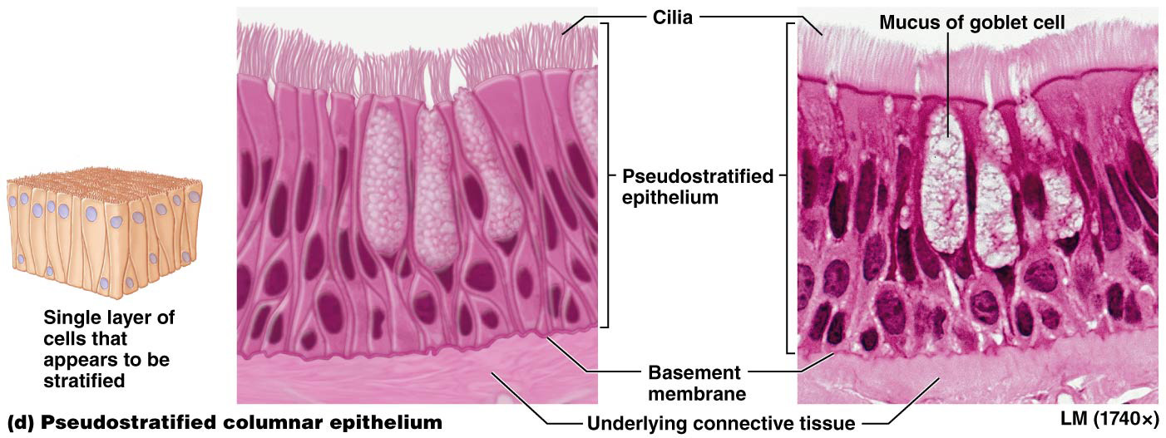
Covering and Lining Epithelia
Four types of simple epithelia (continued):
Pseudostratified columnar epithelium appears to be layered because nuclei are found at various heights, but only one cell-layer thick with basal part of cell firmly in contact with basement membrane; found in segments of respiratory tract and nasal cavity; ciliated

Slide 36
Covering and Lining Epithelia
Transport across simple epithelia occurs via one of two routes:
Paracellular transportation – where substances leak between cells in an epithelial membrane; limited due to tight junctions that make spaces between cells nearly impermeable
Transcellular transportation – where a substance enters a cell by crossing plasma membrane, diffusing across cytosol, and exiting cell at opposite side

Slide 37
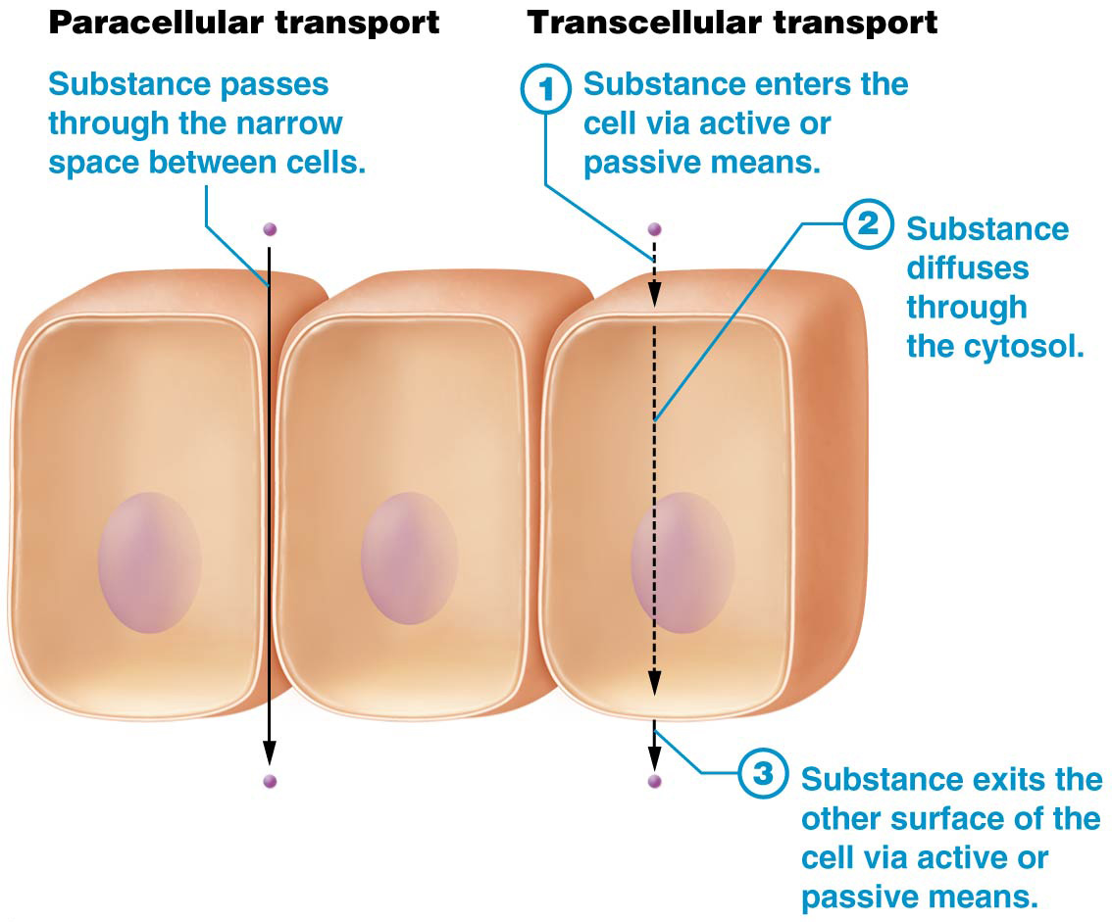
Covering and Lining Epithelia

Slide 38
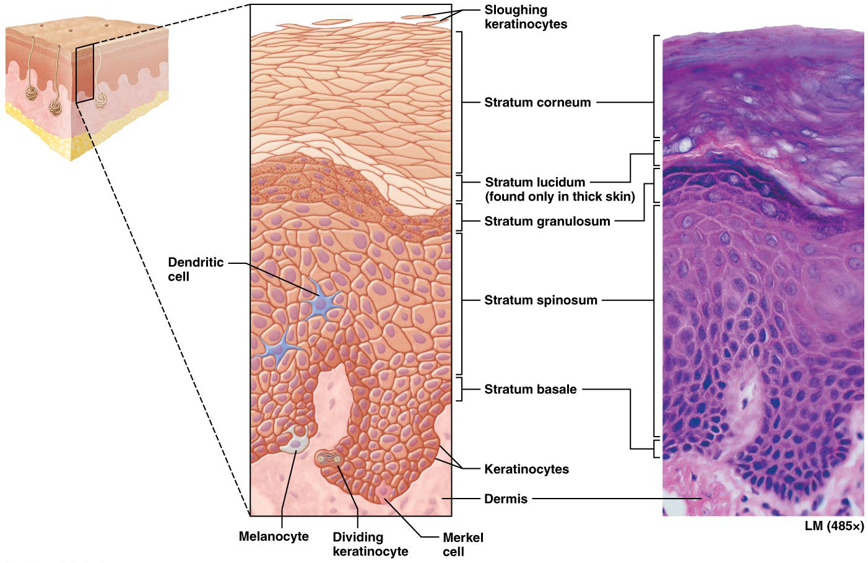
Covering and Lining Epithelia
Stratified epithelium – more than one layer of cells; best suited as protective barriers in locations subjected to high degrees of mechanical stress; types include:
Keratinized stratified squamous epithelium – apical cellular layers are dead; lack nuclei; filled with protein keratin; makes tissue tough and resistant to friction; well adapted for outer layers of skin

Slide 39
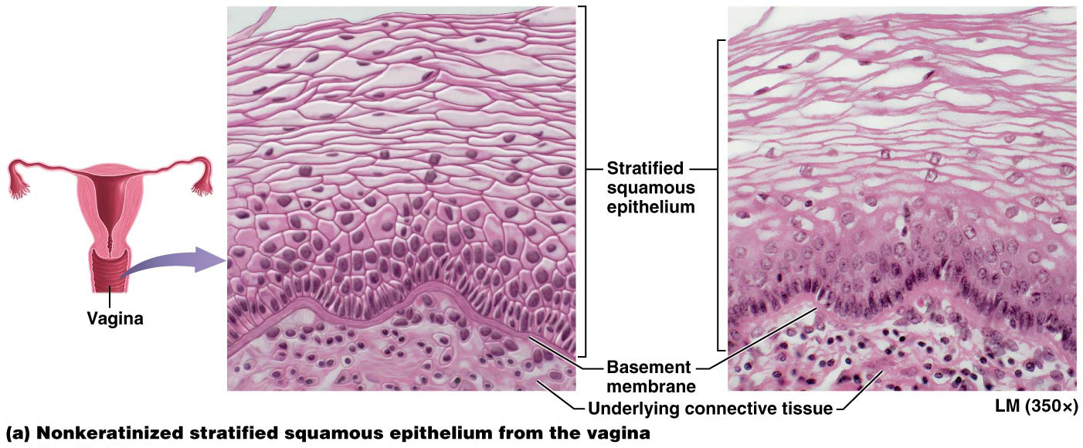
Covering and Lining Epithelia
Stratified epithelium (continued):
Nonkeratinized stratified squamous epithelium – apical cellular layers retain nuclei; still alive; found in regions subjected to mechanical stress where surface must remain moist; mouth, throat, esophagus, anus, and vagina

Slide 40
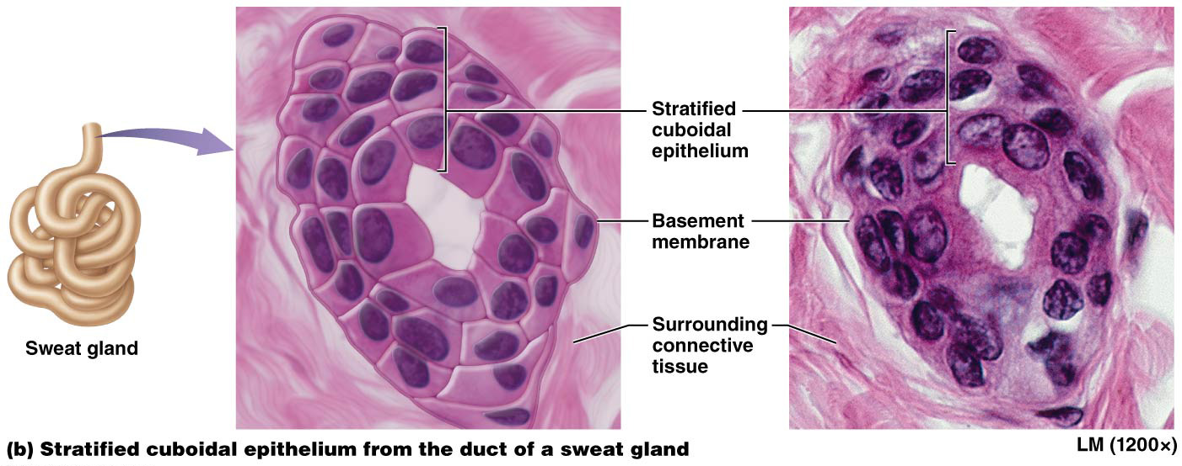
Covering and Lining Epithelia
Stratified cuboidal epithelium, rare in humans, consists of two cell layers and lines ducts of sweat glands

Slide 41
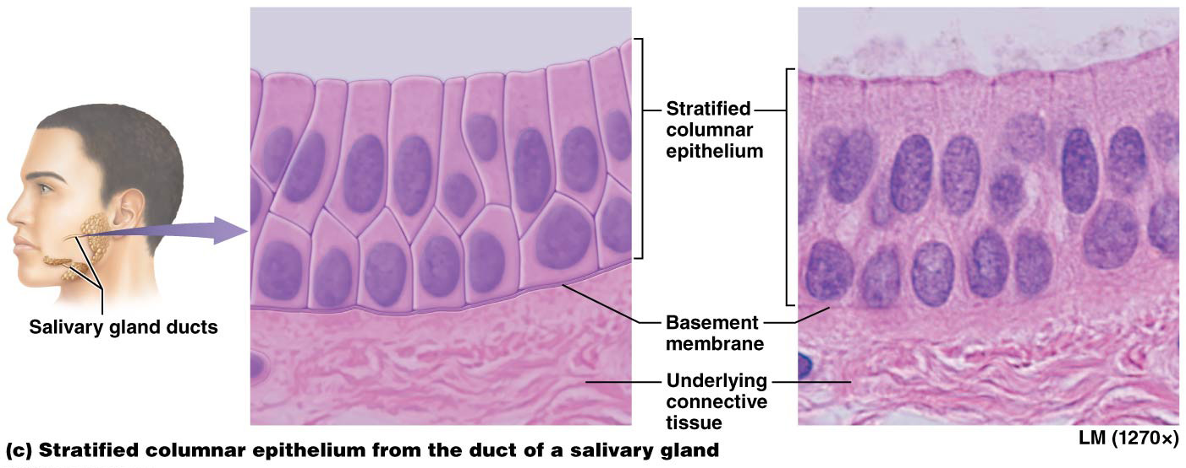
Covering and Lining Epithelia
Stratified columnar epithelium – also rare in humans; consists of only a few layers; apical cell layer is columnar and basal cell layer is cuboidal; found in male urethra, cornea of eye, and in ducts of certain glands like salivary glands

Slide 42
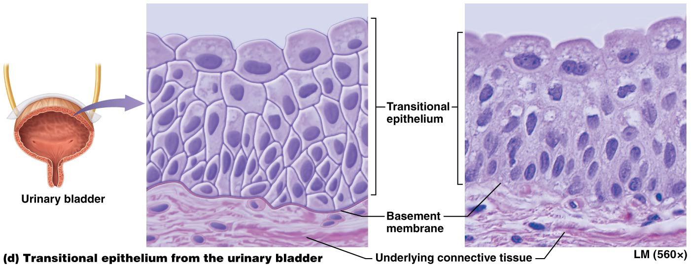
Covering and Lining Epithelia
Transitional epithelium – only found in urinary system; lines interior of kidney, ureters, urinary bladder, and urethra; basal cell layers are cuboidal while apical cell layers are dome-shaped when tissue is relaxed; ability of apical cells to flatten contributes to ability of urinary tissues to stretch

Slide 43
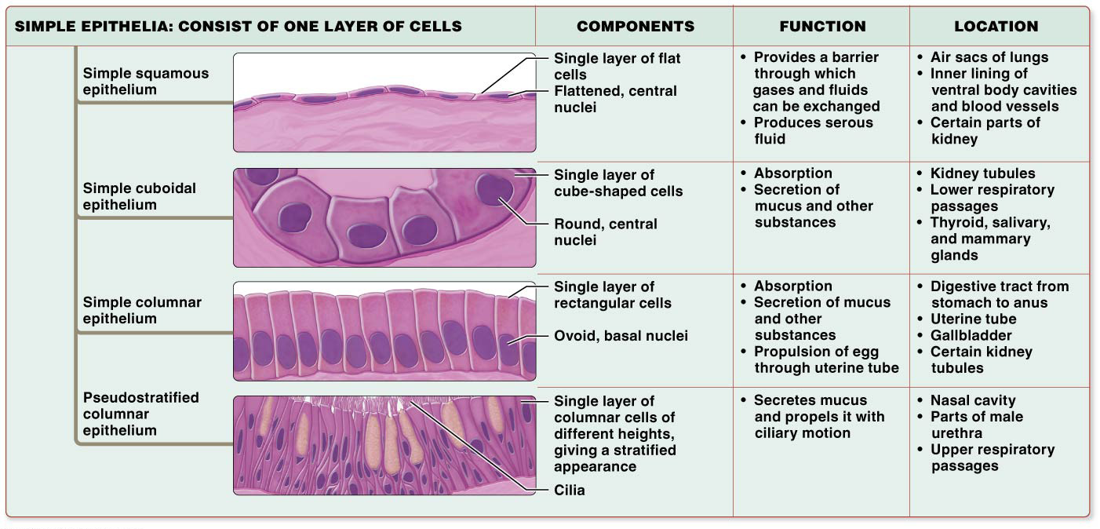
Covering and Lining Epithelia

Slide 44
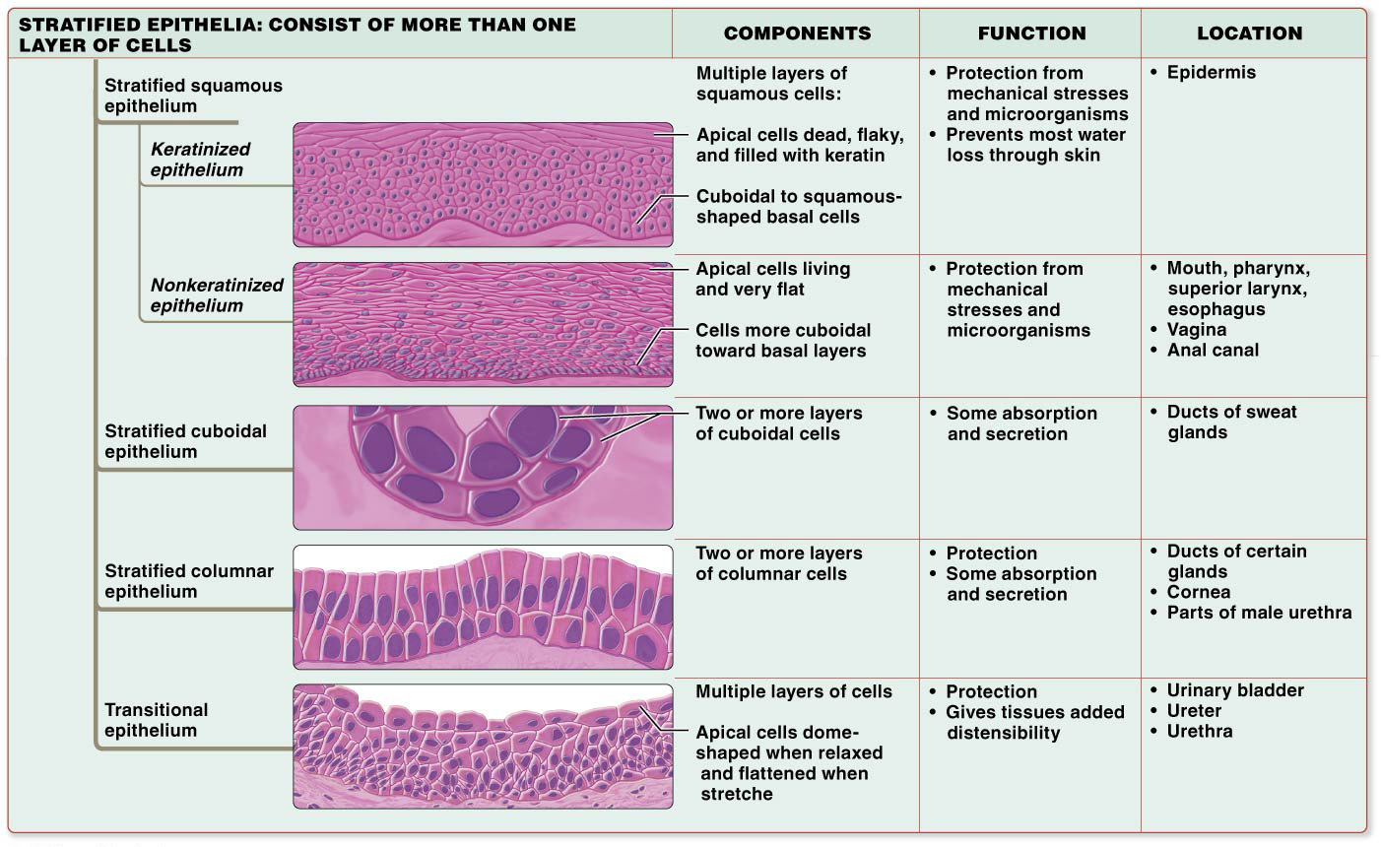
Covering and Lining Epithelia

Slide 45
Glandular Epithelia
Gland – structure of epithelial origin that synthesizes and secretes a product by secretory cells
Arise from epithelial tissue that migrated into deeper connective tissue instead of remaining at surface
Can be classified by their shape and by how they release products
Products are released by two mechanisms:
Endocrine
Exocrine

Slide 46
Glandular Epithelia
Endocrine glands- LACK DUCTS, secrete their products, usually hormones, directly into the bloodstream :
Allows products to have widespread systemic effects on distant cells in different areas of body
Example of Cell-Cell Communication Core Principle

Slide 47
Glandular Epithelia
Exocrine glands release products to the apical surface of epithelium, generally to the exterior of the body or into a hollow organ that opens to the outside of the body:
The product of an exocrine gland is secreted through a duct lined with epithelial cells, products of exocrine gland have LOCAL actions only, affecting cells only in their general vicinity.

Slide 48
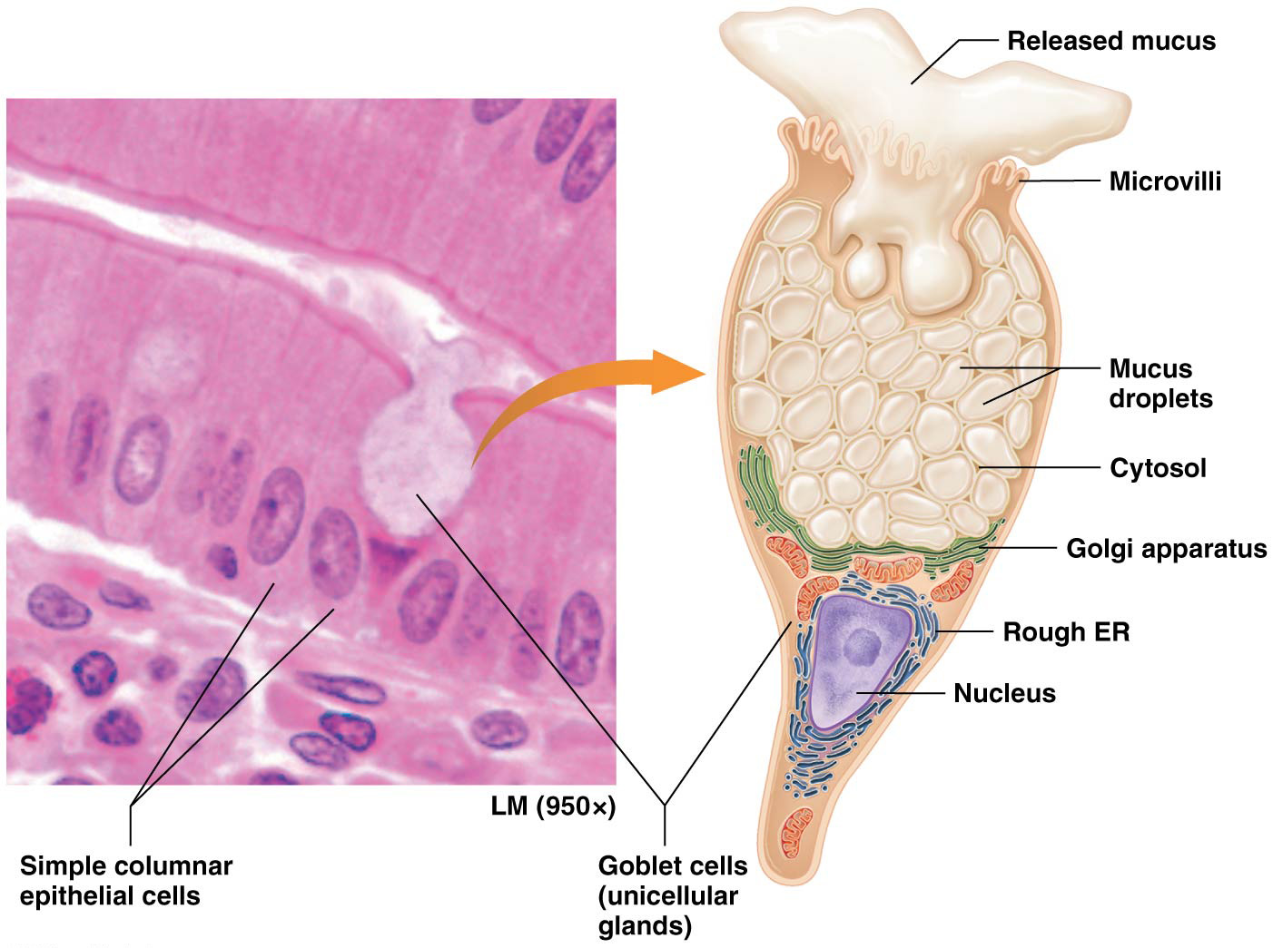
Glandular Epithelia
Goblet cells – most common unicellular gland; found abundantly in epithelial lining the digestive and respiratory tracts;
-Secrete mucus-thick, sticky liquid that protects underlying epithelium

Slide 49
Glandular Epithelia
Most exocrine glands are multicellular glands made up of clusters of secretory cells arranged in different ways
Multicellular glands are classified according to structure of their ducts and shape of secretory cell clusters
Simple glands—ducts don’t branch
Compound glands—branched ducts
Clusters of secretory cells may be arranged in three shapes: tubular (long and straight or coiled), acinar (spherical), or tubuloacinar (with both tubular and acinar sections)

Slide 50
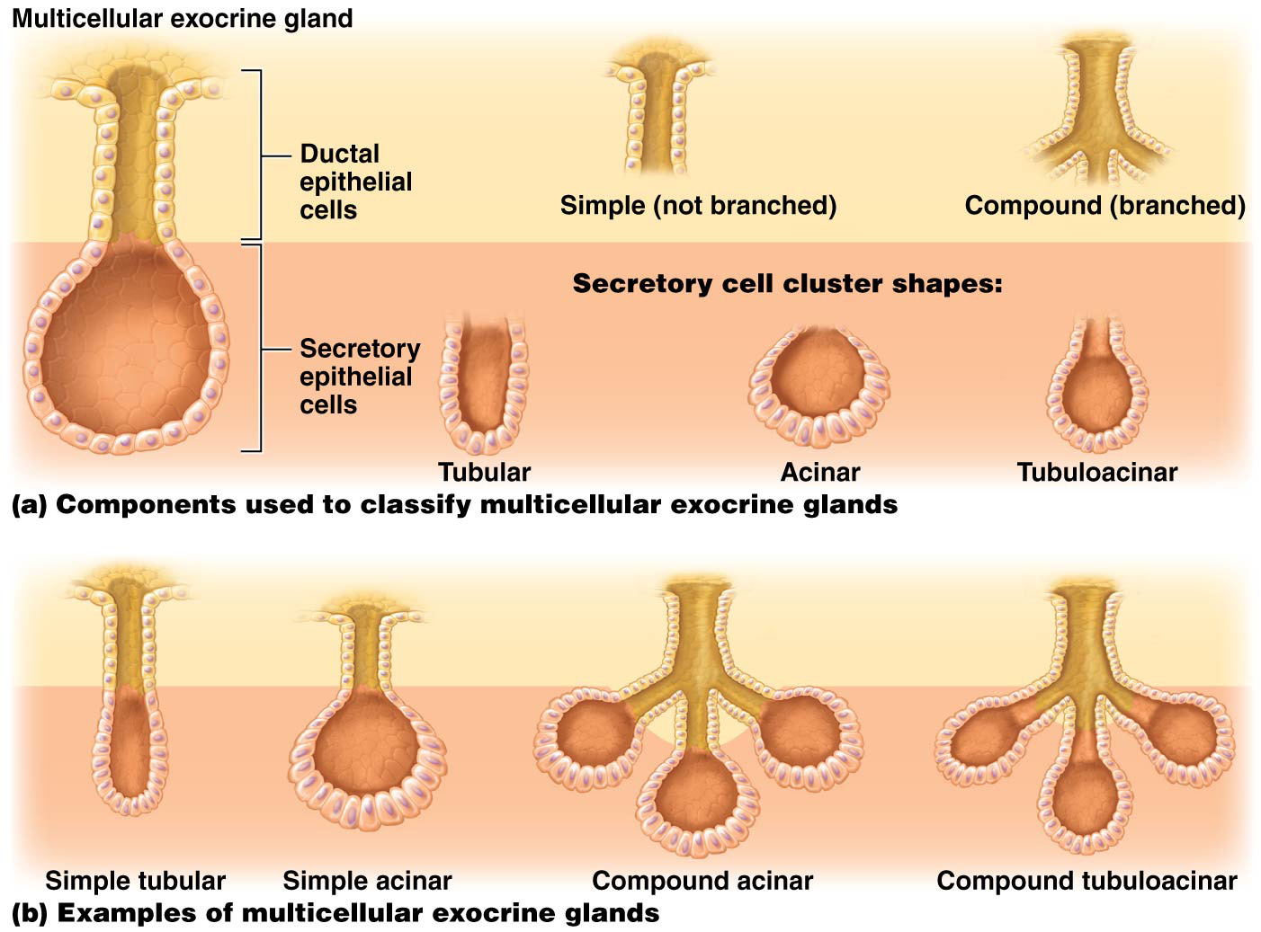
Glandular Epithelia

Slide 51
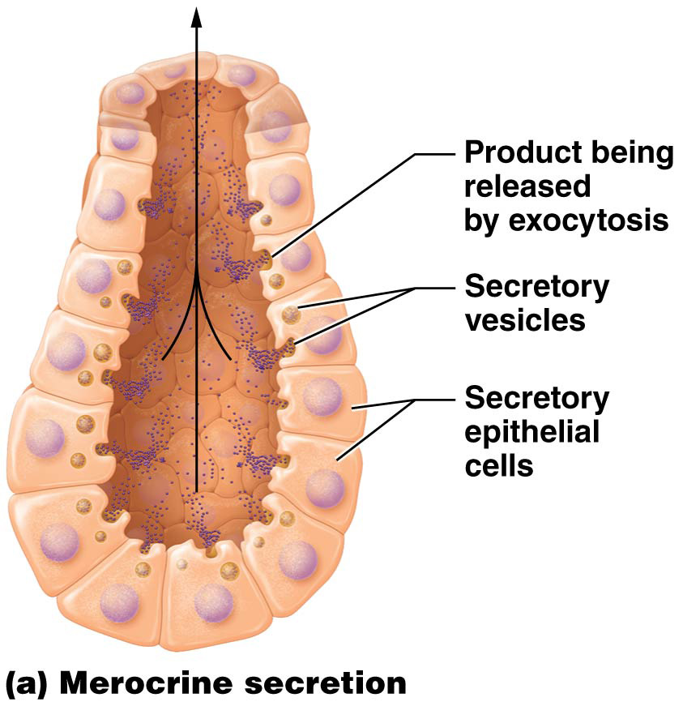
Glandular Epithelia
Exocrine glands have two types of secretion: merocrine and holocrine
Merocrine secretion, used by majority of exocrine glands in body including salivary and sweat glands; package products into secretory vesicles for release by exocytosis

Slide 52
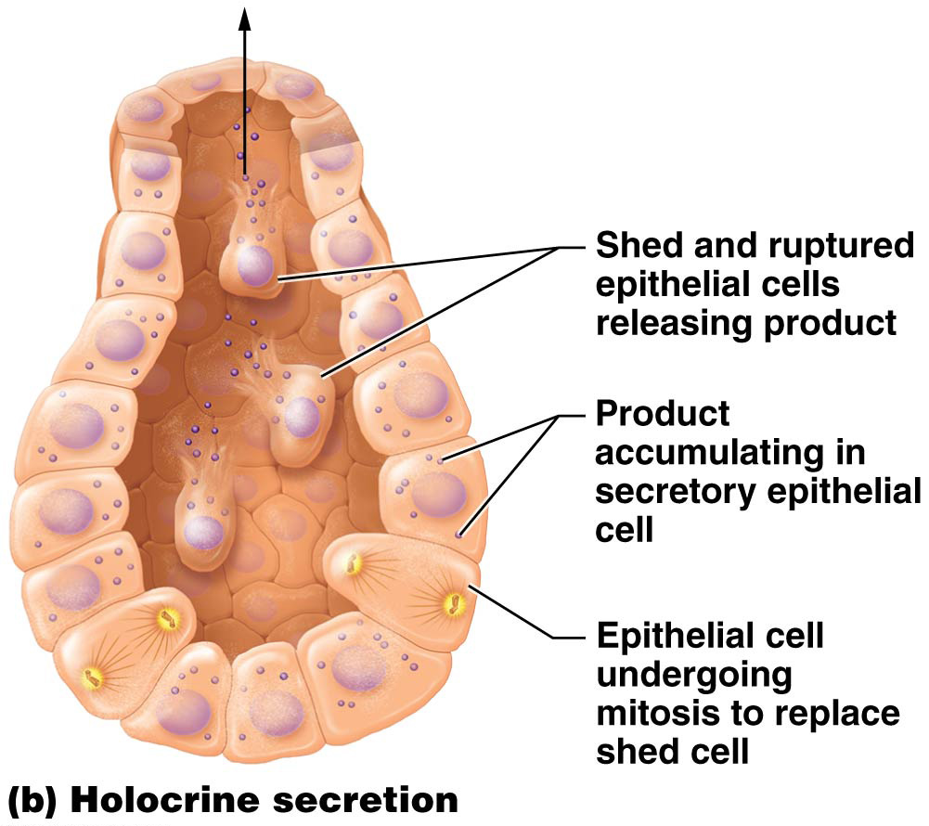
Glandular Epithelia
Exocrine gland methods for secreting products (continued):
Holocrine secretion – used by sebaceous gland in skin to secrete sebum; secretory cells accumulate product in cytosol; only release product when cell ruptures and dies

Slide 53
Carcinogens and Epithelial Tissues
Epithelia cover all body surfaces; therefore more subject to injury than most other tissues
Carcinogens – agents that induce DNA changes; can lead to cancer
Carcinoma – cancers of epithelial tissues; common examples include:
Lung Adenocarcinoma
Ductal and Papillary Carcinoma – cancers of breast

Slide 54
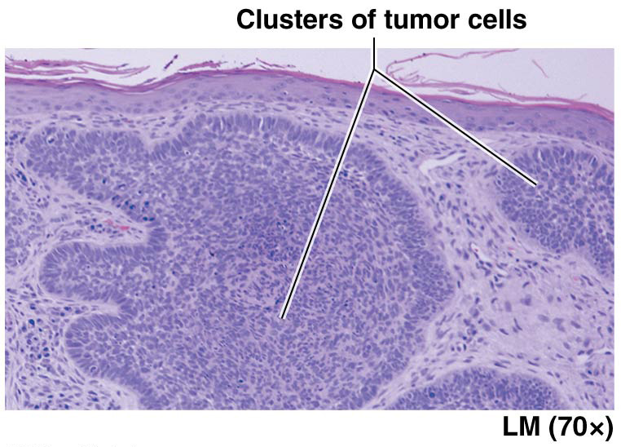
Carcinogens and Epithelial Tissues
Basal cell carcinoma-a cancer of the skin
Basement membrane provides barrier that helps prevent/slow spread of carcinomas; cancers that have not penetrated the basement membrane/have not invaded other tissues are termed “pre-malignant” or carcinoma in situ; cancer cells often produce enzymes that degrade components of the basement membrane, facilitating spread

Slide 55
Module 4.3 Connective Tissues

Slide 56
Connective Tissue
Connective tissues are divided into two basic groups that differ in their cell types and ECM components:
Connective tissue proper (loose connective tissue, dense connective tissue, reticular tissue, and adipose tissue)
Specialized connective tissue (bone, cartilage, and blood)

Slide 57
Connective Tissue
Connective tissues are a diverse group of tissues with a variety of functions:
Connecting and binding – connect structures in the body, in organs bind other tissues layers together
Support – bone and cartilage support weight of the body
Protection – bone tissue protects certain internal organs and cartilage and fat provide shock absorption; components of immune system are found within connective tissues
Transport- Blood is a fluid connective tissue that is the main transport medium in the body.

Slide 58
Connective Tissue
Connective tissue consists of cells and ECM, like all tissues
Arrangement consists of loosely packed cells surrounded by protein fibers, all of which are embedded in ground substance.
Although diverse in function, connective tissues do share a common feature-their ECM plays an extensive role in their functions.

Slide 59
Connective Tissue Proper
Connective tissue proper
Also known as general connective tissue
Widely distributed in body
Connect tissues and organs to one another
Components of internal architecture of some organs

Slide 60
Connective Tissue Proper
Cells of connective tissue proper – resident cells permanently inhabit tissue; migrant cells migrate into different areas of body depending on situation; cells in connective tissue proper include:
Fibroblasts
Adipocytes
Mast cells
Phagocytes
Other immune system cells

Slide 61
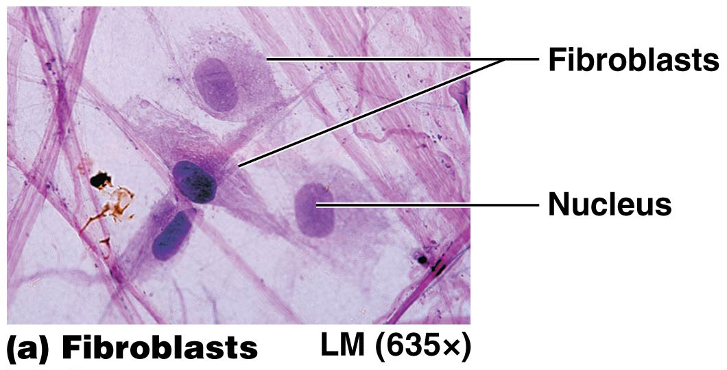
Connective Tissue Proper
Cells of connective tissue proper (continued):
Fibroblasts – most common resident cell
Mature cells that have properties of an immature “blast” cell
Make protein fibers and ground substance (components of ECM); continually produce collagen proteins

Slide 62
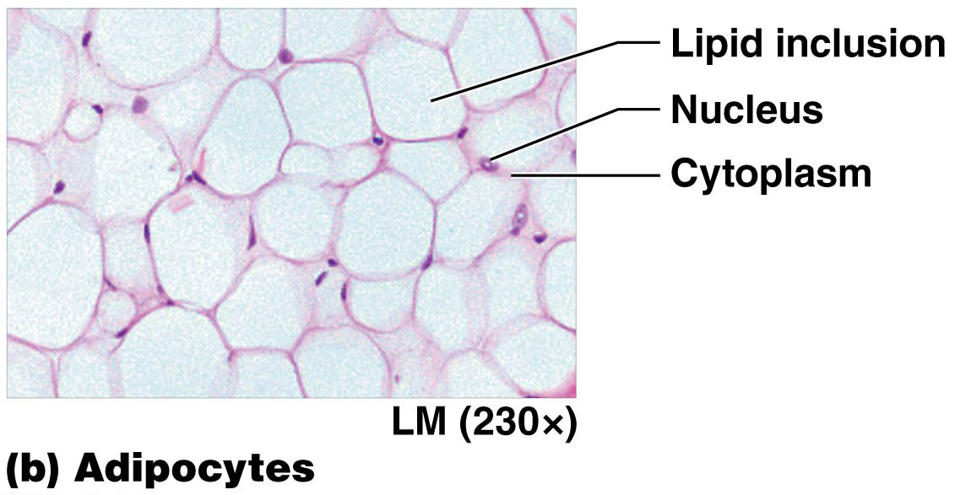
Connective Tissue Proper
Cells of connective tissue proper (continued):
Adipocytes (fat cells) – found in many different connective tissues; cytoplasm of each cell is filled with a single large lipid inclusion

Slide 63
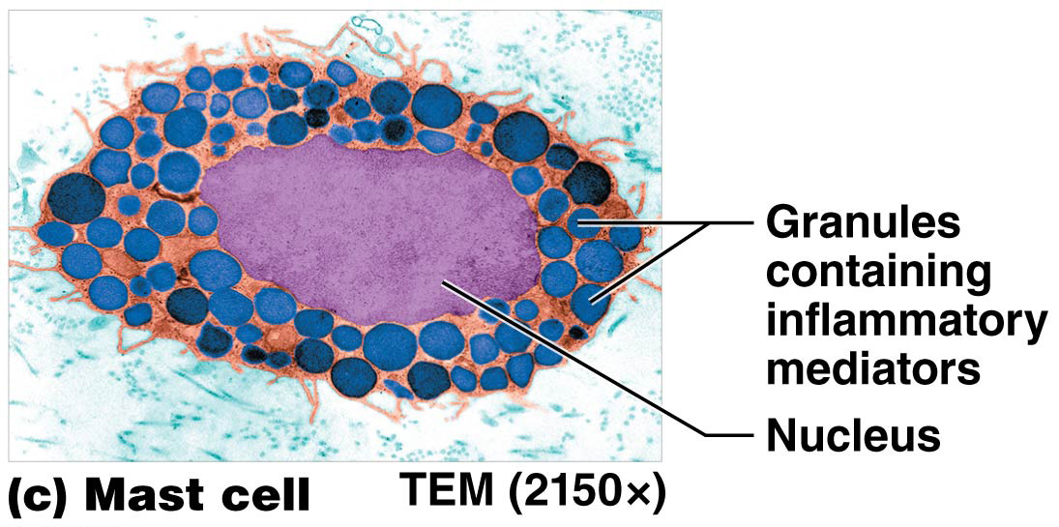
Connective Tissue Proper
Cells of connective tissue proper (continued):
Mast cells – largest resident cell
Immune system cells filled with cytosolic inclusions (granules) of inflammatory mediators such as histamine
Release mediators when stimulated, causing inflammation (protective response that activates immune system)

Slide 64
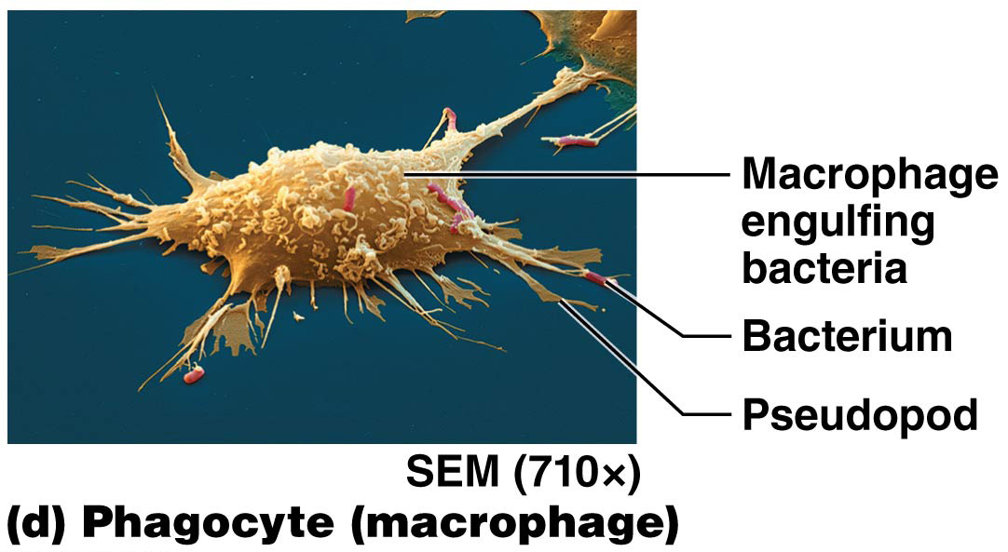
Connective Tissue Proper
Cells of connective tissue proper (continued):
Phagocytes – also immune system cells; can ingest foreign substances, microorganisms, and dead or damaged cells by phagocytosis; include macrophages (either resident or migrant) and neutrophils (migrant cells)
Other immune system cells can migrate in and out of connective tissues depending on body’s needs

Slide 65
Connective Tissue Proper
Four basic types of connective tissue proper:
Loose connective tissue
Dense connective tissue
Reticular tissue
Adipose tissue

Slide 66
Connective Tissue Proper
Four basic types of connective tissue proper (continued):
Loose connective tissue (areolar tissue) – mostly ground substance, with all three types of protein fibers, fibroblasts, and other cells such as adipocytes, suspended in ground substance:
Found beneath epithelium of skin, in membranes lining body cavities, and within walls of hollow organs
Contains and supports blood vessels vital to avascular epithelial tissues; houses immune system cells that protect body from microorganisms

Slide 67
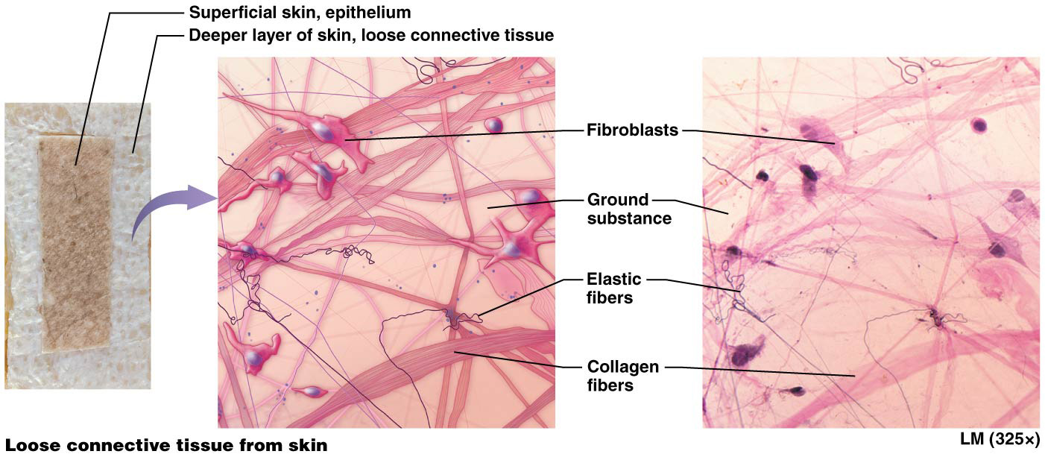
Connective Tissue Proper

Slide 68
Connective Tissue Proper
Four basic types of connective tissue proper (continued):
Dense connective tissue (fibrous connective tissue) – mostly protein fibers; grouped into three classes:
Dense irregular connective tissue – predominantly disorganized collagen bundles
Strong and resists tension in all three planes of movement
Found in high tension areas like dermis (deep to skin) and surrounding organs and joints

Slide 69
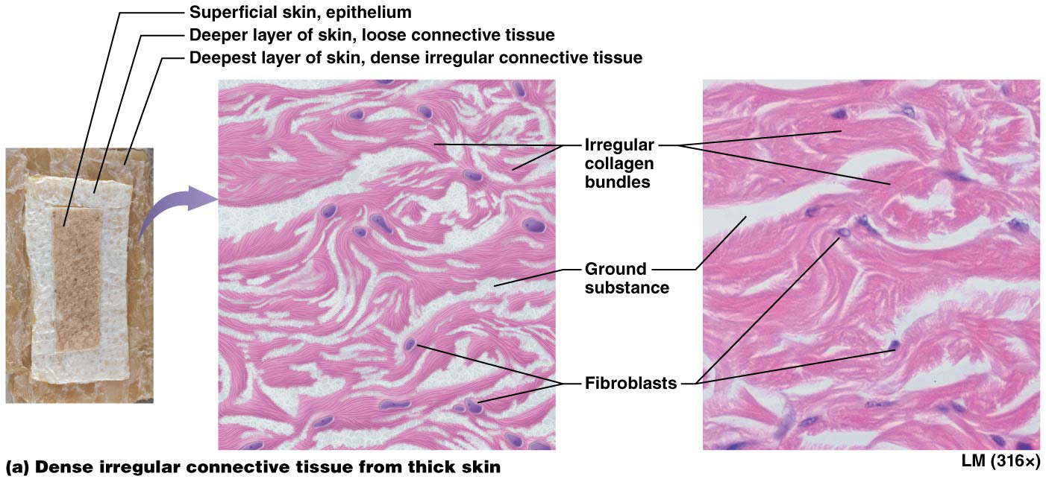
Connective Tissue Proper

Slide 70
Connective Tissue Proper
Four basic types of connective tissue proper (continued):
Dense connective tissue (continued):
Dense regular connective tissue
Predominantly organized into parallel collagen bundles; resistant to tension in one plane
Found in tendons and ligaments that are subject to tension in one plane of movement

Slide 71
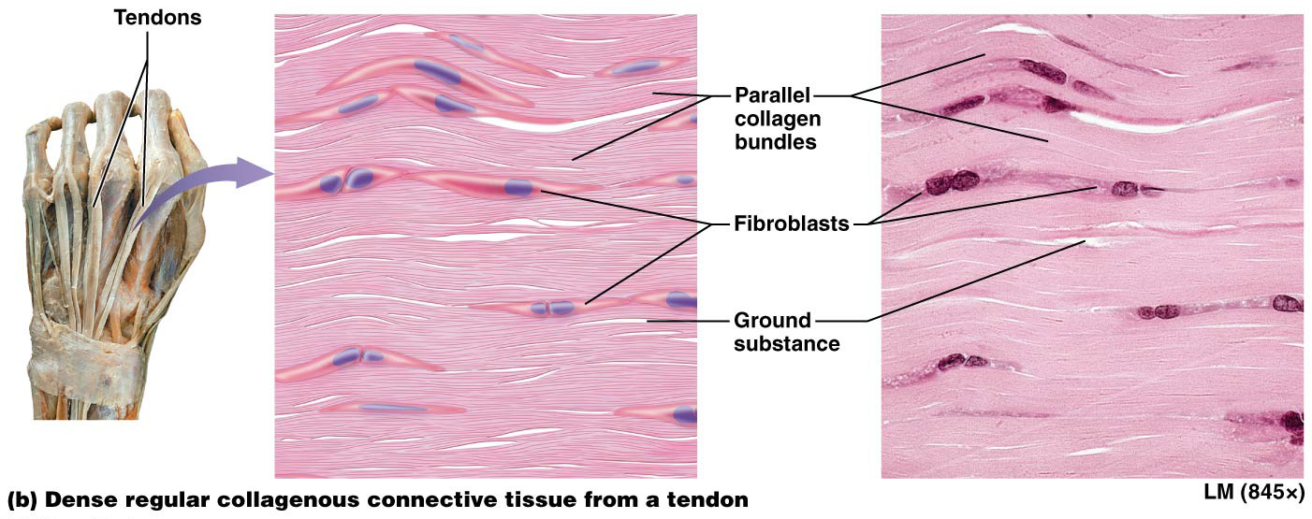
Connective Tissue Proper

Slide 72
Connective Tissue Proper
Four basic types of connective tissue proper (continued):
Dense connective tissue (continued):
Dense regular elastic connective tissue (elastic tissue)
Mostly parallel-oriented elastic fibers with randomly oriented collagen fibers
Found in walls of organs that stretch to perform their function, such as large blood vessels and certain ligaments

Slide 73
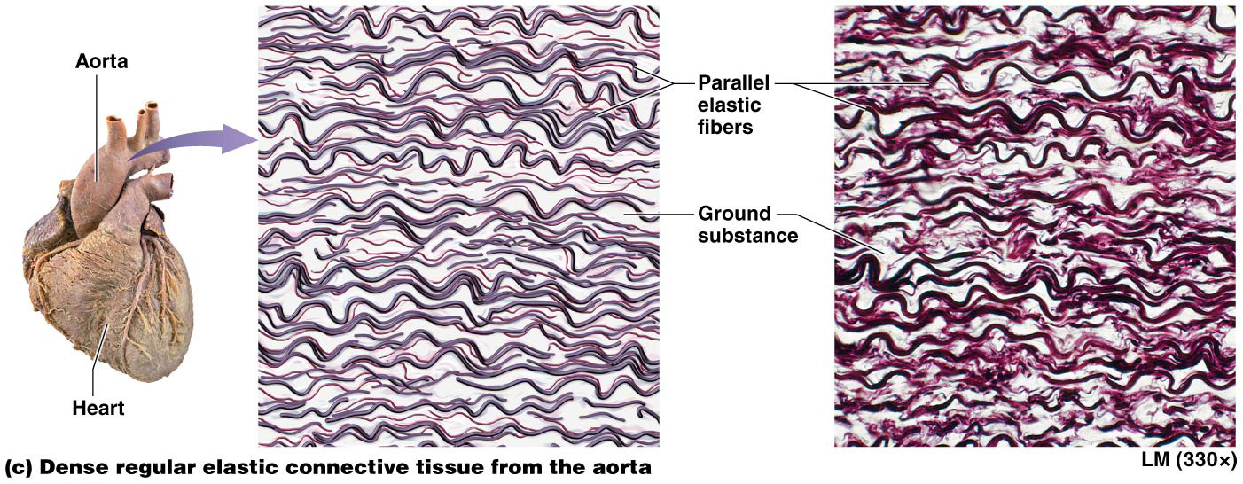
Connective Tissue Proper

Slide 74
Connective Tissue Proper
Note: arrangement of fibers in dense regular and irregular connective tissues is another example of the Structure-Function Core Principle

Slide 75
Connective Tissue Proper
Four basic types of connective tissue proper (continued):
Reticular tissue – composed mostly of reticular fibers produced by fibroblasts (reticular cells); form fine networks that can support small structures like blood and lymphatic vessels
Also found in lymph nodes and spleen; form weblike nets that trap old and foreign cells
Forms part of basement membrane that supports all epithelia and internal structure of liver and bone marrow

Slide 76
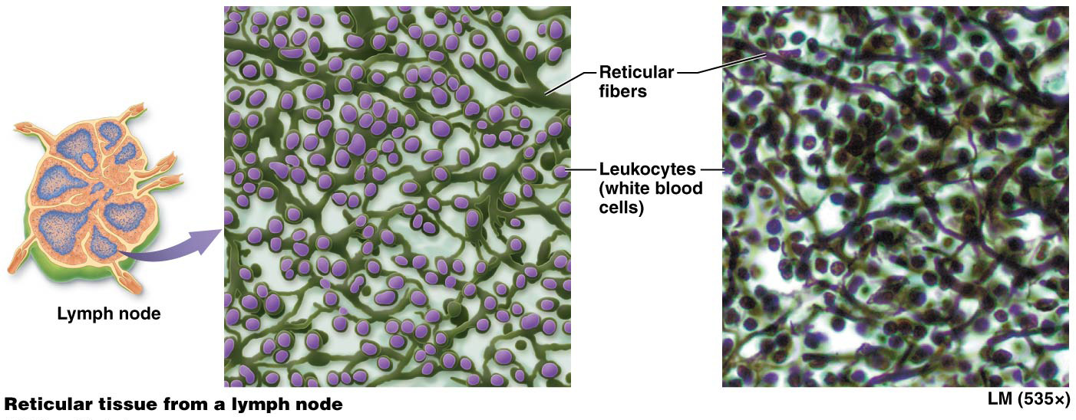
Connective Tissue Proper

Slide 77
Connective Tissue Proper
Four basic types of connective tissue proper (continued):
Adipose tissue (fat tissue) – consists of fat-storing adipocytes and surrounding fibroblasts and ECM; adipocytes can increase in size to point where fibroblasts and ECM are scarcely visible; functions include:
Fat storage (major energy reserve of body)
Insulation (retains warmth)
Shock absorption and protection

Slide 78
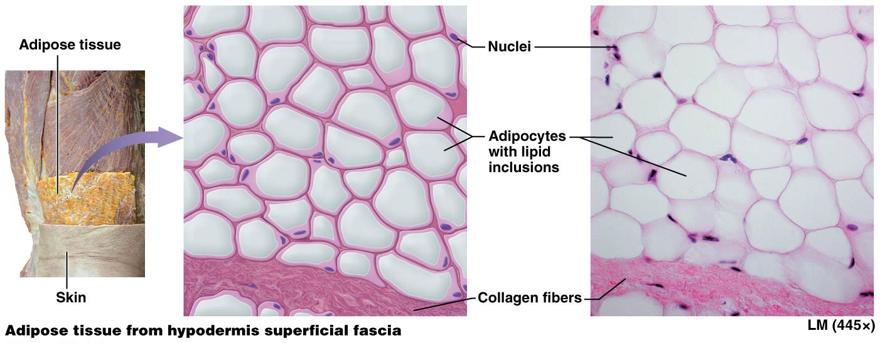
Connective Tissue Proper

Slide 79
Connective Tissue Proper
Four basic types of connective tissue proper (continued):
Adipose tissue (continued):
White adipose tissue – predominant fat tissue; appears white; consists of adipocytes with one large lipid inclusion in cytosol; found deep to skin as subcutaneous fat, and in abdomen, breasts, hips, buttocks, and thighs; white adipose surrounds heart and abdominal organs is known as visceral fat
Brown adipose tissue – less common; has a brown appearance due to numerous mitochondria in cytoplasm and a vast blood supply; contain multiple lipid inclusions, cells of brown adipose tissue can oxidize fatty acids about 20 times as fast as white adipose tissue, additional energy used to generate heat.

Slide 80
Adipose Tissue and Obesity
Obesity – condition of having excess adipose tissue in proportion to lean body mass; two forms:
Hypertrophic – lipid inclusions accumulate excess fatty acids and increase in size up to 4× normal; number of adipocytes remains unchanged
Hypercellular – generally severe; number of adipocytes increases; correlates with development of obesity in infancy or early childhood; adult adipocytes lack ability to divide to form new cells
Both forms increase risk for certain health problems; development of related disorders is complex; depends on distribution of adipose tissue and genetic factors

Slide 81
Specialized Connective Tissues
Specialized connective tissues have more specific functions and include the following three types of tissue:
Cartilage – found in joints between bones, in ear, nose, and segments of respiratory tract
Bone tissue (osseous tissue) – supports body; protects vital organs; provides attachments for muscles that allow for movement; stores calcium, and houses bone marrow (produces blood cells and stores fat)
Blood – unique connective tissue with a liquid ECM called plasma; consists of mostly water, dissolved solutes, and proteins

Slide 82
Specialized Connective Tissues
Specialized connective tissues (continued):
Cartilage – tough, flexible tissue; absorbs shock and resists tension, compression, and shearing forces; ECM consists of collagen and elastic fibers, glycosaminoglycans, and proteoglycans
Populated with two cell types:
Chondroblasts – immature cells that divide by mitosis and make most of ECM
Surround themselves in ECM gradually mature and become relatively inactive chondrocytes, which eventually inhabit small cavities in ECM called lacunae.

Slide 83
Specialized Connective Tissues
Specialized connective tissues (continued):
Cartilage (continued):
One of few connective tissues that is essentially avascular, few if any blood vessels course through cartilage itself, blood supply to tissue is mostly limited to outer sheath (perichondrium)
Oxygen and nutrients must diffuse from blood vessels in perichondrium through ECM to supply chondroblasts and chondrocytes; limits thickness of living cartilage

Slide 84
Specialized Connective Tissues
Specialized connective tissues (continued):
Cartilage can be further divided into three classes based on ECM composition:
Hyaline cartilage – most abundant cartilage
ECM mostly ground substance made of small bundles of fine collagen; give tissue a glassy appearance
Found on ends of bones in joints (articular cartilage), linking sternum to ribs, framing sections of respiratory tract, and in nose
Most of fetal skeleton begins as hyaline cartilage; replaced with bone during development

Slide 85
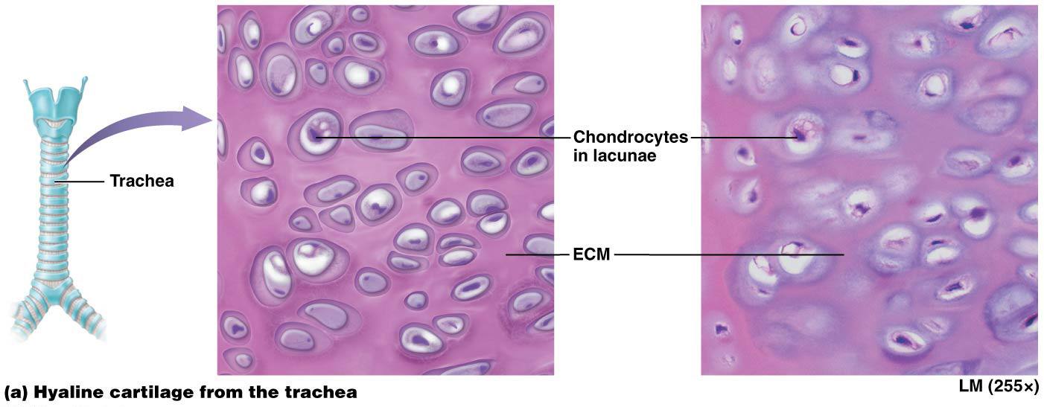
Specialized Connective Tissues

Slide 86
Specialized Connective Tissues
Specialized connective tissues (continued):
Cartilage can be further divided into three classes based on ECM composition (continued):
Fibrocartilage – filled with bundles of collagen fibers with little room for ground substance in ECM
Fibroblasts reside in tissue in addition to chondroblasts and chondrocytes; fill ECM with collagen and some elastic fibers
Tissue has great tensile strength with some degree of elasticity
Found in fibrous joints; intervertebral discs and forms articular discs that improve fit of bones in joints

Slide 87
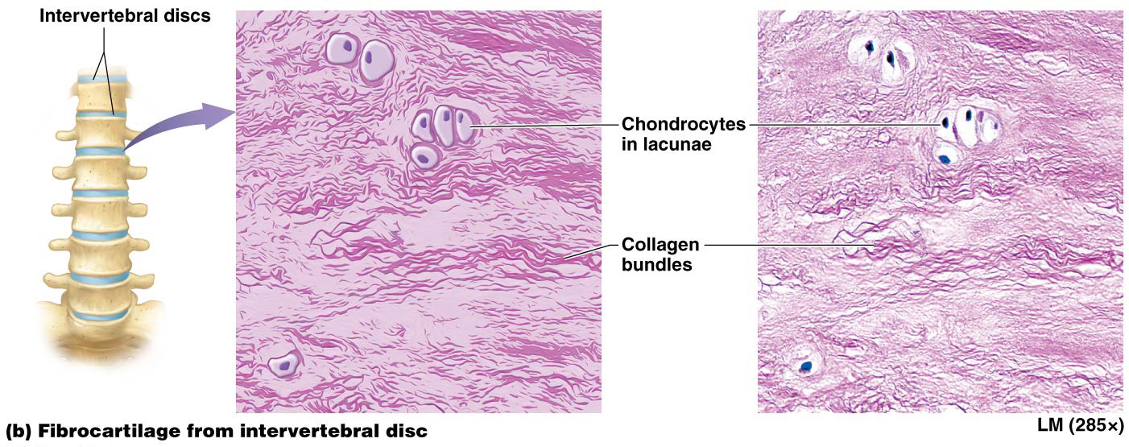
Specialized Connective Tissues

Slide 88
Specialized Connective Tissues
Specialized connective tissues (continued):
Cartilage can be further divided into three classes based on ECM composition (continued):
Elastic cartilage –ECM is filled with elastic fibers
Allows this tissue to vibrate
Found in a limited number of structures; external ear and parts of larynx (“voice box”)

Slide 89
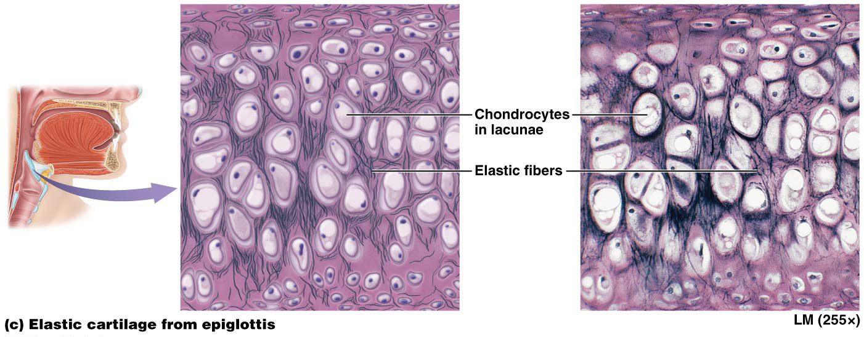
Specialized Connective Tissues

Slide 90
Specialized Connective Tissues
Specialized connective tissues (continued):
Bone
Bone ECM is composed of about 35% organic components consisting of collagen fibers and ground substance called osteoid; remaining 65% of ECM is inorganic portion composed of calcium phosphate crystals making bone one of hardest substances in body
Bone is a dynamic tissue capable of remodeling; bone deposition and resorption is constantly occurring in healthy bone; tension increases osteoblast activity and bone deposition; pressure can increase osteoclast activity and bone resorption

Slide 91
Specialized Connective Tissues
Specialized connective tissues (continued):
Bone (continued):
Osteoblasts
“Bone-builders” found on outer surface of bones; closely associated with dense irregular collagenous connective tissue covering called periosteum
Carry out process of bone deposition; synthesize and secrete organic portion of ECM and required chemicals for calcium to deposit within ECM.

Slide 92
Specialized Connective Tissues
Specialized connective tissues (continued):
Bone (continued):
Osteocytes – osteoblasts that have surrounded themselves with ECM in lacunae; mature bone cells, relatively inactive but continue to make and secrete substances required for bone maintenance
Osteoclasts – large, multinucleated bone destroyers; carry out process of bone resorption; secrete hydrogen ions and enzymes that break down components of ECM

Slide 93
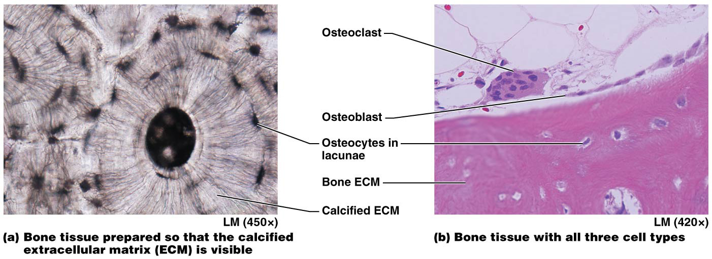
Specialized Connective Tissues

Slide 94
Specialized Connective Tissues
Specialized connective tissues (continued):
Blood – unique in that ECM is fluid
ECM of blood is called plasma.
Plasma proteins – not fibers, smaller proteins with a variety of functions including transport of substances and blood clotting
Erythrocytes (red blood cells) bind to and transport oxygen through body
Leukocytes (white blood cells) function in immunity
Platelets – cell fragments; major role in blood clotting

Slide 95
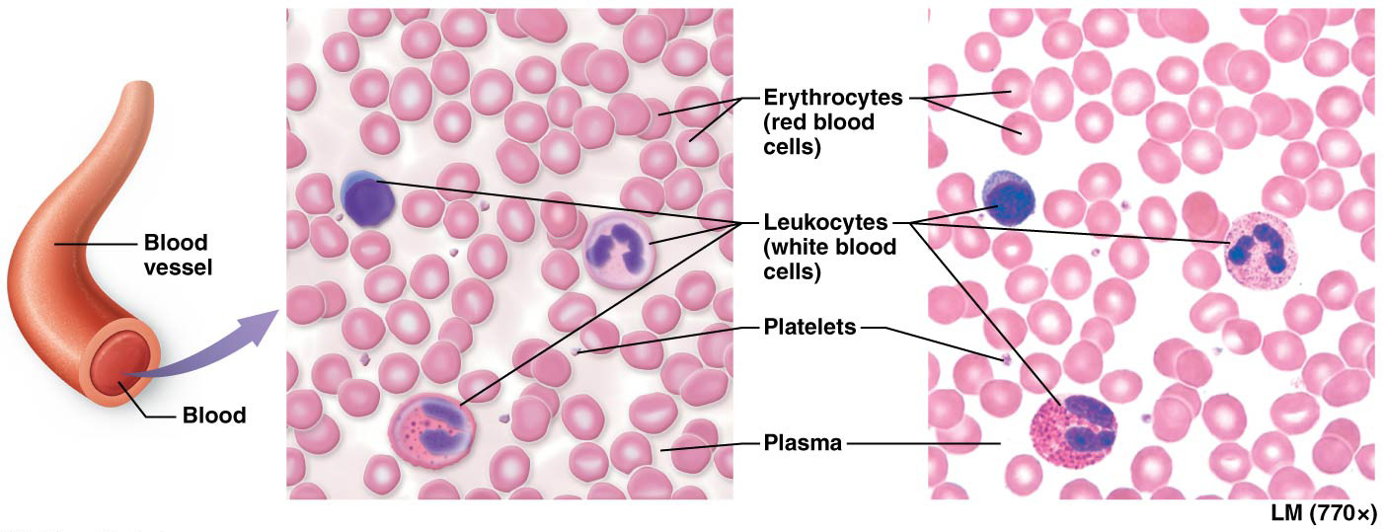
Specialized Connective Tissues

Slide 96
Osteoarthritis and Glucosamine Supplements
Osteoarthritis – caused by a variety of factors including: age, joint trauma, genetic disorders, and infection
Develops as hyaline cartilage lining joints degenerates
Leads to destruction of proteoglycan and collagen fibers; may continue until bone is exposed
Bones grind painfully together as motion occurs
Chondroblasts use glucosamine in synthesis of proteoglycans; further studies needed to determine if glucosamine supplementation can truly slow osteoarthritic degeneration of joints

Slide 97
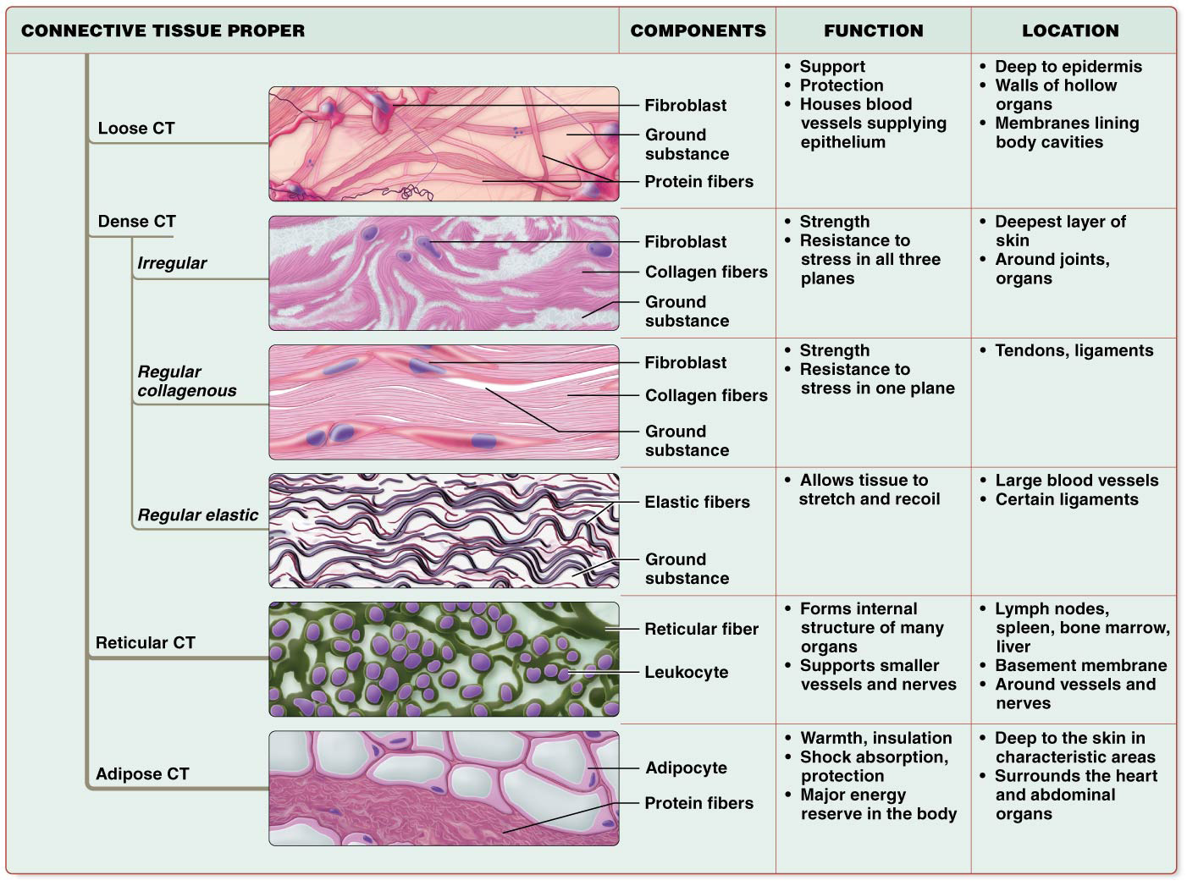
Connective Tissues

Slide 98
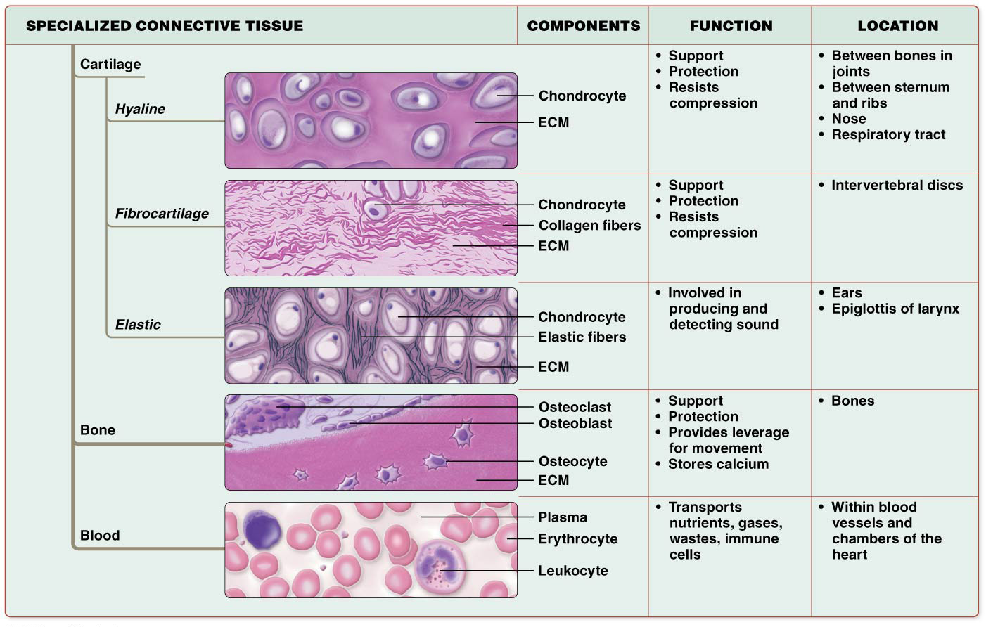
Connective Tissues

Slide 99
Module 4.4 Muscle Tissues

Slide 100
Muscle Tissues
Muscle tissues are specialized for contraction
Three muscle tissue types share common ability to turn chemical energy of ATP into mechanical energy of movement
Walking, breathing, heart beating, and propulsion of substances through hollow organs all result from contractions of different muscle tissues
Main component of muscle tissue is muscle cell or myocyte; excitable (ability to respond to electrical or chemical stimulation)

Slide 101
Components of Muscle Tissue
Two forms of muscle cells based on arrangement of myofilaments (protein bundles) in cytoplasm:
Striated muscle cells – myofilaments are organized in such a way that there are regions where the myofilaments overlap and regions where they don’t. This produces both dark and light areas called “bands”, appear striped or striated under microscope (striations)
Smooth muscle cells – have myofilaments arranged in irregular bundles throughout cytoplasm, NO STRIATIONS visible
Endomysium – small amount of ECM that surrounds each muscle cell; helps to hold muscle cells together in tissue

Slide 102
Types of Muscle Tissue
There are three types of muscle tissue that feature different structural and functional characteristics:
Skeletal muscle
Cardiac muscle
Smooth muscle
Skeletal and cardiac muscle tissue are striated while smooth muscle tissue is not

Slide 103
Types of Muscle Tissue
Skeletal muscle tissue – found mostly attached to skeleton where its contraction produces body movement:
Skeletal muscle must be stimulated by the nervous system to contract; generally under voluntary or conscious control
Most skeletal muscle cells are long, extending nearly length of whole muscle; often called muscle fibers
Form by fusion of embryonic myoblasts resulting in cells with more than one nucleus (multinucleate); useful for nearly constant synthesis of enzymes, structural proteins, and contractile proteins

Slide 104
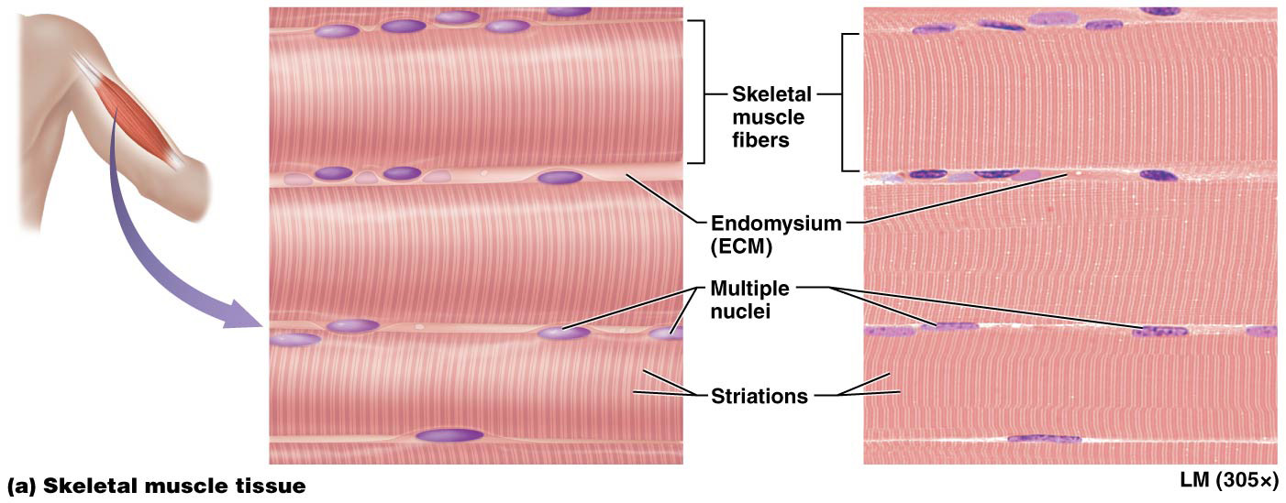
Components of Muscle Tissue

Slide 105
Types of Muscle Tissue
Cardiac muscle tissue – found only in heart; composed of cardiac muscle cells; although these cells are striated like skeletal muscle cell, many differences can be seen:
Cardiac muscle tissue is involuntary; brain does not have conscious control over its contraction
Cells are short, branched, and usually have only one nucleus (uninucleate)
Intercalated disc – dark line separating individual cardiac muscle cells; not seen in skeletal muscle; contain gap junctions and modified tight junctions; allow heart muscle to contract as a unit

Slide 106
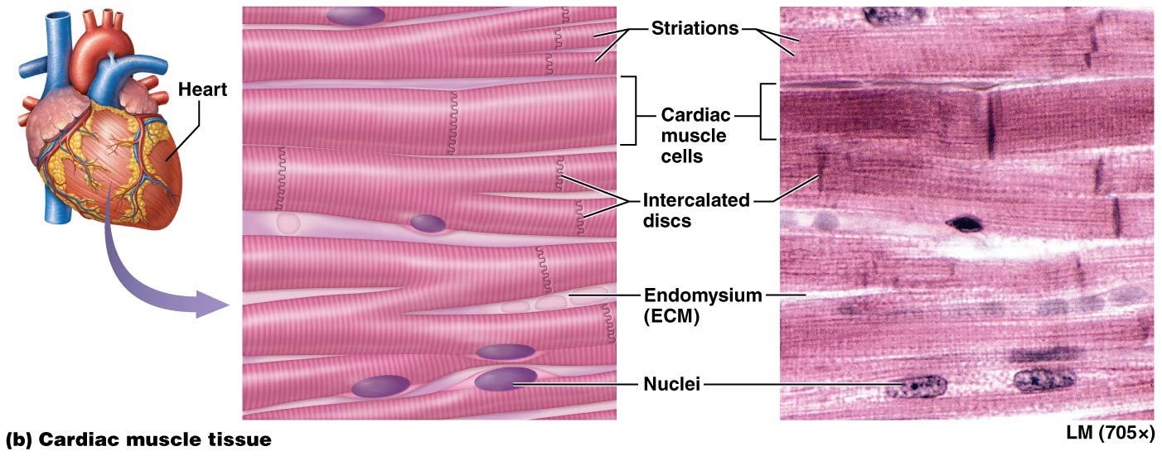
Types of Muscle Tissue

Slide 107
Types of Muscle Tissue
Smooth muscle tissue – consists of smooth muscle cells whose contractions are involuntary like cardiac muscle cells:
Found in walls of nearly every hollow organ, blood vessels, eyes, skin, and ducts of certain glands
Flattened cells with one centrally located ovoid nucleus
Most smooth muscle cells contain gap junctions in their plasma membranes that link them with other smooth muscle cells.

Slide 108
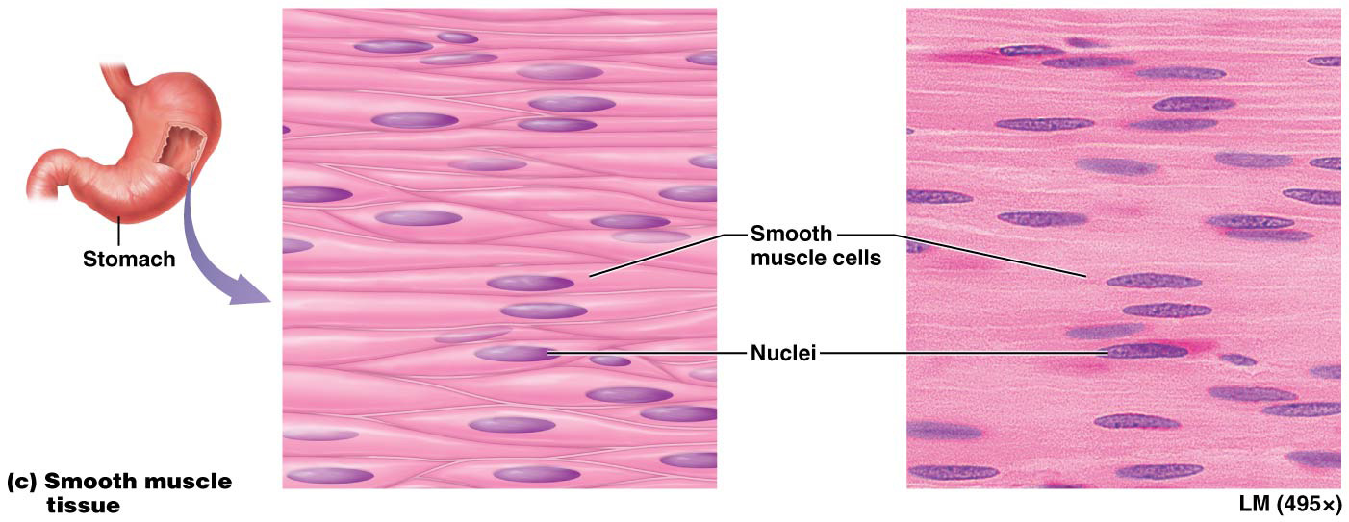
Types of Muscle Tissue

Slide 109
Module 4.5 Nervous Tissues

Slide 110
Nervous Tissues
Nervous tissue makes up majority of brain, spinal cord, and nerves; composed of two main cell types and their surrounding ECM
Neurons – capable of sending and receiving messages
Neuroglial cells – perform various functions that support neurons
ECM is unique; made up of ground substance with unique proteoglycans not found in other tissues of body; contains few protein fibers

Slide 111
Neurons
Neurons (like muscle cells) are excitable cells; most mature neurons are amitotic (do not undergo mitosis); Neurons contain three main components:
Cell body or soma – biosynthetic center of neuron where nucleus and most organelles are found
Solitary axon extends from one end of soma; responsible for moving a nerve impulse from soma to a target cell (may be another neuron, muscle cell, or gland); axons illustrate Cell-Cell Communication Core Principle
Dendrites – other extensions protruding from soma; typically short with multiple branches; receive impulses from axons of neighboring neurons; deliver impulses to soma

Slide 112
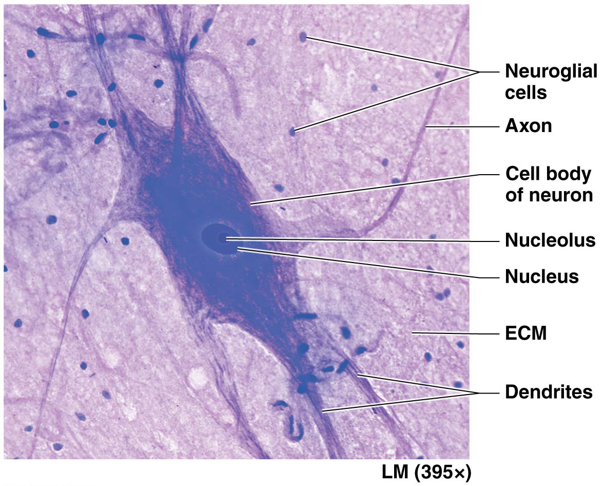
Neurons

Slide 113
Neuroglial Cells
Neuroglial cells – much smaller cells surrounding neurons; supportive cells:
Functions:
Anchoring neurons and blood vessels in place
Monitoring composition of extracellular fluid
Speeding up rate of nerve impulse transmission
Circulating fluid surrounding brain and spinal cord
Able to divide by mitosis (unlike neurons)

Slide 114
Concept Boost: But It All Looks Pink! Part 2
In Examples A, B, and C:
Identify the cells and ECM (review basics from Concept Boost Part 1 as needed)
Notice how the cells are shaped and arranged:
Are the cells packed tightly together, or are they widely spaced?
Do they form a continuous sheet, as in epithelial tissue—or do they seem to be surrounded by ECM, as in connective tissue?
Are the cells all identical, or are there clearly different types?
Do the cells have “arms” extending from a central body?

Slide 115
Concept Boost: But It All Looks Pink! Part 2
Notice how the ECM is arranged:
Is the ECM confined to one specific part of the tissue, or is it spaced evenly between the cells?
Does ground substance predominate, or are protein fibers the main elements?
What types of protein fibers can you see?
Determine the class of tissue. Using your analysis in the preceding steps, now you are ready to identify the class of tissue (answers are in text)
Notes:
Answers: A: loose connective tissue, B: skeletal muscle tissue, C: simple columnar epithelium

Slide 116
Concept Boost: But It All Looks Pink! Part 2

Slide 117
Module 4.6 Putting It All Together: The Big Picture of Tissues in Organs

Slide 118
The Big Picture of Tissues in Organs
Two or more tissues that combine structurally and functionally form an organ:
Example,
Skeletal muscle composed of 2 main tissues: skeletal muscle tissue and dense irregular collagenous connective tissue
Each has distinct functional role; skeletal muscle tissue allows it to contract; surrounding connective tissue binds muscle cells together and supports them so that their activity produces a contraction of whole organ

Slide 119
The Big Picture of Tissues in Organs
More complex organ; consists of many different tissue types – trachea
Hollow organ; provides passageway through which air passes on its way into/out of lungs
(next slide) – illustration of tissues of trachea from superficial to deep with list of their main functions
Each tissue layer serves an important role in overall function of trachea: conducting air

Slide 120
The Big Picture of Tissues in Organs

Slide 121
Module 4.7 Membranes

Slide 122
Membranes
Membranes – thin sheets of one or more tissues that line a body surface or cavity:
Most consist of a superficial epithelial layer resting on a connective tissue layer; sometimes contains smooth muscle
Functions: anchor organs in place, serve as barriers, function in immunity, and secrete various substances
True membranes – include serous and synovial membranes; fit above structural and functional definitions
Membrane-like structures – include mucous and cutaneous membranes; don’t fit above structural and functional definitions but perform many of same functions

Slide 123
True Membranes
True membranes do not open to outside of body; two examples:
Serous membranes or serosae – line pericardial, peritoneal, and pleural body cavities; structural and functional features:
Consist of a mesothelium (layer of simple squamous epithelium) associated basement membrane, and a layer of loose connective tissue

Slide 124
True Membranes
True membranes do not open to outside of body; two examples (continued):
Serous membranes or serosae (continued):
Fold over themselves giving appearance of two layers; outer parietal layer contact with body wall; inner visceral layer covers organ within body cavity
Mesothelial cells produce a thin, watery serous fluid; fills space between parietal and visceral layers; reduces friction created when organs (like heart or lungs) move within respective membranes

Slide 125
True Membranes

Slide 126
True Membranes
True membranes (continued):
Synovial membranes – line cavities surrounding freely moveable joints like knee or shoulder; made up of two connective tissue layers without a layer of epithelial cells:
Outer layer – usually composed of a mixture of loose and dense irregular connective tissue
Inner layer – synoviocytes (modified fibroblasts) secrete synovial fluid, a watery, slippery fluid; primarily functions to lubricate joint

Slide 127
True Membranes

Slide 128
Membrane-like Structures
Cutaneous membranes and mucous membranes are membrane-like structures (do not fit full description of a true membrane):
Mucous Membranes (mucosae) line all body passages as components of walls of hollow organs that open to outside of body; includes respiratory passages, mouth, nasal cavity, digestive tract, and male and female reproductive tracts:
Consist of a layer of epithelium and its basement membrane (layer of connective tissue called the lamina propria) and occasionally a thin layer of smooth muscle
Contain glands with goblet cells; produce and secrete mucus; serves several functions, primarily protection

Slide 129
Membrane-like Structures

Slide 130
Membrane-like Structures
Cutaneous membrane – refers to skin; largest organ of body; consists of:
Outer layer of keratinized stratified squamous epithelium called epidermis; tough, continuous protective surface that protects structures deep to it
Dermis
Layer of loose connective tissue is found beneath epidermis plus even deeper layer of dense irregular connective tissue
Home to many blood vessels; provide a means for oxygen and nutrients to diffuse into avascular epidermis

Slide 131
Membrane-like Structures

Slide 132
Friction Rubs
Certain viral or bacterial infection can cause inflammation of serous membranes of pleural and pericardial cavities
Serous fluid for lubrication becomes inadequate to reduce friction; layers rub together as organs contract and expand
Resulting grating sound is termed a friction rub; can be heard with stethoscope
Cause chest pain; worsens with inhalation, body movement, and swallowing
Usually resolve with treatment of underlying condition

Slide 133
Module 4.7 Tissue Repair

Slide 134
Tissue Repair
Tissue repair – process of wound healing; dead and damaged cells are removed and remaining gap is filled for maintenance of homeostasis; process differs with different tissues:
Some tissues are capable of regeneration where dead and damaged cells are replaced with cells of same type; when regeneration is complete, the function of the tissue is in general completely restored

Slide 135
Tissue Repair

Slide 136
Tissue Repair
Other tissues are not capable of full regeneration; fibroblasts fill in gaps left from injury by a process called fibrosis:
Fibroblasts divide by mitosis and produce collagen that fills in gap and tissue loses some level of functional ability
End result of fibrosis is development of scar tissue a type of dense irregular connective tissue

Slide 137
Tissue Repair

Slide 138
Capacity for Tissue Repair
The extent to which regeneration or fibrosis takes place in a particular tissue type is largely determined by the degree to which the cells in that tissue can undergo mitosis.
Epithelial tissues typically undergo regeneration:
Skin and digestive tract lining are subjected to a great deal of stress; must have a mechanism for replacing dead, damaged or worn out cells; Skin & Digestive tract contain immature cells called stem cells that divide to continually replace dead, injured, or worn out epithelial cells.
Other epithelial tissues (like liver and blood vessels) – mature cells divide to replace those that have been lost.

Slide 139
Capacity for Tissue Repair
Capacity of specific tissues for tissue repair (continued):
Most connective tissues heal by regeneration:
Connective tissue proper, bone, and blood regenerate easily through division of immature cells
Cartilage is exception as cells have a limited capacity to divide; this tissue often heals by fibrosis

Slide 140
Capacity for Tissue Repair
Capacity of specific tissues for tissue repair (continued):
Smooth muscle tissue usually regenerates; cardiac and skeletal muscle tissues generally heal by fibrosis
Smooth muscle cells largely retain ability to undergo mitosis; heal by regeneration, HOWEVER…..
Mature skeletal muscle fibers and cardiac muscle cells cannot undergo mitosis due to their large size and complicated cellular architecture.
Satellite cells in skeletal muscle tissue can divide and become skeletal muscle fibers, allowing a limited degree of regeneration.
No satellite cells associated with cardiac muscle tissue; injuries are healed by fibrosis

Slide 141
Capacity for Tissue Repair
Capacity of specific tissues for tissue repair (continued):
Nervous tissue generally undergoes fibrosis. Neurons are generally unable to undergo mitosis
In general, damaged neurons in brain and spinal cord are replaced by neuroglial cells (remember they can divide) and produce a scar.
If the cell body of a neuron is intact and only the axon is damaged, there is some chance that the axon will regenerate, depending on location and nature of damage.

Slide 142
Other Factors Affecting Tissue Repair
Other factors affecting tissue repair (beside ability to undergo mitosis) include nutrition and blood supply.
Tissue repair involves production of proteins, such as collagen; requires an adequate supply of amino acids to proceed
Vitamin C is needed by fibroblasts to produce collagen
Blood supply to injured region must be adequate to deliver much-needed oxygen and nutrients and cells of immune system needed for tissue repair

Slide 143
Tissue Repair
3 Important Determinants of Tissue Repair
Ability of cells to undergo mitosis
Nutrition-Adequate Protein (Amino Acid) intake and sufficient intake of Vitamin C (needed by fibroblasts to produce collagen)
Blood Supply-Blood brings in oxygen, nutrients, and cells of immune system

