Slide 1
Human Anatomy & Physiology
Second Edition
Chapter 02
The Chemistry of Life
PowerPoint® Lectures created by Suzanne Pundt, University of Texas at Tyler
Copyright © 2019, 2016 Pearson Education, Inc. All Rights Reserved

Slide 2
Module 2.1 Atoms and Elements

Slide 3
Matter
Matter – anything that has mass and occupies space; exists in three states: solid, liquid, or gas
Chemistry – study of matter and its interactions

Slide 4
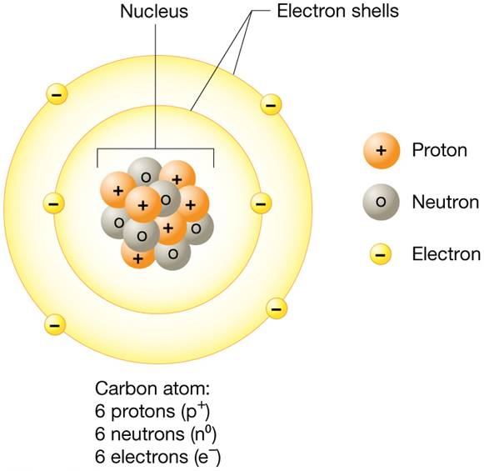
Atoms and Atomic Structure (1 of 3)
Atom – smallest unit of matter that retains original properties
Made up of even smaller structures called subatomic particles

Slide 5
Atoms and Atomic Structure (2 of 3)
Subatomic particles:
Protons (p⁺) – in central core of atom (atomic nucleus); positively charged
Neutrons (n⁰) – in atomic nucleus; slightly larger than protons; no charge
Electrons (e⁻) – outside atomic nucleus; negatively charged
Atoms are electrically neutral – no charge; number of protons and electrons are equal; cancel each other’s charge; neutron number does not have to equal proton number

Slide 6
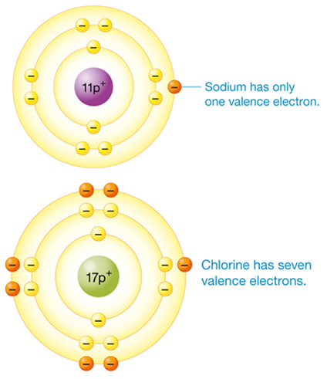
Atoms and Atomic Structure (3 of 3)
Electron shells – regions surrounding atomic nucleus where electrons exist; each holds certain number of electrons:
1st shell (closest to nucleus) – 2 electrons
2nd shell – 8 electrons
3rd shell – 18 electrons; “satisfied” with 8
Some atoms may have more than 3 shells

Slide 7
Elements in the Periodic Table and the Human Body (1 of 3)
Atomic number – number of protons in atomic nucleus; defines every element:
Element – substance that cannot be broken down into simpler substance by chemical means
Each element is made of atoms with same number of protons

Slide 8
Elements in the Periodic Table and the Human Body (2 of 3)
Periodic table of elements – lists elements by increasing atomic numbers:
Groups – organized by certain properties
Chemical symbol – represents each element

Slide 9
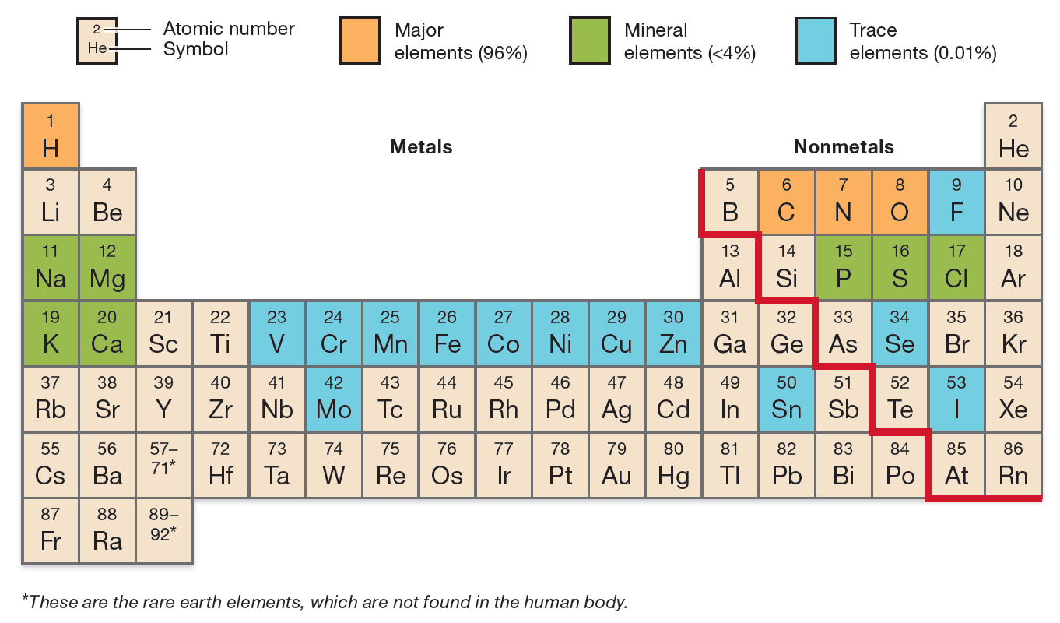
The Periodic Table

Slide 10
Elements in the Periodic Table and the Human Body (3 of 3)
Human body is made up of four major elements:
Hydrogen
Oxygen
Carbon
Nitrogen
Also 7 mineral elements and 13 trace elements

Slide 11
Isotopes and Radioactivity
Mass number – equal to sum of all protons and neutrons in atomic nucleus
Isotope – atom with same atomic number (number of protons) but different mass number (number of neutrons)
Radioisotopes – unstable isotopes; high energy or radiation released by radioactive decay; allows isotope to assume more stable form

Slide 12
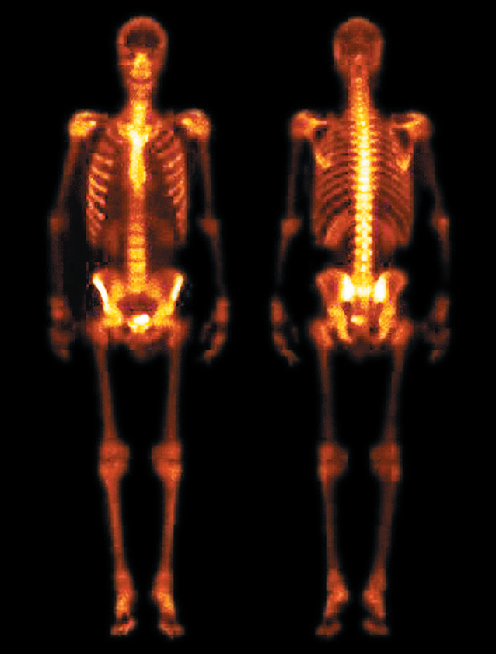
Nuclear Medicine
Common applications of radioisotopes:
Cancer radiation therapy – radiation damages structure of cancer cells; interferes with functions
Radiotracers – injected into patient; radiation they produce is detected by a camera; image analyzed by computer; shows size, shape, and activity of organs and cells
Treatment of thyroid disorders – high doses of iodine-131 treat overactive or cancerous thyroid tissue; radioisotope accumulates and damages cells

Slide 13
Module 2.2 Matter Combined: Mixtures and Chemical Bonds

Slide 14
Matter Combined
Matter can be combined physically to form mixtures – atoms of two or more elements physically intermixed without changing chemical nature of atoms
Three basic types of mixtures: suspensions, colloids, and solutions (Figure 2.3)

Slide 15
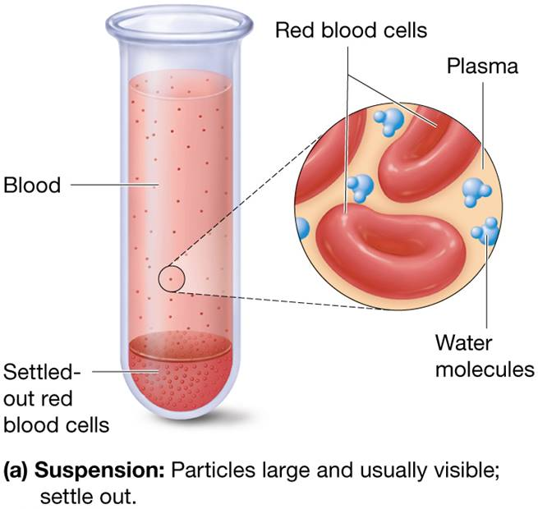
Mixtures (1 of 3)
Suspension – mixture containing two or more components
Large, unevenly distributed particles
Will settle out when left undisturbed

Slide 16
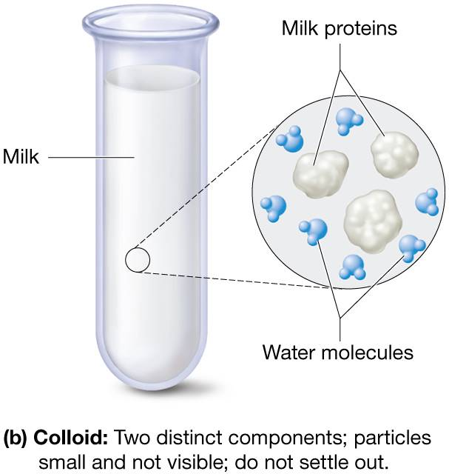
Mixtures (2 of 3)
Colloids – two or more components
Small, evenly distributed particles
Will not settle out

Slide 17
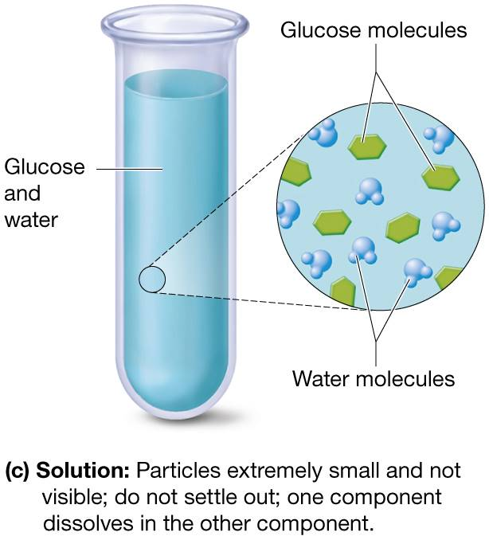
Mixtures (3 of 3)
Solutions – two or more components; extremely small, evenly distributed particles; will not settle out:
Solute – substance dissolved
Solvent – substance that dissolves solute
Figure 2.3c The three types of mixtures.

Slide 18
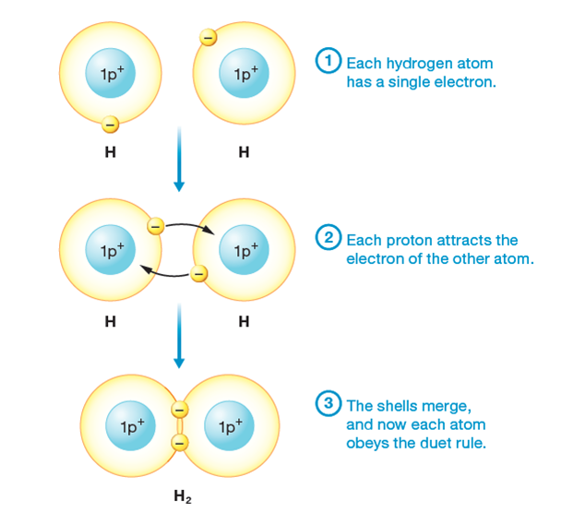
Chemical Bonds (1 of 4)
Matter can be combined chemically when atoms are combined by chemical bonds
Chemical bond is not physical structure; energy relationship or attractive force between atoms
Molecule – formed by chemical bonding between two or more atoms of same element
Compound – formed when two or more atoms from different elements combine by chemical bonding
Figure 2.5 Formation of a covalent bond.

Slide 19
Chemical Bonds (2 of 4)
Table 2.1 Electron Sharing in Covalent Bonds.

Slide 20
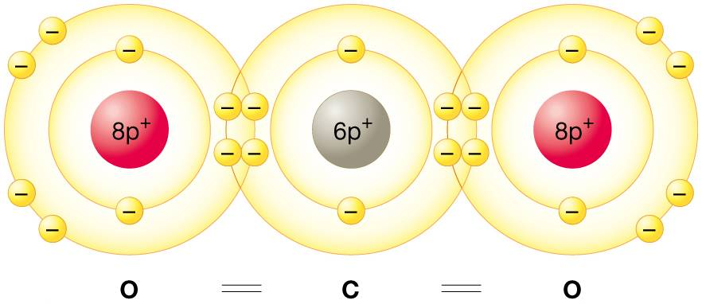
Chemical Bonds (3 of 4)
Chemical bonds are formed when valence electrons (outermost shell) of atoms interact
Valence electrons determine how an atom interacts with other atoms; whether it will form bonds with specific atom
Octet rule – atom is most stable when 8 electrons in valence shell (CO₂)

Slide 21
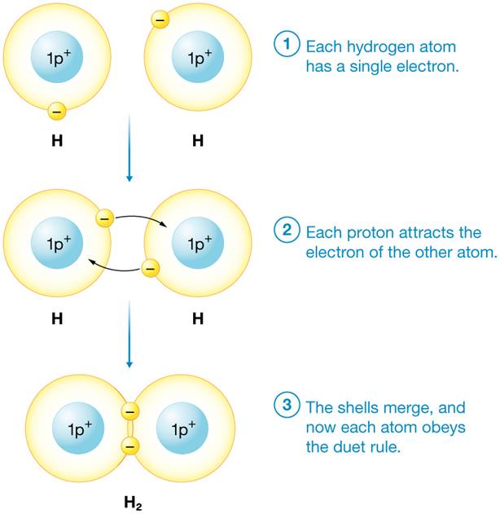
Chemical Bonds (4 of 4)
Duet rule (atoms with 5 or fewer electrons) – atom is most stable when valence electron shell holds 2 electrons
Figure 2.5 Formation of a covalent bond.

Slide 22
Ions and Ionic Bonds
Ionic bond – electrons are transferred from metal atom to nonmetal atom; results in formation of ions: cations and anions (Figure 2.4)
Cation – positively charged ion; metal loses one or more electrons
Anion – negatively charged ion; nonmetal gains one or more electrons
Attraction between opposite charges bonds ions to one another forming salt

Slide 23
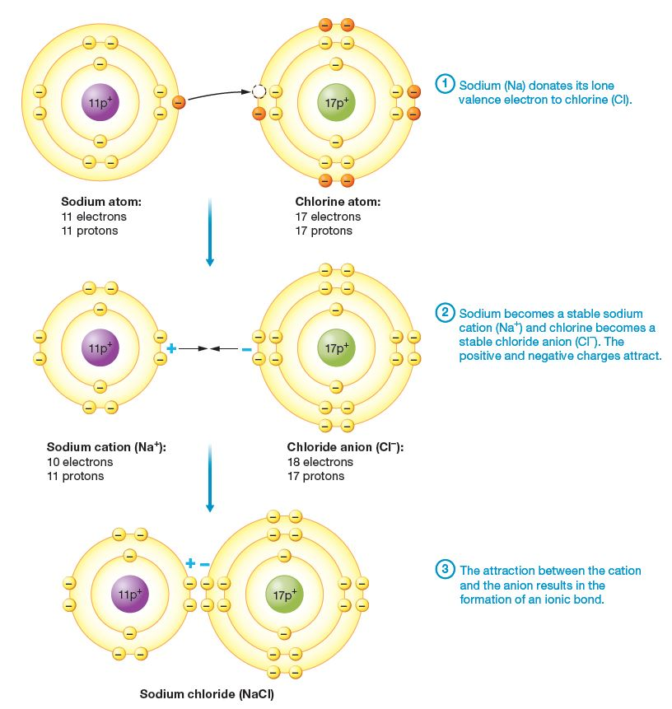
Ionic Bonds
Figure 2.4 Formation of an ionic bond.

Slide 24
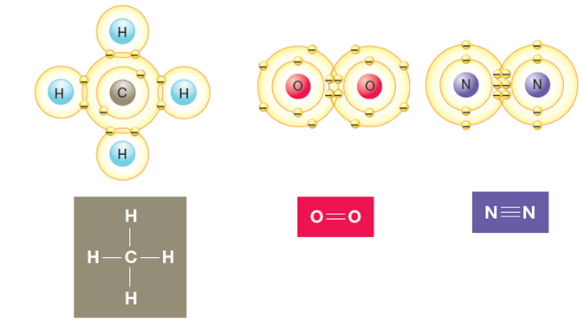
Covalent Bonds (1 of 2)
Covalent bonds – strongest bond; two or more nonmetals share electrons (Figures 2.5, 2.6; Table 2.1)
Two atoms can share one (single bond), two (double bond), or three (triple bond) electron pairs:
Table 2.1 Electron Sharing in Covalent Bonds.

Slide 25
Covalent Bonds (2 of 2)
Protons attract electrons; known as electronegativity:
Element’s electronegativity increases from bottom left to upper right of periodic table; fluorine (F) is most electronegative element
Electronegative elements strongly attract electrons; pull away from less electronegative elements

Slide 26
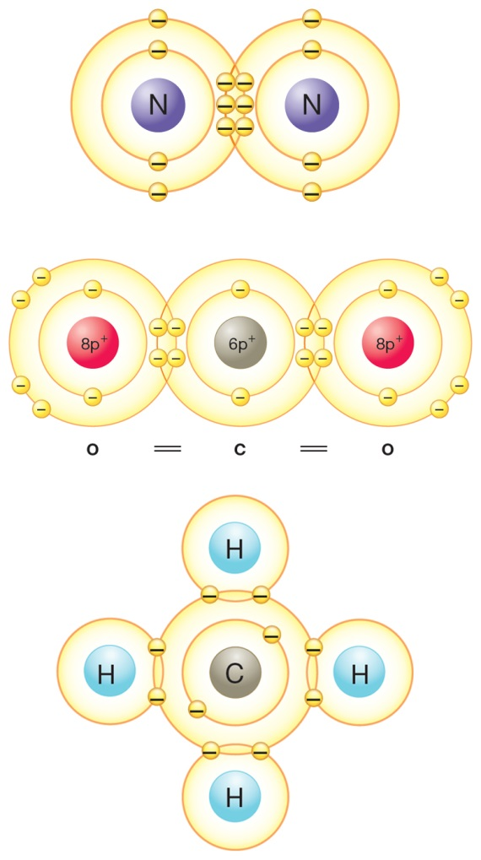
Nonpolar Covalent Bonds (1 of 2)
Nonpolar covalent bonds – two nonmetals in molecule with similar or identical ectronegativities pull with equal force; share electrons equally (Figure 2.6a)
Nonpolar molecules occur in 3 situations:
Atoms sharing electrons are same element
Arrangement of atoms makes one atom unable to pull more strongly than another atom (CO₂)
Bond is between carbon and hydrogen

Slide 27
Nonpolar Covalent Bonds (2 of 2)
Figure 2.6a Nonpolar vs. polar covalent bonds.

Slide 28
Polar Covalent Bonds (1 of 2)
Polar covalent bonds – nonmetals with different electronegativities share electrons unequally; form polar molecules (Figure 2.6b)
Atom with higher electronegativity becomes partially negative (δ−); pulls shared electrons close to itself
Atom with lower electronegativity becomes partially positive (δ+); shared electrons are pulled toward other atom
Dipoles – polar molecules with partially positive and partially negative ends

Slide 29
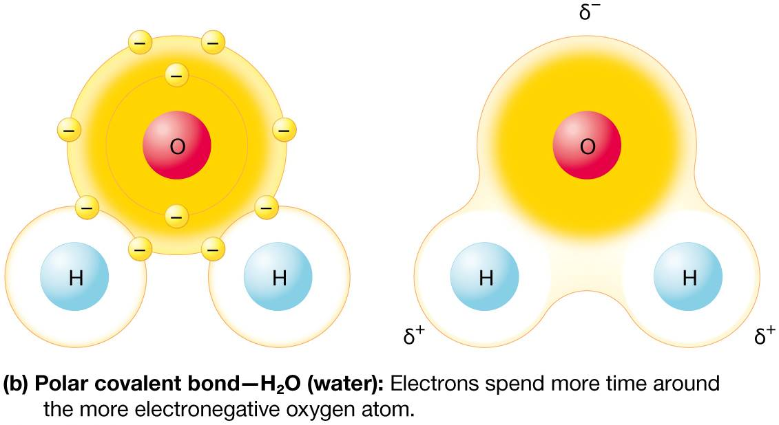
Polar Covalent Bonds (2 of 2)
Figure 2.6b Nonpolar vs. polar covalent bonds.

Slide 30
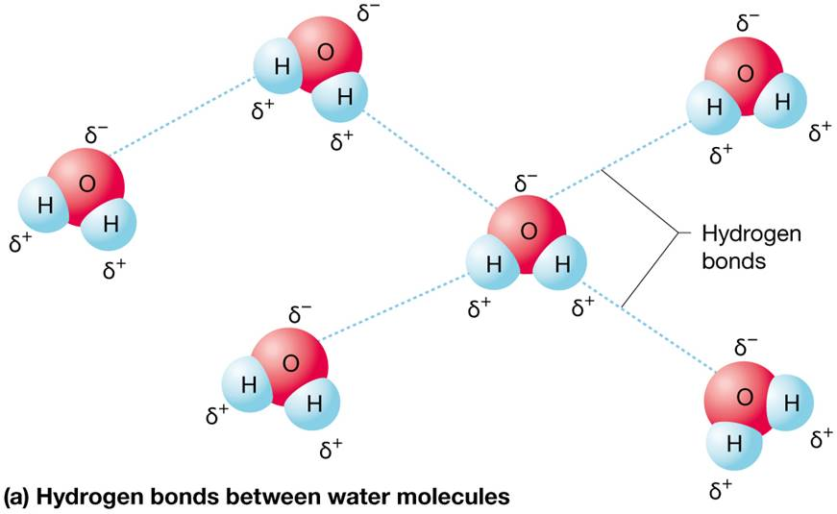
Hydrogen Bonds (1 of 2)
Hydrogen bonds – weak attractions between partially positive hydrogen atoms and partially negative nonmetal atoms in polar covalent molecules.
Responsible for key property of water – surface tension
Figure 2.7a Hydrogen bonding and surface tension between water molecules.

Slide 31
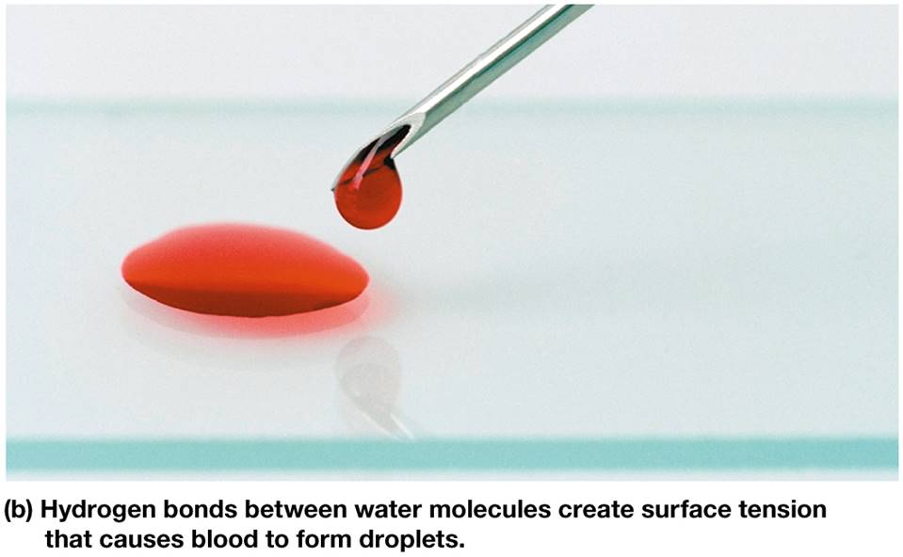
Hydrogen Bonds (2 of 2)
Polar water molecules are more strongly attracted to one another than to nonpolar air molecules at surface
Figure 2.7b Hydrogen bonding and surface tension between water molecules.

Slide 32
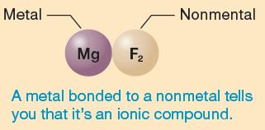
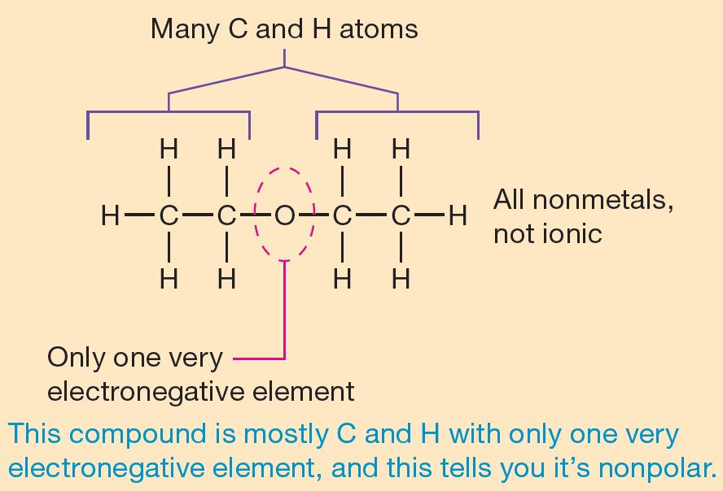
Concept Boost: Determining the Type of Bonds in a Molecule (1 of 2)
Basic “rules”:
A compound is ionic when: the compound contains both a metal and a nonmetal.
If the molecule or compound contains two or more nonmetals; bond is covalent (hydrogen behaves like nonmetal):
Molecule contains two identical nonmetals; nonpolar covalent (e.g., O₂)
Molecule contains only (or primarily) carbon and hydrogen; nonpolar covalent (e.g., CH₄)

Slide 33
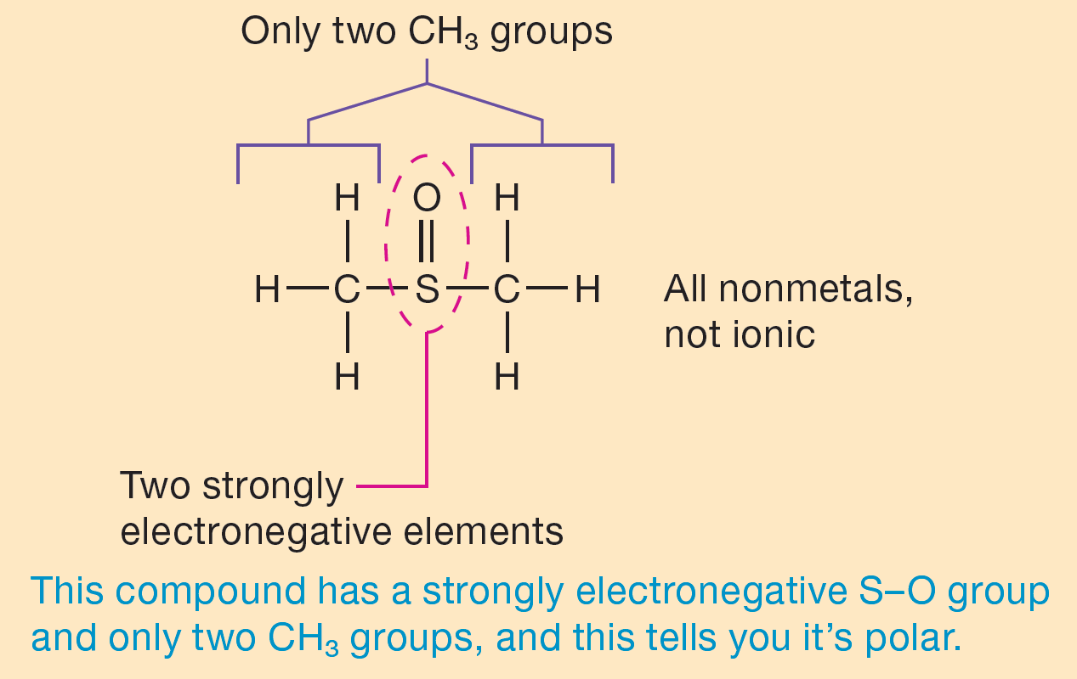
Concept Boost: Determining the Type of Bonds in a Molecule (2 of 2)
Basic “rules” (continued):
A compound is polar when: The molecule contains two nonmetals of significantly different electronegativities, then polar covalent (hydrogen and carbon have low electronegativities; oxygen, nitrogen, and phosphorus have high electronegativities); compounds with proportionally high number of C-O$,$C-N$,$P-O$,$H-N$,$C-Cl$,$ and H-O bonds are polar (e.g., C₅H₁₀O₅$,$CH₃Cl, H₃PO₄)

Slide 34
Concept Boost: Determining the Type of Bonds in a Molecule
Remember that these rules don’t apply to every situation, but in general, they are a good place to start.

Slide 35
Module 2.3 Chemical Reactions

Slide 36
Chemical Notation (1 of 2)
Chemical reaction – when chemical bond is formed, broken, or rearranged, or electrons are transferred between two or more atoms (or molecules)
Chemical notation – series of symbols and abbreviations; demonstrates what occurs in a reaction; chemical equation (basic form of chemical notation) has two parts:
Reactants (left side of equation) – starting ingredients; will undergo reaction
Products (right side of equation) – results of chemical reaction

Slide 37
Chemical Notation (2 of 2)
Reversible reactions – proceed in either direction; denoted by two arrows in opposite directions
Irreversible reactions – proceed from left to right; denoted by a single arrow

Slide 38
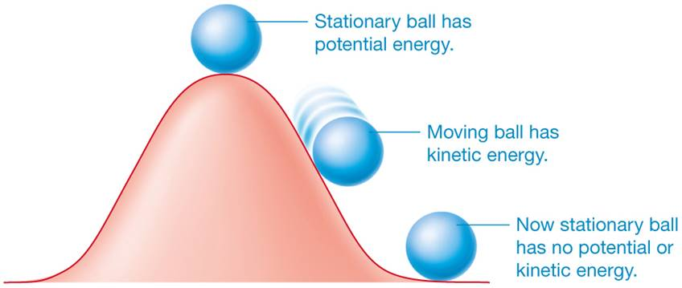
Energy and Chemical Reactions (1 of 3)
Energy – capacity to do work or put matter into motion or fuel chemical reactions; two general forms:
Potential energy – stored; can be released later to do work
Kinetic energy – potential energy; has been released or set in motion to perform work; all atoms have kinetic energy (in constant motion); faster movement = greater energy

Slide 39
Energy and Chemical Reactions (2 of 3)
Three forms of energy in human body: chemical, electrical, and mechanical, each may be potential or kinetic depending on location or process
Chemical energy – in bonds between atoms; drives nearly all chemical processes
Electrical energy – generated by movement of charged particles or ions
Mechanical energy – energy directly transferred from one object to another

Slide 40
Energy and Chemical Reactions (3 of 3)
Energy, inherent in all chemical bonds, must be invested any time chemical reaction occurs:
Endergonic reactions – require input of energy from another source; products contain more energy than reactants (energy invested so reaction could proceed)
Exergonic reactions – release excess energy; products have less energy than reactants

Slide 41
Homeostasis and Types of Chemical Reactions (1 of 5)
Three fundamental processes maintain homeostasis (breaking down molecules, converting energy in food to usable form, and building new molecules); carried out by three types of chemical reactions:
Catabolic reactions (decomposition reactions)
Exchange reactions
Anabolic reactions (synthesis reactions)

Slide 42
Homeostasis and Types of Chemical Reactions (2 of 5)
Catabolic reactions (decomposition reactions) – large substance is broken down into smaller substances
General chemical notation
Usually exergonic; chemical bonds are broken

Slide 43
Homeostasis and Types of Chemical Reactions (3 of 5)
Exchange reactions – one or more atoms from reactants are exchanged
General chemical notation

Slide 44
Homeostasis and Types of Chemical Reactions (4 of 5)
Oxidation-reduction reactions (redox reactions) – special kind of exchange reaction; electrons and energy are exchanged instead of atoms
Oxidized – reactant that loses electrons
Reduced – reactant that gains electrons
Redox reactions are usually exergonic reactions; release large amounts of energy
OIL RIG
(Oxidation is Loss, Reduction is gain)

Slide 45
Homeostasis and Types of Chemical Reactions (5 of 5)
Anabolic reactions (synthesis reactions) – small simple subunits united by chemical bonds; make large complex substances
General chemical notation
Reactions are endergonic; fueled by chemical energy

Slide 46
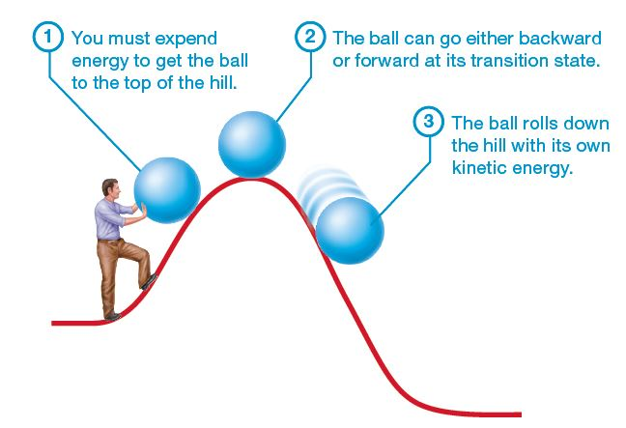
Reaction Rates and Enzymes (1 of 9)
For a reaction to occur atoms must collide with enough force to overcome the repulsion of their electrons
This energy required for all chemical reactions is called the activation energy (Ea)
Figure 2.8 Activation energy.

Slide 47
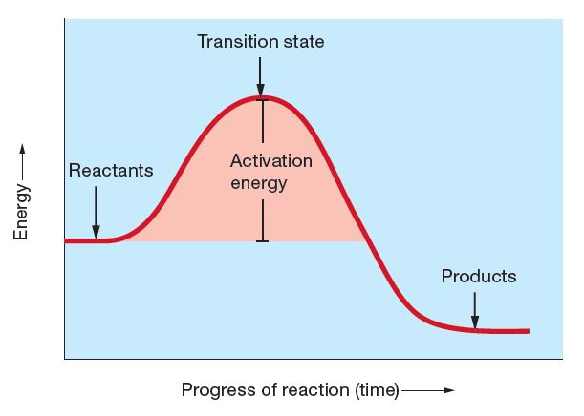
Reaction Rates and Enzymes (2 of 9)
Analogy – activation energy must be supplied so that reactants reach transition states (i.e., get to top of energy “hill”) to react and form products (i.e., roll down hill)
Figure 2.8 Activation energy.

Slide 48
Reaction Rates and Enzymes (3 of 9)
Following factors increase reaction rate by reducing activation energy or increasing likelihood of strong collisions between reactants:
Concentration
Temperature
Reactant properties
Presence or absence of catalyst

Slide 49
Reaction Rates and Enzymes (4 of 9)
When reactant concentration increases, more reactant particles are present; increases chance of successful collisions between reactants
Raising temperature of reactants increases kinetic energy of atoms; leads to more forceful and effective collisions between reactants
Please note: for biological reactions, this works only up to a point, because many molecules in the human body are destroyed at high temperatures

Slide 50
Reaction Rates and Enzymes (5 of 9)
Both particle size and phase (solid, liquid, or gas) influence reaction rates:
Smaller particles move faster; more energy than larger particles
Reactant particles in gaseous phase have higher kinetic energy than either solid or liquid phase

Slide 51
Reaction Rates and Enzymes (6 of 9)
Catalyst – increases reaction rate by lowering activation energy; not consumed or altered in reaction
Enzymes – biological catalysts; most are proteins with following properties:
Speed up reactions by lowering activation energy (Figure 2.9)
Highly specific for individual substrates (substance that can bind to enzyme’s active site)
Do not alter reactants or products
Not permanently altered in reactions catalyzed

Slide 52
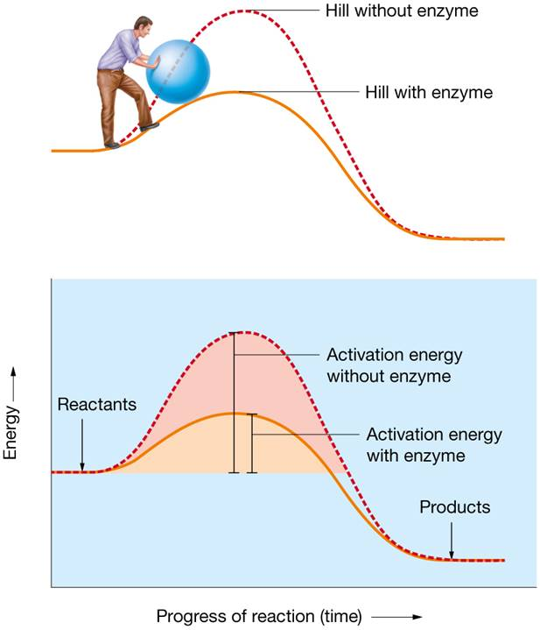
Reaction Rates and Enzymes (7 of 9)
Figure 2.9 The effect of enzymes on activation energy.

Slide 53
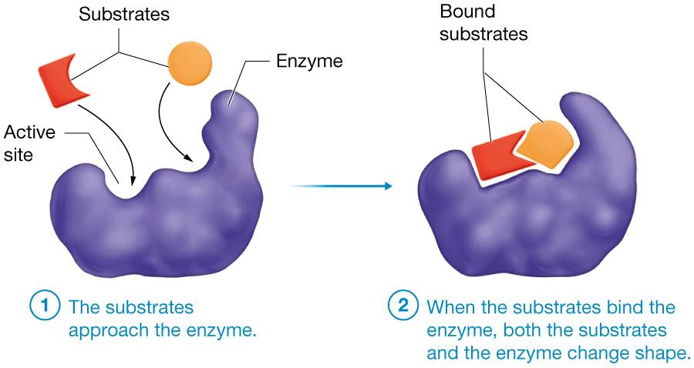
Reaction Rates and Enzymes (8 of 9)
Induced-fit mechanism – enzyme’s interaction with substrate(s)
Binding of substrate causes a small shape change that reduces activation energy
Figure 2.10 Enzyme–substrate interaction.

Slide 54
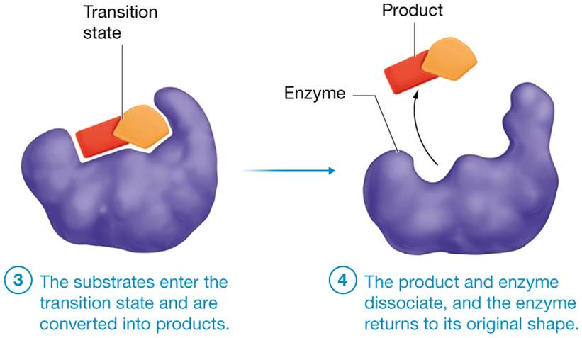
Reaction Rates and Enzymes (9 of 9)
Induced-fit mechanism (continued):
Allows transition state to proceed to final products
Figure 2.10 Enzyme–substrate interaction.

Slide 55
Enzyme Deficiencies
Examples of common enzyme deficiencies:
Tay-Sachs Disease – deficiency of hexosaminidase; gangliosides accumulate around neurons of brain; death usually by age 3
Severe Combined Immunodeficiency Syndrome (SCIDs) – may be due to adenosine deaminase deficiency; nearly complete absence of immune system; patients must live in sterile “bubble”
Phenylketonuria – deficiency of phenylalanine hydroxylase; converts phenylalanine into tyrosine; resulting seizures and mental retardation can be prevented by dietary modification

Slide 56
Module 2.4 Inorganic Compounds: Water, Acids, Bases, and Salts Bonds

Slide 57
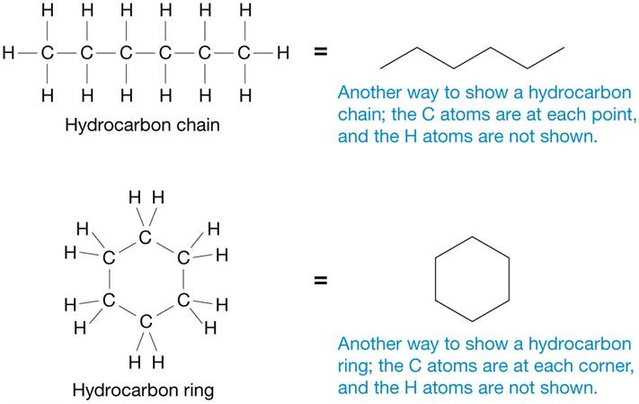
Biochemistry
Biochemistry – the chemistry of life
• Inorganic compounds generally do not contain carbon bonded to hydrogen; include water, acids, bases, and salts
• Organic compounds – those that do contain carbon bonded to hydrogen

Slide 58
Water (1 of 4)
Water (H2O) makes up 60–80% of mass of human body and has several key properties vital to our existence:
• High heat capacity – able to absorb heat without significantly changing temperature itself
• Carries heat with it when it evaporates (when changing from liquid to gas)
• Cushions and protects body structures because of relatively high density
• Acts as a lubricant between two adjacent surfaces (reduces friction)

Slide 59
Water (2 of 4)
Water serves as body’s primary solvent; often called the universal solvent because so many solutes will dissolve in it entirely or to some degree
REMEMBER water is a polar covalent molecule:
Oxygen – partially negative (δ-)
Hydrogen – partially positive (δ+)
Allows water molecules to interact with certain solutes, surround them, and keep them apart

Slide 60
Water (3 of 4)
Only able to dissolve hydrophilic solutes (with fully or partially charged ends); “like dissolves like”; water dissolves ionic and polar covalent solutes
Figure 2.11a,b The behavior of hydrophilic and hydrophobic molecules in water.

Slide 61
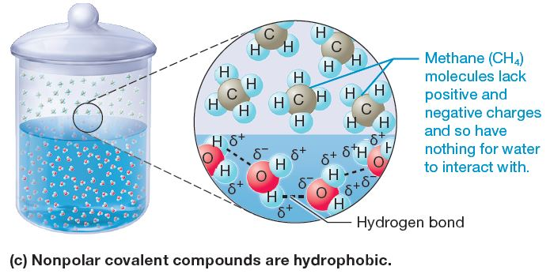
Water (4 of 4)
Hydrophobic solutes – do not have full or partially charged ends; do not dissolve in water; include uncharged nonpolar covalent molecules (oils and fats)
Figure 2.11c The behavior of hydrophilic and hydrophobic molecules in water.

Slide 62
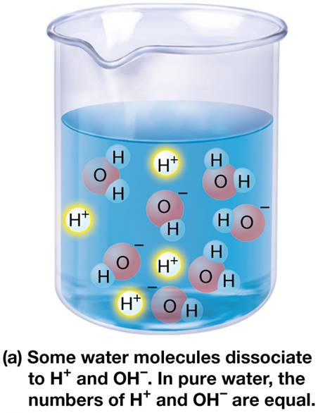
Acids and Bases (1 of 6)
Study of acids and bases is really study of hydrogen ions (H⁺)
Water molecules in solution may dissociate (break apart) into positively charged hydrogen ions (H⁺) and negatively charged hydroxide ions (OH)
Acids and bases are defined according to behavior with respect to hydrogen ions (next slide)
Figure 2.12a The behavior of acids and bases in water.

Slide 63
Acids and Bases (2 of 6)
Acid – hydrogen ion or proton donor; number of hydrogen ions increases in water when acid is added (Figure 2.12b)
Base (alkali) – hydrogen ion acceptor; number of hydrogen ions decreases in water when base is added (Figure 2.12c)

Slide 64
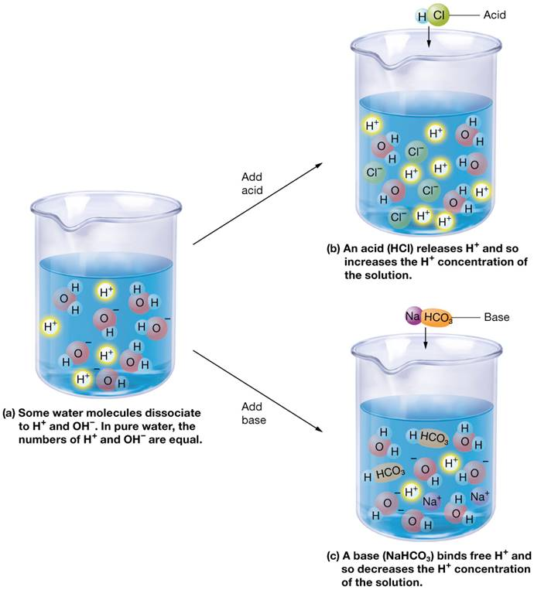
Acids and Bases (3 of 6)
Figure 2.12 The behavior of acids and bases in water.

Slide 65
Acids and Bases (4 of 6)
pH scale – ranges from 0–14 (Figure 2.13)
Simple way of representing hydrogen ion concentration of a solution
Literally the negative logarithm of the hydrogen ion concentration:

Slide 66
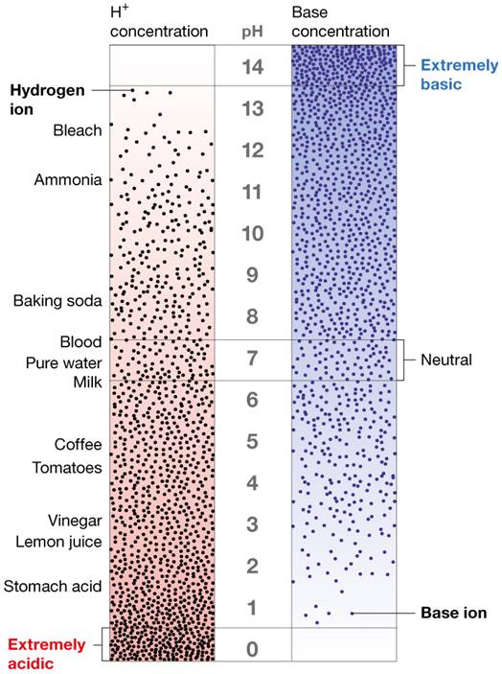
Acids and Bases (5 of 6)
pH = 7; solution is neutral; number of hydrogen ions and base ions are equal
pH less than 7 is acidic; hydrogen ions outnumber base ions
pH greater than 7 is basic or alkaline; base ions outnumber hydrogen ions
Figure 2.13 ‘The pH Scale.’

Slide 67
Acids and Bases (6 of 6)
Buffer – chemical system that resists changes in pH; prevents large swings in pH when acid or base is added to solution
Blood pH must remain within its narrow range to maintain homeostasis: Blood pH is 7.35–7.45

Slide 68
Concept Boost: Making Sense of the pH Scale (1 of 2)
Why does pH decrease if solution has more hydrogen ions?
Remember: pH = – Log [H+]
The smaller the pH number, the bigger its negative log
Single-digit changes in negative logarithm (e.g., from 2 to 3) accompanies a 10-fold change in hydrogen ion concentration (e.g., from 0.01 to 0.001)

Slide 69
Concept Boost: Making Sense of the pH Scale (2 of 2)
Example: • Solution A has a hydrogen ion concentration of 0.015 M and a pH of 1.82; solution B has a hydrogen ion concentration of 0.0003 M and a pH of 3.52
The solution with the higher hydrogen ion concentration has the lower −log. For this reason, the more acidic a solution, the lower its pH, and vice-versa

Slide 70
Salts and Electrolytes
Salt – any metal cation and nonmetal anion held together by ionic bonds
Can dissolve in water to form cations and anions called electrolytes; capable of conducting electrical current

Slide 71
Module 2.5 Organic Compounds: Carbohydrates, Lipids, Proteins, and Nucleotides

Slide 72
Monomers and Polymers
Each type of organic molecule in body (carbohydrate, lipid, protein, or nucleic acid) has its own monomer and a corresponding polymer built from those subunits.
• Monomers are single subunits that can be combined to build larger structures called polymers by dehydration synthesis (anabolic reaction that links monomers together and makes a molecule of water in process)
• Hydrolysis is a catabolic reaction that uses water to break up polymers into smaller subunits

Slide 73
Carbohydrates (1 of 5)
Carbohydrates
most monomers composed of carbon, hydrogen, and oxygen, function primarily as fuel; some limited structural roles
Monosaccharide (simple sugar) – consist of 3 to 7 carbons; monomers from which all carbohydrates are made; examples are: glucose, fructose, galactose, ribose, and deoxyribose
Figure 2.14

Slide 74
Carbohydrates (2 of 5)
Figure 2.14a, b Carbohydrates: structure of monosaccharides.

Slide 75
Carbohydrates (3 of 5)
Disaccharides – formed by union of two monosaccharides by dehydration synthesis
Figure 2.15 Carbohydrates: formation and breakdown of disaccharides.

Slide 76
Carbohydrates (4 of 5)
Polysaccharides consist of many monosaccharides joined to one another by dehydration synthesis reactions (Figure 2.16)
• Glycogen is the storage polymer of glucose; mostly in skeletal muscle and liver cells
• Some polysaccharides are found covalently bound to either proteins or lipids forming glycoproteins and glycolipids; various functions in body

Slide 77
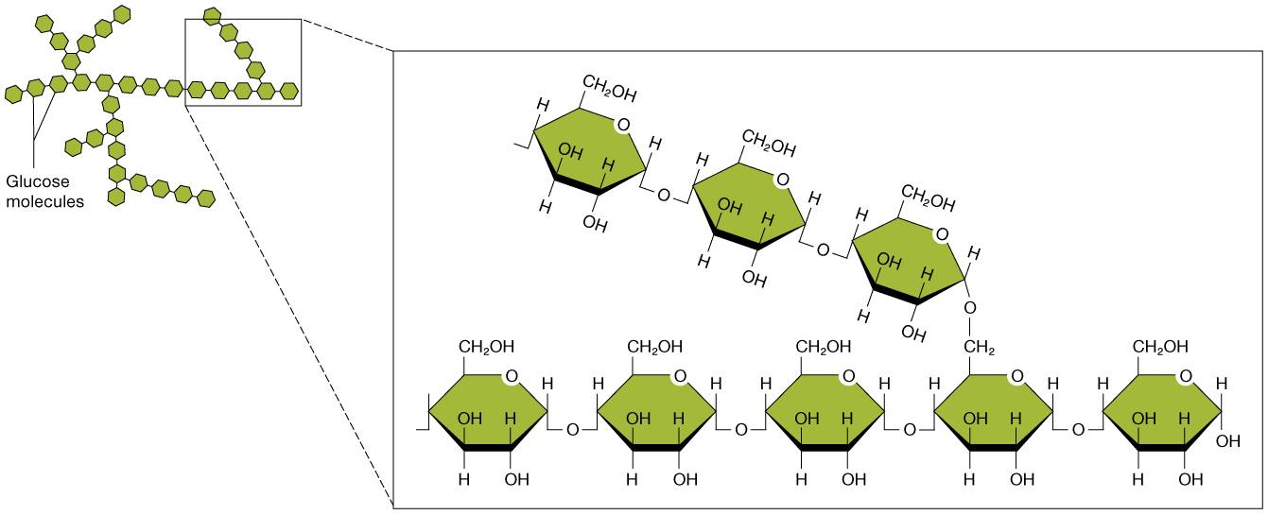
Carbohydrates (5 of 5)
Figure 2.16 Carbohydrates: the polysaccharide glycogen.

Slide 78
Lipids (1 of 8)
Lipids – group of nonpolar hydrophobic molecules composed primarily of carbon and hydrogen; include fats and oils
Fatty acid – a basic lipid monomer consisting of 4 to 20 or more carbon atoms; the hydrocarbon chain may have none, one, or more double bonds between its carbon atoms, which provides a way to classify fatty acids (Figure 2.17)

Slide 79
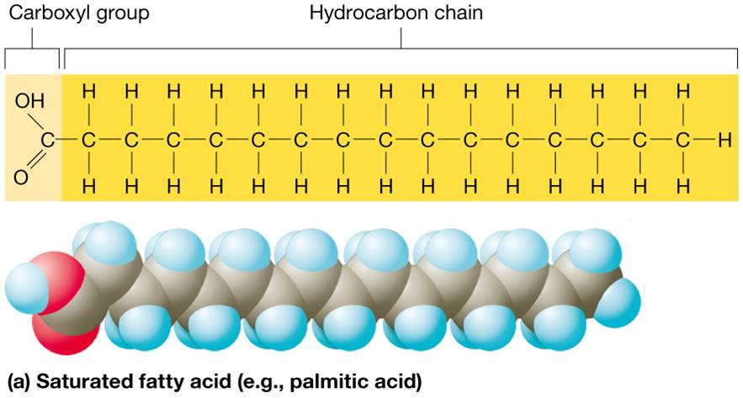
Lipids (2 of 8)
Saturated fatty acids – solid at room temperature; no double bonds between carbon atoms; carbons are “saturated” with maximum number of hydrogen atoms
At room temperature, the molecules of a saturated fat such as butter are packed closely together, forming a solid.
Figure 2.17a Lipids: structure of fatty acids.

Slide 80
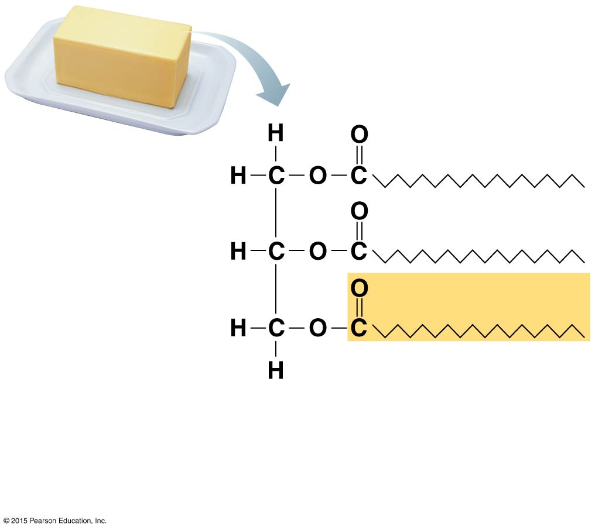
Structural formula of a
saturated fat molecule.
(a) Saturated fat. At room temperature, the
molecules of a saturated fat such as this
butter are packed closely together, forming
a solid.

Slide 81
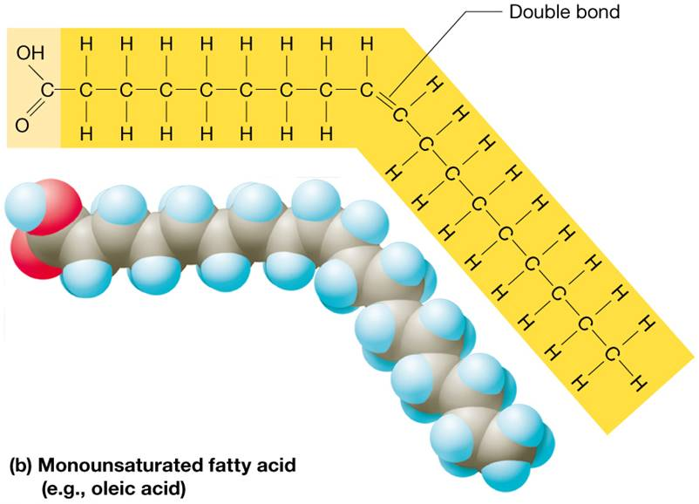
Lipids (3 of 8)
Monounsaturated fatty acids – generally liquid at room temperature; one double bond between two carbons in hydrocarbon chain
generally liquid at room temperature; have one double bond between two carbons in hydrocarbon chain, causes chain to bend, can’t pack together as tightly
Figure 2.17b Lipids: structure of fatty acids.

Slide 82
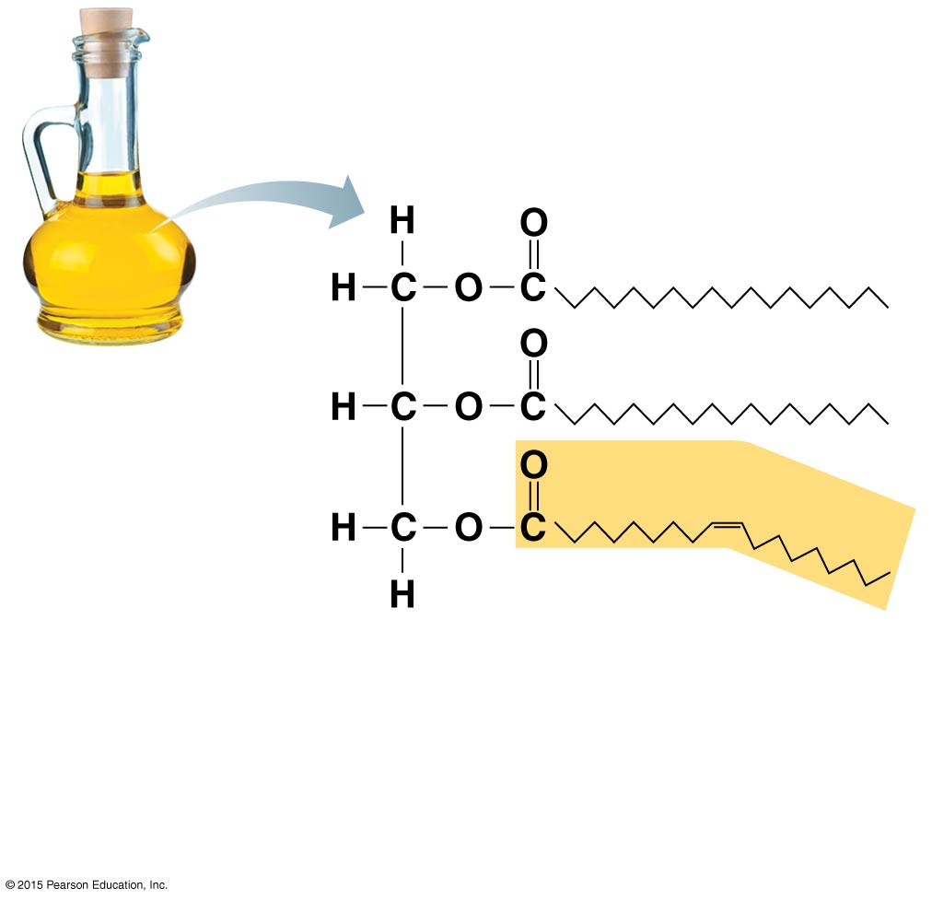
Figure 2.16b Examples of saturated and unsaturated fats and fatty acids.
Structural formula of an
unsaturated fat molecule.
(b) Unsaturated fat. At room temperature,
the molecules of an unsaturated fat such as
this olive oil cannot pack together closely
enough to solidify because of the kinks in
some of their fatty acid chains.

Slide 83
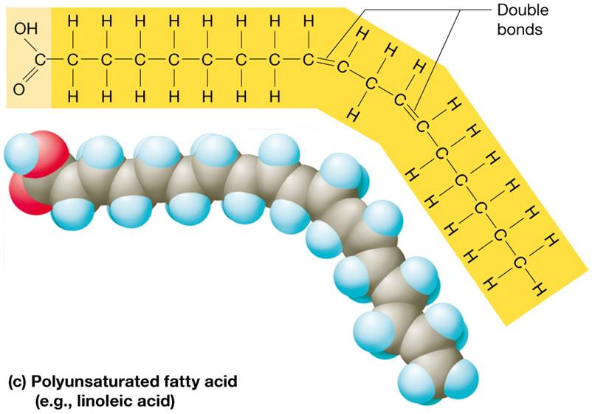
Lipids (4 of 8)
Polyunsaturated fatty acids – liquid at room temperature; two or more double bonds between carbons in hydrocarbon chain
Figure 2.17c Lipids: structure of fatty acids.

Slide 84
The Good, the Bad, and the Ugly of Fatty Acids (1 of 2)
Not all fatty acids were created equally:
• The Good: Omega – 3 Fats
• Found in flaxseed oil and fish oil but cannot be made by humans; must be obtained in diet
•Research has shown positive effects on cardiovascular health
• The Bad: Saturated Fats
• Found in animal fats; also in palm and coconut oils
• Link between overconsumption of saturated fats and increased risk for certain diseases, especially heart disease

Slide 85
The Good, the Bad, and the Ugly of Fatty Acids (2 of 2)
The Ugly: Trans Fats
Produced by adding H atoms to certain unsaturated plant oils (producing “partially hydrogenated oils”)
No safe consumption level; significantly increase risk of heart disease

Slide 86
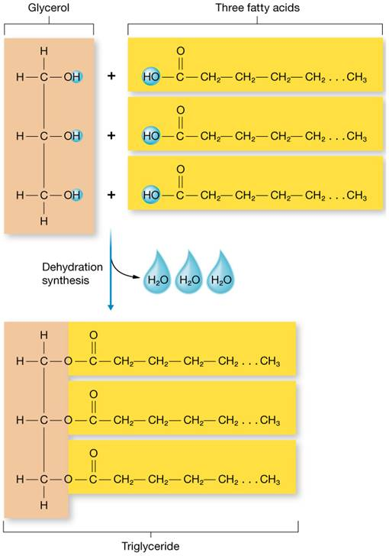
Lipids (5 of 8)
Triglyceride – Our bodies can’t package fatty acids into long chains like monosaccharides. Instead, fatty acids are stored by linking 3 of them (via dehydration synthesis) to a modified sugar called glycerol. These reactions produce a polymer called a triglyceride (neutral fat).
Figure 2.18 Lipids: structure and formation of triglycerides.

Slide 87
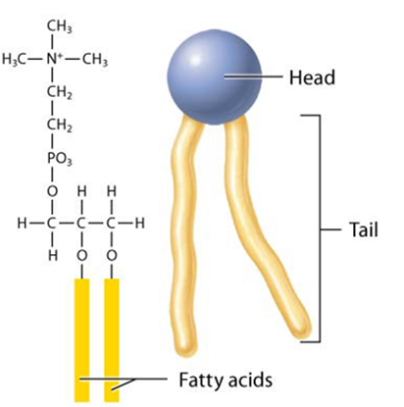
Lipids (6 of 8)
Phospholipids – composed of a glycerol backbone, two fatty acid “tails” and one phosphate “head” in place of third fatty acid (Figure 2.3) • Molecules such as phospholipids with strongly polar and strongly nonpolar parts are known as amphiphilic
• This amphiphilic nature makes phospholipids vital to the structure of cell membranes
Table 2.3 Organic Molecules.

Slide 88
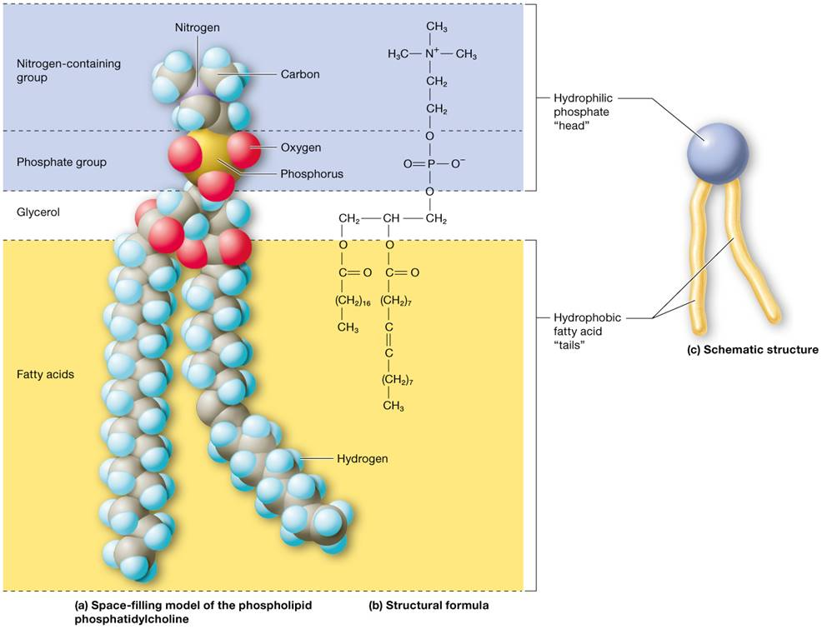
Lipids (7 of 8)
Figure 2.19a, b, c Lipids: structure of phospholipids.

Slide 89
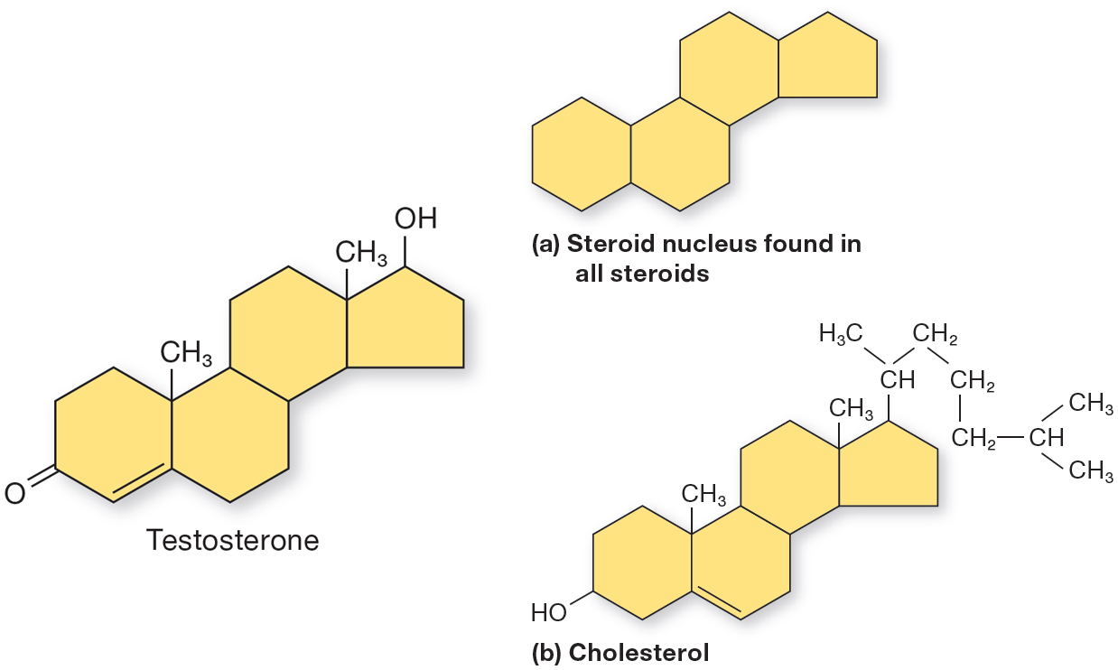
Lipids (8 of 8)
Steroids – nonpolar and share a four ring hydrocarbon structure called the steroid nucleus
Cholesterol – steroid that forms basis for body’s other steroids, including bile acids and sex hormones
Figure 2.20a, b Lipids: structure of steroids and Table 2.3 Organic Molecules.

Slide 90
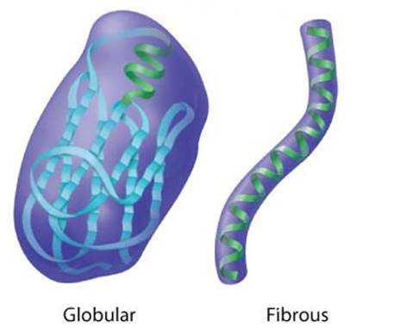
Proteins
Proteins are macromolecules that:
• Function as enzymes
• Play structural roles
• Are involved in movement
• Function in the body’s defenses
• Can be used as fuel
• Allow cells to communicate
Two basic types of proteins by structure:
Fibrous proteins – long rope-like strands; mostly nonpolar amino acids; add strength and durability to structures
Globular proteins – spherical or globe-like; mostly polar amino acids; function as enzymes, hormones, and other cell messengers

Slide 91
Proteins (1 of 7)
The monomer of ALL proteins is the amino acid
• 21 different amino acids; can be linked by peptide bonds into a peptide
Peptides are named for the number of amino acids they contain: Dipeptides consist of two amino acids, tripeptides three amino acids, and polypeptides contain 10 or more amino acids
• Proteins consist of one or more polypeptide chains folded into distinct structures which must be maintained to be functional; example of Structure-Function Core Principle

Slide 92
Proteins (2 of 7)
Four levels of complex protein structure :
Primary structure – amino acid sequence of polypeptide chain
Figure 2.23a Levels of protein structure.

Slide 93
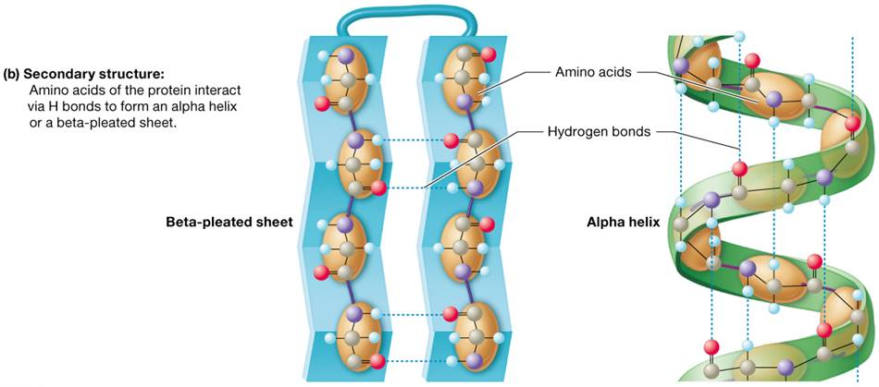
Proteins (3 of 7)
Complex protein structure (continued):
Secondary structure – one or more segments of primary structure folded in specific ways; held together by hydrogen bonds
Alpha helix – coiled spring
Beta-pleated sheet – Venetian blind

Slide 94
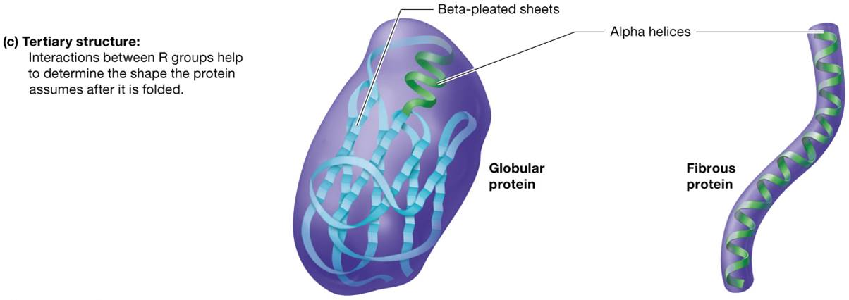
Proteins (4 of 7)
Complex protein structure (continued):
Tertiary structure – final three-dimensional shape that polypeptide chain assumes, consists of the twists, folds, and coils that form between and around the alpha helices and pleated sheets; stabilized by hydrogen bonds and ionic interactions.

Slide 95
Proteins (5 of 7)
Complex protein structure (continued):
Quaternary structure – Many proteins consists of more than one polypeptide chain, and the manner in which these polypeptide chains assemble makes up the quaternary structure.
Figure 2.23d Levels of protein structure.

Slide 96
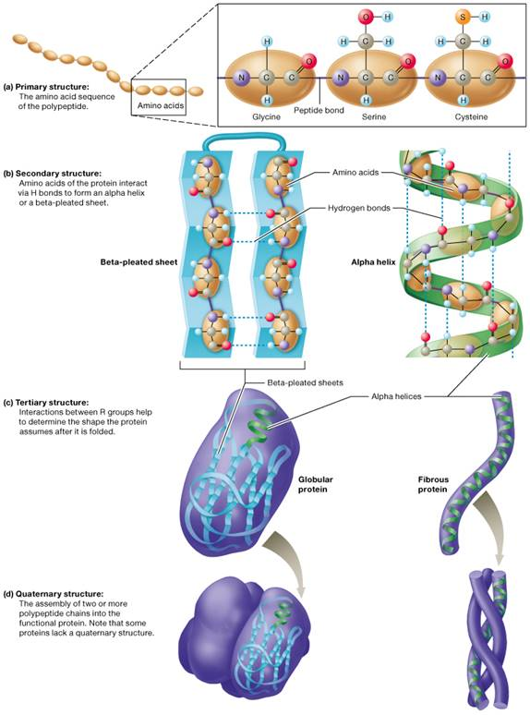
Proteins (6 of 7)
Figure 2.23 Levels of protein structure.

Slide 97
Proteins (7 of 7)
Protein denaturation – destroying protein’s shape by heat, pH changes, or exposure to chemicals
Disrupts hydrogen bonding and ionic interactions that stabilize structure and function

Slide 98
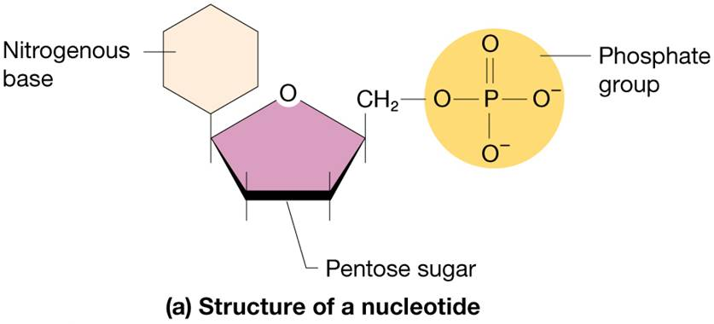
Nucleotides and Nucleic Acids (1 of 12)
Nucleotides – monomers of nucleic acids; named for abundance in nuclei of cells; make up genetic material
Nucleotide structure:
Nitrogenous base with hydrocarbon ring structure
Five-carbon pentose sugar (ribose or deoxyribose)
Phosphate group

Slide 99
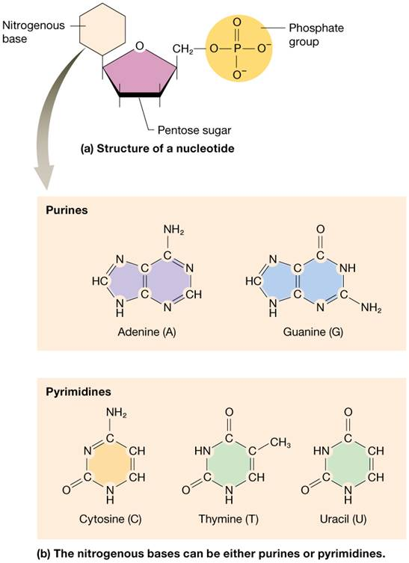
Nucleotides and Nucleic Acids (2 of 12)
Types of nitrogenous bases:
Purines – double-ringed molecule; adenine (A) and guanine (G)
Pyrimidines – single-ringed molecule; cytosine (C), uracil (U), and thymine (T)
Figure 2.24a, b Structure of nucleotides.

Slide 100
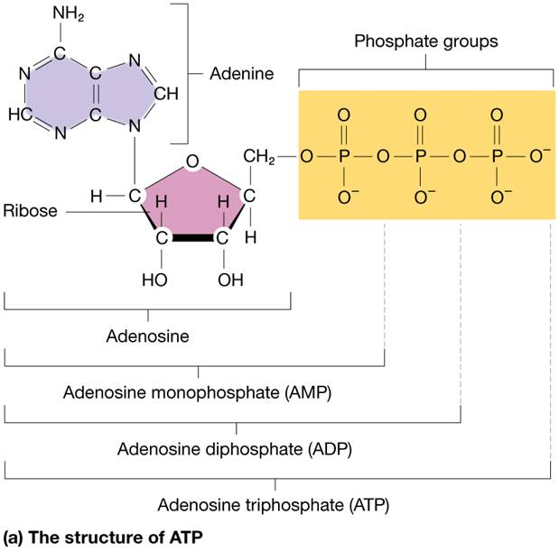
Nucleotides and Nucleic Acids (3 of 12)
Adenosine triphosphate (ATP)
Adenosine triphosphate (ATP)
The primary source of chemical energy in the body comes in form of a nucleotide called adenosine triphosphate (ATP)
Adenine attached to ribose and three phosphate groups
ATP is generally synthesized by adding a third phosphate to adenosine diphosphate
Figure 2.25a Nucleotides: structure and formation of ATP.

Slide 101
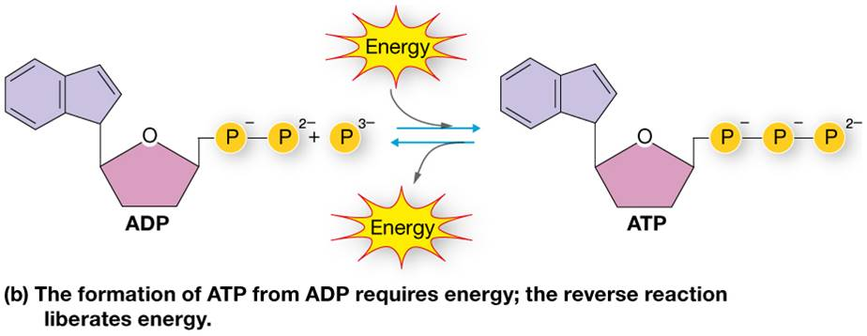
Nucleotides and Nucleic Acids (4 of 12)
Adenosine triphosphate (continued):
Potential energy in this “high-energy” bond can be released as kinetic energy to do work
Production of large quantities of ATP requires oxygen; why we breathe air

Slide 102
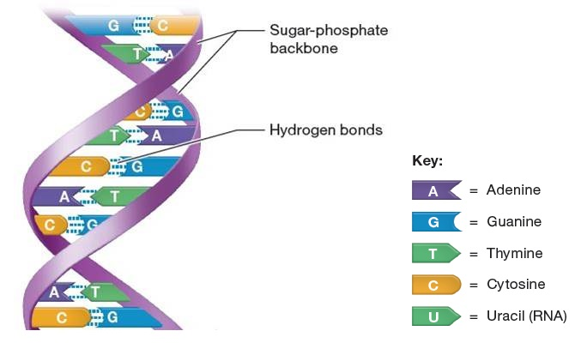
Nucleotides and Nucleic Acids (5 of 12)
Two main nucleic acids are deoxyribonucleic acid (DNA) and ribonucleic acid (RNA)-together they are responsible for the storage and execution of the genetic code.
DNA – extremely large molecule in nuclei of cells; composed of two long chains that twist around each other to form double helix
Contains genes – recipe (code) for protein synthesis (process to make every protein)
Figure 2.26a Structure of nucleic acids.

Slide 103
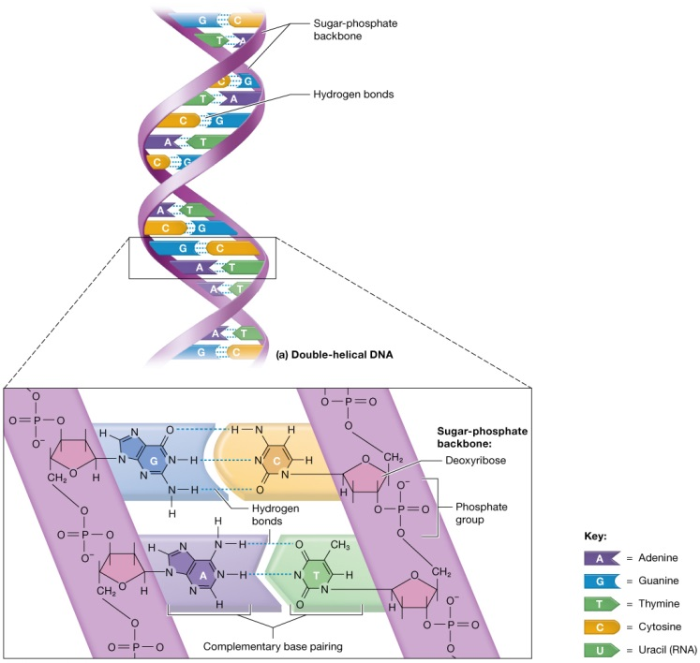
Nucleotides and Nucleic Acids (6 of 12)
Structural features of DNA:
Pentose sugar deoxyribose forms backbone of strand; alternates with phosphate group-think of it like the sides of a ladder
Bases: adenine, guanine, cytosine, and thymine- like the rungs on a ladder

Slide 104
Nucleotides and Nucleic Acids (7 of 12)
Structural features of DNA (continued):
Double helix strands – held together by hydrogen bonding between bases of each strand
Each base faces inside of double helix as strands run in opposite directions

Slide 105
Nucleotides and Nucleic Acids (8 of 12)
Structural features of DNA (continued):
DNA exhibits complementary base pairing; purine A always pairs with pyrimidine T; purine G always pairs with pyrimidine C
A = T (where = denotes 2 hydrogen bonds) and C ≡ G (where ≡ denotes 3 hydrogen bonds)
Figure 2.26a Structure of the nucleic acids DNA and RNA.

Slide 106
Nucleotides and Nucleic Acids (9 of 12)
RNA – single strand of nucleotides; moves between nucleus and cytosol; critical to making proteins
RNA contains pentose sugar ribose
RNA contains uracil instead of thymine; still pairs with adenine (A = U)

Slide 107
Nucleotides and Nucleic Acids (10 of 12)
RNA – single strand of nucleotides (continued)
Transcription – RNA copies recipe for specific protein (gene in DNA)
Translation – RNA exits nucleus to protein synthesis location; directs making of protein from recipe

Slide 108
Nucleotides and Nucleic Acids (11 of 12)
RNA –single strand of nucleotides (continued)
Most of cell’s DNA resides in nucleus but protein synthesis occurs on ribosomes which are found outside the nucleus in the cytoplasm.
Hmmmm…..that’s a problem, right?
DNA codes for the proteins but doesn’t leave the nucleus and somehow information must leave and get to ribosome. Our cells solve this problem by making a copy of the gene, called a transcript, which is a molecule of RNA that can exit the nucleus.

Slide 109
Nucleotides and Nucleic Acids (12 of 12)
Figure 2.26 Structure of the nucleic acids DNA and RNA.

Slide 110
Organic Molecules (1 of 4)

Slide 111
Organic Molecules (2 of 4)

Slide 112
Organic Molecules (3 of 4)

Slide 113
Organic Molecules (4 of 4)

