Slide 1
Health Information Management Technology: An Applied Approach
Chapter 6 Data Management

Slide 2
Data Management
The definition and structure of data elements and the creation, storage, and transmission of data elements
Organizations need to know and understand
How data is produced
Why certain types and formats of data are produced
How data are stored and managed
How to ensure data integrity

Slide 3
Data Sources
Locations where data is being generated and stored within an organization
Includes both
Clinical Data Elements
Example: Data about a patient visit in an electronic health record
Administrative Data Elements
Example: Billing data and quality improvement data

Slide 4
Common Data Sources In Healthcare
Electronic health record (EHR)
Practice management system
Lab information systems
Radiology information systems
Picture archival and communications (PACs)
Other clinical documentation systems (home health, therapy, long-term care)
Master patient index
Other patient index (indices)
Databases
Registries

Slide 5
System Characterization
Process of creating an inventory of all systems that contain data, including documenting where the data are stored, what type of data are created or stored, how they are managed, with what hardware and software they interact, and providing basic security measures for the systems

Slide 6
Data Elements
A single or individual fact that represents the smallest unique subset of a larger database sometimes referred to as the raw facts and figures
Examples
Age
Gender
Blood Pressure

Slide 7
Data Dictionary
A listing of all the data elements within a specific system that defines each individual data element, standard input of the data element, and specific data length

Slide 8
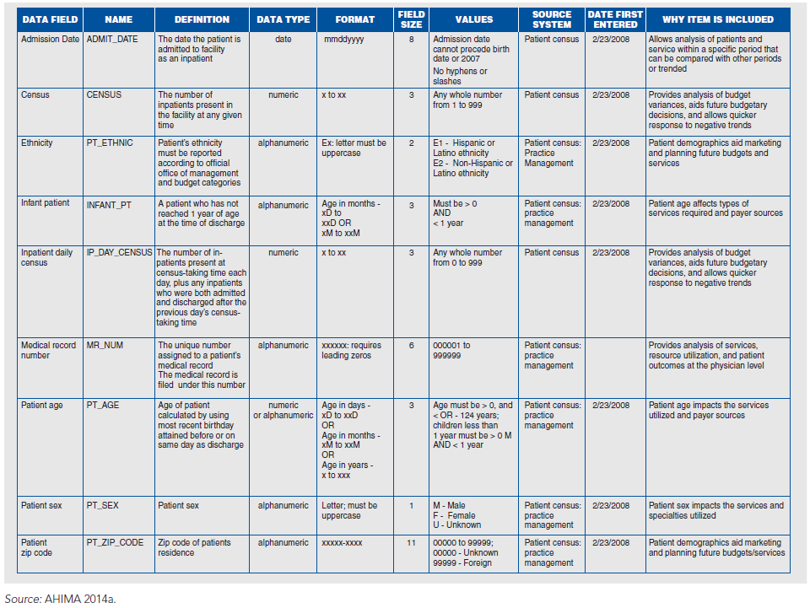

Slide 9
Data Sets
A recommended list of data elements that have defined and uniform definitions that are specific to a type of healthcare industry
Common Data Sets in Healthcare
Uniform Hospital Discharge Data Set (UHDDS)
Uniform Ambulatory Care Data Set (UACDS)
Data Elements for Emergency Department Systems (DEEDS)
Minimum Data Set (MDS)
Outcomes and Assessment Information Set (OASIS)
Essential Medical Data Set (EMDS)

Slide 10
Databases
A collection of data that are organized in such a way that its contents can be easily accessed, managed, reported, and updated
Types of Databases
Relational database
Object-oriented database

Slide 11
Database Lifecycle
Initial study (determining need for database)
Design (identify data fields, structure, and so forth)
Implementation (development of database)
Testing and evaluation (ensuring system works as expected)
Operation (use of database)
Database maintenance and evaluation (updating and backing up database and ensuring that it still meets needs)

Slide 12
Indices
A report or list from a database that provides guidance, indication, or other references to the data contained in the database.
Serves as a guide or indicator to locate something within a database or other systems storing data

Slide 13
Common Healthcare Indices
Master patient index
Disease index
Operation or procedure index
Physician index

Slide 14
Data Mapping
A process that allows for connections between two systems.
Source Data
Location from which the data originates, such as a database or a data set
Target Data
Location from which the data is mapped or to where it is sent

Slide 15
Example Data Map
Target Data
Source Data

Slide 16
Data Warehousing
The process of collecting the data from different data sources within an organization and storing it in a single database that can be used for decision making.
Data Warehouse: a single database that makes it possible to access data that exists in multiple databases through one single query and reporting interface

Slide 17
Data Governance
Process for ensuring that control and accountability for enterprise data management is established through out an organization
Focuses on how healthcare organizations create processes, policies, and procedures for keeping information that is relevant to patient care and healthcare operations

Slide 18
Information Governance
An organization-wide framework for managing information throughout its lifecycle and supporting the organization’s strategy, operations, regulatory, legal, risk, and environmental requirements

Slide 19
AHIMA’s Information Governance Principles
Accountability
Transparency
Integrity
Protection
Compliance
Availability
Retention
Disposition

Slide 20
Data Stewardship
Creation of responsibility for data through principles and practices to ensure that the appropriate knowledge and use of the data from personal health information is being used appropriately

Slide 21
Data Integrity
The assurance that the data entered into an electronic system or maintained on paper are only accessed and amended by individuals with the authority to do so.
Includes
Data governance
Patient authentication
Authorship validation
Amendment and records correct
Audit validation

Slide 22
Data Information Exchange
Allow for electronic exchange of information between providers’ electronic systems
Needed to support interoperability
Capability of two or more information systems and software applications to communicate and exchange information
Data Interchange Standards are created to support the electronic exchange of information

Slide 23
Common Standards Development Organizations
Health Level 7
Digital Imaging and Communication in Medicine
Institute of Electrical and Electronics Engineers
National Council for Prescription Drug Programs

Slide 24
Data Strategy
Clearly defines the organization’s data policies and procedures, roles and responsibilities for data governance, business rules for data governance, process for controlling data redundancy, management of key master data, use of structured and unstructured data, storage for all healthcare data, and safeguards and protections of the data

Slide 25
Data Strategy Components
Data standardization and integration
Data quality
Metadata management
Data modeling
Data ownership
Data stewardship

Slide 26
Enterprise Information Assets
Information assets
Information collected during day-to-day operations of a healthcare organization that has value within an organization
Enterprise information management
Set of functions created by an organization to plan, organize, and coordinate the people, processes, technology, and content needed to manage information for the purposes of data quality, patient safety, and ease of use

Slide 27
Data Quality
Ensuring the information entered into the patient’s record is reliable and has integrity in order to support patient care, patient safety, and provide evidence for reimbursement and accreditation

Slide 28
AHIMA’s Data Quality Management Model
Accuracy
Accessibility
Comprehensiveness
Consistency
Currency
Definition
Definition
Precision
Relevancy
Timeliness

Slide 29
Clinical Documentation Improvement
A program designed to ensure the quality and integrity of the patient data while supporting healthcare operations such as coding and reimbursement
Clinical Documentation Improvement (CDI) Goals
Obtain specific documentation that can be used to identify the patient’s severity of illness
Identify missing, conflicting, or unclear documentation
Support code assignment and reimbursement
Facilitate health record completion
Support communication between care providers
Facilitates education
Improve quality of care

Slide 30
CDI Queries
Communication tool for CDI staff to communicate with providers to obtain clinical clarification, provide a documentation alert, clarify documentation, or ask additional questions regarding documentation
Paper Queries
Electronic Queries

Slide 31
Data Management and Bylaws
Written documents that provide details and information regarding the rules and regulations established by a healthcare organization to help support healthcare operations
Bylaws can support and facilitate the collection and assurance of quality data

Slide 32
Common Types of Bylaws Used
Provider Contracts with Facilities
Delineate all expectations of the provider as they care for patients in a specific ambulatory care setting
Medical Staff Bylaws
Describe the manner in which providers will practice medicine within an organization that aligns with the mission and values of the organization
Hospital Bylaws
Written documents that govern the staff members who create data within the record for additional support of patient care and reimbursement

